Slide 1
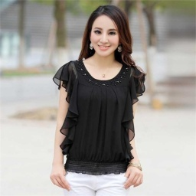
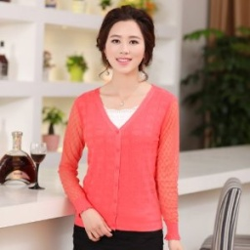
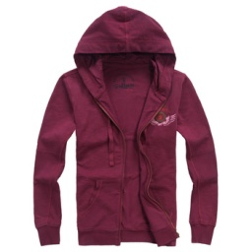
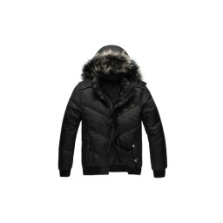
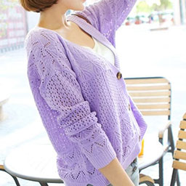
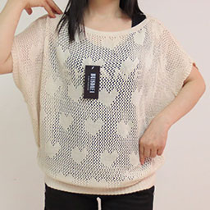
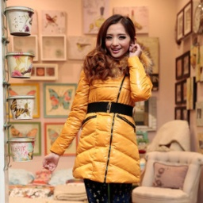
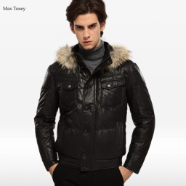
Windbreaker ×
Shawl ×
T-Shirt ×
Shirt ×
Pure Random Noise
Chiffon √
Knitwear √
Coat √
Down Coat √
Supervision
Inference
Label Noise Model and Convolutional Neural Networks
Inference
Supervision
Knitwear √
Knitwear √
Down Coat √
Down Coat √
Confusing Noise
Sweater ?
Sweater ?
Windbreaker ?
Windbreaker ?

Slide 2

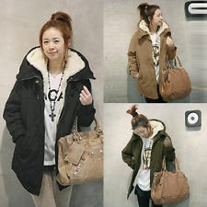
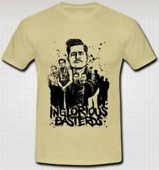
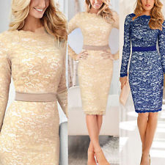
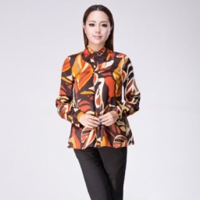
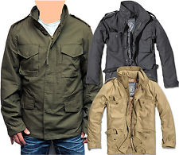
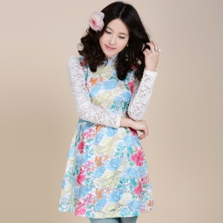



Corrected Labels
Chiffon √
Sweater √
Knitwear √
Down Coat √
Label Noise Model
Detect and correct the wrong labels
CNNs
Extract features
Training
Images
Noisy Labels
Windbreaker ×
Shawl ×
Sweater ?
Windbreaker ?
Web
Images

Slide 3
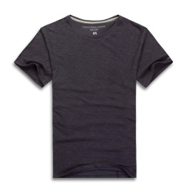
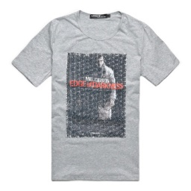

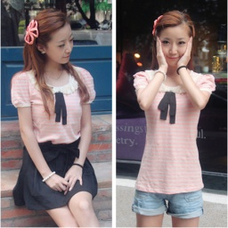
Noise Free
Pure Random 2%
Confusing Noise 7%
Noise Free
Pure Random 5%
Confusing Noise 13%
91%
82%
Noise Free 31%
Pure Random 6%
Confusing Noise
Noise Free 24%
Pure Random 18%
Confusing Noise
63%
58%

Slide 4
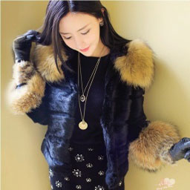
5 Layers of
Conv +
Pool + Norm
3 FC Layers
of Size
4096→4096→14
75%
94%
Down Coat
Windbreaker 11%
Jacket 4%
……
Down Coat
Windbreaker 4%
Jacket 1%
……
Data with
Clean Labels
Label Noise Model Layer
Noisy Label:
Windbreaker
5 Layers of
Conv +
Pool + Norm
3 FC Layers
of Size
4096→1024→3
Noise Free 41%
Random 3%
Confusing 56%
Noise Free 11%
Random 4%
Confusing
85%

Slide 5
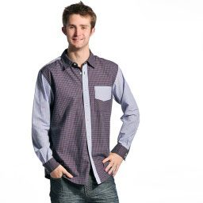
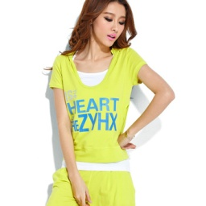
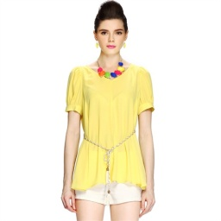
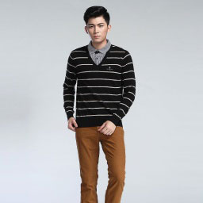
Layout in each block
Sweater 44%
Shirt 39%
Knitwear 10%
91%
Image
Shirt
Sweater 3%
Chiffon 1%
65%
91%
Noise Free
Random 19%
Confusing 16%
Noise Free
Random 6%
Confusing 3%
Noisy
Label
True
Label
Shirt
Shirt
89%
71%
86%
64%
T-Shirt
Chiffon 5%
Vest 2%
T-Shirt
Coat 24%
Chiffon 1%
Chiffon
Shirt 11%
T-Shirt 3%
Chiffon
Shirt 13%
T-Shirt 9%
Noise Free 53%
Random 12%
Confusing 34%
Noise Free 24%
Random 5%
Confusing
Noise Free 36%
Random 4%
Confusing
Noise Free 9%
Random 4%
Confusing
Coat
T-Shirt
71%
T-Shirt
Chiffon
60%
87%
T-Shirt 40%
Sweater 30%
Knitwear 27%
71%
Sweater
Knitwear 24%
T-Shirt 2%
Noise Free 57%
Pointless 10%
Confusing 33%
71%
Noise Free
Pointless 5%
Confusing 24%
Sweater
Sweater

Slide 6
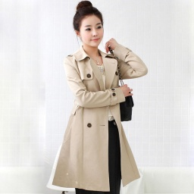
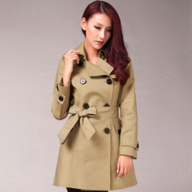
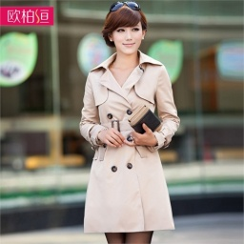
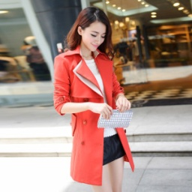
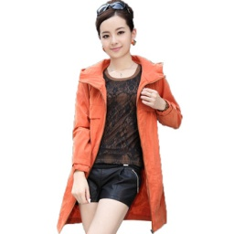
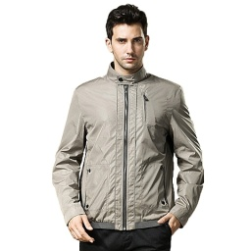
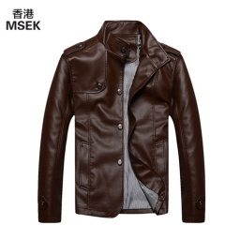
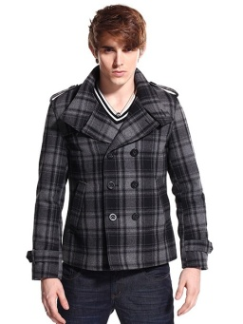

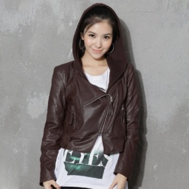
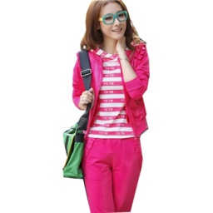
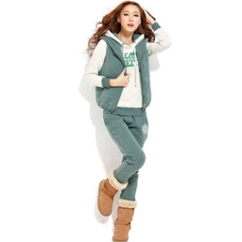
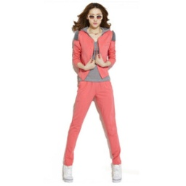
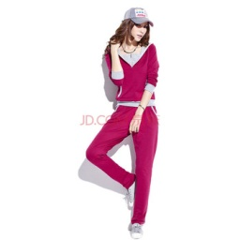
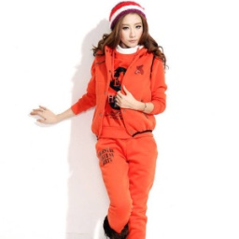
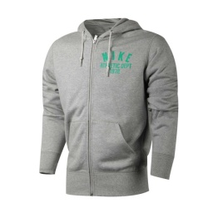
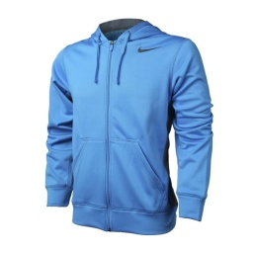
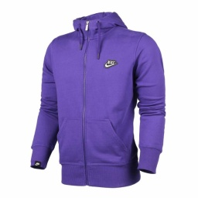
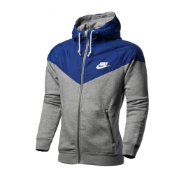
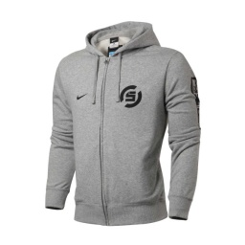
Hoodie
Hoodie
Hoodie
Hoodie
Hoodie
Windbreaker
Windbreaker
Windbreaker
Jacket
Jacket

Slide 7
Layout in each block
Image
Noisy
Label
True
Label

