Slide 1
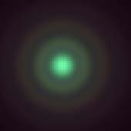
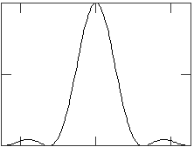

Image plane
Image plane
I₀
D
I
θ
0
0
$$θ_{0}$$
θ
D
d
D_{laser}
D_{lens}
d
f

Slide 2
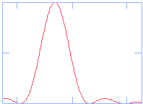
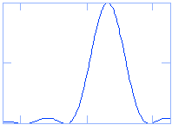
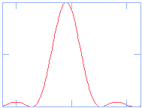
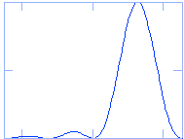
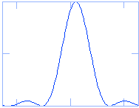
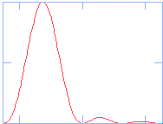
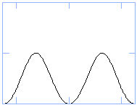
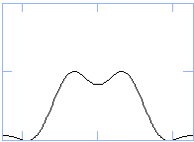
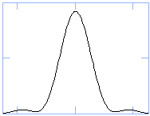
α=2α_{c}
α=α_{c}
α=α_{c}/3
I₀
I₀
I₀
I
I
I
0
0
0
2I₀
2I₀
2I₀
Sum
Sum
Sum
0
y
0
y
0
y
Two images
resolvable
‘Diffraction limit’
of resolution
Two images
not resolvable

Slide 3
mirror
Total path length L₁
2I₁
2I₁
Total path length L₂
Source
4I₁
2I₁
mirror
beam-splitter
2I₁
mirror
beam
splitter
Two pairs out
I₁
I₁
mirror
beam splitter

