Slide 1
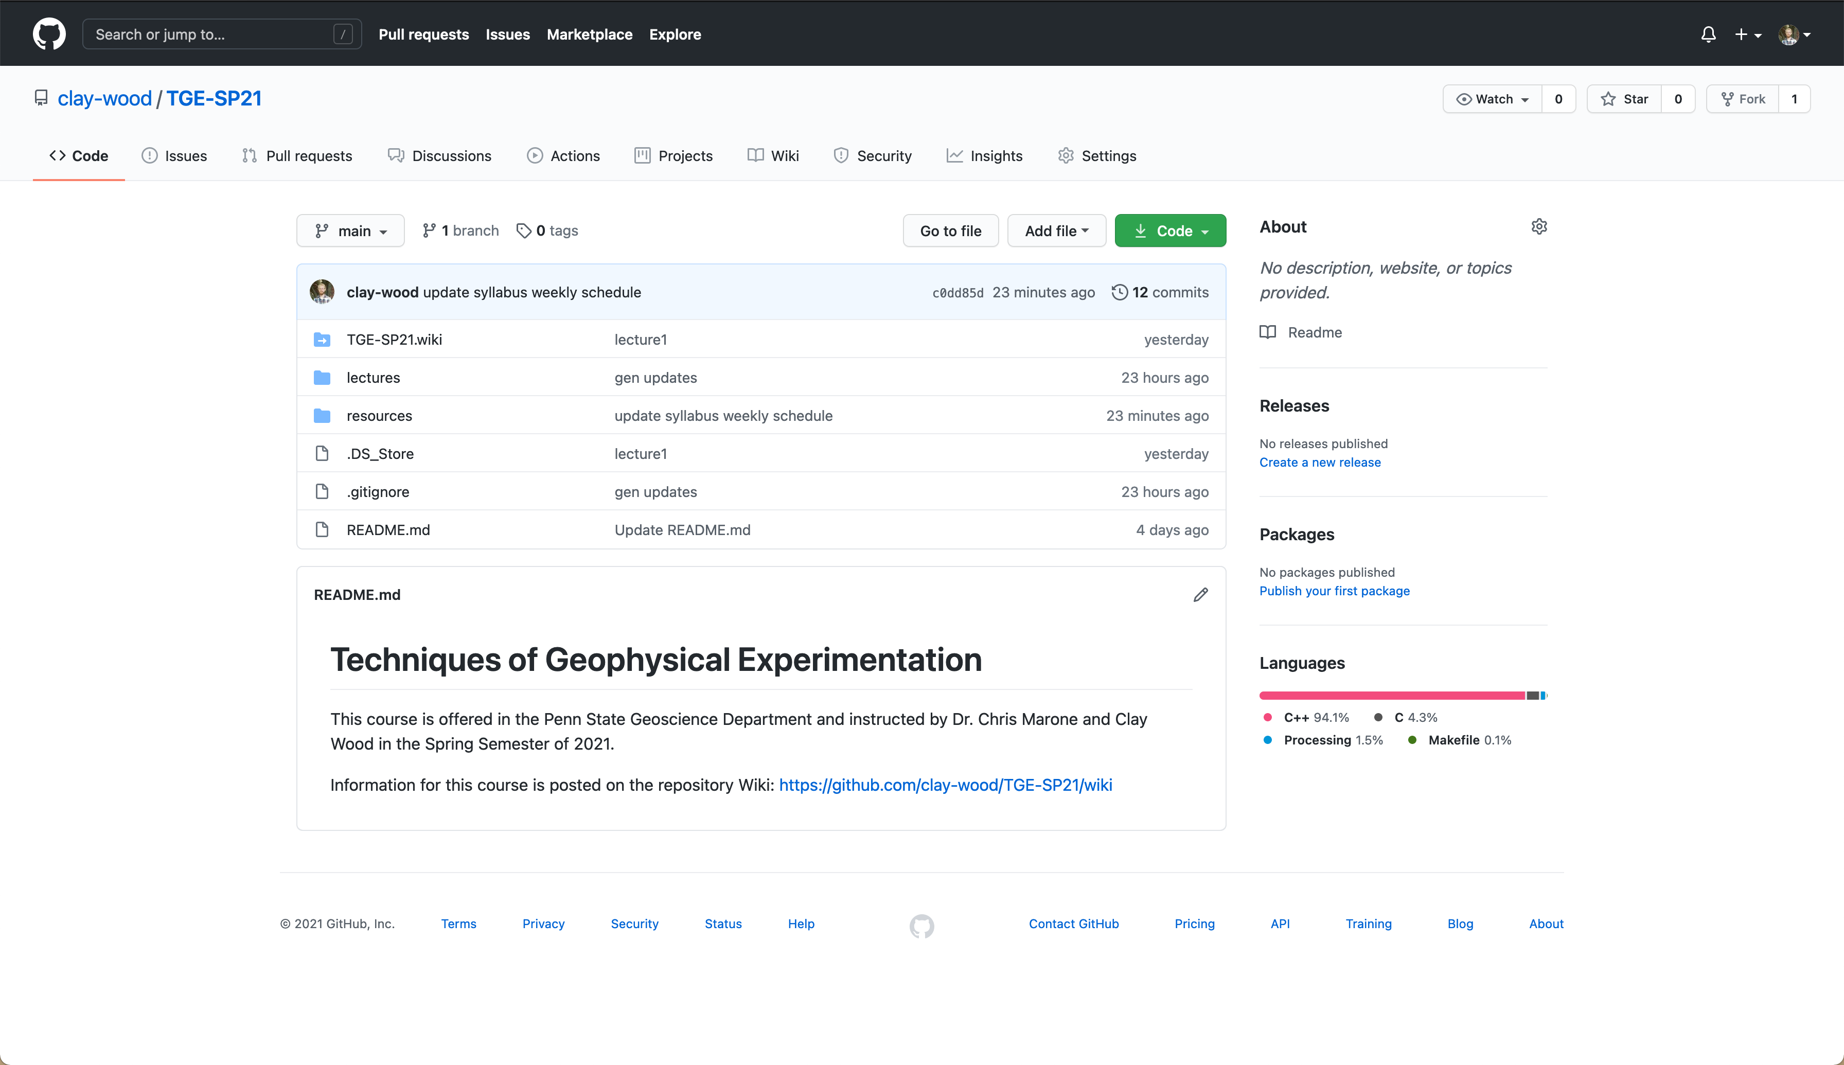
https://www.github.com/clay-wood/TGE-SP21/
Directories contain course materials:
lectures
resources
assignments (coming soon)

Slide 2
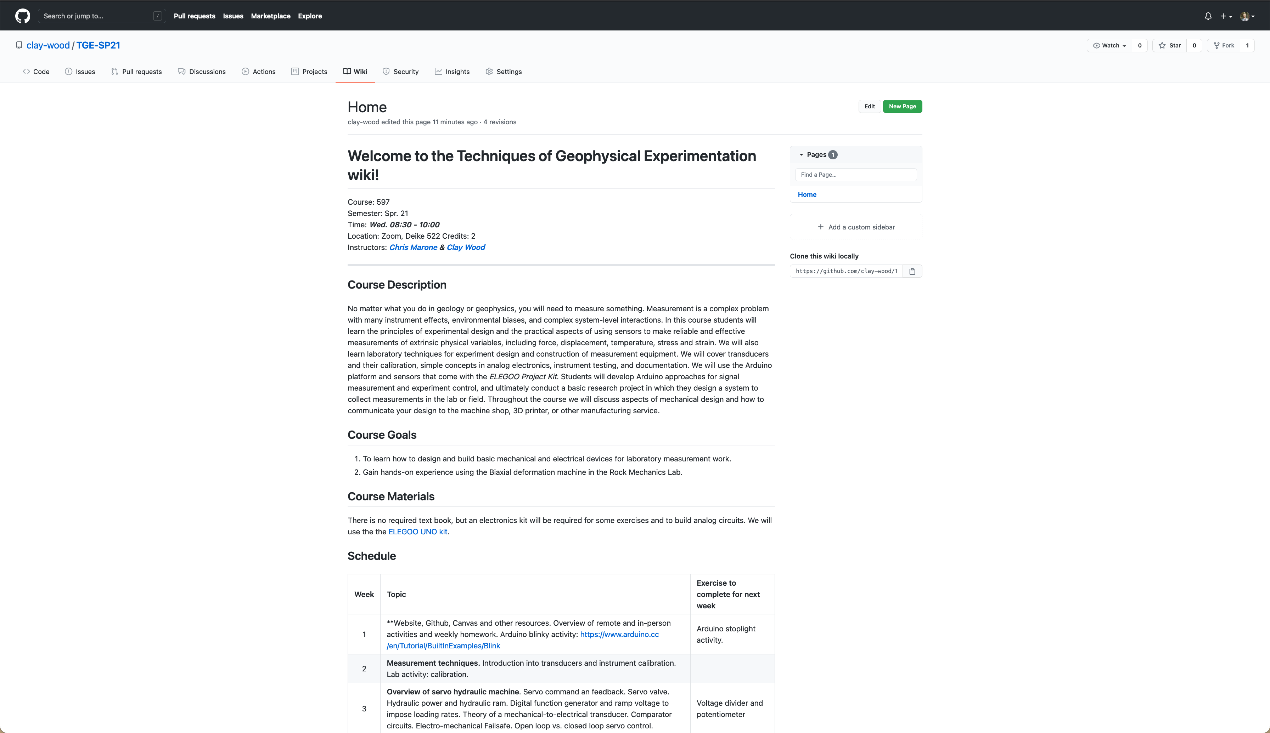
Course Syllabus
Will be regularly updated.

Slide 3
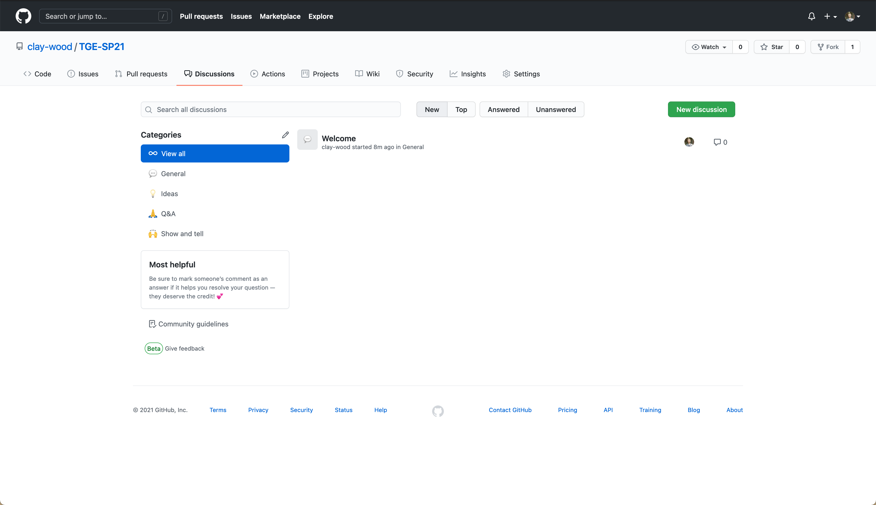
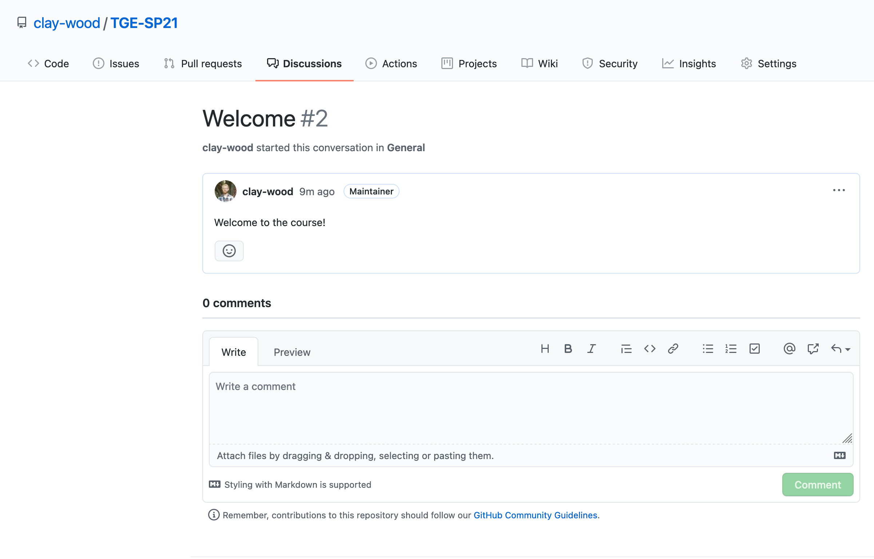
Create GitHub Account
Navigate to “Discussions” tab
Say hi on the ”Welcome” post.
OR email cew52@psu.edu your GitHub username
----------------------------
We will interact with the Git repo more later in the semester.

