Slide 1
Transducers and Calibration
Instructors: C. Marone, C. Wood
Techniques of Geoscientific Experimentation
Geosc. 597-003
27 January 2021

Slide 2
Transducers
-- Device that converts one form of energy to another.
Sensors
Actuator
Bidirectional
Active
Passive

Slide 3
Sensors
Receives and responds to a signal.
Active
External stimulus --> electric current
Passive
Excitation signal is modulated --> output signal

Slide 4
Sensors
Actuator
Moves or controls a mechanism/system.
Signal --> motion.
Bidirectional
Physical stimulus --> electric signal --> physical stimulus
Example: antenna

Slide 5
Transducer Selection
The following must be taken into consideration for transducer application:
Range
Linearity
Sensitivity
Response Time
Stability
Accuracy
Durability
Cost
Signal Conditioning

Slide 6
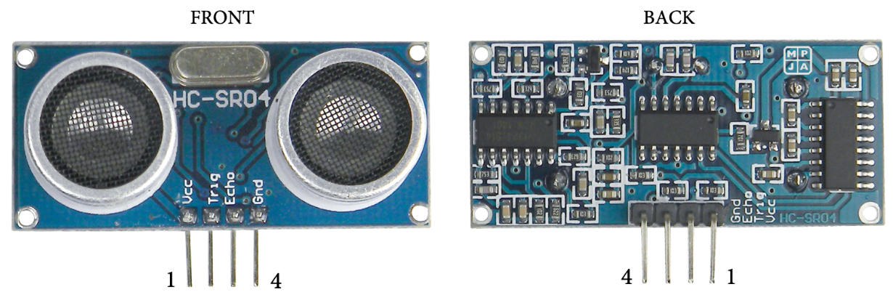
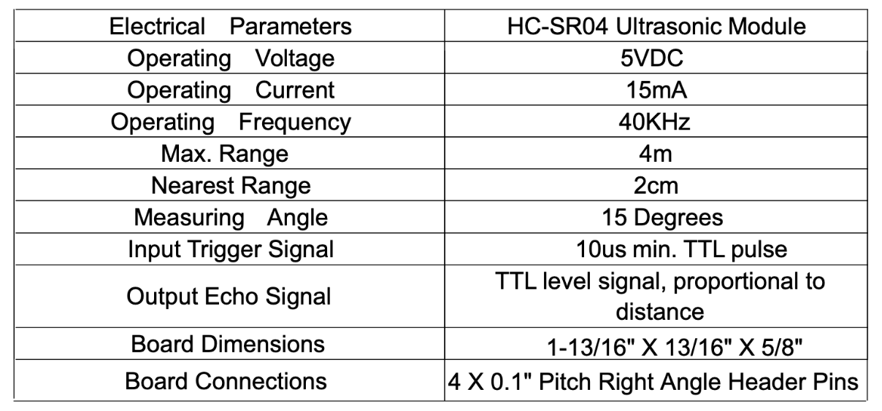
Range
Range: span of values over which transducer is rated to perform
Elegoo Starter Kit Ultrasonic Module
HC-SR04 User Guide, Page 2

Slide 7
Sensitivity
Minimum input of a physical stimulus that will create detectable output change
+f_{s}
Sensitivity Error
Ideal
Total Range
-f_{s}

Slide 8
Linearity
Amount of divergence from an ideal linear output
Sensor Output
Ideal
Output
-f_{s}
+f_{s}
Input

Slide 9
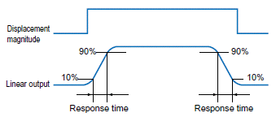
Response Time
How long a transducer takes to register a change
Image: Intech

Slide 10
Stability
How constant the output of a transducer remains when the physical stimulus is static.
Precision
Reproducibility of a measurement.
Accuracy
Maximum difference between real and indicated values.

Slide 11
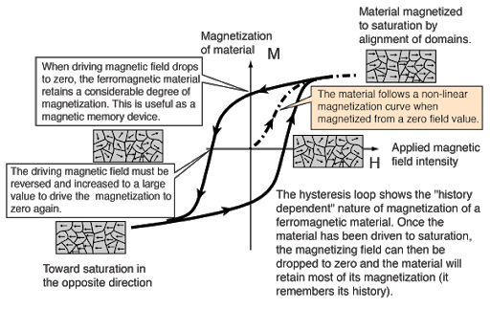
Hysteresis
Transducer’s sensitivity to which direction the physical quantity is changing.
Image: Hyperphysics

Slide 12
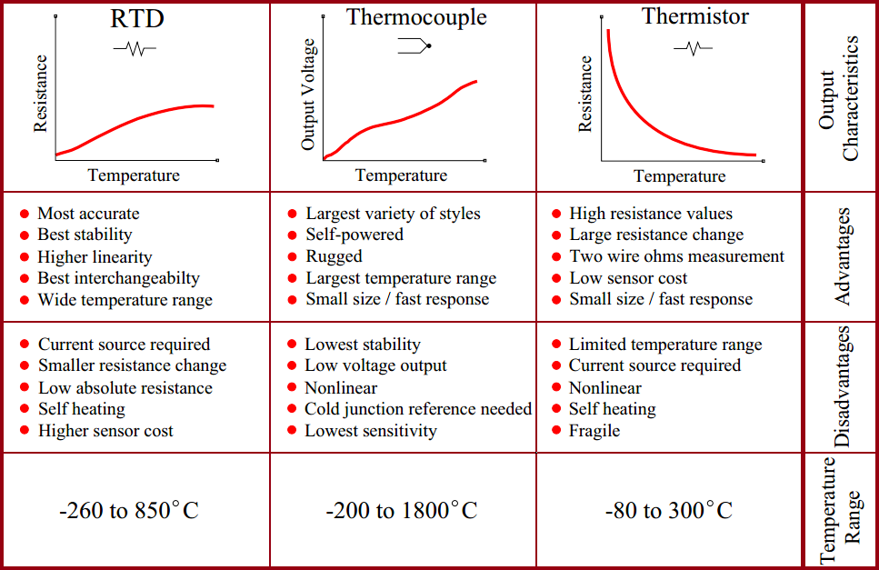
Temperature Sensors
Image: Inst Tools

Slide 13
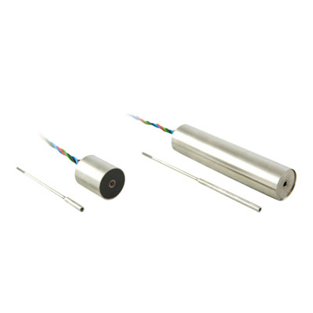
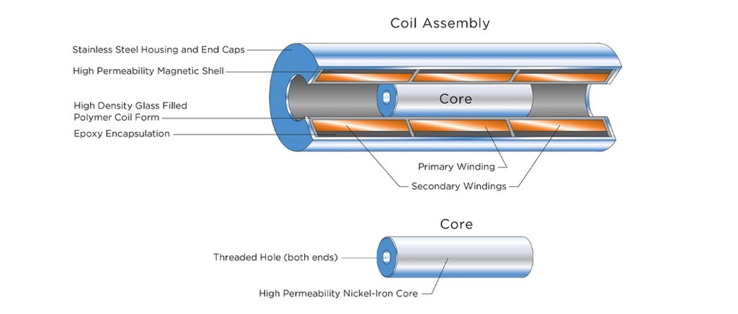
Displacement
Relative or absolute measurements. There are many types of transducers.
We commonly use DCDTs (Direct Current Differential Transformer) and LVDTs (Linear Variable Differential Transformer) to measure displacement in the lab.
Image: TransTek
Image: te.com

Slide 14
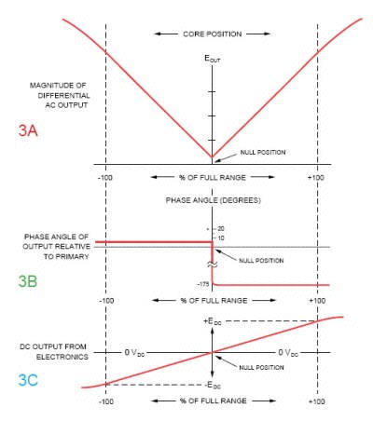
DCDTs & LVDTs
Image: te.com

Slide 15
Other Sensors
Capacitive displacement sensors – what are the pros/cons?
Eddy current sensors – what are the pros/cons?
Pressure transducers – how do these various sensors (potentiometric, capacitance, differential transformer) measure changes in pressure?
Strain gages… more details in a subsequent lecture.

Slide 16
In-class Activity
Calibrate transducers in Rock Mechanics Lab.
Keep the following in mind for good calibration values: hysteresis, accuracy, linearity, range, calibration history.
Information for DCDTs can be found here: https://transtekinc.com/products/series-240/
Update lab calibration sheet.
Answer questions from slide #15

Slide 17
Calibrations
Calibrate the following TransTek DCDTs:
TT 245 – High & Low gains
TT 242 – High & Low gains
TT 244 – High & Low gains for Short and Long cores
Short = 43.6 mm, Long = 50.1 mm
A bit about “gain”… for now, let’s define it like this:
A sensor in high-gain has a larger output (voltage) than in low-gain for the same physical input

