Slide 1
Modeling Win, Draw, or Loss Outcomes in Football with Team Stats and Odds
By Cyusa Niyibaho Landry Id:25539

Slide 2
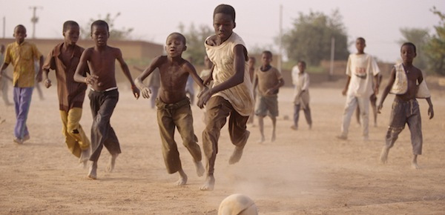
INTRODUCTION - 1
Loved by millions, played in every corner of the world — football is more than just a sport.
It’s a game of passion, strategy, unpredictability, and moments that unite fans globally.
But what if we could go beyond the emotion and use data to understand it better?
This project explores how statistics and betting odds can help us predict the outcome of the beautiful game.

Slide 3
INTRODUCTION - 2
Context
Football outcomes (win, lose, or draw) are influenced by a wide range of factors: team strength, form, and bookmaker expectations.
Accurate prediction of match results is valuable for analytics, betting, and performance evaluation.
📅 Dataset Scope
Analyzed all matches from the Premier League, Championship, and League One from the 2016/17 season to the 2024/25 season.
Data includes match stats, team performance, and bookmaker odds.
🎯 Objective
Build a machine learning model to predict match outcomes (Home Win, Draw, Away Win).
Investigate how much team statistics and betting odds contribute to predictive accuracy.

Slide 4
Methodology -1
Data Preparation
Collected data from 27 CSV files containing 13,204 match records from the Premier League, Championship, and League One (2016/17 to 2024/25).
Selected and renamed relevant columns for clarity.
Cleaned and standardized division names, engineered new features (e.g., Season, Match Time).
Normalized bookmaker probabilities to remove the margin.
Exploratory Data Analysis (EDA)
Performed descriptive statistics on match outcomes, goals, red cards, and betting odds.
Created visualizations: ▪ Histograms (Goals, Odds) ▪ Bar charts (Division, Result Counts) ▪ Box plots (Goals by Division) ▪ Scatter plots (Goals vs Goals, Odds vs Result Probabilities)

Slide 5
Methodology – 2
Machine Learning Pipeline
Defined the target variable: Match outcome (Home Win, Draw, Away Win).
Selected features including team stats and bookmaker odds.
Split the data into training and test sets, then trained classification models.
Evaluated model using accuracy, confusion matrix, and other performance metrics.
Power BI Dashboard
Built an interactive dashboard to present insights from the dataset and model.
Included filters, charts, and summary metrics for deeper exploration.

Slide 6
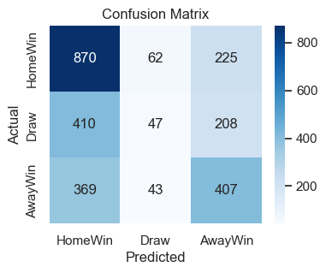
MODEL RESULTS: RANDOM FOREST CLASSIFIER
Confusion Matrix
Largest success: Home Wins are predicted most accurately
Major confusion: Draws are often misclassified as Home wins

Slide 7
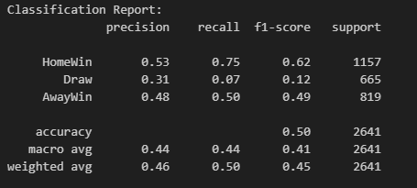
MODEL RESULTS: RANDOM FOREST CLASSIFIER
Key Insights
Model is reasonably effective at predicting wins, especially Home Wins
Draws are hardest to predict due to their low frequency and variance
Overall accuracy: 50%, better than random guessing for a 3-class problem (baseline ≈ 33%)

Slide 8
RECOMMENDATIONS – DATA DRIVEN SUGGESTIONS
🏠 Home Advantage is Predictable
The model most accurately predicts Home Wins (75% recall), reinforcing the strong home advantage in English football.
Recommendation: Factor home advantage heavily when making match forecasts or setting odds.
⚠️ Draw Outcomes Are Highly Uncertain
Draws were the least predictable outcome — with only 7% recall, they occur inconsistently across matches.
Recommendation: Avoid over-reliance on predicting draws in betting or forecasting models; treat them as high-variance events.

Slide 9
RECOMMENDATIONS – DATA DRIVEN SUGGESTIONS
📈 Bookmaker Odds Add Predictive Value
Features derived from bookmaker odds contributed to the model’s ability to predict match results.
Recommendation: Continue using odds as signals in predictive models or analytics dashboards.
Match Result Prediction is Feasible
An overall accuracy of 50% shows that modeling match outcomes is achievable and better than random guessing (33% baseline).
Recommendation: Predictive modeling can be a valuable support tool for analysts, scouts, and strategic decision-makers.

Slide 10
FUTURE WORK
📅 Extend Dataset
Incorporate more recent seasons and international leagues to generalize the model.
🎯 Predict Scorelines
Instead of just result (Win/Draw/Loss), model exact score predictions for higher granularity.
📍 Integrate Live Data
Use APIs to include real-time betting odds, team news, and injuries.

Slide 11
SUMMARY OF KEY FINDINGS
Project Goal:
Build a machine learning model to predict football match outcomes using team stats and bookmaker odds.
📂 Data:
13,204 matches from Premier League, Championship, and League One (2016/17–2024/25)
Model:
Random Forest Classifier
Accuracy: 50%
Best performance on Home Wins, weakest on Draws
🔍 Conclusion:
While predicting draws remains a challenge, the model demonstrates that match stats and odds hold predictive power, especially for wins.

