Slide 1
A detail tutorial of GLCM algorithm
Mohammad Shamim Imtiaz

Slide 2
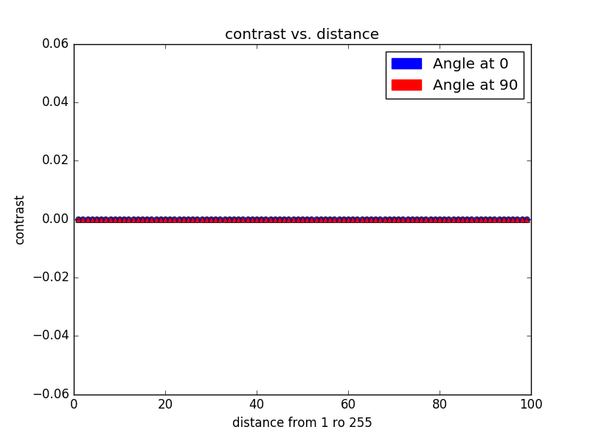

Contrast vs distance
Black image
Size: 100 x 100

Slide 3
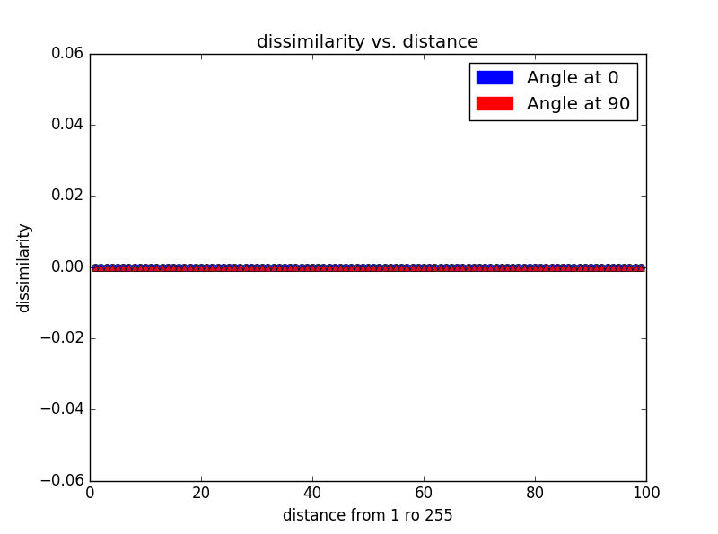
Dissimilarity vs distance
Black image
Size: 100 x 100

Slide 4
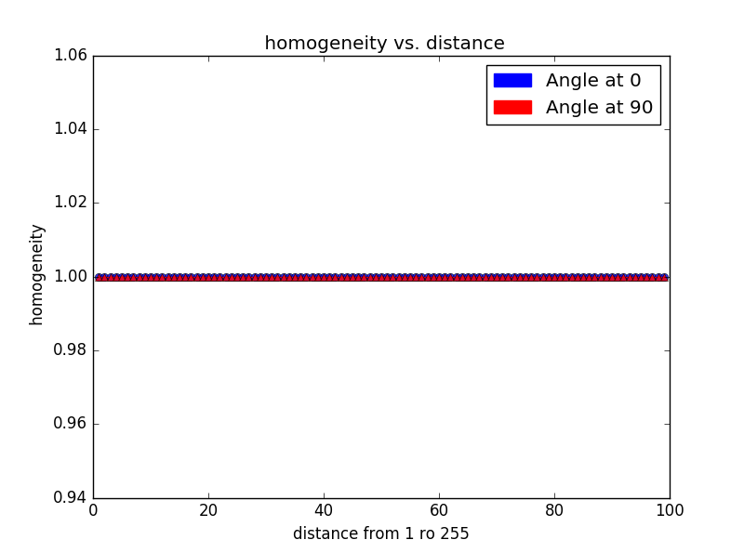
Homogeneity vs distance
Black image
Size: 100 x 100

Slide 5

ASM vs distance
Black image
Size: 100 x 100

Slide 6

Correlation vs distance
Black image
Size: 100 x 100

Slide 7
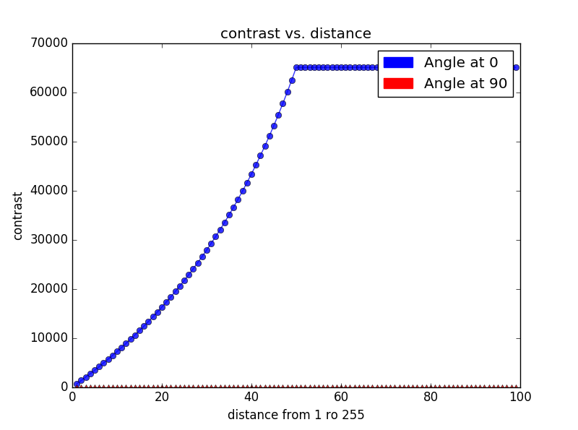

Contrast vs distance
Image size: 100 x 100
Block size 100x50

Slide 8
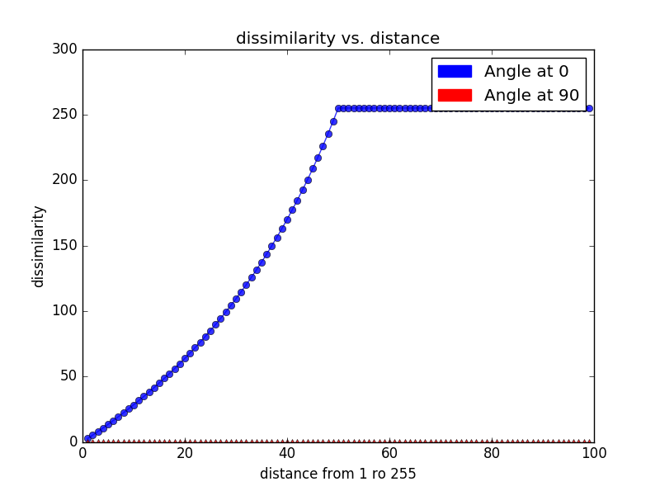
Dissimilarity vs distance
Image size: 100 x 100
Block size 100x50

Slide 9
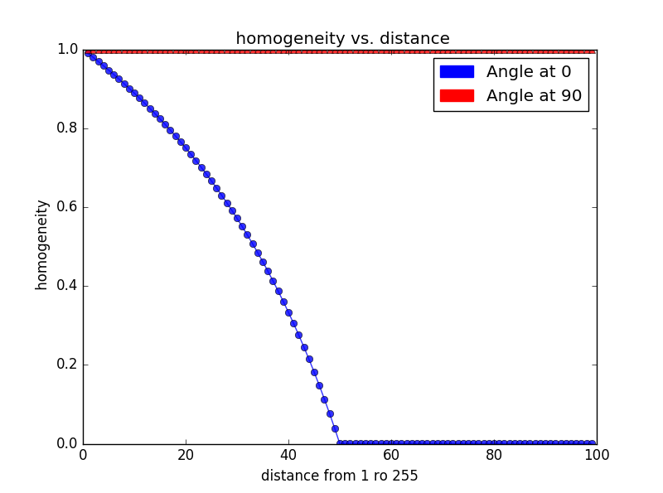
Homogeneity vs distance
Image size: 100 x 100
Block size 100x50

Slide 10
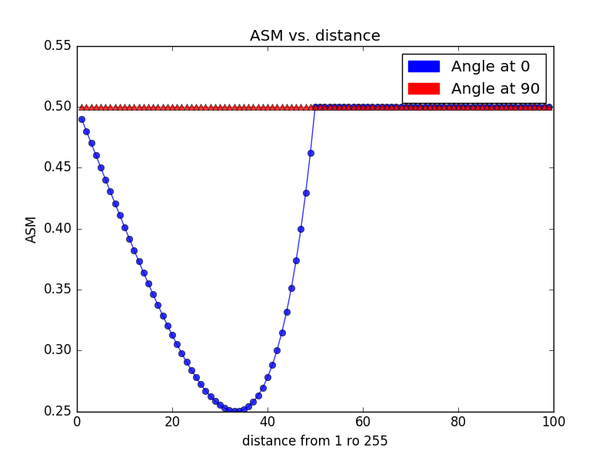
ASM vs distance
Image size: 100 x 100
Block size 100x50

Slide 11
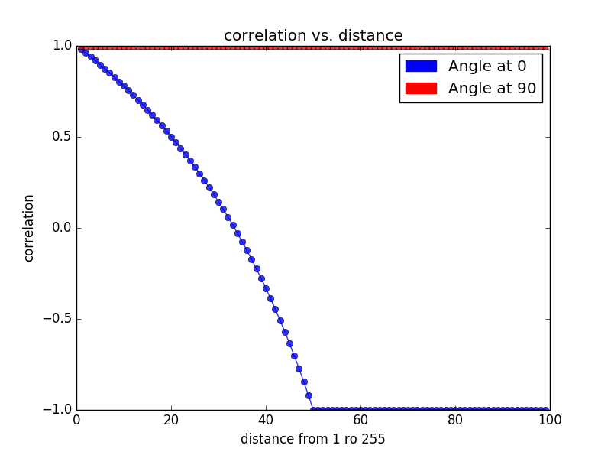
Correlation vs distance
Image size: 100 x 100
Block size 100x50

Slide 12
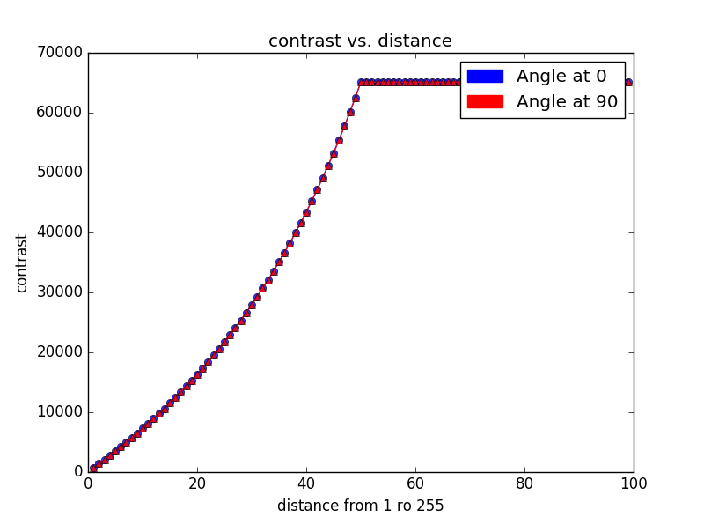

Contrast vs distance
Image size: 100 x 100
Block size 100x50

Slide 13
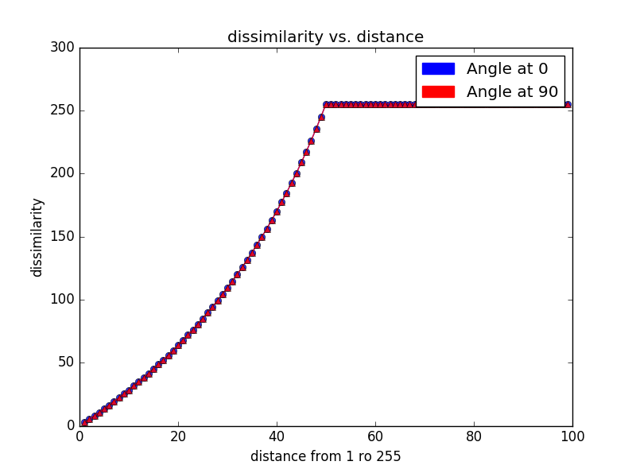
Dissimilarity vs distance
Image size: 100 x 100
Block size 100x50

Slide 14
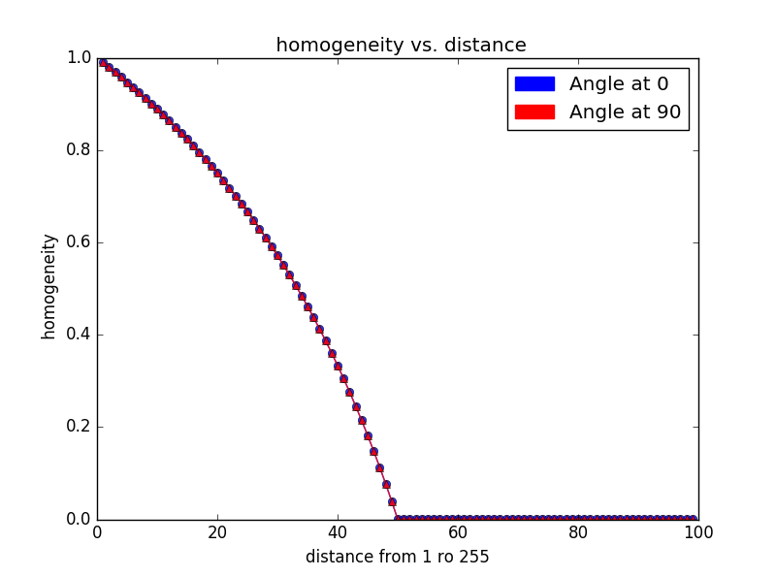
Homogeneity vs distance
Image size: 100 x 100
Block size 100x50

Slide 15
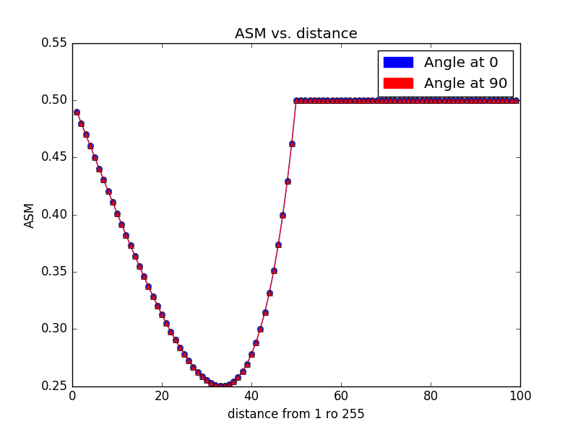
ASM vs distance
Image size: 100 x 100
Block size 100x50

Slide 16
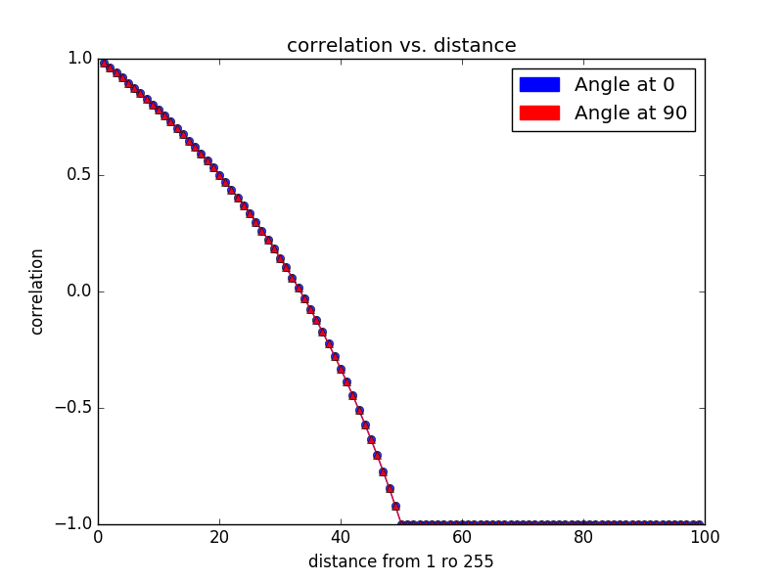
Correlation vs distance
Image size: 100 x 100
Block size 100x50

Slide 17
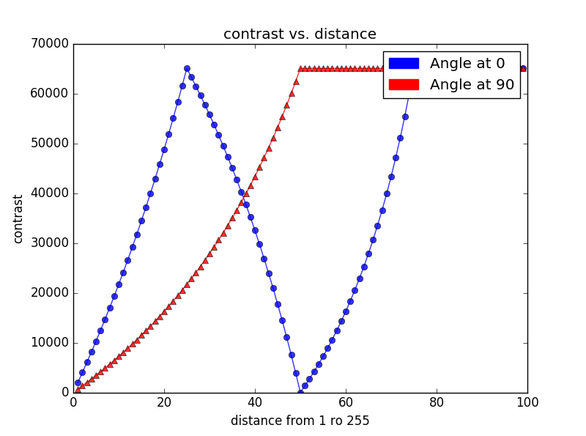

Contrast vs distance
Image size: 100 x 100
Block size 100x50

Slide 18
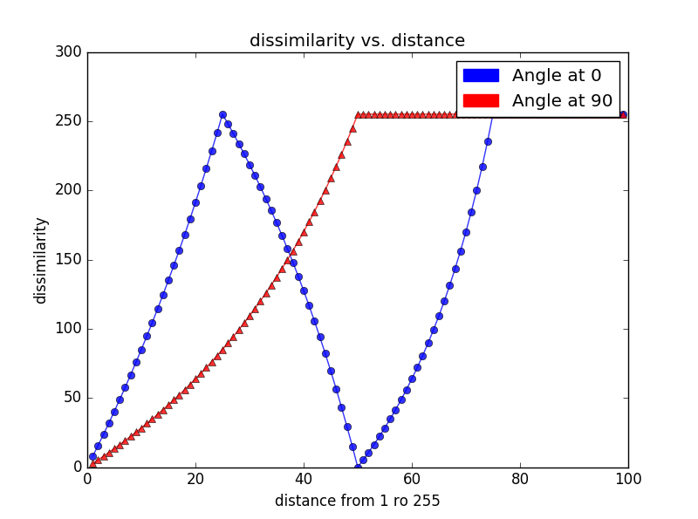
Dissimilarity vs distance
Image size: 100 x 100
Block size 50x25

Slide 19
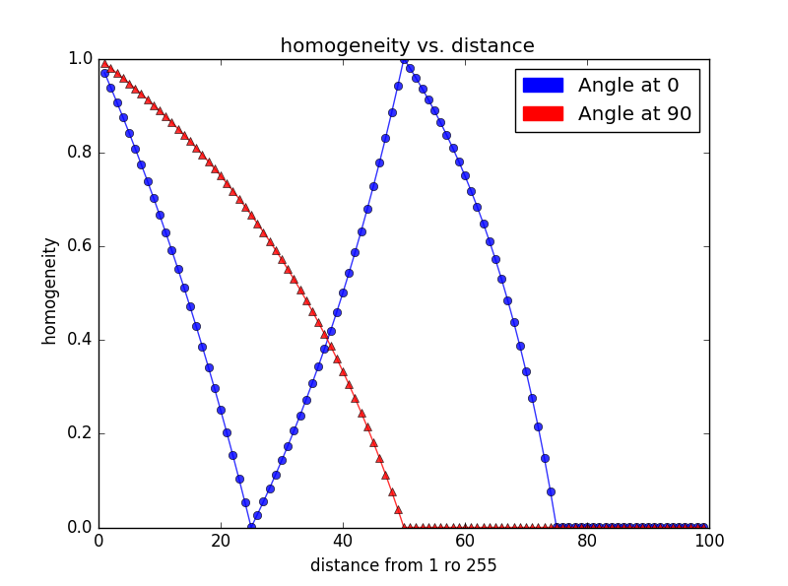
Homogeneity vs distance
Image size: 100 x 100
Block size 50x25

Slide 20
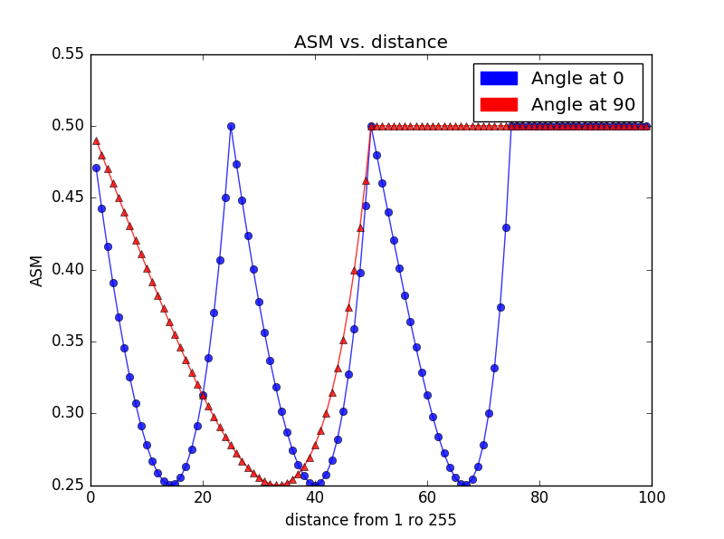
ASM vs distance
Image size: 100 x 100
Block size 50x25

Slide 21

Correlation vs distance
Image size: 100 x 100
Block size 50x25

Slide 22
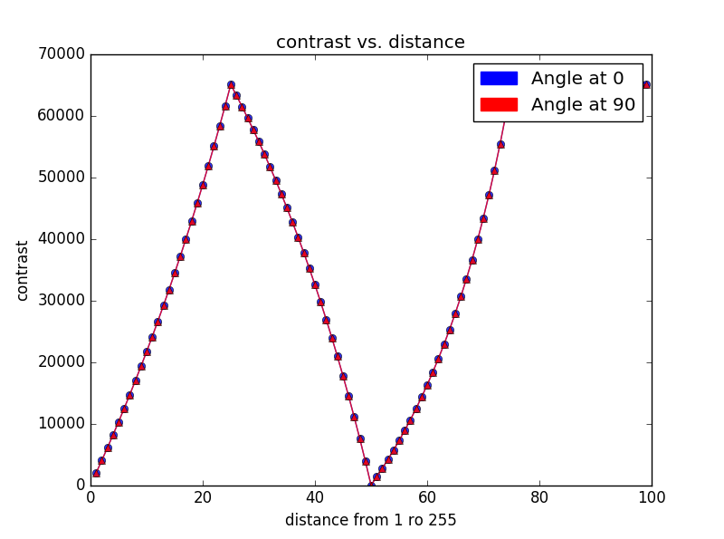

Contrast vs distance
Image size: 100 x 100
Block size 25x25

Slide 23
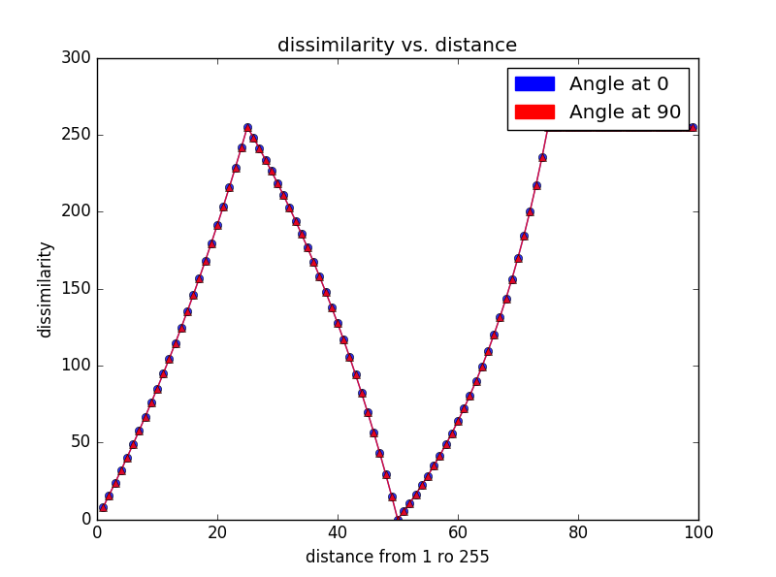
Dissimilarity vs distance
Image size: 100 x 100
Block size 25x25

Slide 24
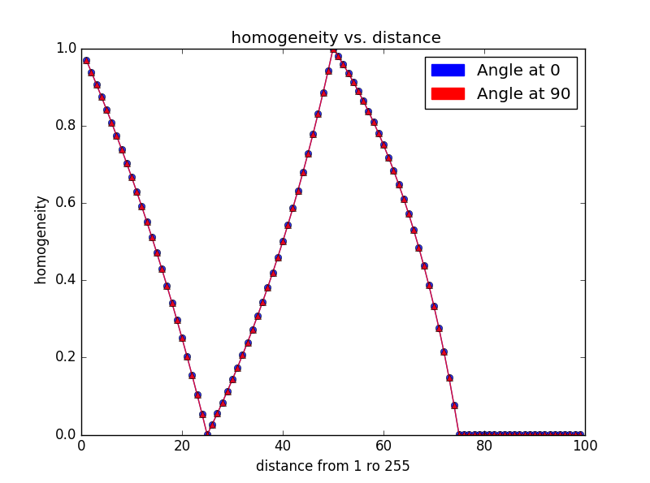
Homogeneity vs distance
Image size: 100 x 100
Block size 25x25

Slide 25
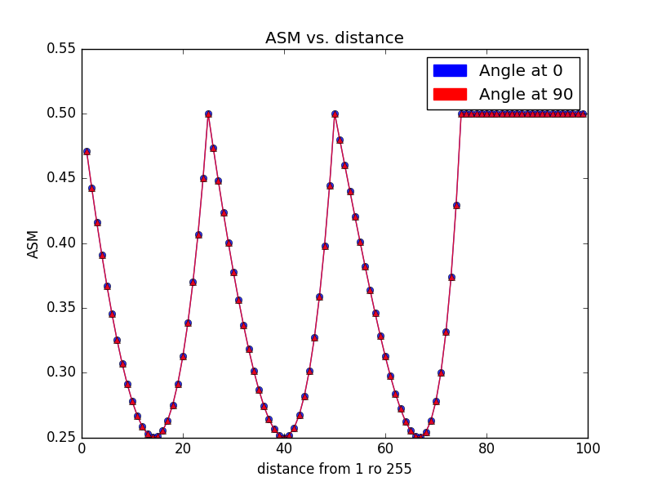
ASM vs distance
Image size: 100 x 100
Block size 25x25

Slide 26

Correlation vs distance
Image size: 100 x 100
Block size 25x25

Slide 27
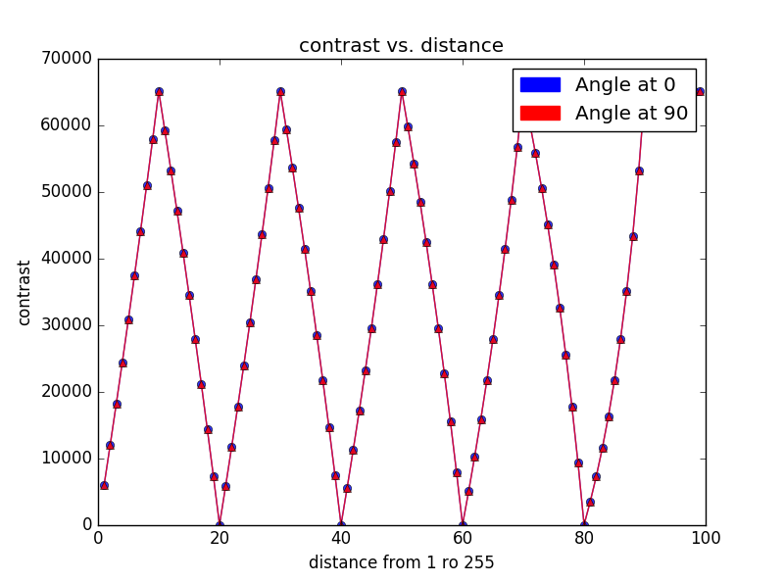
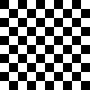
Contrast vs distance
Image size: 100 x 100
Block size 100x50

Slide 28
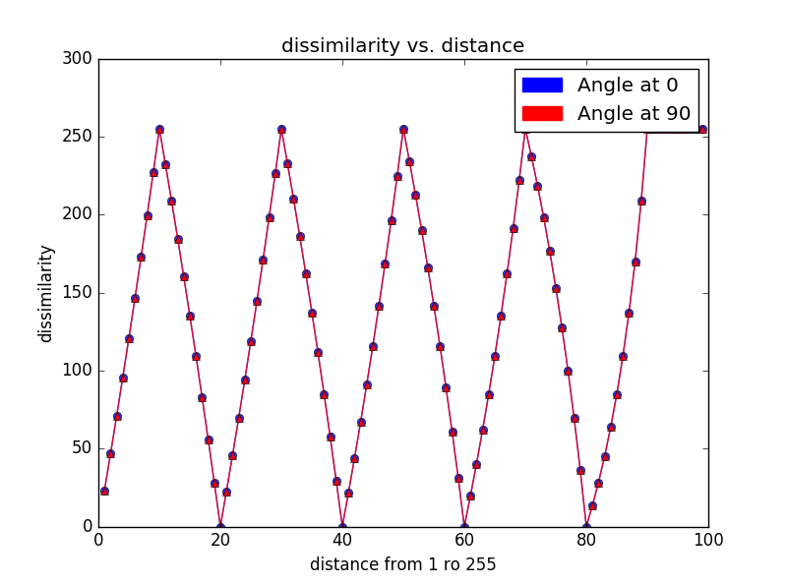
Dissimilarity vs distance
Image size: 100 x 100
Block size 100x50

Slide 29
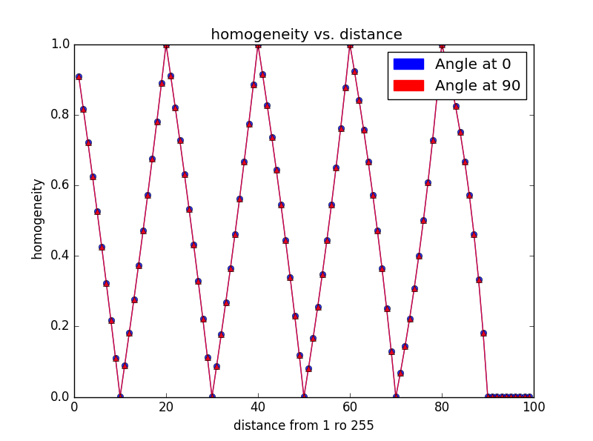
Homogeneity vs distance
Image size: 100 x 100
Block size 100x50

Slide 30
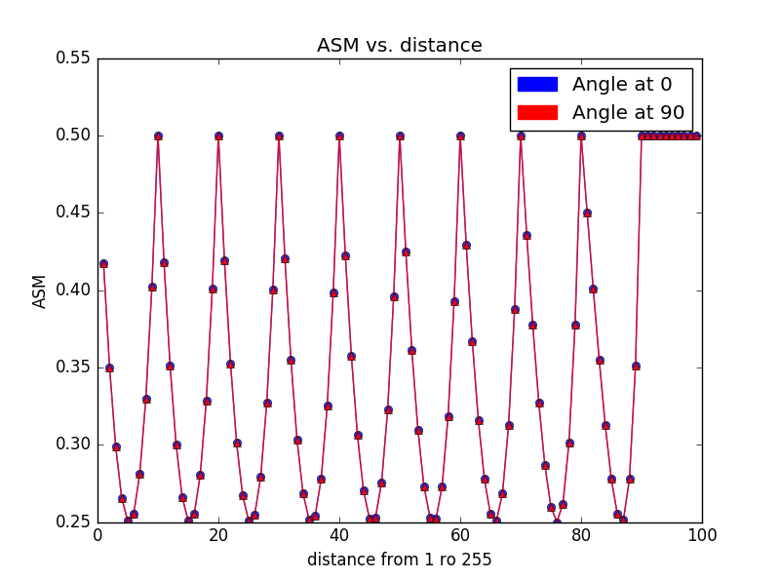
ASM vs distance
Image size: 100 x 100
Block size 100x50

Slide 31
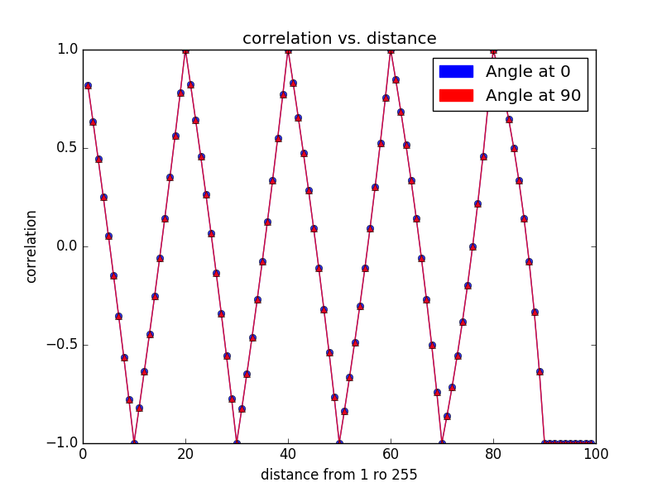
Correlation vs distance
Image size: 100 x 100
Block size 100x50

Slide 32
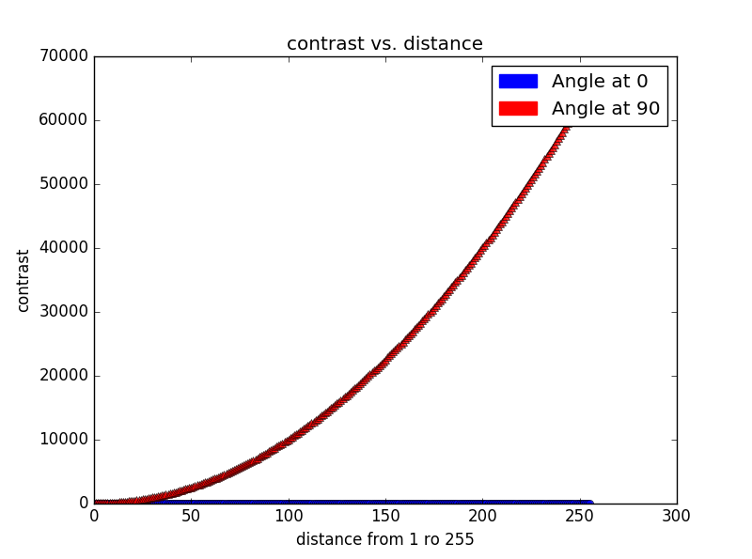

Contrast vs distance
Image size: 256 x 256
Block size 1x256
Each column has gray values from 0 to 255

Slide 33
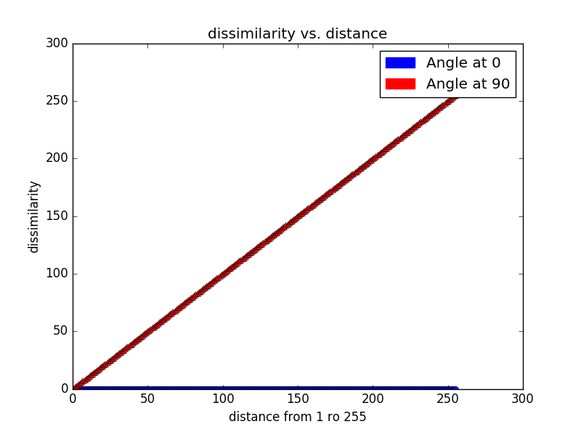
Dissimilarity vs distance
Image size: 256 x 256
Block size 1x256
Each column has gray values from 0 to 255

Slide 34
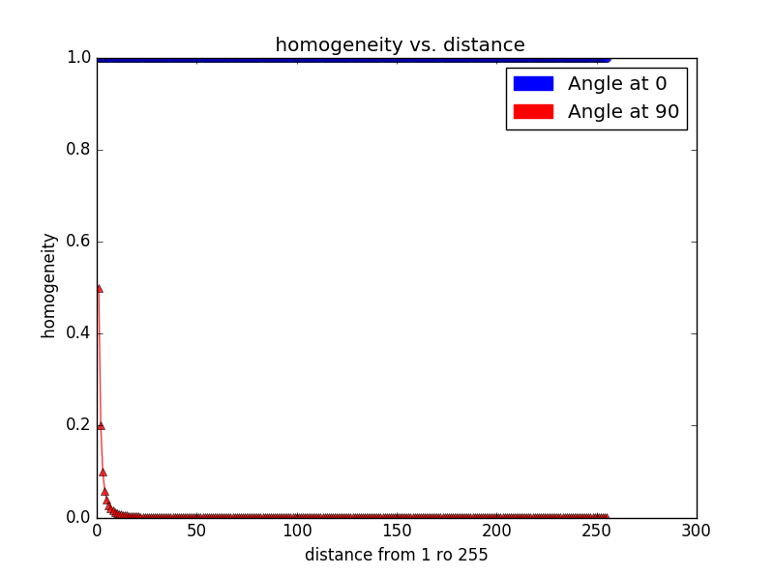
Homogeneity vs distance
Image size: 256 x 256
Block size 1x256
Each column has gray values from 0 to 255

Slide 35
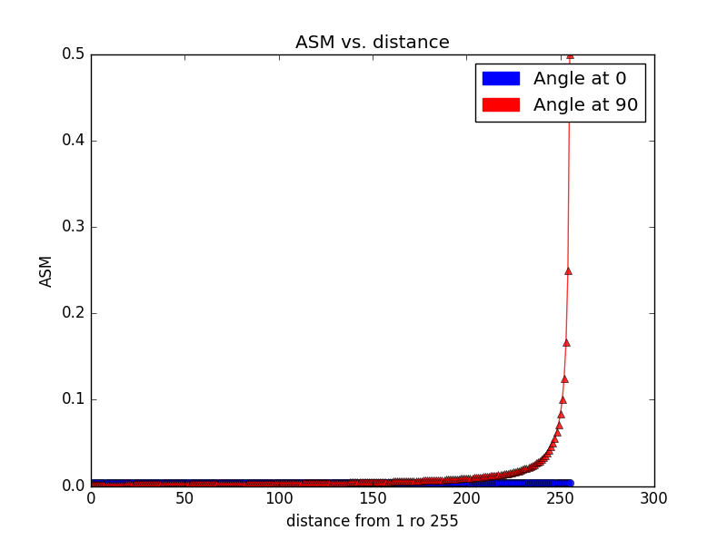
ASM vs distance
Image size: 256 x 256
Block size 1x256
Each column has gray values from 0 to 255

Slide 36
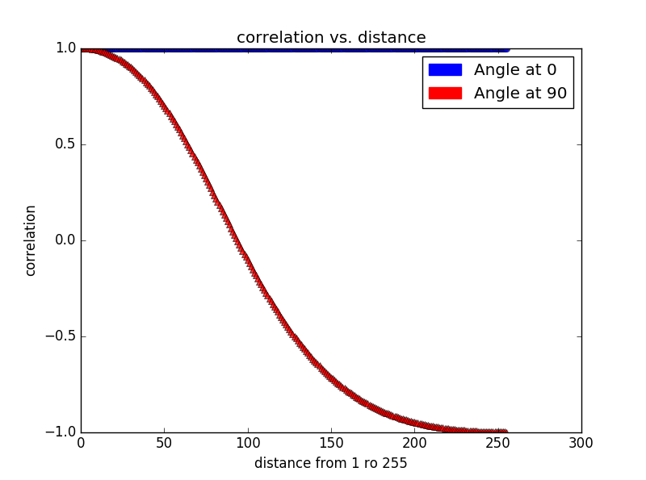
Correlation vs distance
Image size: 256 x 256
Block size 1x256
Each column has gray values from 0 to 255

Slide 37
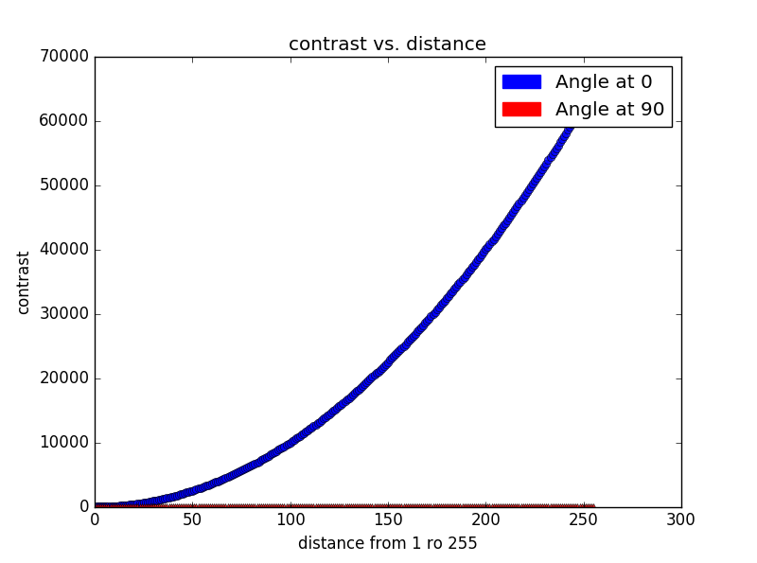

Contrast vs distance
Image size: 256 x 256
Block size 256x1
Each row has gray values from 0 to 255

Slide 38
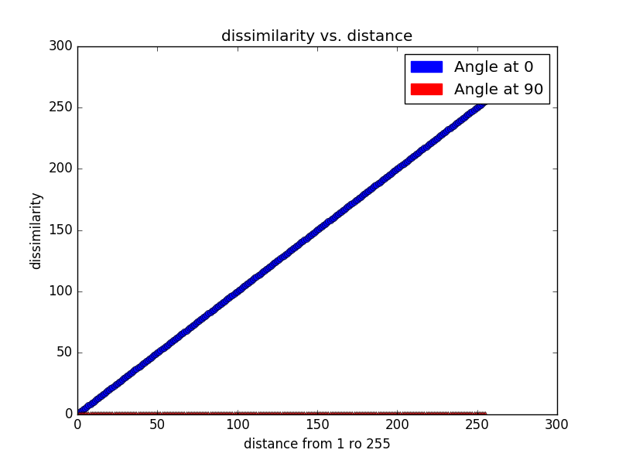
Dissimilarity vs distance
Image size: 256 x 256
Block size 256x1
Each row has gray values from 0 to 255

Slide 39
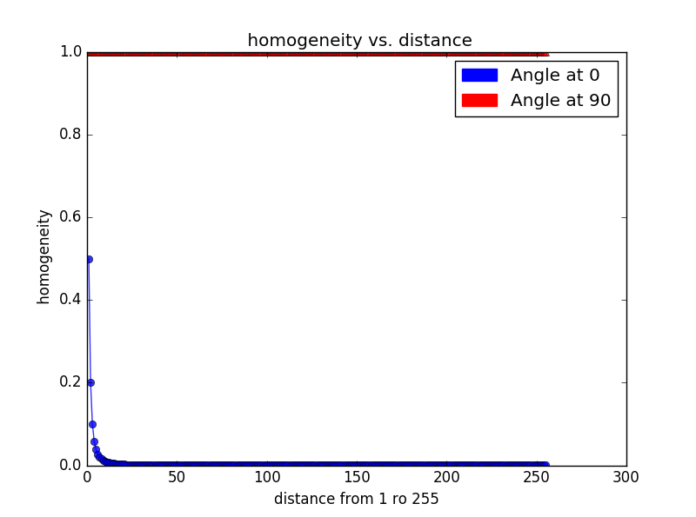
Homogeneity vs distance
Image size: 256 x 256
Block size 256x1
Each row has gray values from 0 to 255

Slide 40
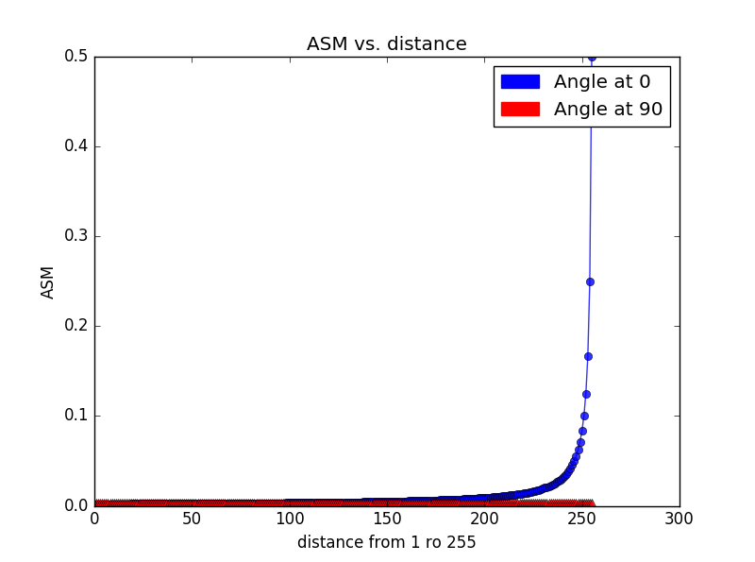
ASM vs distance
Image size: 256 x 256
Block size 256x1
Each row has gray values from 0 to 255

Slide 41
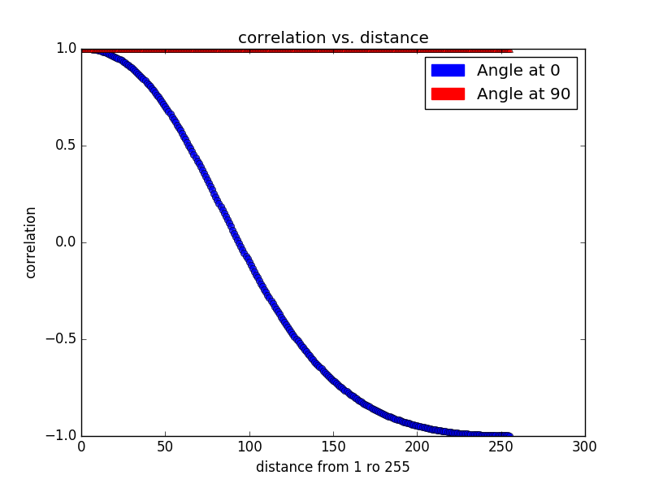
Correlation vs distance
Image size: 256 x 256
Block size 256x1
Each row has gray values from 0 to 255

Slide 42
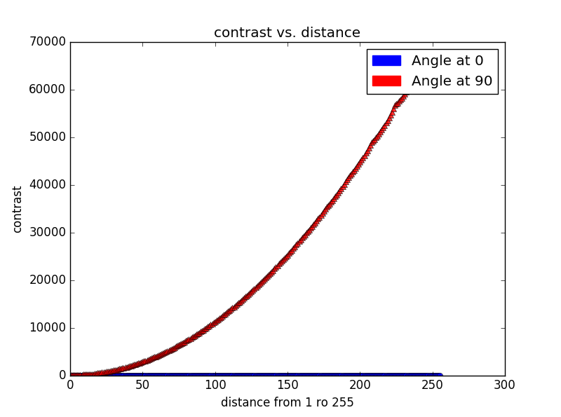
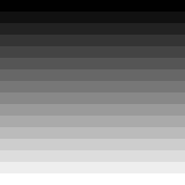
Contrast vs distance
Image size: 256 x 256
Block size 16x256
Each block has gray values from 0, 17, 34, 51 …….255

Slide 43
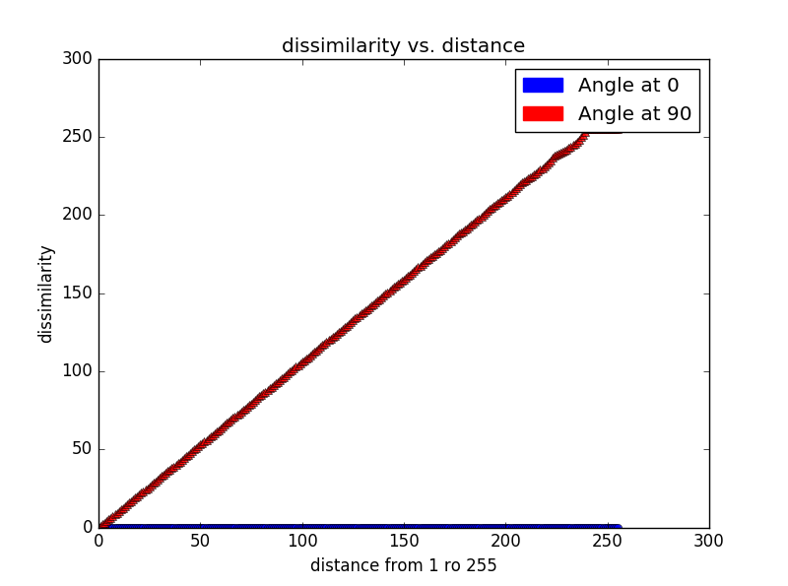
Dissimilarity vs distance
Image size: 256 x 256
Block size 16x256
Each block has gray values from 0, 17, 34, 51 …….255

Slide 44
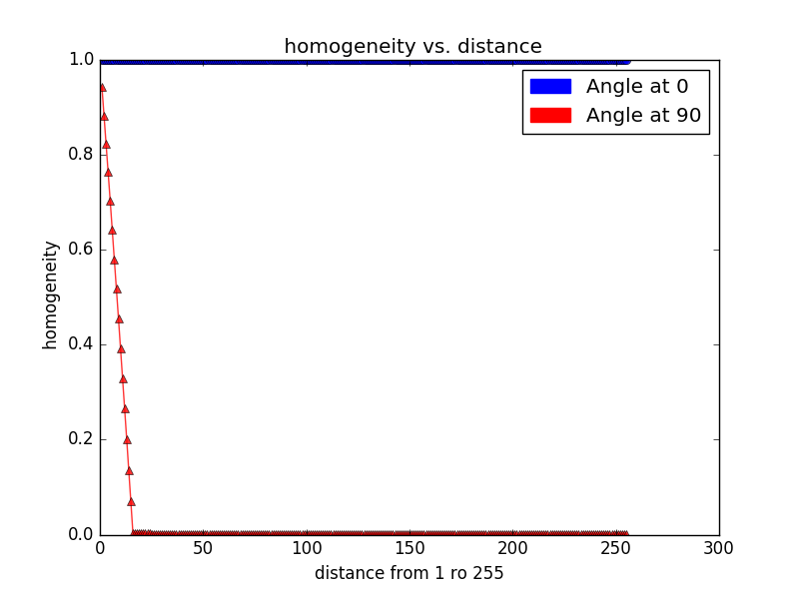
Homogeneity vs distance
Image size: 256 x 256
Block size 16x256
Each block has gray values from 0, 17, 34, 51 …….255

Slide 45
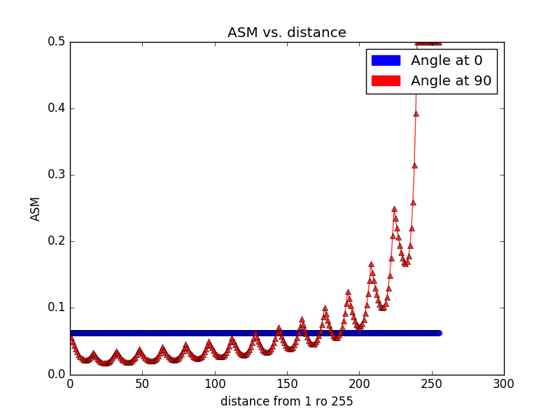
ASM vs distance
Image size: 256 x 256
Block size 16x256
Each block has gray values from 0, 17, 34, 51 …….255

Slide 46

Correlation vs distance
Image size: 256 x 256
Block size 16x256
Each block has gray values from 0, 17, 34, 51 …….255

Slide 47
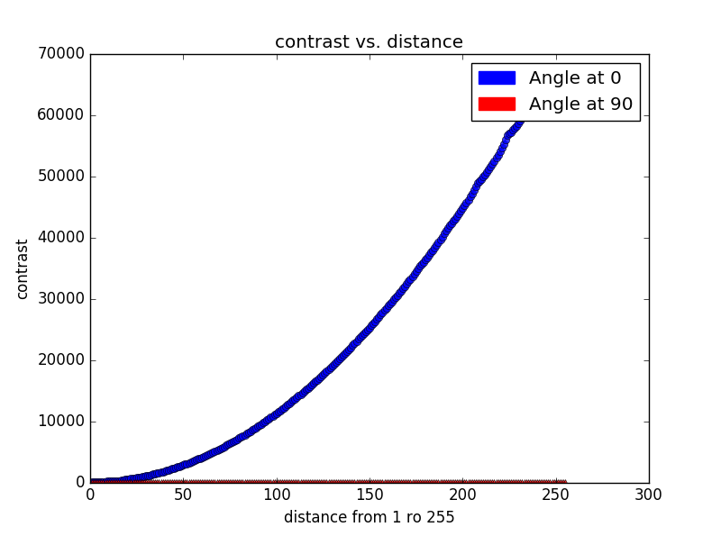

Contrast vs distance
Image size: 256 x 256
Block size 256x16
Each block has gray values from 0, 17, 34, 51 …….255

Slide 48
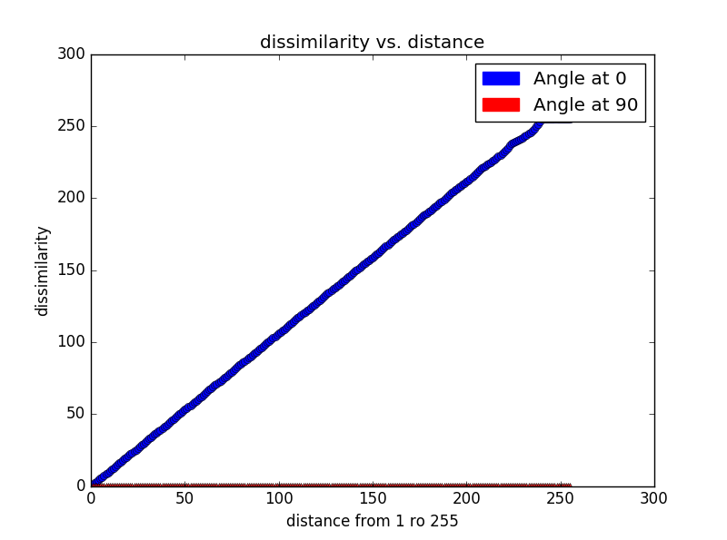
Dissimilarity vs distance
Image size: 256 x 256
Block size 256x16
Each block has gray values from 0, 17, 34, 51 …….255

Slide 49
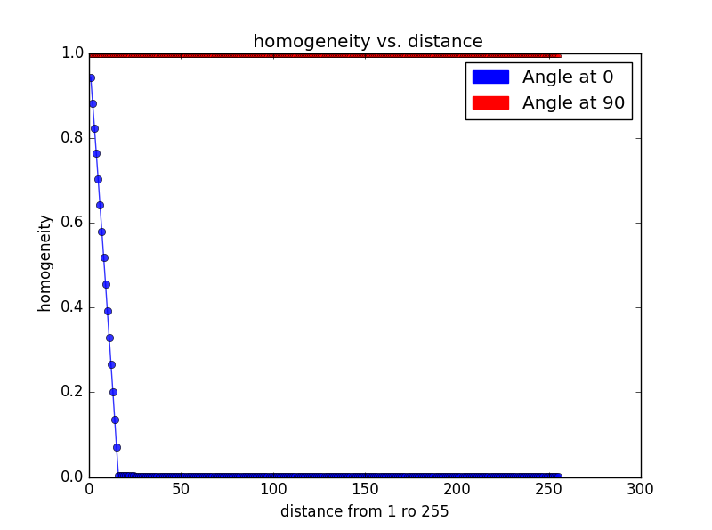
Homogeneity vs distance
Image size: 256 x 256
Block size 256x16
Each block has gray values from 0, 17, 34, 51 …….255

Slide 50
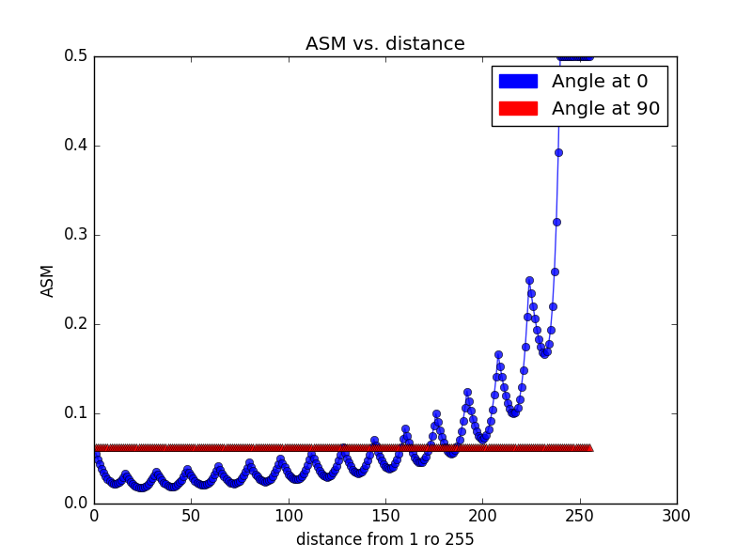
ASM vs distance
Image size: 256 x 256
Block size 256x16
Each block has gray values from 0, 17, 34, 51 …….255

Slide 51
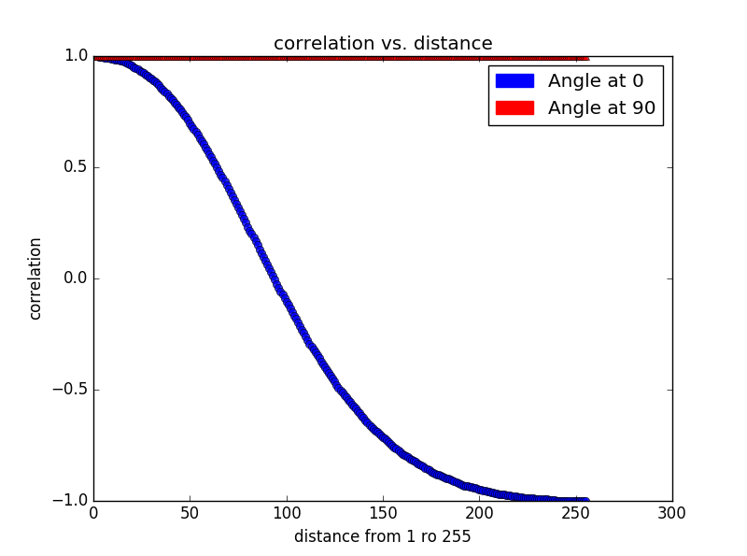
Correlation vs distance
Image size: 256 x 256
Block size 256x16
Each block has gray values from 0, 17, 34, 51 …….255

Slide 52
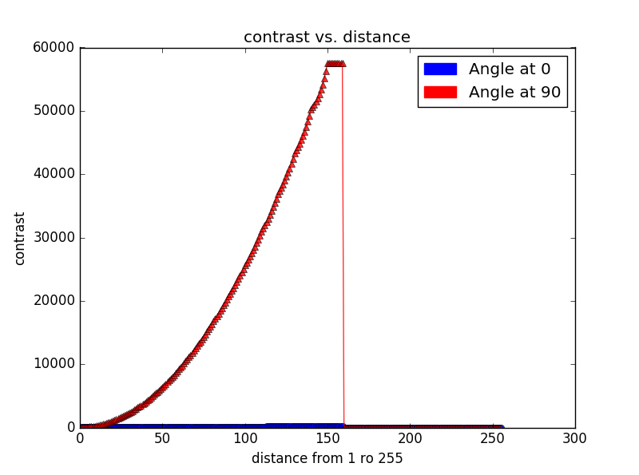

Contrast vs distance
Image size: 256 x 256
Block size 16x16
Each block has gray values from 0,1,2,3….255

Slide 53
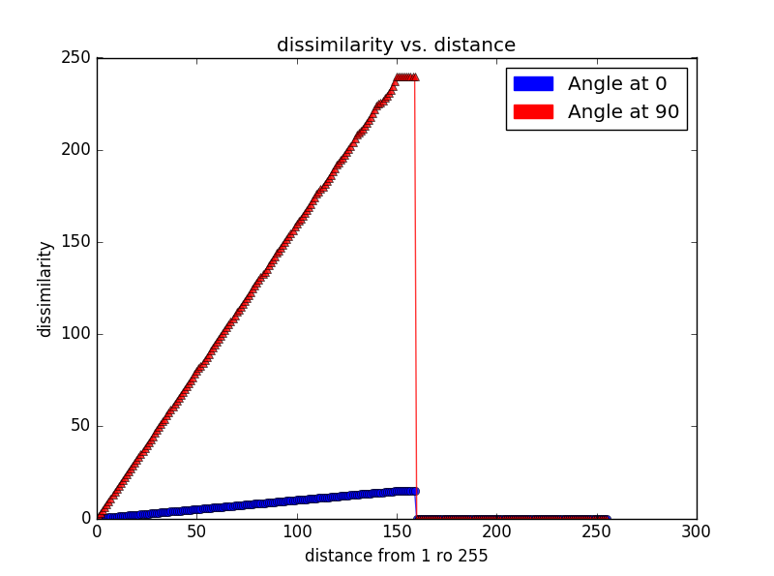
Dissimilarity vs distance
Image size: 256 x 256
Block size 16x16
Each block has gray values from 0,1,2,3….255

Slide 54
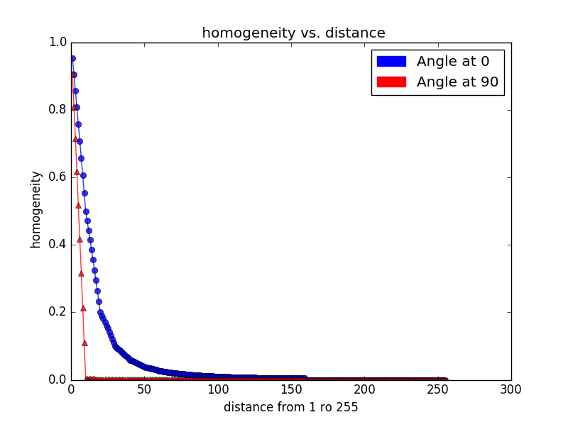
Homogeneity vs distance
Image size: 256 x 256
Block size 16x16
Each block has gray values from 0,1,2,3….255

Slide 55

ASM vs distance
Image size: 256 x 256
Block size 16x16
Each block has gray values from 0,1,2,3….255

Slide 56

Correlation vs distance
Image size: 256 x 256
Block size 16x16
Each block has gray values from 0,1,2,3….255

Slide 57


Contrast vs distance
Image size: 256 x 256
Block size 16x16
Each block has gray values from 0,1,2,3….255

Slide 58

Dissimilarity vs distance
Image size: 256 x 256
Block size 16x16
Each block has gray values from 0,1,2,3….255

Slide 59

Homogeneity vs distance
Image size: 256 x 256
Block size 16x16
Each block has gray values from 0,1,2,3….255

Slide 60

ASM vs distance
Image size: 256 x 256
Block size 16x16
Each block has gray values from 0,1,2,3….255

Slide 61

Correlation vs distance
Image size: 256 x 256
Block size 16x16
Each block has gray values from 0,1,2,3….255

