Slide 1
A detail tutorial of GLCM algorithm
Mohammad Shamim Imtiaz

Slide 2
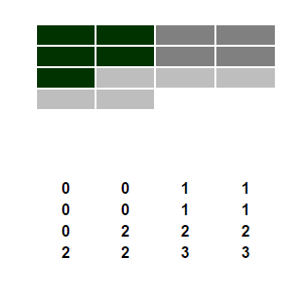
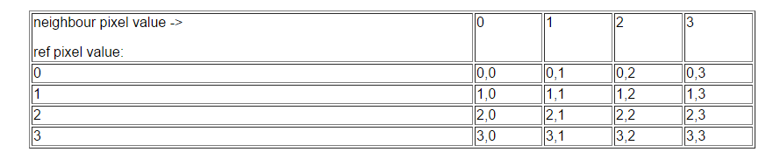
Let’s begin with an example
This 4x4 matrix will be used as an example through out this tutorial
1st step build a frame work

Slide 3
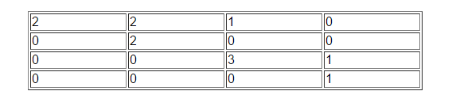
Fill in the matrix frame work
Fill in the matrix framework with 1 pixel offset

Slide 4
Fill in the matrix frame work
Fill in the matrix framework with 2 pixel offset
0 | 4 | 1 | 0
0 | 0 | 0 | 0
0 | 0 | 1 | 2
0 | 0 | 0 | 0

Slide 5
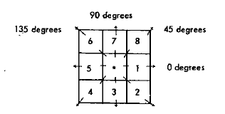
Require a symmetrical matrix
The texture calculations require a symmetrical matrix
The next step is therefore to get the GLCM into this form
A symmetrical matrix means that the same values occur in cells on opposite sides of the diagonal
the value in cell 3,2 would be the same as the value in cell 2,3
For GLCM calculation, the symmetry can be achieved if each pixel pair is counted twice: once "forwards" and once "backwards"

Slide 6
Require a symmetrical matrix
Fill in the matrix framework at 1 pixel offset with
forward and backward flow
4 | 2 | 1 | 0
2 | 4 | 0 | 0
1 | 0 | 6 | 1
0 | 0 | 1 | 2

Slide 7
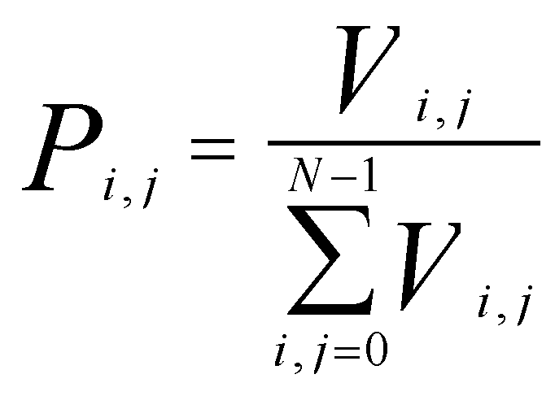
Normalize of the symmetrical matrix
1 pixel offset with
forward and backward flow
Normalization equation where V is the input from symmetrical matrix
4 | 2 | 1 | 0
2 | 4 | 0 | 0
1 | 0 | 6 | 1
0 | 0 | 1 | 2
Symmetrical Normalized matrix which we called Gray level cooccurrence matrix
0.167 | 0.083 | 0.042 | 0
0.083 | 0.167 | 0 | 0
0.042 | 0 | 0.25 | 0.042
0 | 0 | 0.042 | 0.083
Offset = 1
Angle = 0

Slide 8
Properties of GLCM matrix
It is square
Has the same number of rows and columns as the quantization level of the image
It is symmetrical around the diagonal
The diagonal elements all represent pixel pairs with no grey level difference (0-0, 1-1, 2-2, 3-3 etc.)
If there are high probabilities in these elements, then the image does not show much contrast: most pixels are identical to their neighbors
Cells one cell away from the diagonal represent pixel pairs with a difference of only one grey level (0-1, 1-2, 2-3 etc.).
Similarly, values in cells two away from the diagonal show how many pixels have 2 grey level differences, and so forth
The farther away from the diagonal, the greater the difference between pixel grey levels
Symmetrical Normalized matrix which we called Gray level cooccurrence matrix
0.167 | 0.083 | 0.042 | 0
0.083 | 0.167 | 0 | 0
0.042 | 0 | 0.25 | 0.042
0 | 0 | 0.042 | 0.083
Offset = 1
Angle = 0

Slide 9

Different texture Properties of GLCM
Contrast
Dissimilarity
Homogeneity
ASM
Energy
Correlation
Here, P is the GLCM array
Symmetrical Normalized matrix which we called Gray level cooccurrence matrix
0.167 | 0.083 | 0.042 | 0
0.083 | 0.167 | 0 | 0
0.042 | 0 | 0.25 | 0.042
0 | 0 | 0.042 | 0.083
Offset = 1
Angle = 0

Slide 10
Different texture Properties of GLCM
Contrast
Dissimilarity
Homogeneity
ASM
Energy
Correlation
Here, P is the GLCM array
As contrast increase away from the diagonal, create a weight that increases as distance from the diagonal increases
create weights so that the calculation results in a larger figure when there is great contrast
Second degree measure

Slide 11
Different texture Properties of GLCM
Contrast
Dissimilarity
Homogeneity
ASM
Energy
Correlation
Here, P is the GLCM array
In the dissimilarity measure weights increase linearly, as one moves away from the diagonal
First degree measure

Slide 12
Different texture Properties of GLCM
Contrast
Dissimilarity
Homogeneity
ASM
Energy
Correlation
Here, P is the GLCM array
Dissimilarity and Contrast result in larger numbers for more contrasty windows
If weights decrease away from the diagonal, the result will be larger for windows with little contrast, which is homogeneity

Slide 13
Different texture Properties of GLCM
Contrast
Dissimilarity
Homogeneity
ASM
Energy
Correlation
Here, P is the GLCM array
Orderliness measures, like contrast measures, use a weighted average of the GLCM values
The weight is constructed related to how many times a given pair occurs
A weight that increases with commonness will yield a texture measure that increases with orderliness
A weight that decreases with commonness yields a texture measure that increases with disorder
Since the Pij values in the GLCM are already a measure of commonness of occurrence, it makes sense to use them in some form as weights for themselves
The square root of the ASM is sometimes used as a texture measure, and is called Energy

Slide 14
Different texture Properties of GLCM
Contrast
Dissimilarity
Homogeneity
ASM
Energy
Correlation
Here, P is the GLCM array
The Correlation texture measures the linear dependency of grey levels on those of neighboring pixels

Slide 15
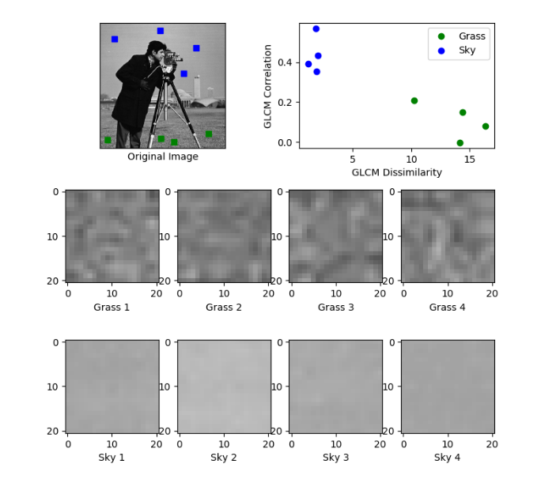
The way GLCM can be applied
The result of a texture calculation is a single number representing the entire window
This number is put in the place of the center pixel of the window
Then the window is moved one pixel
and the process is repeated of calculating a new GLCM
and a new texture measure
In this way an entire image is built up of texture values
That’s how different texture properties of GLCM can be calculated of sky and grass images

