Slide 1
STAT4011 Group 4
Face recognition by PCA,KNN &DF
Chan Sze Yuen 1155127616
Lai Tsz Chun 1155125208
Lam Man Ting 1155125890
Lee Wai Hin 1155125562
Kwok Ho Hin 1155126159

Slide 2
TABLE OF CONTENTS
Introduction
Data Description
Model Description & Method
Comparison of Multiple Models
Conclusion

Slide 3
Introduction
Idea:
Face recognition system compares the image with the database to perform function of identification.
We are interested in,
1. Building a classification model for the individuals in our database
2. Predicting the accurate individual from the input image based on our model.
3. investigating whether we should apply Principal Component Analysis (PCA) to simplify the large dataset before classification.
Chan Sze Yuen 1155127616

Slide 4
Introduction
Idea:
We propose three approaches for classification,
1. Use PCA for extraction and K-Nearest Neighbors (KNN)
2. Use PCA and then decision tree
3. Use PCA and then random forest
Comparison of the performances of the two approaches
Chan Sze Yuen 1155127616

Slide 5
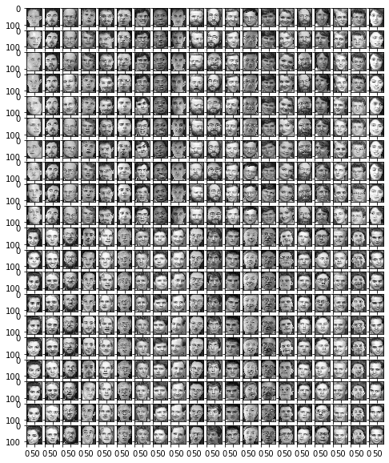
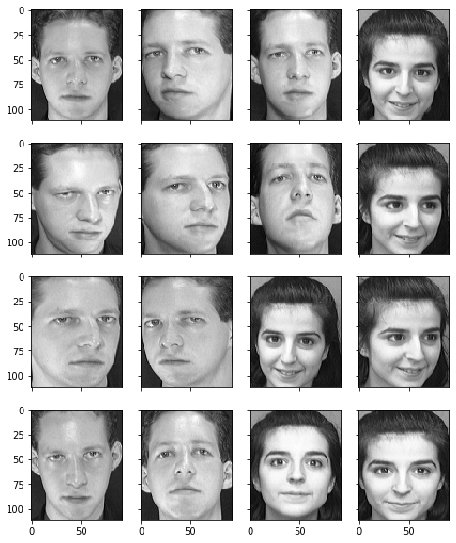
Our data
400 images in total
40 people with 10 faces each
show some of the faces
Chan Sze Yuen 1155127616

Slide 6
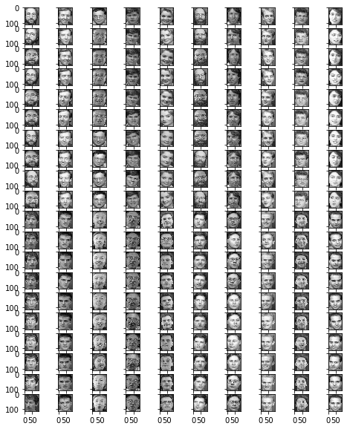
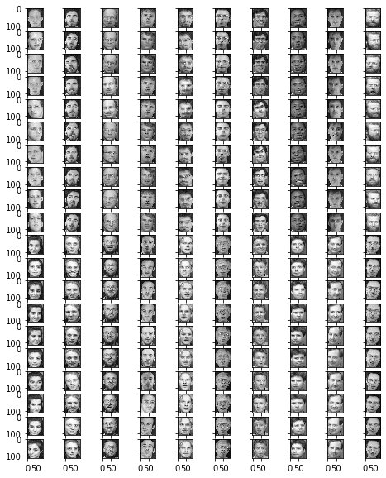
Testing and training Dataset
training dataset: 200 images with 5 faces for each person
testing dataset: remaining 200 images with 5 faces for each person
Chan Sze Yuen 1155127616

Slide 7
Pre-Processing
Projection of data
Idea: try to project the data to a smaller dimension in order to reduce the burden to the computer system when training the algorithm.
Unitary projection
Idea: simply rotation or sign flip of the coordinate system
Benefit: vector length and mean square vector length are conserved.
Kwok Ho Hin 1155126159

Slide 8
Pre-Processing
More information in Unitary projection:
Energy distribution(mean square vector length)
unevenly distributed among the coefficients.
How to know so call energy?
Look the diagonal of the autocorrelation matrix
Kwok Ho Hin 1155126159

Slide 9
Pre-Processing
More insight in Unitary projection:
Karhunen-Loeve transformation
Using the eigen matrix of the autocorrelation matrix to do the unitary transformation.
Benefit:
Being able to keep only first n coefficients with minimized mean square error
The most powerful transformation amony the unitary transformation that pack the most mean square vector length in the first n coefficients.
Kwok Ho Hin 1155126159

Slide 10
Pre-Processing
After projection, the dimension of the data is reduced.
Want a further reduce in dimension of the data.
LDA vs principle component analysis
Why choose PCA ?
LDA does not work well when the sample size is small.
PCA serves as dimension reduction, helpful for reducing complexity and hence boost the runtime of the program when data is large.
Kwok Ho Hin 1155126159

Slide 11
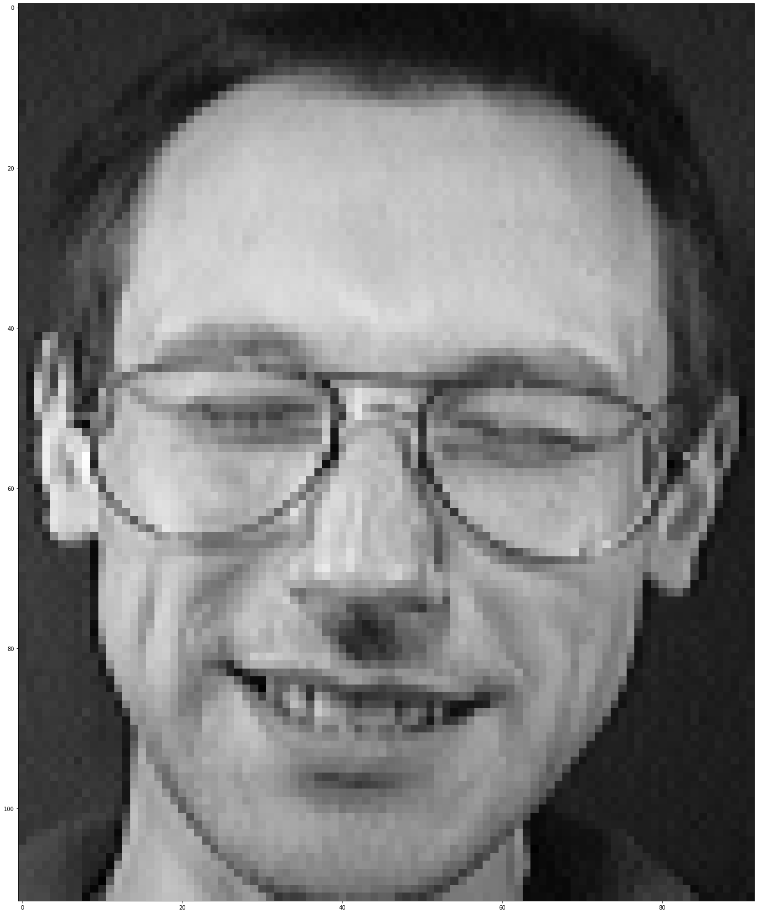
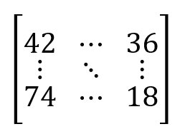
Pre-Processing
Convert an image to a matrix
dimension: 112x92
Kwok Ho Hin 1155126159

Slide 12
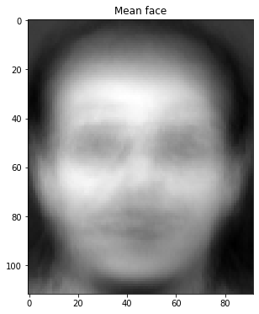
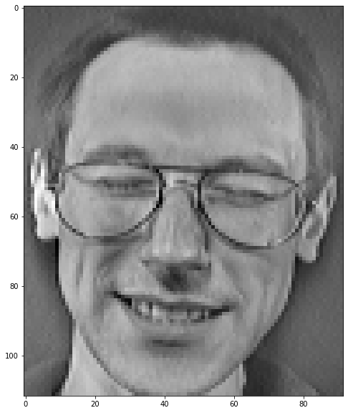
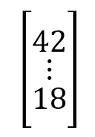
Model Description & Method- PCA & KNN
1. eigenfaces extraction (PCA)
For each image in the training dataset:
=
minus
dimension: 112x92
dimension: 10304x1
mean face of our training data
face after subtraction
Lai Tsz Chun 1155125208

Slide 13
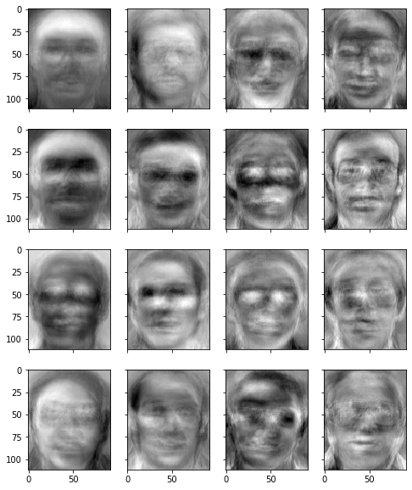
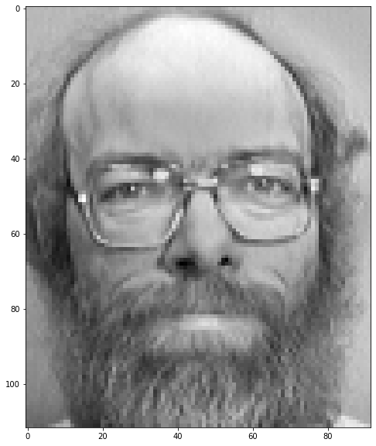
Model Description & Method- PCA & KNN
1. eigenfaces extraction (con’t)
...
Covariance Matrix
200 subtracted mean faces as a matrix with dimension 10304x 200
extract first few eigenfaces
Lai Tsz Chun 1155125208

Slide 14
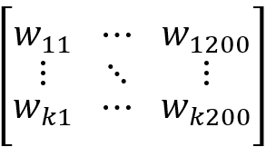

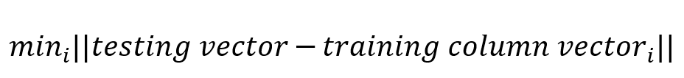
Model Description & Method- PCA & KNN
2. weight computation & Euclidean distance minimization (KNN)
For each image in the training dataset, compute its weight by project it to the k-eigenspace.
For an testing image, also compute its weight.
Compute the Euclidean distance for each column training vector with the testing vector and find the minimum.
dimension: kx200
dimension: kx1
Classification result: The label of the training image with minimum Euclidean distance is the classification result of KNN.
Lai Tsz Chun 1155125208

Slide 15


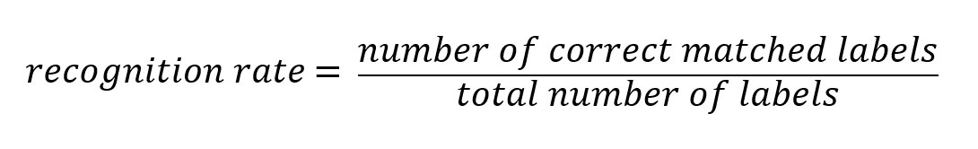
Classification - PCA & KNN
the matched labels by KNN
the true labels of the testing dataset
Lai Tsz Chun 1155125208

Slide 16
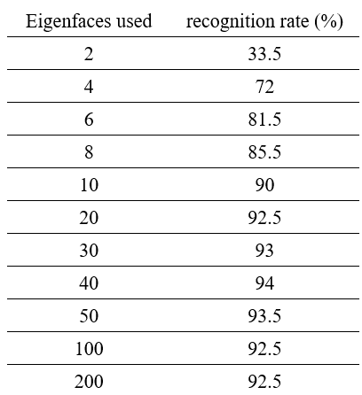
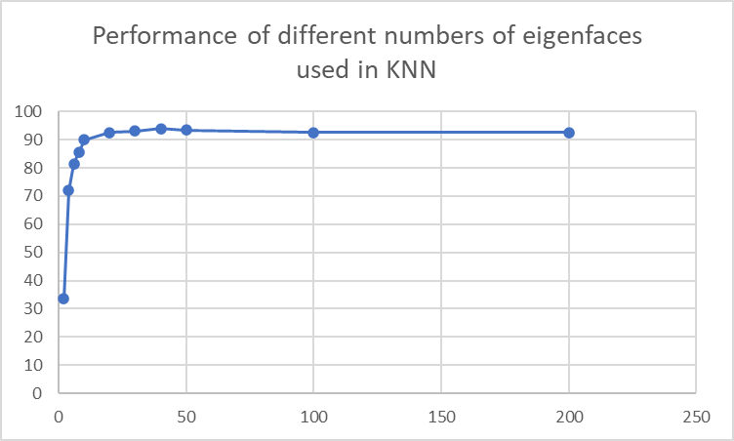
Classification Result- PCA & KNN
We see that the recognition rate reaches its peak with the first 10 eigenfaces used. We conclude that 10 eigenfaces are enough for further classification filter.
Lai Tsz Chun 1155125208

Slide 17
Model Description & Method
Principal Component Analysis (PCA) & Decision Tree/Random Forest
Based on using PCA extracted features, we wish to construct a decision tree
Classify the photo using decision tree
Lam Man Ting 1155125890

Slide 18
Model Description & Method
Decision Tree classifier -- Training
200 training image
Decision Node
Decision Node
Attribute Selection
Measures
. . . . . . . . . .
Class 1/ People 1
Class 2/ People 2
. . . . . .
Class 40/ People 40
Lam Man Ting 1155125890

Slide 19
Model Description & Method
Attribute Selection -- Information Gain
200 training image
Selecting the best features/attributes that provide the most information
about a class
Entropy -> measure of a random variable’s uncertainty
reduce the level of entropy = data that are so different within a class decrease
→ Large information gain = Large reduce in entropy = good split
Decision Node
Decision Node
High Information Gain
Low Information Gain
Lam Man Ting 1155125890
Notes:
Gini Index favors larger partitions and easy to implement whereas information gain favors smaller partitions with distinct values.

Slide 20


Model Description & Method
Attribute Selection -- Information Gain
Feature vector
The information gain Gain(S,A) for Feature A
Entropy of training sample sets (S)
Pi = portion of S belongs to class i
Sv = subset of sample set S belongs to class i
|S| = number of element in S
Best attribute: highest information gain and the smallest entropy
Repeat until we got homogeneous nodes
|Sv| = number of element in Sv
Lam Man Ting 1155125890

Slide 21
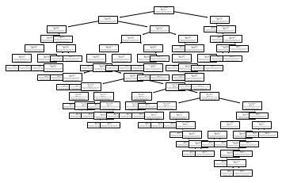
Model Description & Method
Lam Man Ting 1155125890

Slide 22



Model Description & Method
Random Forest classifier -- Training
Create 100 bootstrap samples from the training image
classification tree 1
In each tree,
only some features (m<10) are chosen in choose the best split
10 PCA extracted features
classification tree 2
200 training image
.
.
.
classification tree 100
(unpruned)
Lee Wai Hin 1155125562

Slide 23

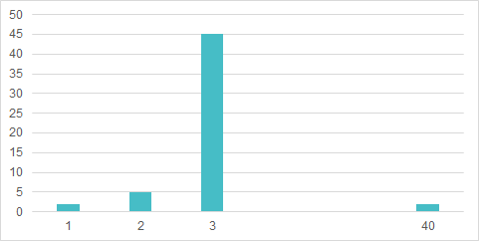
Model Description & Method
Random Forest classifier -- Testing
Decision tree 1
Class i (People A)
Decision tree 2
Class j (People B)
Input image (x1)
.
.
.
.
.
.
. . . . . . .
Decision tree 100
Class j (People B)
People 1- People 40
Lee Wai Hin 1155125562

Slide 24
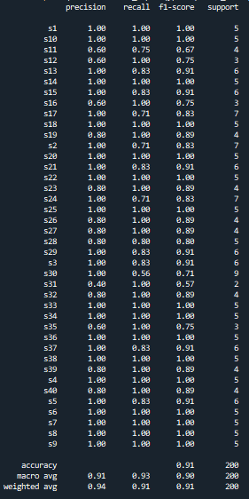

Model Result
The result of random forest using raw data is shown below. The prediction accuracy is 0.91.
However, together with the use of PCA, the accuracy drop dramatically.
Lee Wai Hin 1155125562

Slide 25
Model Result
Possible reasons of failures of using PCA on decision tree and random forest:
Small change in the data may cause a large change in the final estimated tree.
PCA reduces the data dimensions which may also reduces the information and this may affect building a tree.
Lee Wai Hin 1155125562

Slide 26
Model Result
In the test result, several side factor would also affect the prediction rate
The direction of face (eg. lateral face)
For training dataset, using different direction of face would lead to a higher difficulty for recognizing the front face test image
Facial expression (eg. smile)
Facial expression in training data would not affect too much on the performance
Lam Man Ting 1155125890

Slide 27
Comparison
Comparison | KNN | Decision tree | Random Forest
variable for splitting | Using distance | Using PC value | Using PC value
Algotherm for node assignment | Minimized distance between two photo vector | Information gain | Information gain
Chan Sze Yuen 1155127616

Slide 28
Comparison
Comparison | KNN | Decision tree | Random Forest
Interpretability | relatively not easy as we can show the decision boundary but thats all. | easy to explain as we know exactly how the data is classified by the plot | hard
Visualization | Yes but messy for 2D visualization | Yes | No (as we have many trees)
Robustness | KNN is sensitive to outliers since it is based on the distance criteria | Each node is not sensitive to outlier data because splitting based on the majority vote. | Relatively less sensitive to outlier as multiple tree will balance out the outlier effect.
Chan Sze Yuen 1155127616

Slide 29
Conclusion
We have investigated the performances of different methods for face recognition and found that PCA with KNN generally gives a good classification rate while PCA with decision tree and random forest do not. Therefore, PCA is suitable for some classifiers only.
Chan Sze Yuen 1155127616

