Slide 1
Quarterly Report
Generated on: 2022.06.26.

Slide 2
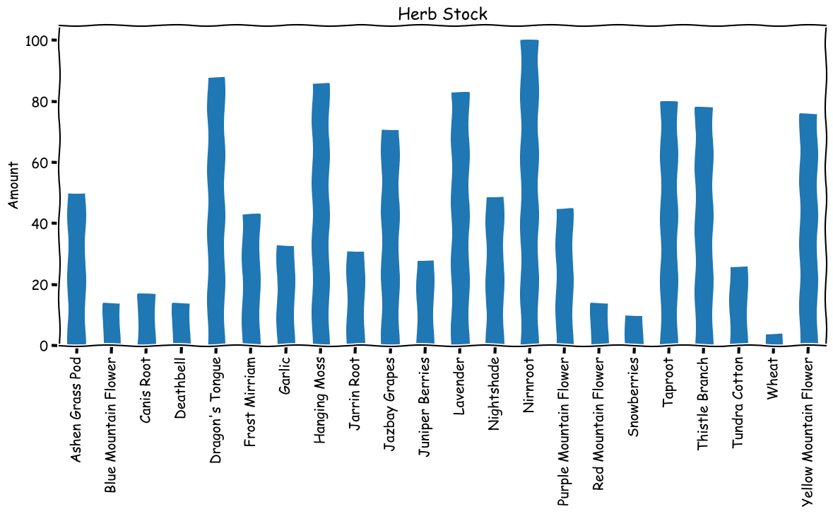
Herbs

