Slide 1
Racecraft AI
Agentic Intelligence for Formula 1
FORMULA 1 · MULTI-AGENT · EXPLAINABLE AI
Notes:
OPENING — 30 sec Open with: 'Racecraft AI is not an F1 dashboard. It is a proof-of-concept for how agentic AI systems should be built.' Pause on the tagline. Let the simplicity land. Judge message: 'We re-architected our way out of a broken system.'

Slide 2
01 / THE PROBLEM
01
Hallucination
AI was
confident.
And wrong.
LLMs generate plausible-sounding but factually wrong predictions
02
No Separation of Concerns
Business logic, retrieval and reasoning tangled inside one model
In early versions, a single LLM generated race predictions directly — and predicted the championship leader to win every race, regardless of circuit or form.
03
No Memory
Every query starts fresh — no context, no follow-up intelligence
Notes:
PROBLEM — 45 sec Tell the story: 'We let the LLM predict. It picked Verstappen every time. It sounded confident. It was always wrong.' This is your hook — a real failure that led to a real architecture decision. Don't rush the left side. Let 'confident and wrong' sit with the judges.

Slide 3
02 / THE INSIGHT
LLMs should
explain results.
Not compute them.
The solution was not better prompting. It was a complete architectural redesign: move all computation, retrieval and ranking into specialized agents — and let the language model do only what it does well: narrate.
Notes:
INSIGHT — 20 sec This is the architectural thesis. Read it slowly. Key line for judges: 'We didn't prompt-engineer our way out. We re-architected.'

Slide 4
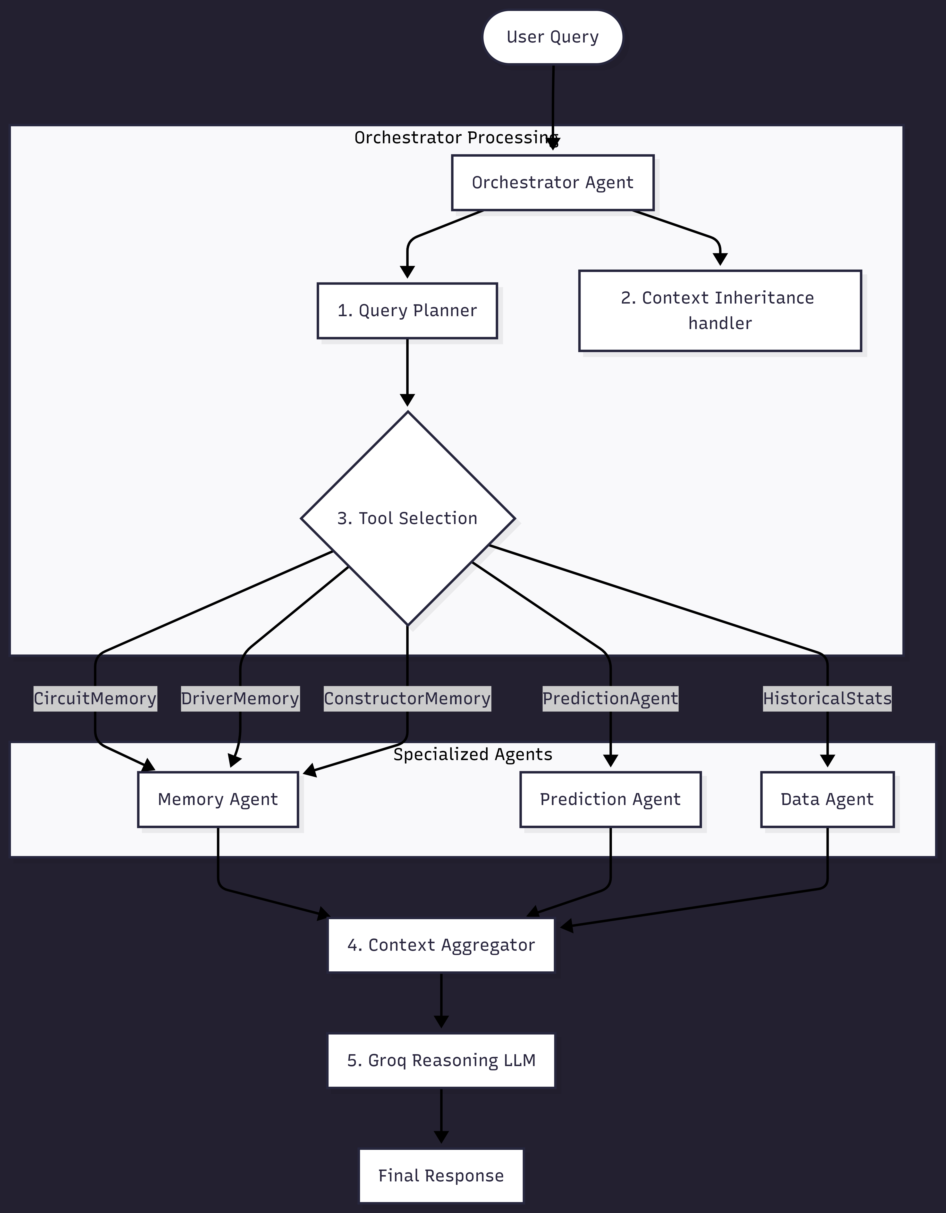
03 / ARCHITECTURE
Multi-Agent Orchestration
01
Orchestrator
Plans queries, routes to agents, coordinates response
02
Memory Agent
Circuit & driver intelligence, precomputed profiles
03
Data Agent
Structured DB retrieval via FastF1 + Ergast
04
Prediction
Deterministic ML scoring — never touched by LLM
05
Analyst LLM
Narrates results only — zero data computation
Notes:
ARCHITECTURE — 60 sec Walk the diagram: User Query → Orchestrator → agents → Context Aggregator → Groq LLM → Response For tech judges: 'The LLM is step 5 of 5. It only sees the aggregated structured output.' For business judges: 'This means predictions are deterministic and auditable — same input always gives same output.'

Slide 5
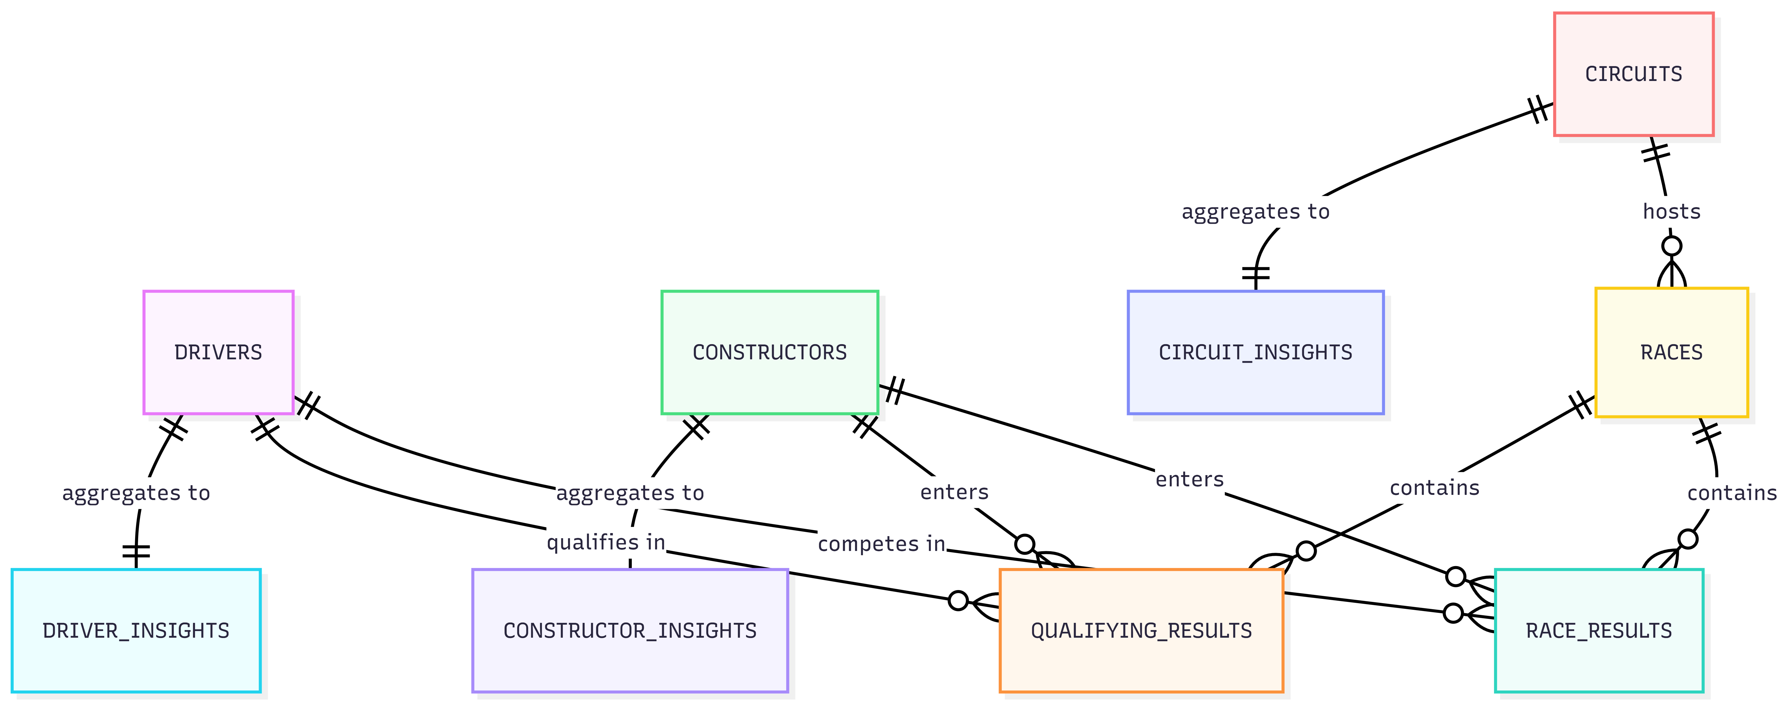
04 / DATA LAYER
9-Table Relational Schema
— FastF1 + Ergast API ingestion
— Seasons 2018 – 2026
— Precomputed INSIGHTS tables eliminate hallucination
— PostgreSQL-compatible via psycopg2
Notes:
DATA LAYER — 25 sec Key insight: the INSIGHTS tables (driver_insights, circuit_insights, constructor_insights) are precomputed aggregates. This is why retrieval is instant and hallucination-free — no LLM is asked to recall statistics.

Slide 6
05 / INNOVATION
Circuit Memory Engine
How it works
Query: "Who performs best at Silverstone?"
1.
System precomputes driver + constructor rankings for every circuit
#1 DRIVER
Lewis Hamilton
2.
Metrics stored: wins, podiums, avg finish, total points per track
8 wins · 15 podiums · P2.3 avg
3.
Serialized as JSON performance profiles in circuit_insights table
#1 CONSTRUCTOR
Mercedes
4.
On query: instant retrieval from DB — LLM never computes rankings
12 wins · 22 podiums
RESPONSE TIME
5.
Result: near-zero hallucination risk, sub-200ms response time
< 200 ms
Pre-computed retrieval
Notes:
CIRCUIT MEMORY — 40 sec This is your strongest innovation. Own it. 'Instead of asking the LLM who wins at Silverstone, we precomputed the answer for every driver at every circuit. The LLM just reads it.' Distinction from a dashboard: a dashboard shows you data. This system has already reasoned about it.

Slide 7
06 / PREDICTION ENGINE
ML-Powered Race Prediction
PREDICTED WINNER
Max Verstappen
CONFIDENCE
78.4%
PREDICTED PODIUM
VER · HAM · LEC
The LLM explains predictions. The engine generates them. These roles never overlap.
Notes:
PREDICTION — 40 sec 40% recent form is the dominant factor — explain why: F1 form is highly correlated with race outcome. For tech: 'scikit-learn composite scoring, deterministic, auditable.' For business: 'Same question asked 100 times gives the same answer. No LLM randomness in the output.'

Slide 8
07 / TECH STACK
Production-Grade Stack
FRONTEND
BACKEND
React 19 · TypeScript · Tailwind CSS v3
Python · FastAPI · Uvicorn ASGI
Vite build · Axios HTTP · React Router v6
SQLAlchemy v2 ORM · Pydantic v2 validation
DATA & ML
AI LAYER
SQLite (PostgreSQL-compatible) · FastF1 · Ergast API
Groq LLM · Llama 3.3-70B-Versatile
Pandas · NumPy · scikit-learn prediction engine
5-agent orchestration · Circuit Memory Engine · Context inheritance
Notes:
TECH STACK — 20 sec One line: 'Every component here is production-grade.' If asked about database: SQLite for the hackathon build, schema is fully PostgreSQL-compatible for production. Pytest test suite exists — mention if judges ask about quality.

Slide 9
08 / LIVE DEMO
6 Questions. One Conversation.
Q1
Q4
Who performs best at Silverstone?
Why?
Circuit Memory Retrieval
Explainable AI Reasoning ←
Q2
Q5
Compare Hamilton and Verstappen there.
Predict the British GP podium.
Multi-Agent + Memory
ML Prediction Engine
Q3
Q6
Who would win today?
What factors drove that prediction?
Context Inheritance ←
Full Agent Transparency ←
← arrows denote context inherited from prior question without re-stating it
Notes:
DEMO — 90 sec Q3 and Q4 are your showstoppers. The system remembers the circuit without you typing it again. Narrate: 'I didn't type Silverstone again. The memory agent inherited the context.' Q6 after Q5: 'I didn't re-specify which GP. It knows.' BACKUP: if demo breaks, open screenshot folder. Always have it ready.

Slide 10
09 / CHALLENGES SOLVED
Problems We Solved
01
LLM hallucinations on predictions
Architectural Separation
Moved all calculations to deterministic agents. The LLM never touches rankings or statistics.
02
Slow retrieval of historical statistics
Precomputed Intelligence
Built the Circuit Memory Engine — precomputed JSON profiles per driver per circuit for instant lookup.
03
Incorrect ranking logic
Deterministic Scoring
Created deterministic composite scoring in the Prediction Agent using scikit-learn, isolated from language model.
04
Loss of conversational context
Context Inheritance
Implemented backwards session traversal — agents inherit prior context (drivers, circuits, predictions) automatically.
Notes:
CHALLENGES — 30 sec Pick challenge 01 and 04 as your emphasis. 01: 'This is the core problem in AI for high-stakes domains. We solved it by architecture, not prompting.' 04: 'Most AI loses context after 2 messages. Ours inherits it across the whole session.'

Slide 11
10 / IMPACT
Where else this works
This architecture
scales beyond
Formula 1.
01
Finance
Portfolio intelligence, risk prediction, audit trails
02
Healthcare
Clinical decision support, diagnostic reasoning
03
Logistics
F1 was selected for its complexity. The agentic pattern — specialized agents + deterministic engines + LLM narration — is domain-agnostic by design.
Route optimization, supply chain intelligence
04
Enterprise
Internal knowledge retrieval, operational analytics
Notes:
IMPACT — 25 sec Business judges: 'We chose F1 because the public data is rich and complex. Replace the data source, the architecture stands.' Tech judges: 'The agent interfaces are generic. Domain swap = data layer swap only.'

Slide 12
11 / CLOSING
Specialized agents.
Deterministic engines.
Explainable outcomes.
WHAT'S NEXT
→ Live telemetry integration
→ Real-time strategy recommendations
→ Driver digital twins
→ Voice-enabled AI analyst
Racecraft AI: github.com/CzPhantom10/F1-AgenticAI
Demo Video: https://youtu.be/_QOfYiclPxk?si=lrJY_EQHsx1ThYwl
Google docs (all required docs are uploaded here): https://drive.google.com/drive/folders/1nev2RsS_R4hBLUCTk-MSJw5A1THFD56Q?usp=sharing
Agentic Intelligence for Formula 1
Notes:
CLOSE — 30 sec Closing line: 'We didn't build a chatbot with F1 data. We built a framework for agentic AI that happens to love Formula 1.' Pause. Then: 'And we're ready to show you.' Invite the hardest F1 question judges can think of.

