Slide 1
Final Presentation
Real Estate Sales
Chengzhuo Xiong
Date: Dec 4, 2023
Data From: https://www.kaggle.com/datasets/anoopjohny/real-estate-sales-2001-2020-state-of-connecticut

Slide 2
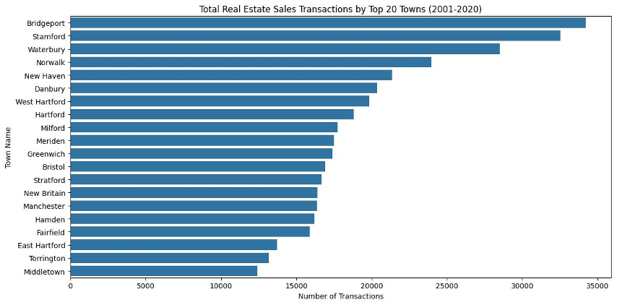
Total Real Estate Sales Transactions by Top 20 Towns (2001-2020) (Bar Chart)
Bridgeport has the highest number of real estate sales transactions, close to 35000.
Middletown has the lowest among the top 20 towns.
The majority of towns have transactions between 10,000 and 20,000.

Slide 3
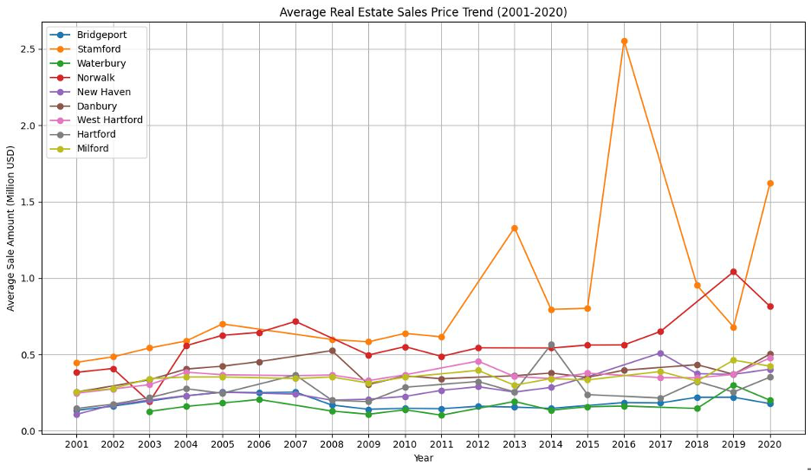
Average Real Estate Sales Price Trend (2001-2020) (Line Plot)
Stamford has the highest average sale price for most of the years during 2001 to 2020.
Waterbury consistently has the lowest average sale price among the highlighted towns.
There's a noticeable dip in average sales prices around 2009 for all towns, likely indicative of the global financial crisis.
Sale prices generally started to recover post-2011, with a notable increase in 2016-2018.
There's a decline in average sale prices for all highlighted towns in 2020.

Slide 4
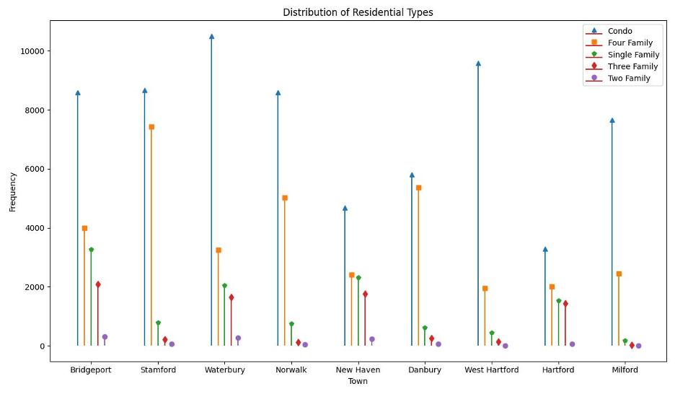
Distribution of Residential Type (Stem Plot)
Condominiums (Condo) are the most popular residential type across all the selected towns, with the highest frequency observed in towns like Stamford, Norwalk, and Milford.
The town of Waterbury has the highest frequency of Condos, reaching over 10,000.
Four Family homes, represented by the orange square, also have a significant presence in many towns but are generally less frequent than Condos.
Three Family and Two Family homes have varying distributions across towns but are typically less frequent than Condos and Single Family homes.
The town of New Heaven has a noticeable diversity in its residential types, with a balanced distribution between Four Family, Single Family, Three Family.
Milford shows a distinct spike in Condos, surpassing all other residential types by a significant margin.

Slide 5
Thank You!
Real Estate Sales Records
Chengzhuo Xiong
Date: Dec 4, 2023
Data From: https://www.kaggle.com/datasets/anoopjohny/real-estate-sales-2001-2020-state-of-connecticut
Code: https://github.com/CzXiong1024/INFSCI_2415_Final_Project/tree/main

