Slide 1
Individual Project XF008064 ZEUS

Slide 2
What is ZEUS?
Made up of 2 programs.
One is a scenario creator and the other is the main program which actually runs the simulations.
Split into 2 parts to make it easier to develop the overall system AND helps to standardise the data that is used between both programs.
Zombie
Epidemic
Universe
Simulator

Slide 3
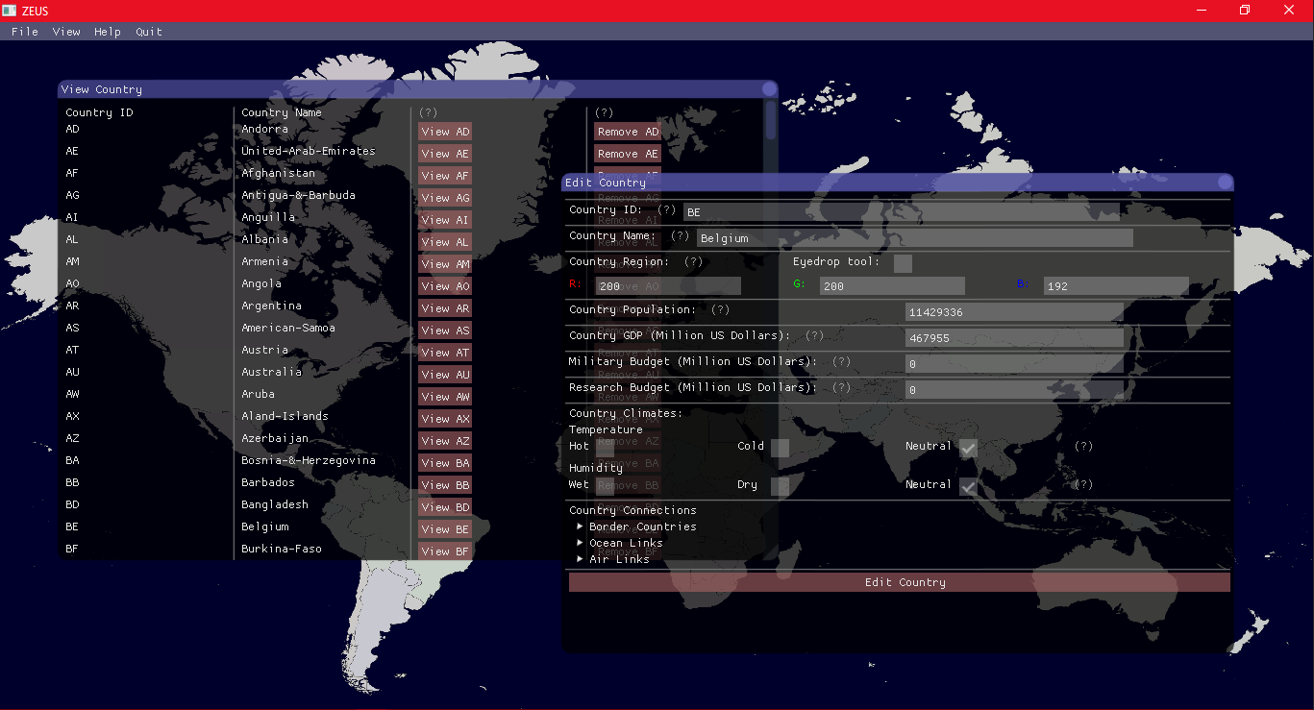
Scenario Creator
Where more advanced users of the system can create their own scenarios which are not pre loaded.
Although the maps have to be in specific format:
- 16:9 ratio and preferably large images
- Each country is a single RGB value
- Background is either transparent or defined (defined is in progress)

Slide 4
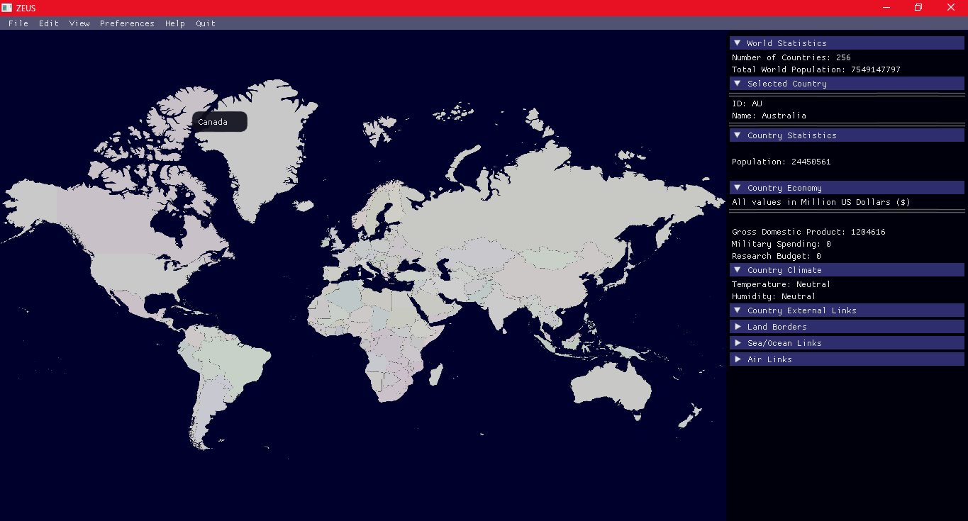
The Simulator
Simulator uses the scenario data to load countries as well as the map which will be rendered.
Also functions as an interactive map that displays country data.
Currently, both programs look similar. But both will end up doing completely different functions

Slide 5
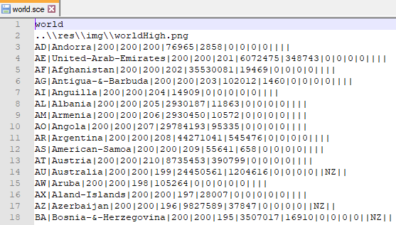
Scenario Files
Scenario Name
The scenario files have data which are used to essentially build the world that the simulation will be run in.
The file is generally split into 3 parts. The first 1 lines are the scenario name and the map image respectively.
The rest are the country data.
The country data itself is split into 14 parts
Scenario Map Image

Slide 6
Country data
Population
Climate types (temperature and humidity)
Military spending
The unique IDs of countries connected to this country
i.e. land borders
Ocean links
And air links
Identifying RGB values
GDP
Research spending
Country Name
Unique country ID

Slide 7



How in the world is this possible?!
There are multiple technologies involved in the project:
SDL (Simple Directmedia Layer):
Used for rendering textures to screen i.e. the world map(s) used in the simulation and scenario creator
dear imgui (ImGui):
A graphical user interface that is created by another person which is usable in both C and C++ and makes use of SDL
C++:
The project is developed using the C++ computer language
https://www.libsdl.org/
Ocornut – dear imgui creator
https://github.com/ocornut

Slide 8
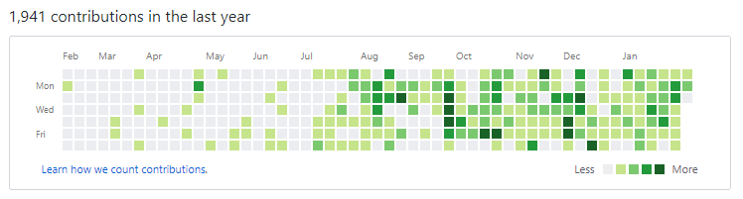
dear imgui
Dear ImGui is also being developed alongside this project i.e. the developer ocornut is still actively changing ImGui while I am using it.
I have to be able to adapt to the changes so that my code still works

Slide 9
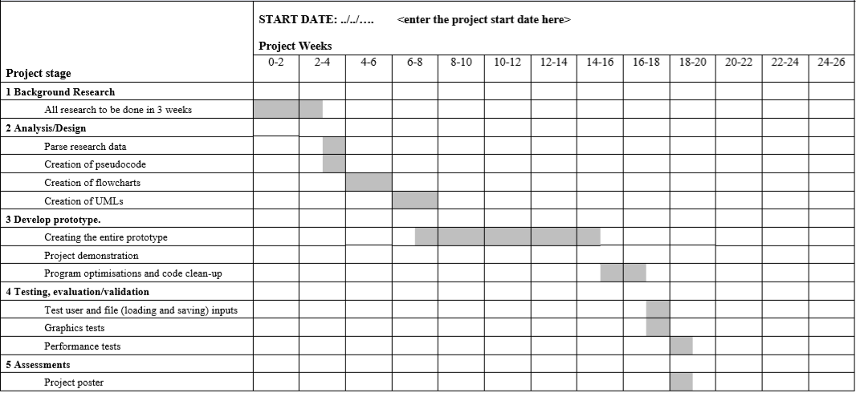
Original Plan
Should be around here by now
But I’m still around here
Assuming no delays from other assignments, the project would still be finished by the end of March or start of April anyway

Slide 10
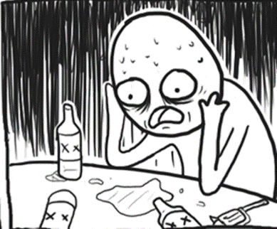
What needs to be done?
Development:
Need to make sure everything works first then can be polished during testing
Scenario creator needs to be double checked if the proper outputs are actually being given
Need to create the simulation part of the simulator. It cannot currently simulate but is so far an amazing interactive map
Possible User Experience addons like a parser which automatically adds data from well known sources such as CIA World Book etc
Testing:
- EVERYTHING
Documentation:
Project poster
Project report
Project log book

Slide 11
Questions

