Slide 1
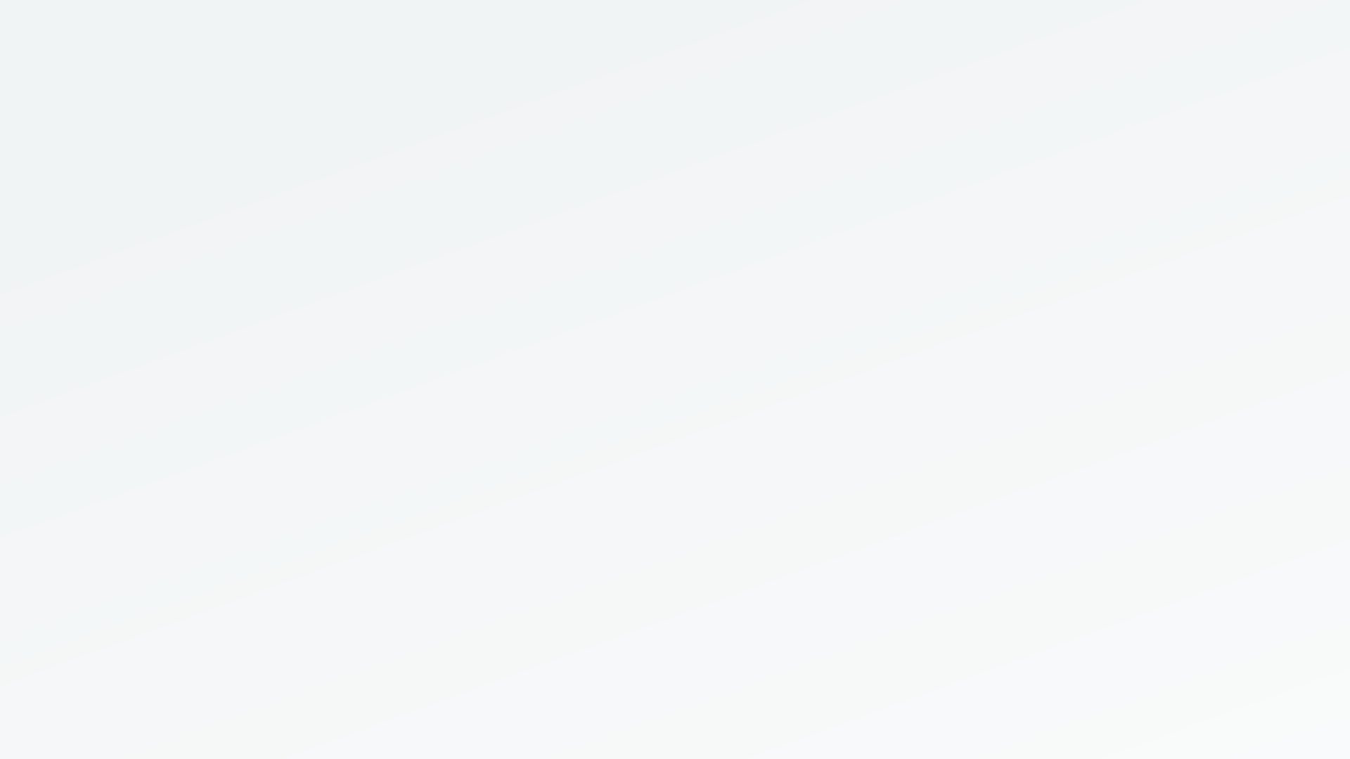
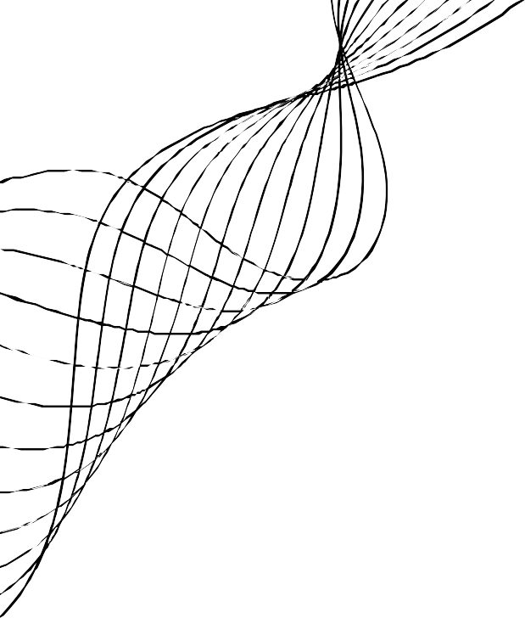

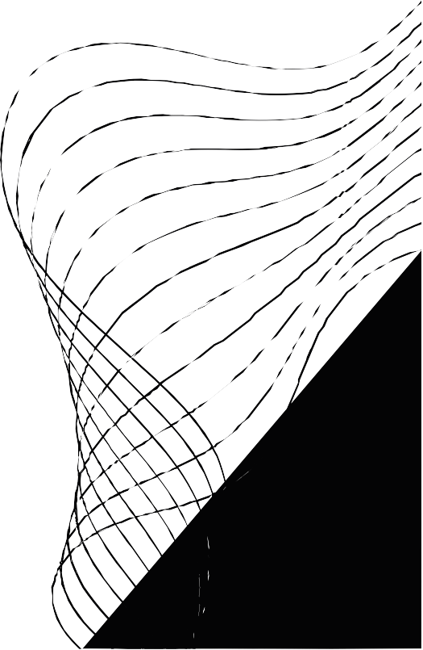
KNOW YOUR CUSTOMER:
SYRIATEL CHURN MODEL

Slide 2
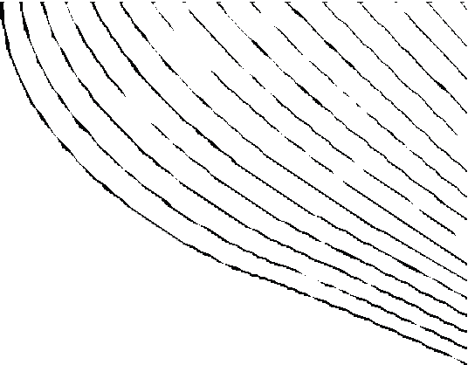
CONTENT
01
02
03
04
05
06 CONTACTS
BUSINESS OBJECTIVES
DATA ANALYSIS AND METHODS
MODELING
RESULTS
NEXT STEPS

Slide 3

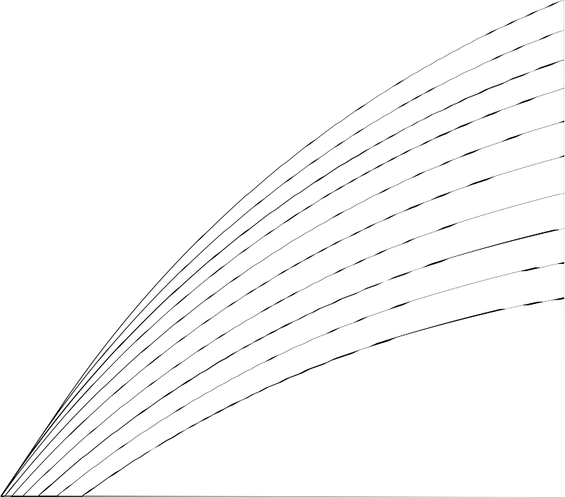
BUSINESS OBJECTIVE
Build a classifier to predict whether a customer will ("soon") stop doing business with SyriaTel, a telecommunications company.
Measure Performance with Recall:

Slide 4


DATA ANALYSIS

Slide 5
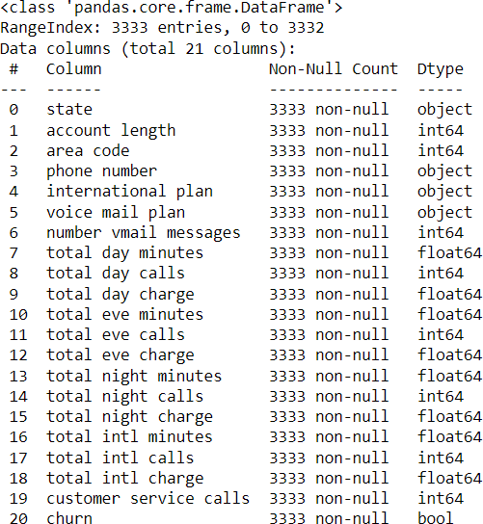
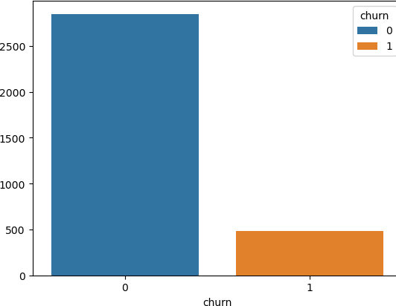
The Data
~85%
~15%

Slide 6
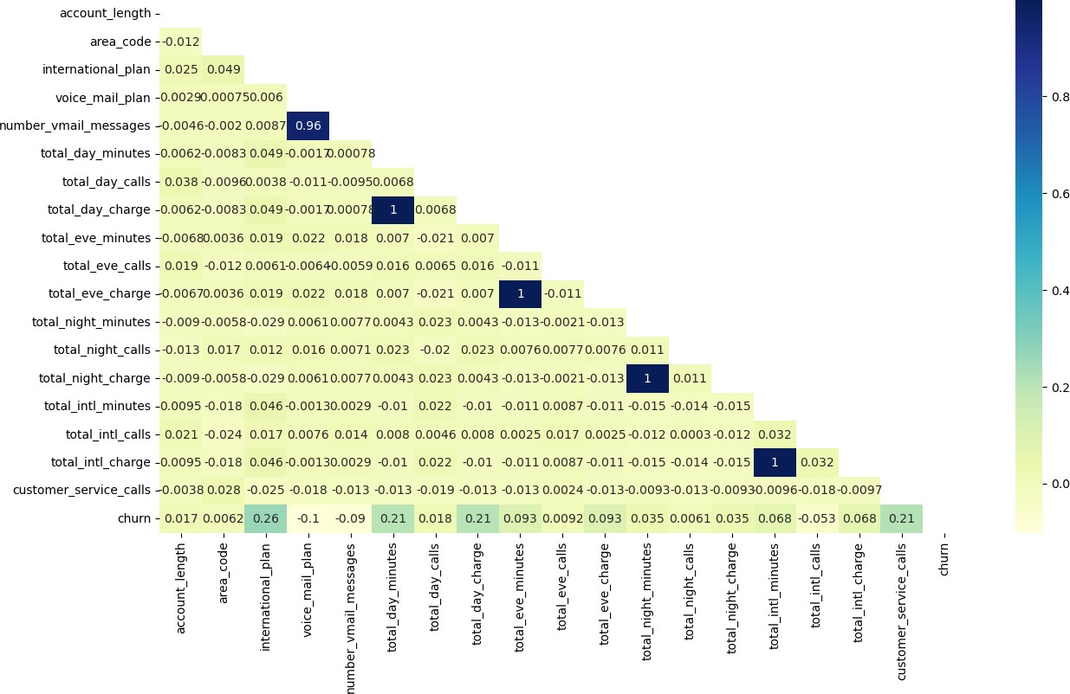

Slide 7
MODELING

Slide 8
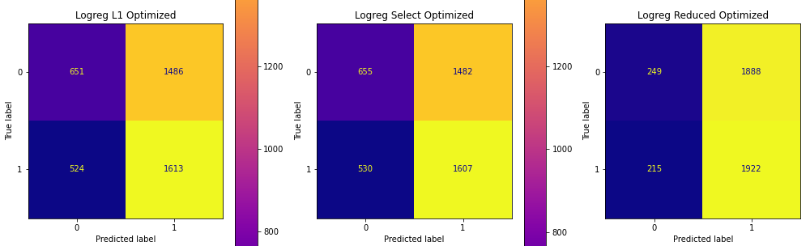
Logistic Regression Models
Logistic L1 Model: Data Prep/Train Results
Logistic Select Model: Data Prep/Train Results
Logistic Reduced Model: Data Prep/Train Results
This model contains all predictor variables, except phone number.
We Used SelectFromModel to select features for us that are most important:
Reduced the dataframe from 69 predictors to 53.
We only included highly correlated predictors with respect to churn.
Processing steps
SMOTE, hyperparameter tuning, and OneHotEncoding
Processing steps SelectFromModel, hyperparameter tuning
Processing steps
SMOTE, hyperparameter tuning, and feature selection

Slide 9
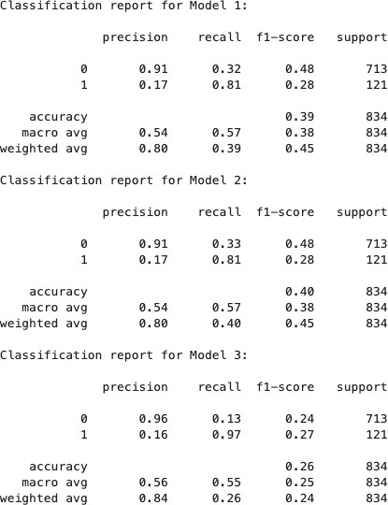
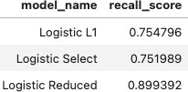
Logistic Regression Models: Test Results
Test Results:
Train Results:
Our Logistic Regression models are underfitting!!!!

Slide 10
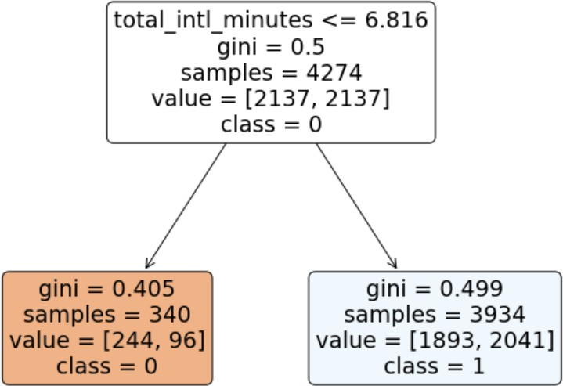
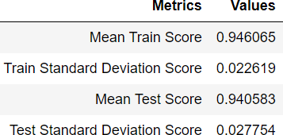
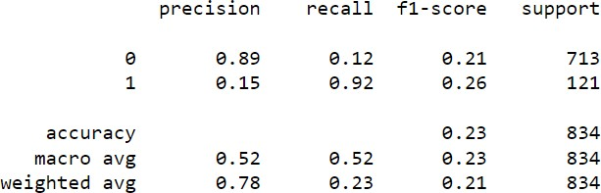
DecisionTree Model
Data Prep/Train Results
We used the same data that was
used for model 3.
Applied GridSearchCV() to find the optimal parameters for the model. Best Parameters:
{'criterion': 'gini', 'max_depth': 1,
'max_features': 1,
'min_samples_leaf': 1,
'min_samples_split': 2, 'splitter': 'best'}
CV Train Results
Test Results

Slide 11

FUTURE
CONSIDERATIONS
Different type of model or ensemble modeling
STEP 1
Tiered Marketing Strategy
STEP 3
STEP 2
Larger data set to offset the underfitting we encountered

