Slide 1
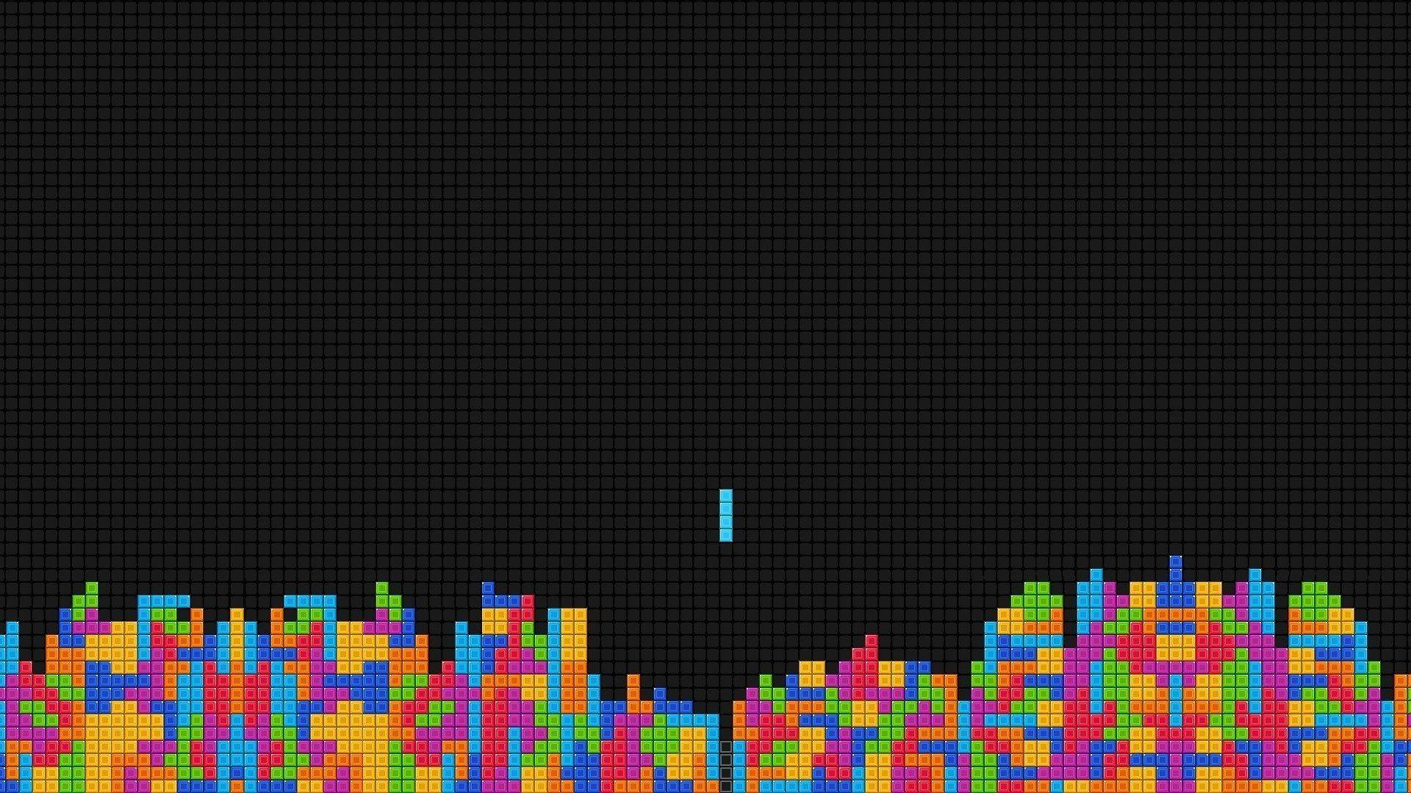
TETRIS-JFX

Slide 2
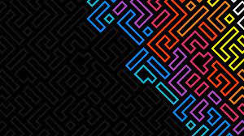

Why Tetris?
Simple yet fun experience for the user
Ended up being challenging
Random shapes composed of different tiles on a mesh
Color coded shapes
Executing strategies

Slide 3
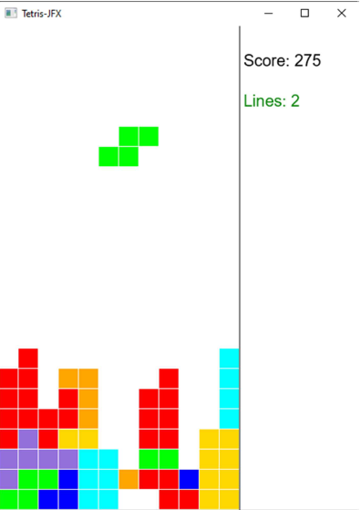
Example:

Slide 4
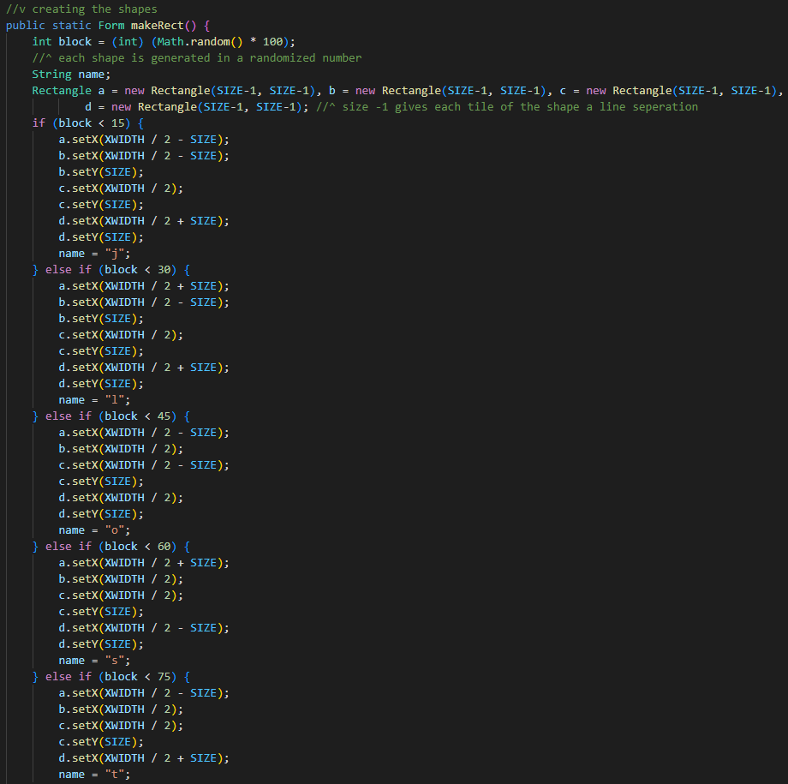

Slide 5
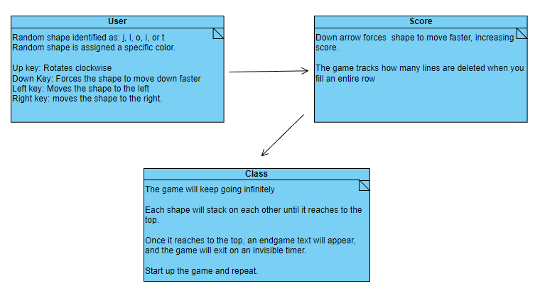
UML

Slide 6
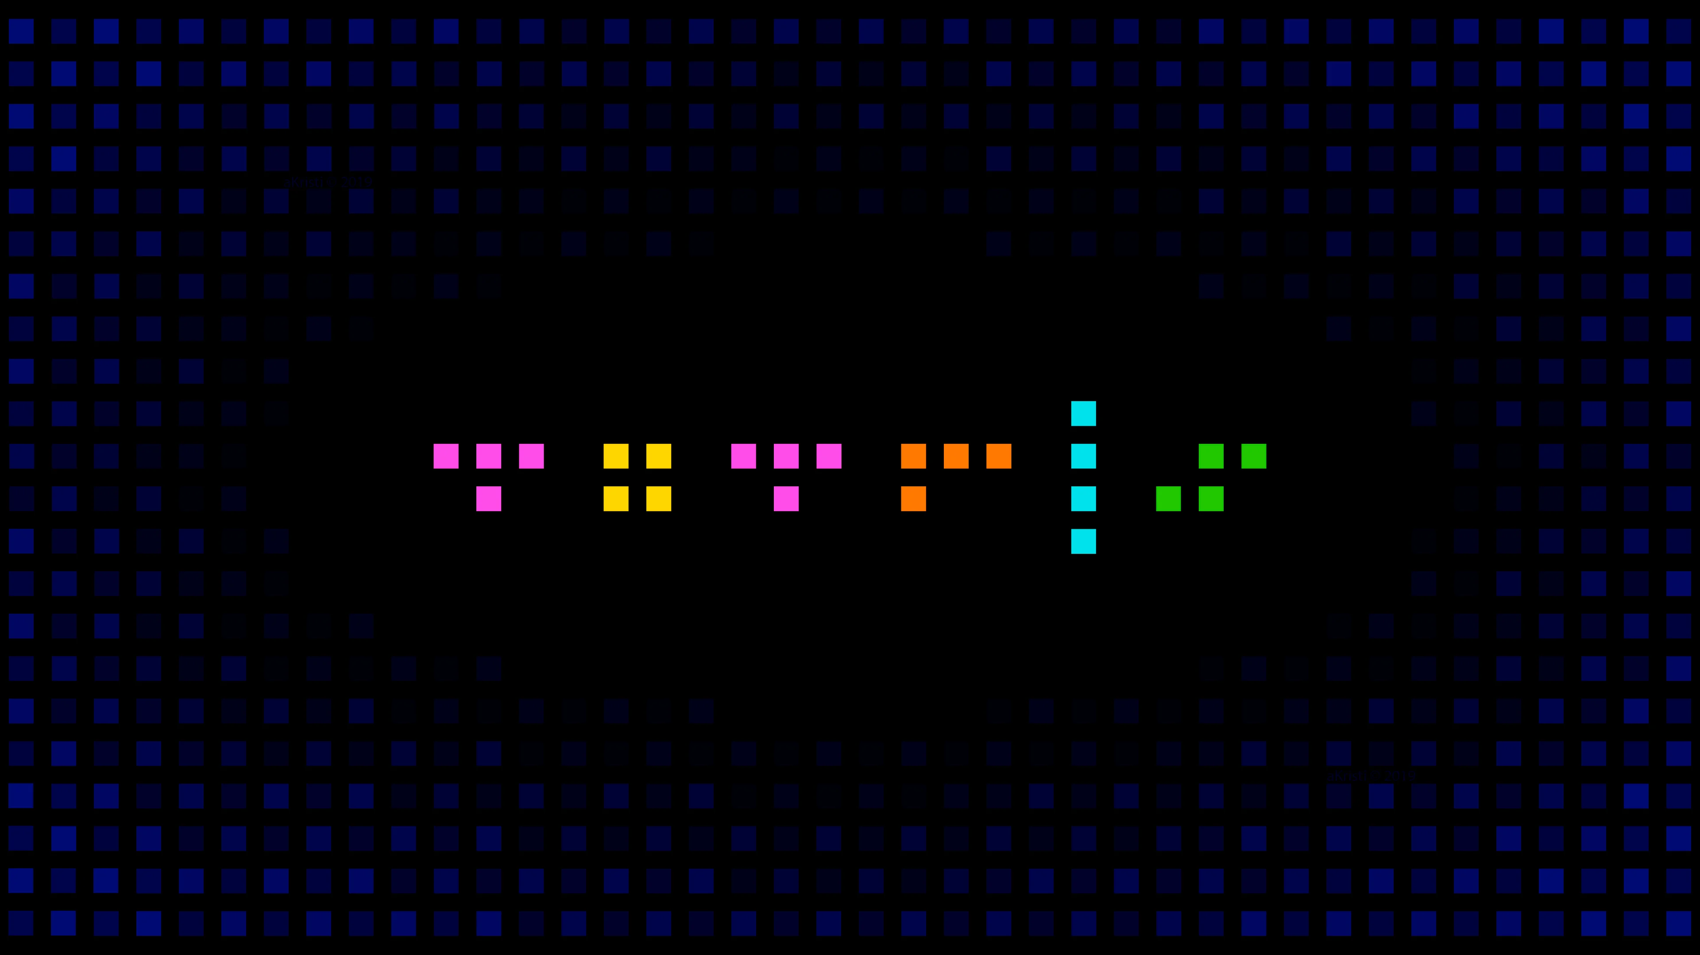
NOW LET’S GO ON WITH THE DEMO!!!

