Slide 1



Using Microsoft Word for preparing XML TEI-compliant digital editions
Boris Lehečka, boris@daliboris.cz
The contribution was supported by a project of the Ministry of Education, Youth and Sports No. LM2015081 "Research Infrastructure for Diachronic Czech Studies" (RIDICS, http://vokabular.ujc.cas.cz).

Slide 2
Overview
https://github.com/CzechLanguageInstitute/tei2019
presentation, examples (DOCX, XML TEI), XSLT stylesheets
History
Core elements
Prerequisites
Process overview
Output validation
Transformation issues
Hierarchy
Merged character styles
Reconstruction
Pros and cons

Slide 3
History (dates and data)
Department of Language Development of the Czech Language Institute
using Microsoft Word since 1990
for personal research
print material for publishing houses
since 2007
generating corpus data in vertical format (Old and Middle Czech Textbank, 1300–1800)
https://vokabular.ujc.cas.cz/banka.aspx
https://korpus.vokabular.ujc.cas.cz (since 2019)
since 2008
cooperation with Manuscriptorium.com ⇒ XML TEI P5 needed
2019
approx. 280 digital editions, 6 mil. tokens
mostly reachable in HTML at https://vokabular.ujc.cas.cz/moduly/edicni/seznam-edic/

Slide 4
Core elements
info table with metadata
title, author, repository, editor

Slide 5
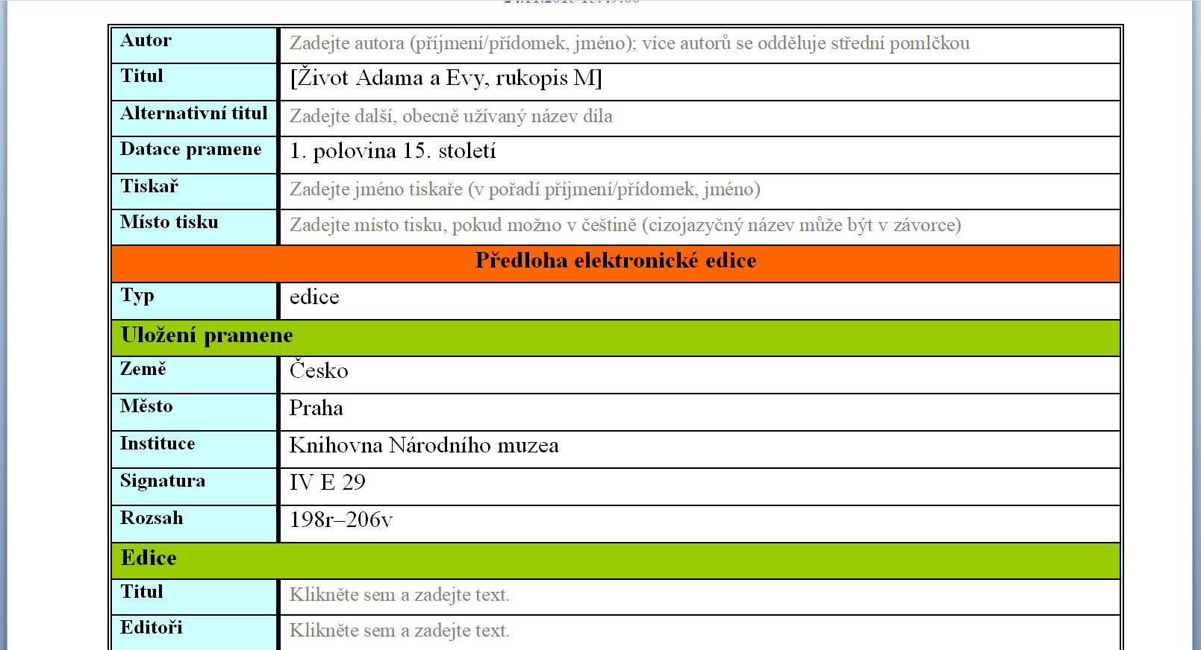

Slide 6
Core elements
info table with metadata
title, author, location of the manuscript, editor
paragraph styles (22)
title, heading, subheading, paragraph, index item etc.
character styles (80)
bold, italic, additions, notes, foreign text, regular form, lemma, hyperlemma

Slide 7
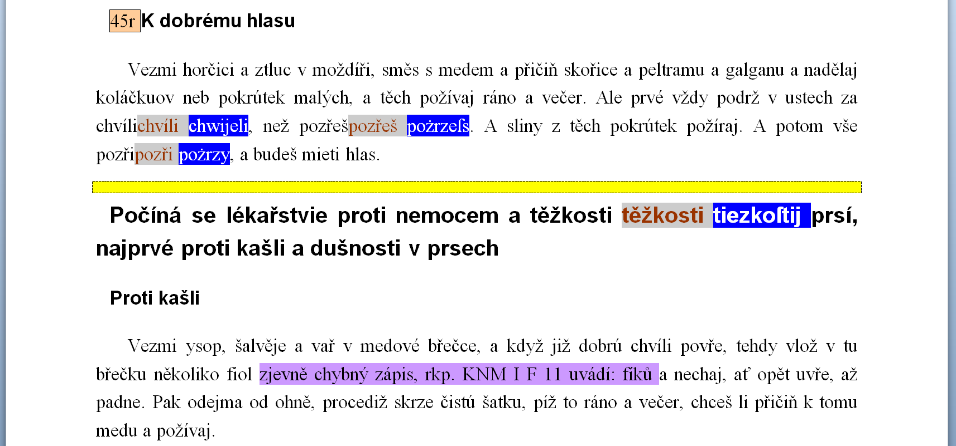
<pb>
<head>
<p>
<corr>
<sic>
<head>
<head>
<p>
<note>

Slide 8
Prerequisites
Microsoft Word 2010 or newer
eEdice – an add-in for Microsoft Word
available at https://vokabular.ujc.cas.cz/moduly/nastroje/e-edice/ke-stazeni
MSI to install, no elevated rights needed

Slide 9
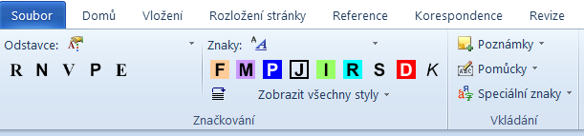
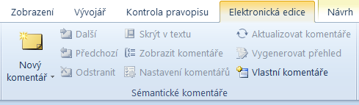
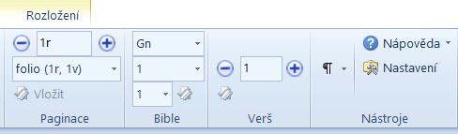

Slide 10
Prerequisites
Microsoft Word 2010 or newer
eEdice – an add-in for Microsoft Word
available at https://vokabular.ujc.cas.cz/moduly/nastroje/e-edice/ke-stazeni
MSI to install, no elevated rights needed
The guidelines for preparing the digital editions of Old Czech texts
available at https://vokabular.ujc.cas.cz/moduly/nastroje/metodika/ke-stazeni
PDF document
Management and metadata
file name, source metadata, output format, text classification etc.

Slide 11
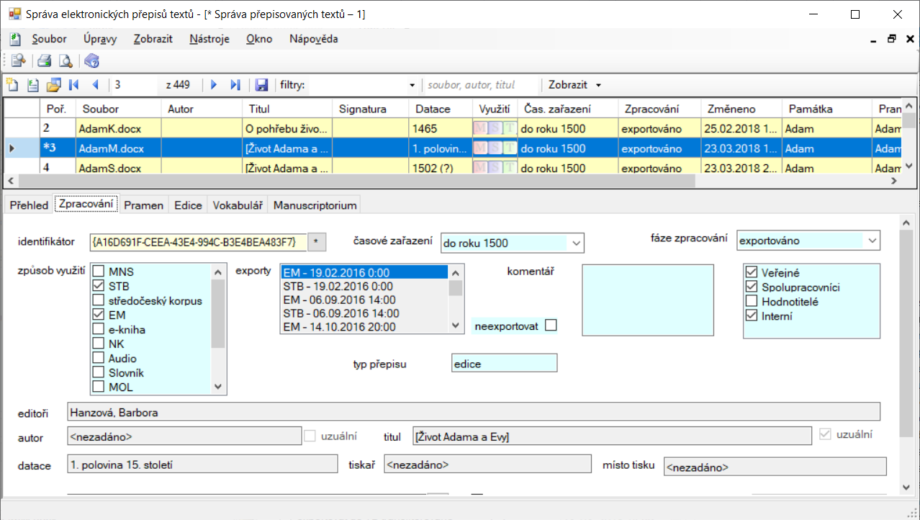

Slide 12
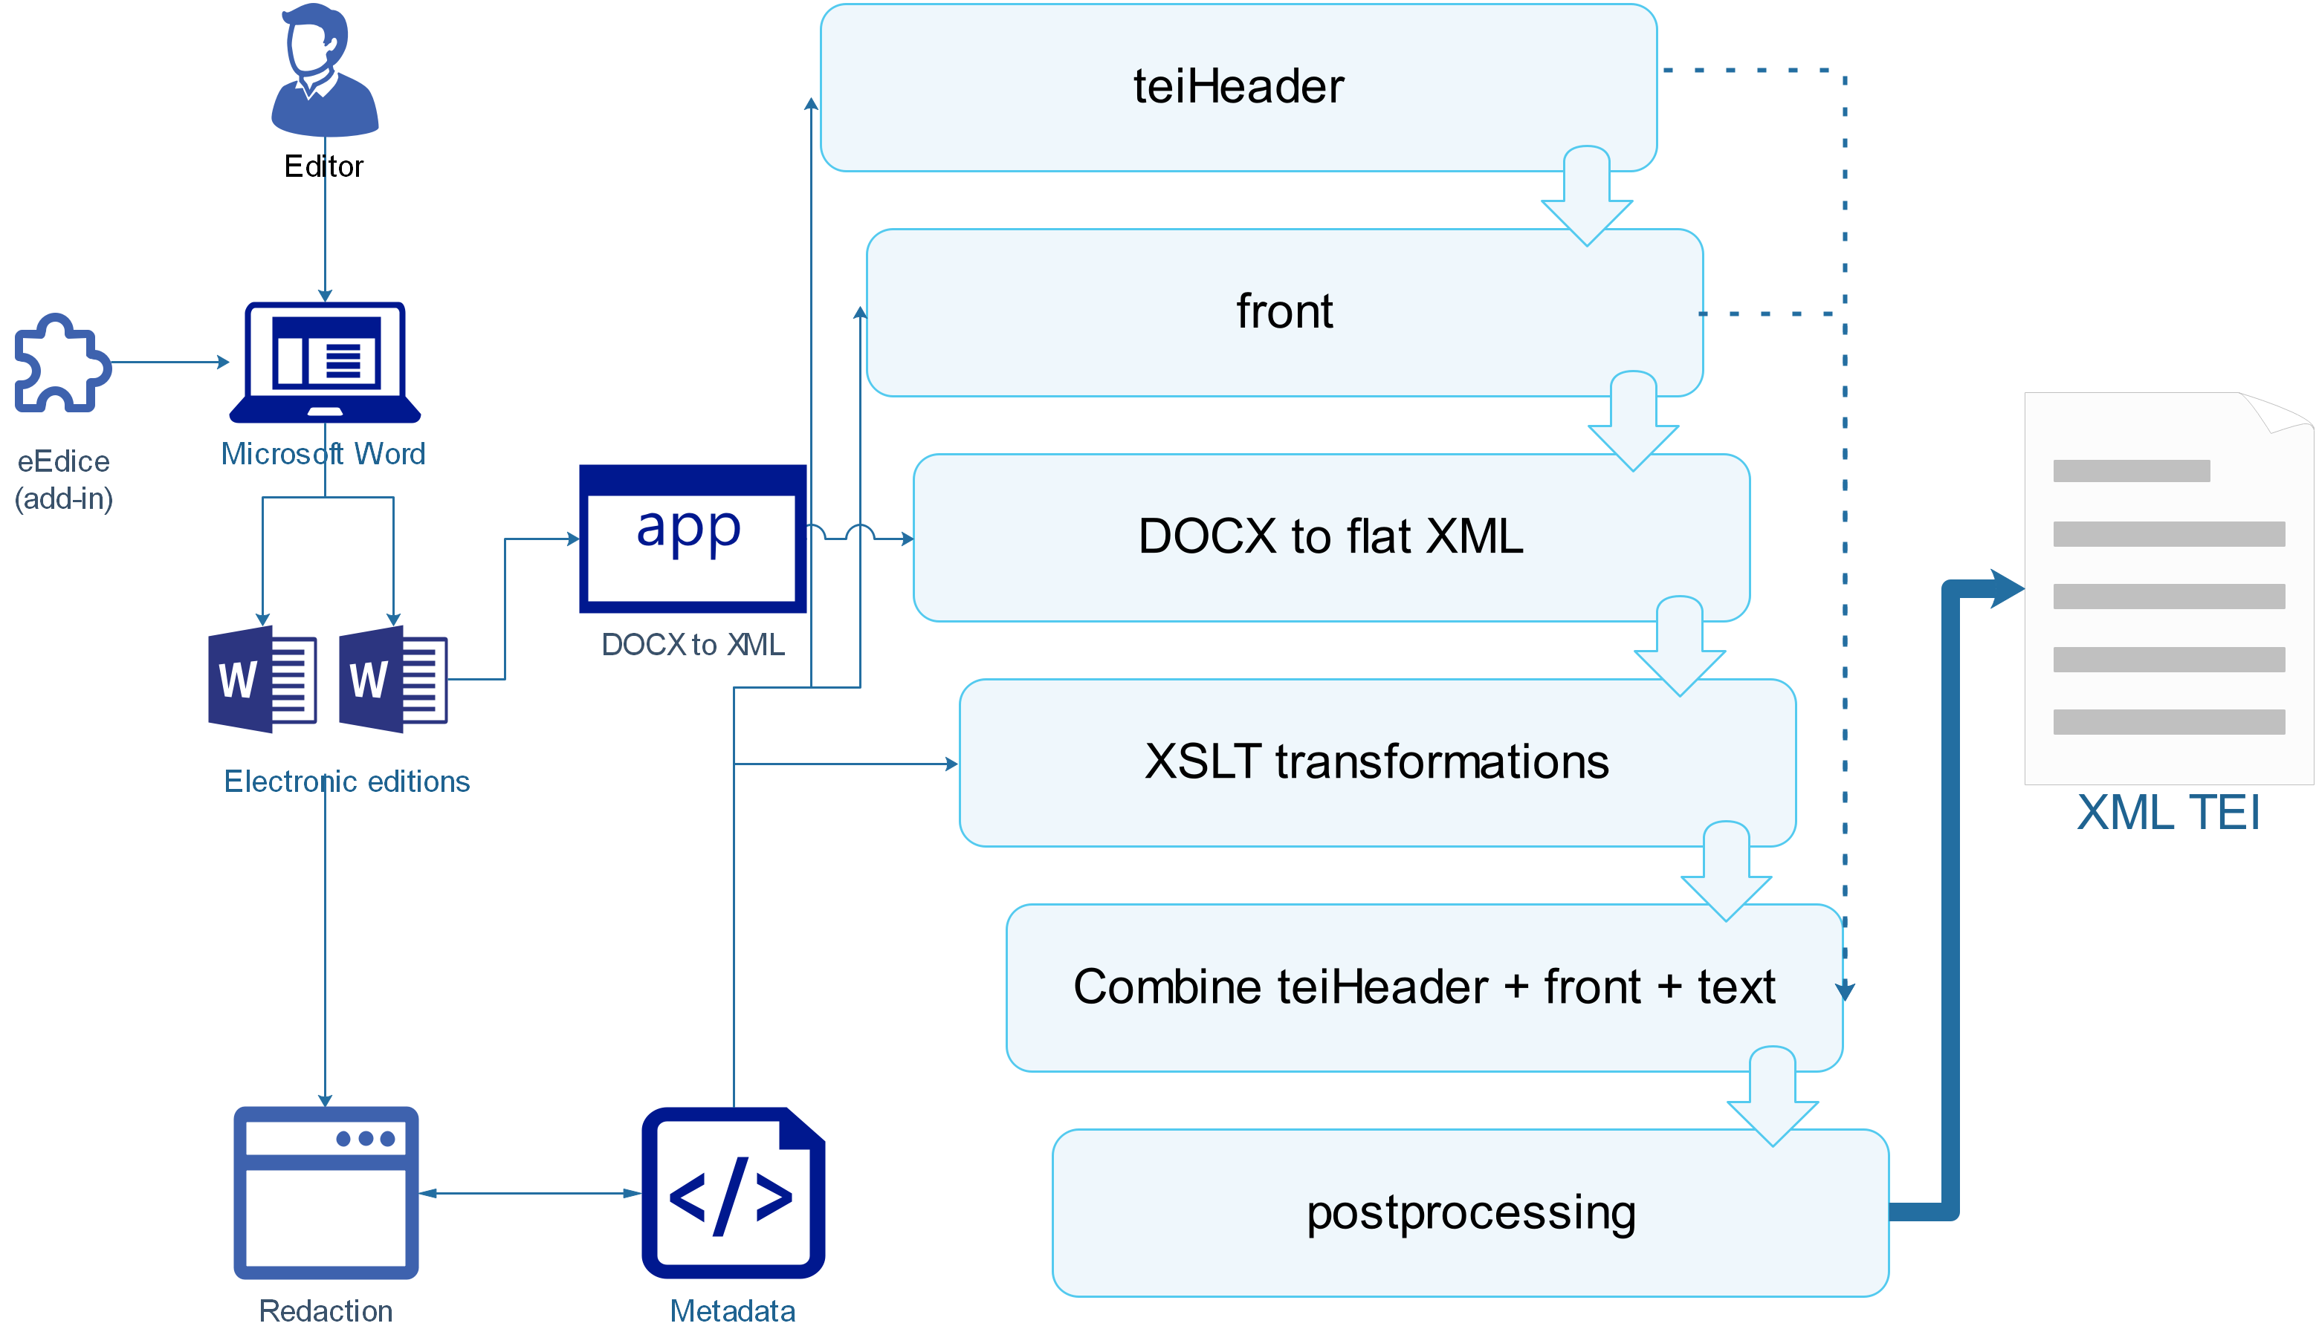
Process

Slide 13
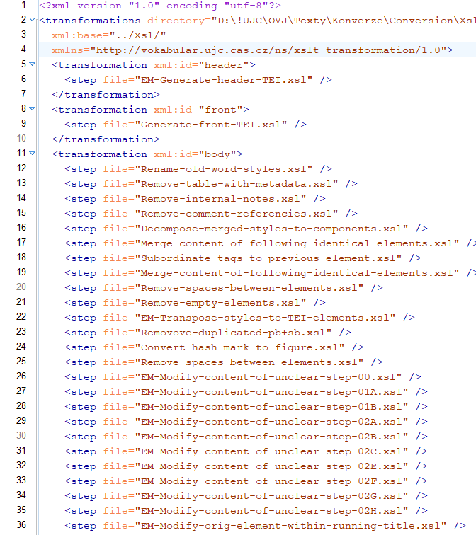

Slide 14
How to check that the output is correct
export plain text from the source (DOCX)
export plain text from the output (XML TEI, or vertical text)
make sure they are comparable
separate main text and notes
simplify markup in XML TEI and export the text
compare generated text files
DOCX to text file: 1 XSLT
XML TEI to text file: 6 XSLT

Slide 15
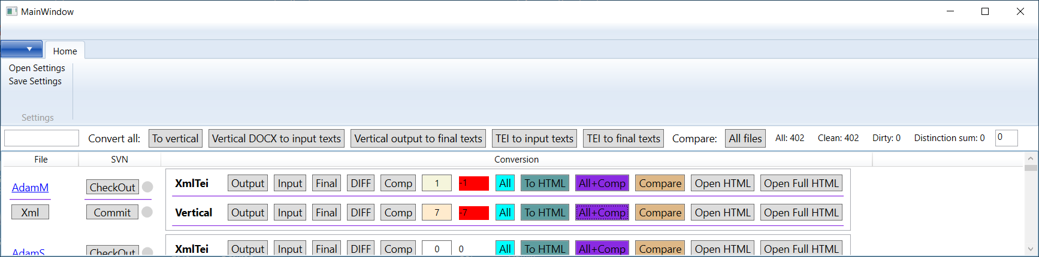
Input and output comparison tool

Slide 16
Hierarchy
STEP 0
STEP 1
<body>
<Normal> <text>Vezmi chléb […] </text> <note>nečitelný […] </note> </Normal> <Subheading> <text>Komu mozk […] </text> </Subheading>
</body>
<body>
<p> <text>Vezmi chléb […] </text> <note>nečitelný […] </note> </p> <head> <text>Komu mozk […] </text> </head>
</body>

Slide 17
Hierarchy
STEP 2
STEP 3
<body>
<p> <text>Vezmi chléb […] </text> <note>nečitelný […] </note> </p> <div>
<head> <text>Komu mozk […] </text> </head>
</div>
</body>
<body>
<div>
<p> <text>Vezmi chléb […] </text> <note>nečitelný […] </note> </p>
</div> <div>
<head> <text>Komu mozk […] </text> </head>
</div>
</body>

Slide 18
Merged character styles
character styles are used for capturing metadata
e.g. original for original text
Microsoft Word can't nest character styles
for capturing multiple metadata
new style must be generated combining all metadata
e.g. original_foreign_superscript
<xsl:template match="original_foreign_superscript"> <xsl:element name="original"> <xsl:copy-of select="@*" /> <xsl:element name="foreign"> <xsl:element name="superscript"> <xsl:value-of select="." /> </xsl:element> </xsl:element> </xsl:element> </xsl:template>

Slide 19

Reconstruction
Microsoft Word
XML TEI
buoha <unclear><supplied>ve</supplied>likého</unclear>. <unclear><supplied>Velik</supplied>o<supplied>st</supplied></unclear> <c xml:space="preserve"> </c> <unclear><supplied>r</supplied>adosti</unclear>

Slide 20
Pros and cons
pros
cons
suitable for sources with simple, straightforward structure
for editors who do not master the XML format
for beginners or occasional editors (students, for example)
can be used for preliminary encoding of the manuscript
not suitable for sources with complex structure
only a subset of all the elements provided by XML TEI Guidelines
not suitable for encoding of the textual variants
there are strict rules where to use space between two character styles

Slide 21
Thank you for your attention
https://github.com/CzechLanguageInstitute/tei2019
http://vokabular.ujc.cas.cz
boris@daliboris.cz

