Slide 1
Studying the dimensionality reduction and visualisation problem of the calibration data for the LHCb vertex detector

Slide 2

Dataset
Calibration data:
Pedestals values,
Low tresholds values,
Link masks values,
Hit tresholds values,

Slide 3
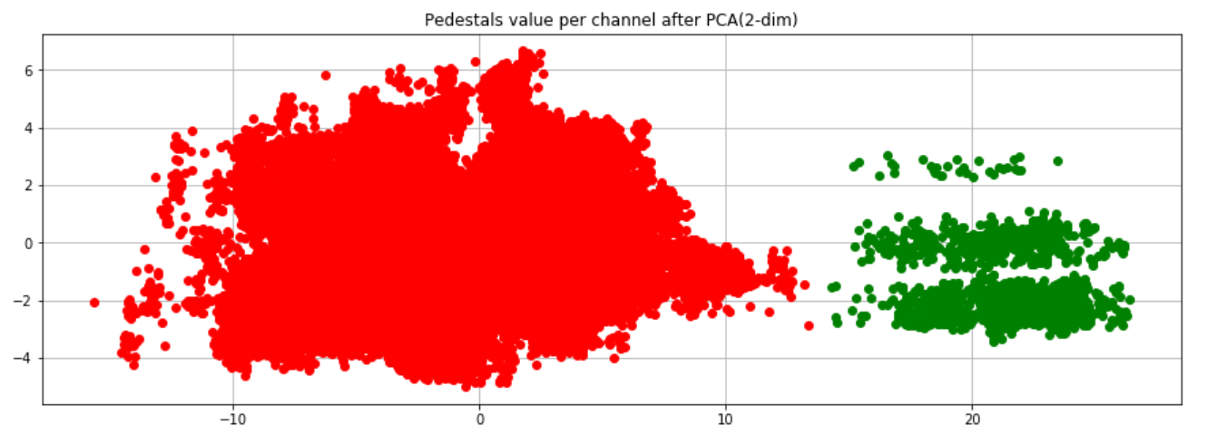
Pedestals all modules (PCA)

Slide 4


Clusters content

Slide 5
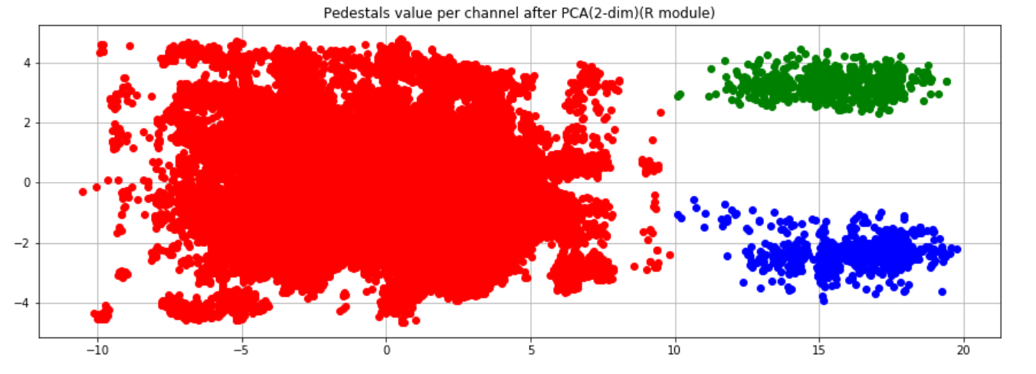
Pedestals R modules (PCA)

Slide 6



Clusters content

Slide 7
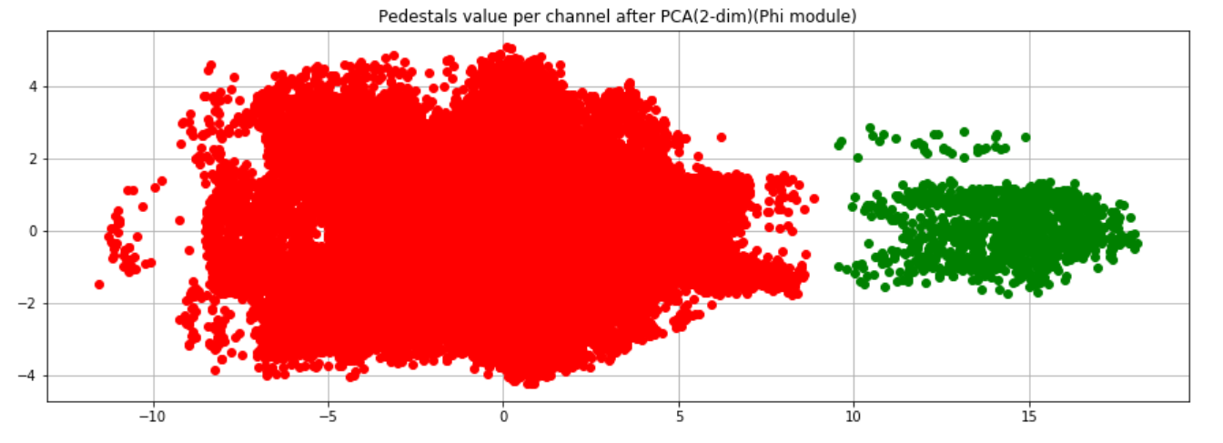
Pedestals Phi modules (PCA)

Slide 8


Clusters content

Slide 9
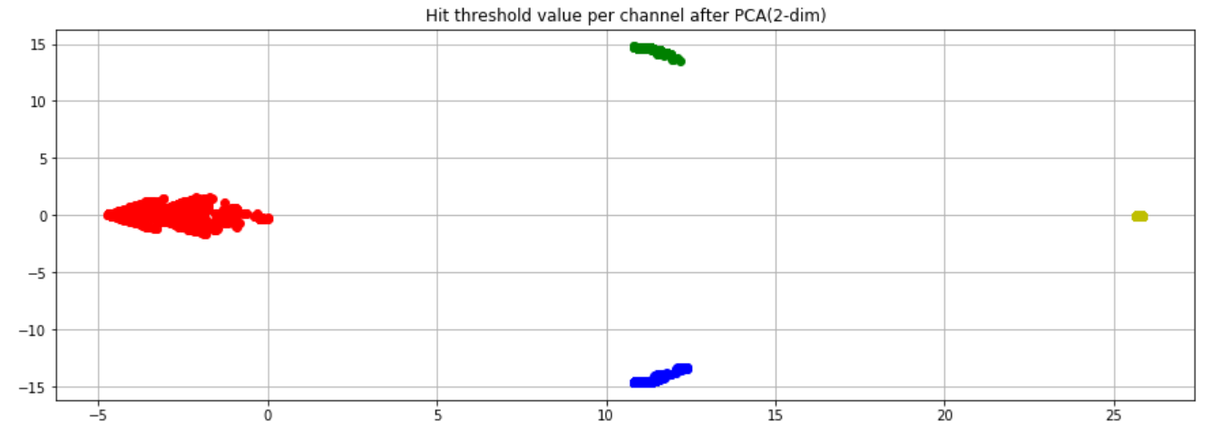
Hit tresholds all modules (PCA)

Slide 10




Clusters content

Slide 11
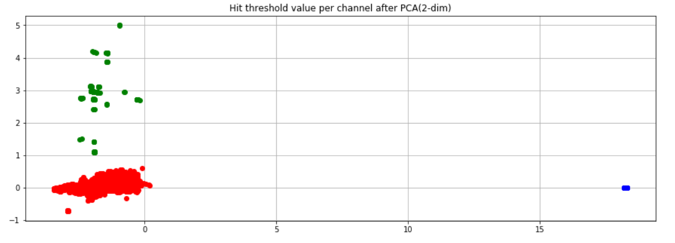
Hit tresholds R modules (PCA)

Slide 12



Clusters content

Slide 13
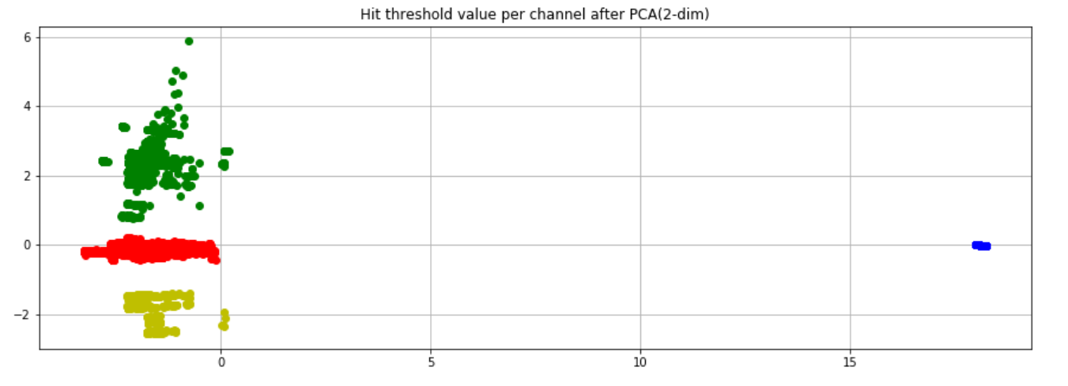
Hit tresholds Phi modules (PCA)

Slide 14




Clusters content

Slide 15

Pedestals all modules (autoencoder)

Slide 16


Clusters content

Slide 17
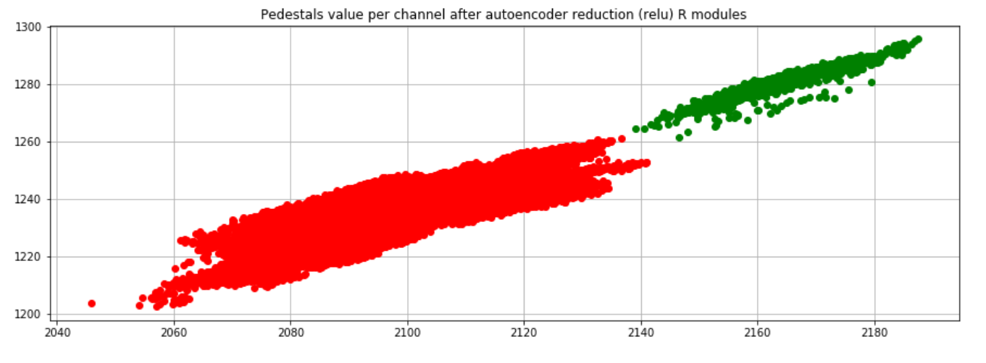
Pedestals R modules (autoencoder)

Slide 18


Clusters content

Slide 19
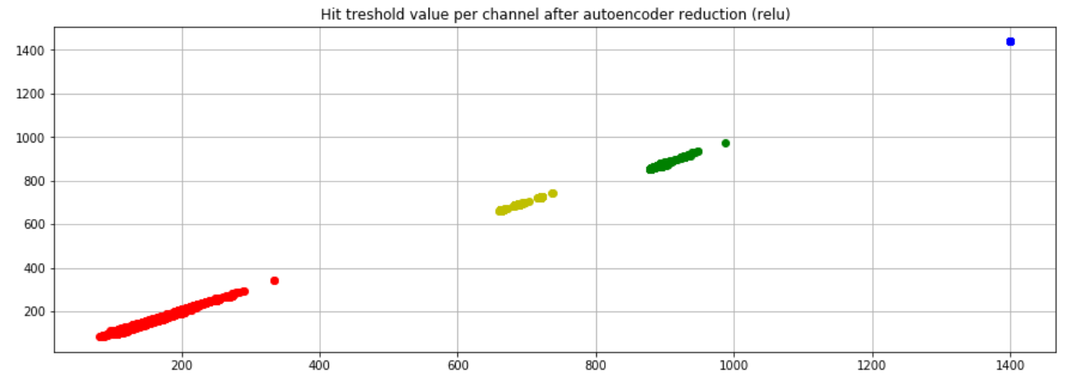
Hit tresholds all modules (autoencoder)

Slide 20
Clusters content

Slide 21
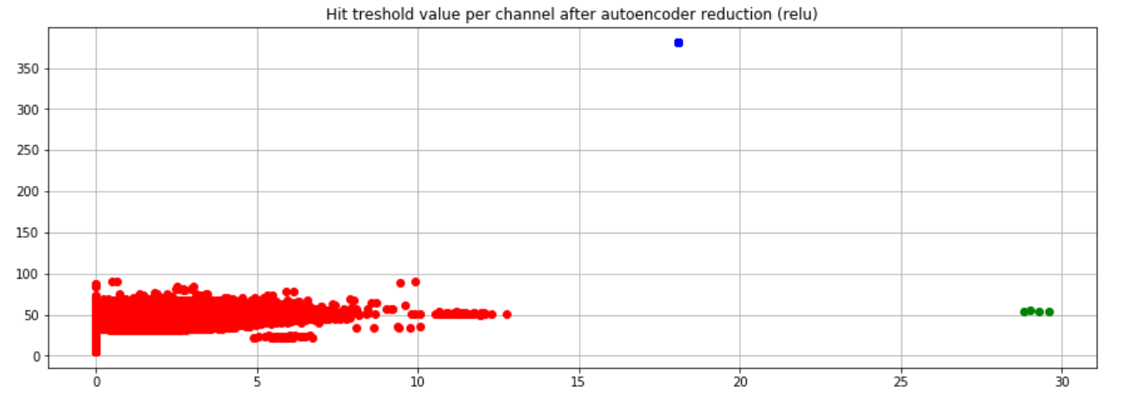
Hit tresholds R modules (autoencoder)

Slide 22



Clusters content

Slide 23
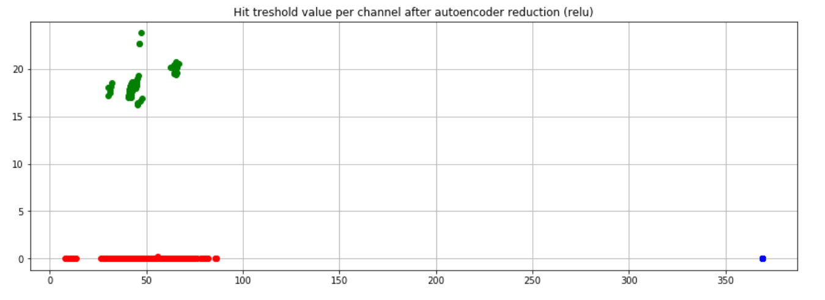
Hit tresholds Phi modules (autoencoder)

Slide 24



Clusters content

