Slide 1
Studying the dimensionality reduction and visualisation problem of the calibration data for the LHCb vertex detector

Slide 2

Dataset
Calibration data:
Pedestals values,
Low tresholds values,
Link masks values,
Hit tresholds values,
Notes:
The database used in the analysis comes from the LHCb vertex detector. The database has values from forty-four calibrations and is divided into four values: pedestals, low thesholds, link masks and hit tresholds. The database also has module names. During the analysis the focus was on the values highlighted on the slide, namely: pedestals values and hit tresholds values. In pedestals analysis we have 44 calibrations with 84 modules and 2048 channels to reduce to two dimensions. Whereas, in hit tresholds analysis we have 44 calibrations with 84 modules and 2304 channels to reduce to two dimensions. In this case we have more channels because we additionally have „dummy” channels.

Slide 3
Principal component analysis
Module 1 | Module 2 | Module 3 | Module 4
Value 1 | Value 2
Channel 1
Channel 2
Channel 3
Channel 4
Channel 5
Channel 1
Channel 2
Channel 3
Channel 4
Channel 5
.
.
.
.
.
.
M x N
M x 2
Notes:
The first reduction was carried out using the PCA method. An attempt was made to reduce by conversing into channels and modules. Firstly, data was prepered using StandardScaler method from sklearn.preprocessing library. This method standardize features by removing the mean and scaling to unit variance. Next step is PCA reduction. By conversing on the channels, interesting results have been obtained which will be presented in a moment. However, by conversing on modules, random values were obtained.

Slide 4
Principal component analysis
Channel 1 | Channel 2 | Channel 3 | Channel 4
Value 1 | Value 2
Module 1
Module 2
Module 3
Module 4
Module 5
Module 1
Module 2
Module 3
Module 4
Module 5
.
.
.
.
.
.
M x N
M x 2
Notes:
The first reduction was carried out using the PCA method. An attempt was made to reduce by conversing into channels and modules. Firstly, data was prepered using StandardScaler method from sklearn.preprocessing library. This method standardize features by removing the mean and scaling to unit variance. Next step is PCA reduction. By conversing on the channels, interesting results have been obtained which will be presented in a moment. However, by conversing on modules, random values were obtained.

Slide 5
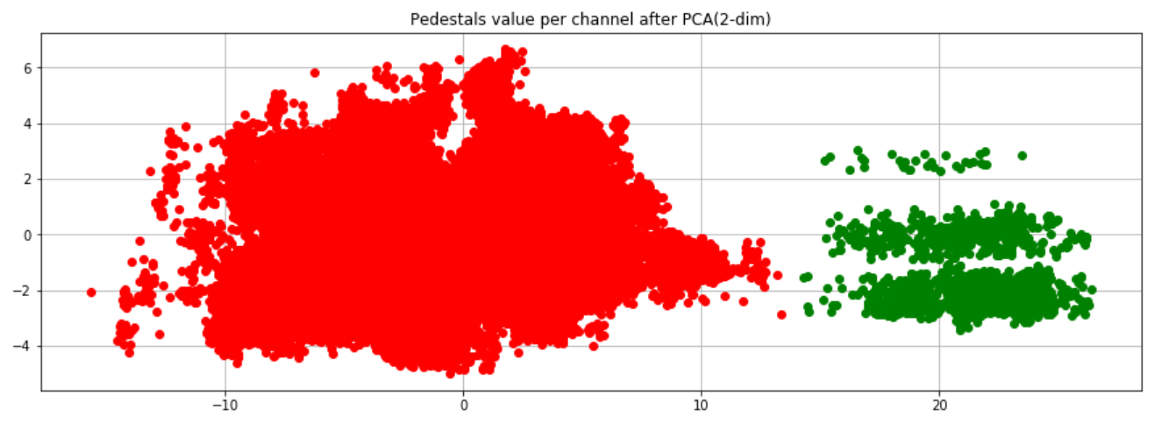
Pedestals all modules (PCA)
Notes:
After the reduction of PCA, two groups were distinguished. This reduction was done without module splitting on R and Phi.

Slide 6
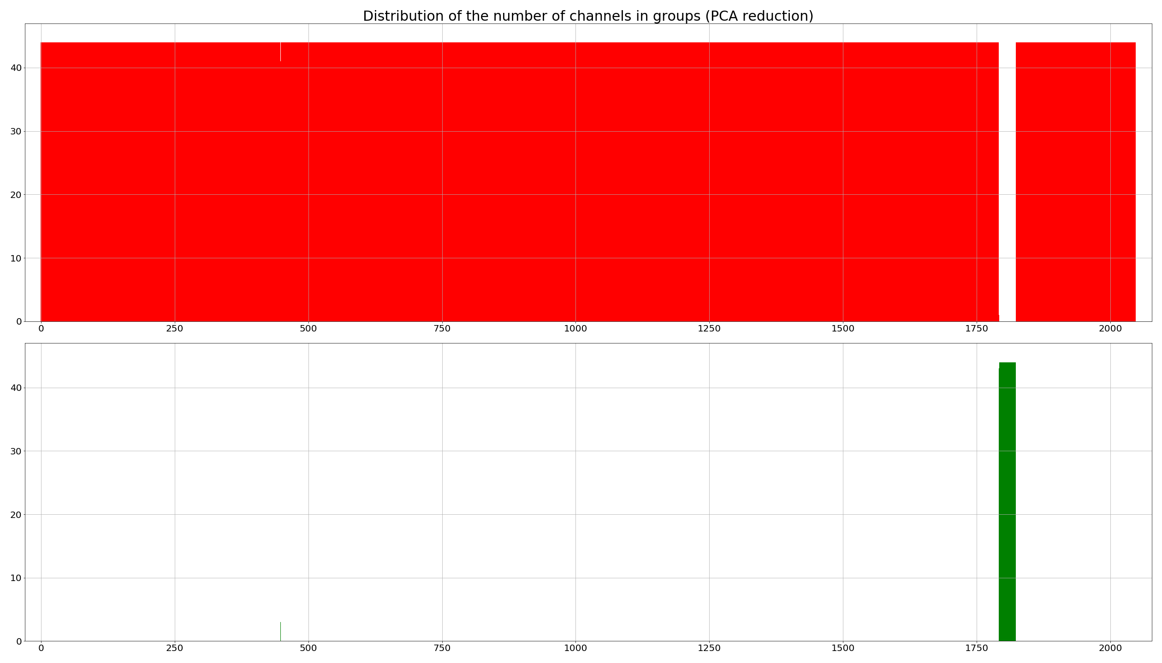
Distribution of the number of channels in groups
Notes:
Thoes plots visualize which channels and how many of them is calculated in previous slide groups. Maximum value is number of calibrations(44). We see that in green group narrow channels. Channels numers 1792 – 1823. After PCA reduction we have also small bar in 448 channel. This value can be rejected. The autoencoder clear green group what will be show in a moment.

Slide 7
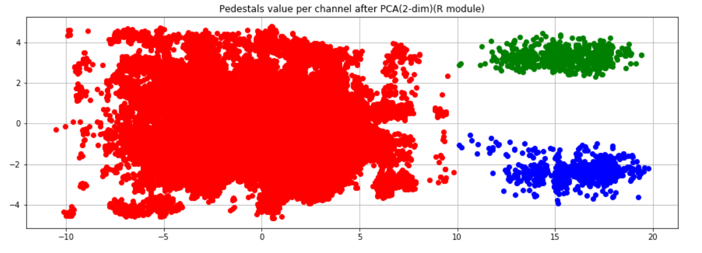
Pedestals R modules (PCA)
Notes:
PCA reduction after module split. In this case R module.

Slide 8
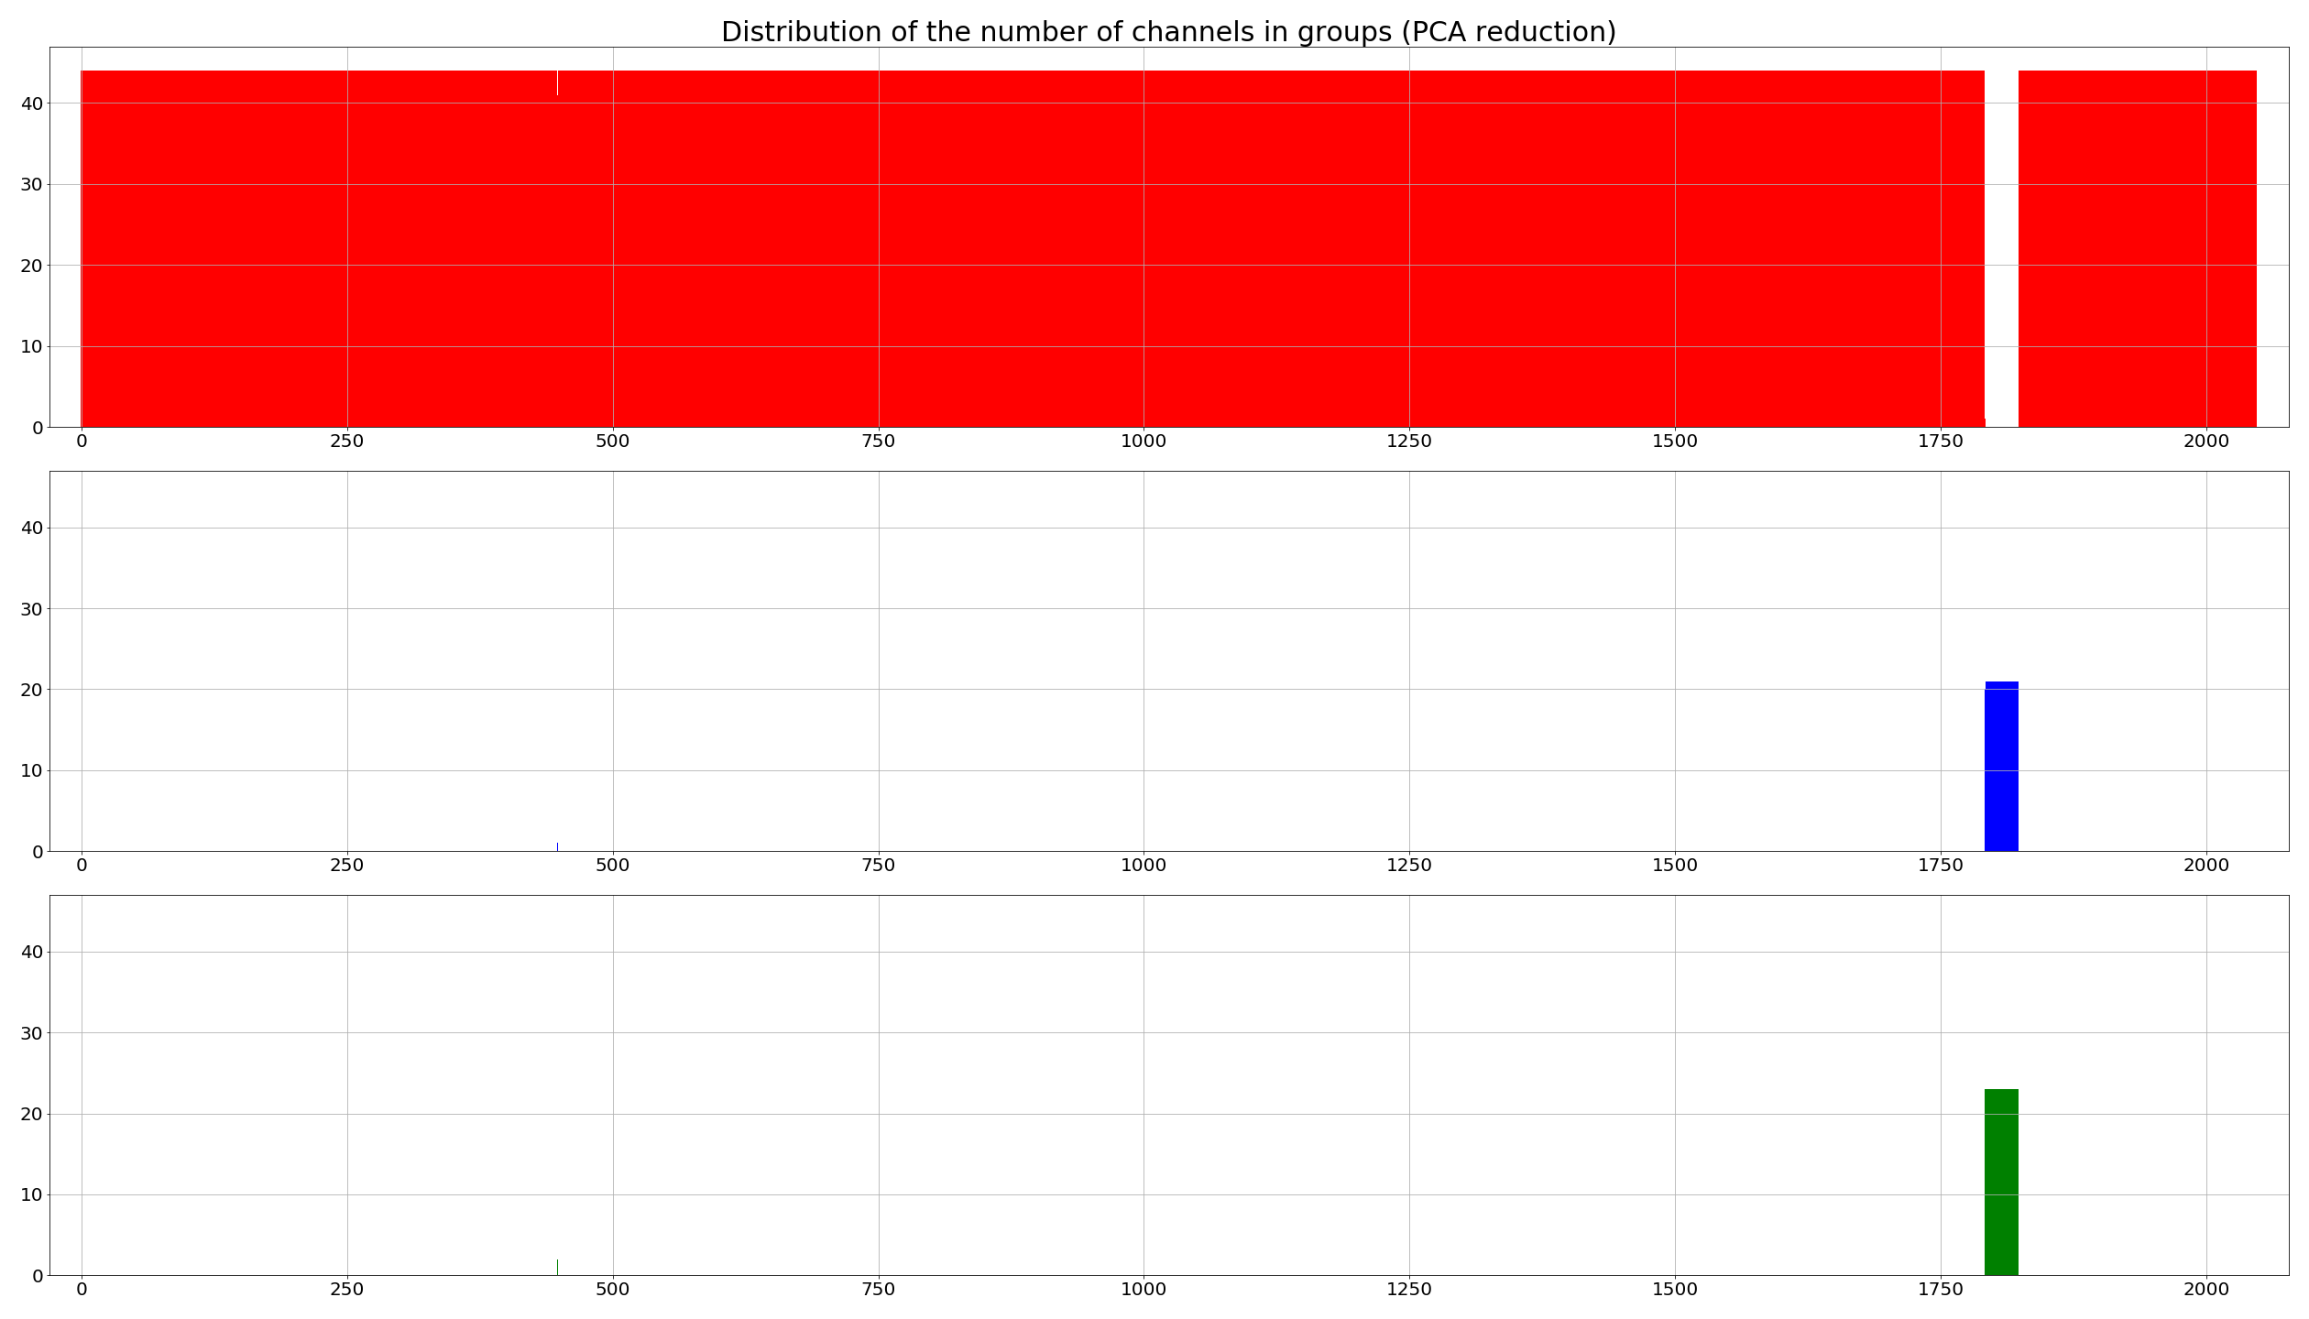
Distribution of the number of channels in groups

Slide 9
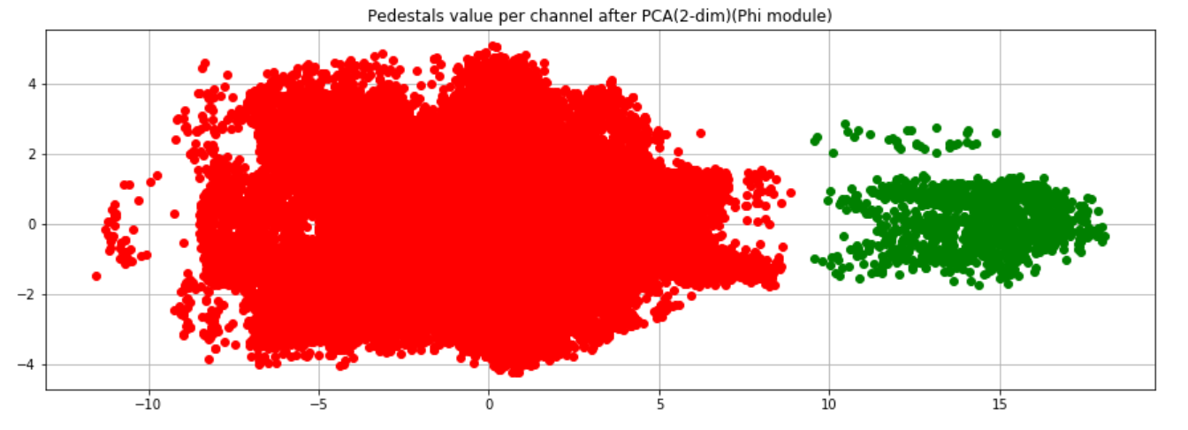
Pedestals Phi modules (PCA)
Notes:
PCA reduction after module split. In this case Phi module.

Slide 10

Distribution of the number of channels in groups

Slide 11
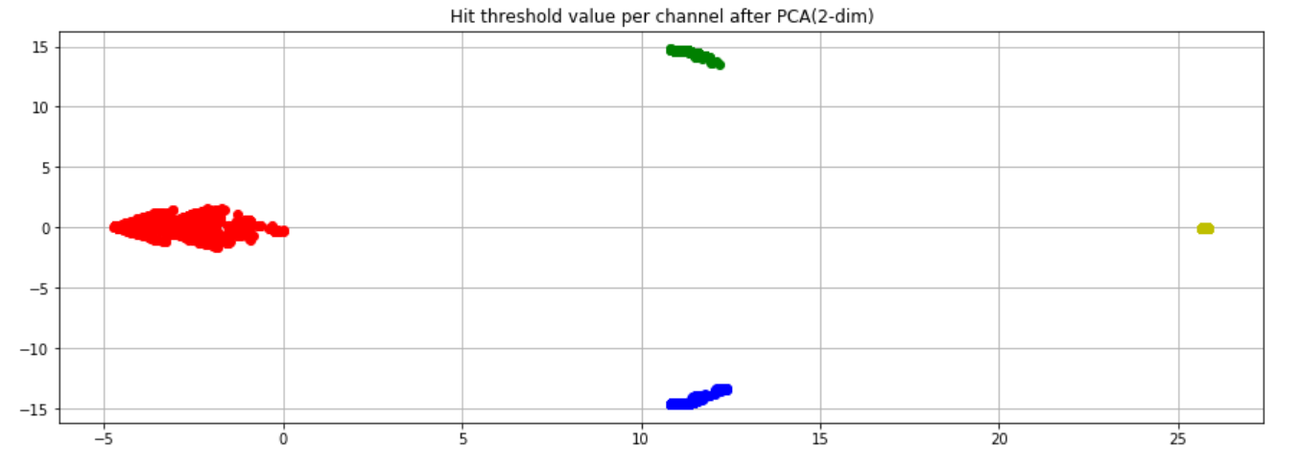
Hit tresholds all modules (PCA)
Notes:
Hit tresholds after PCA reduction spliting into four groups. Reduction without module spliting.

Slide 12
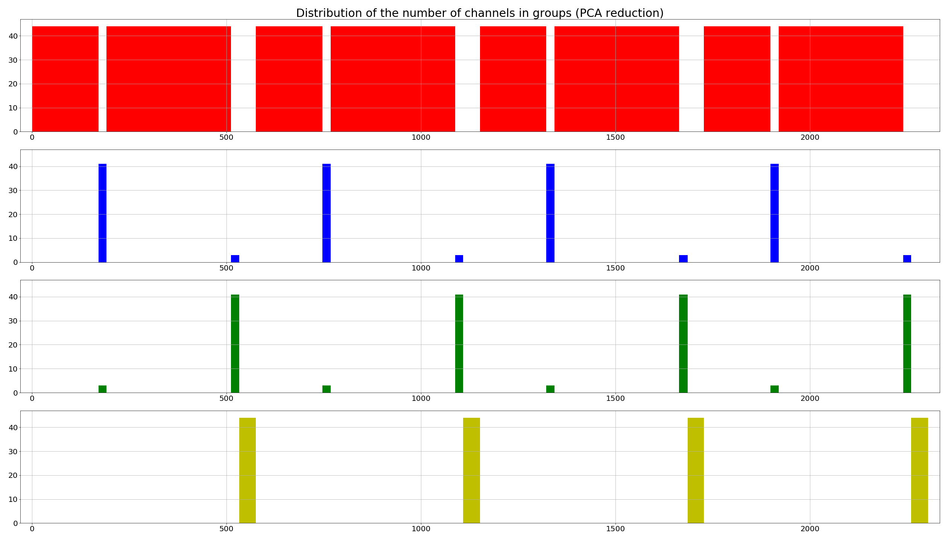
Distribution of the number of channels in groups
Notes:
We can find peroids in thoes plosts. Also we see that green and blue groups have small bars. This will be clean by autoencoder and will show later.

Slide 13
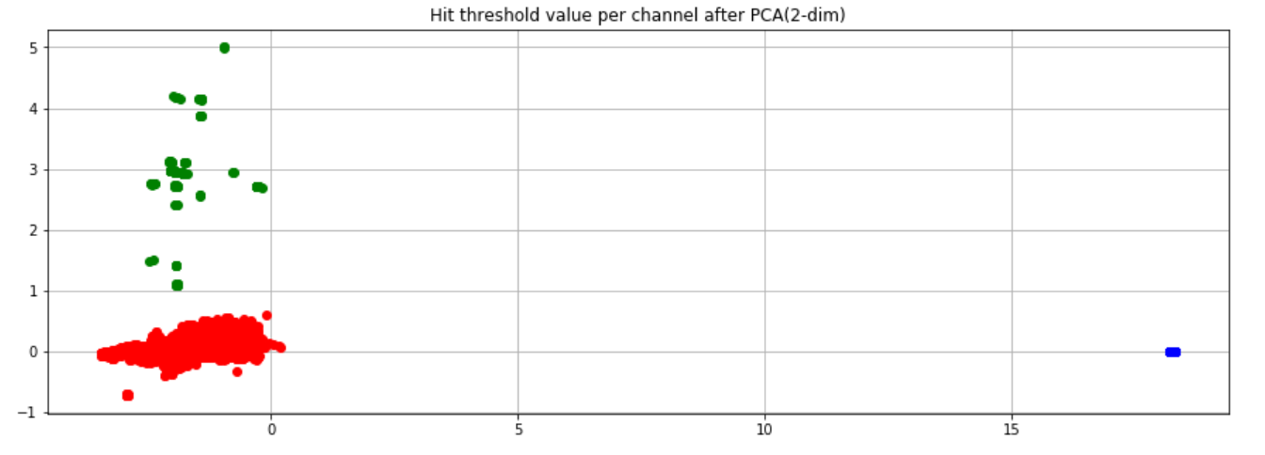
Hit tresholds R modules (PCA)
Notes:
Only R modules after PCA

Slide 14
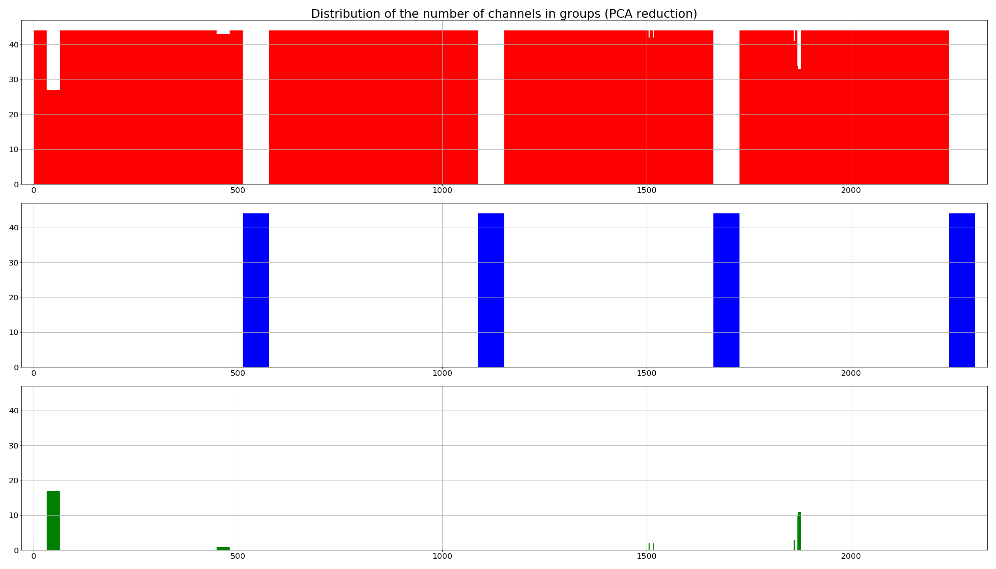
Distribution of the number of channels in groups

Slide 15
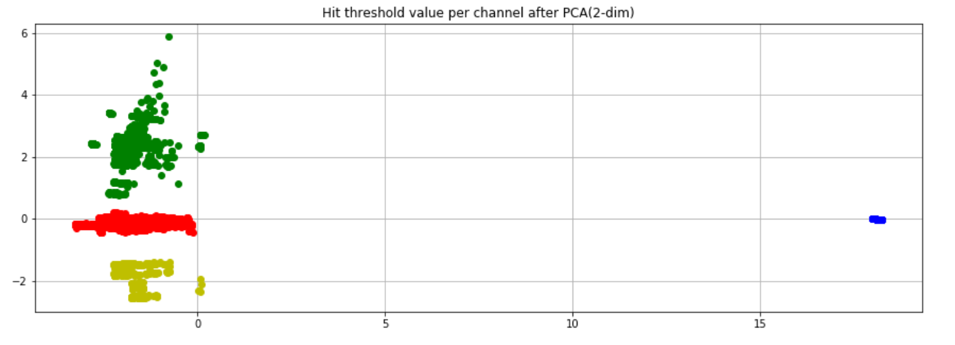
Hit tresholds Phi modules (PCA)
Notes:
Phi modules after PCA

Slide 16
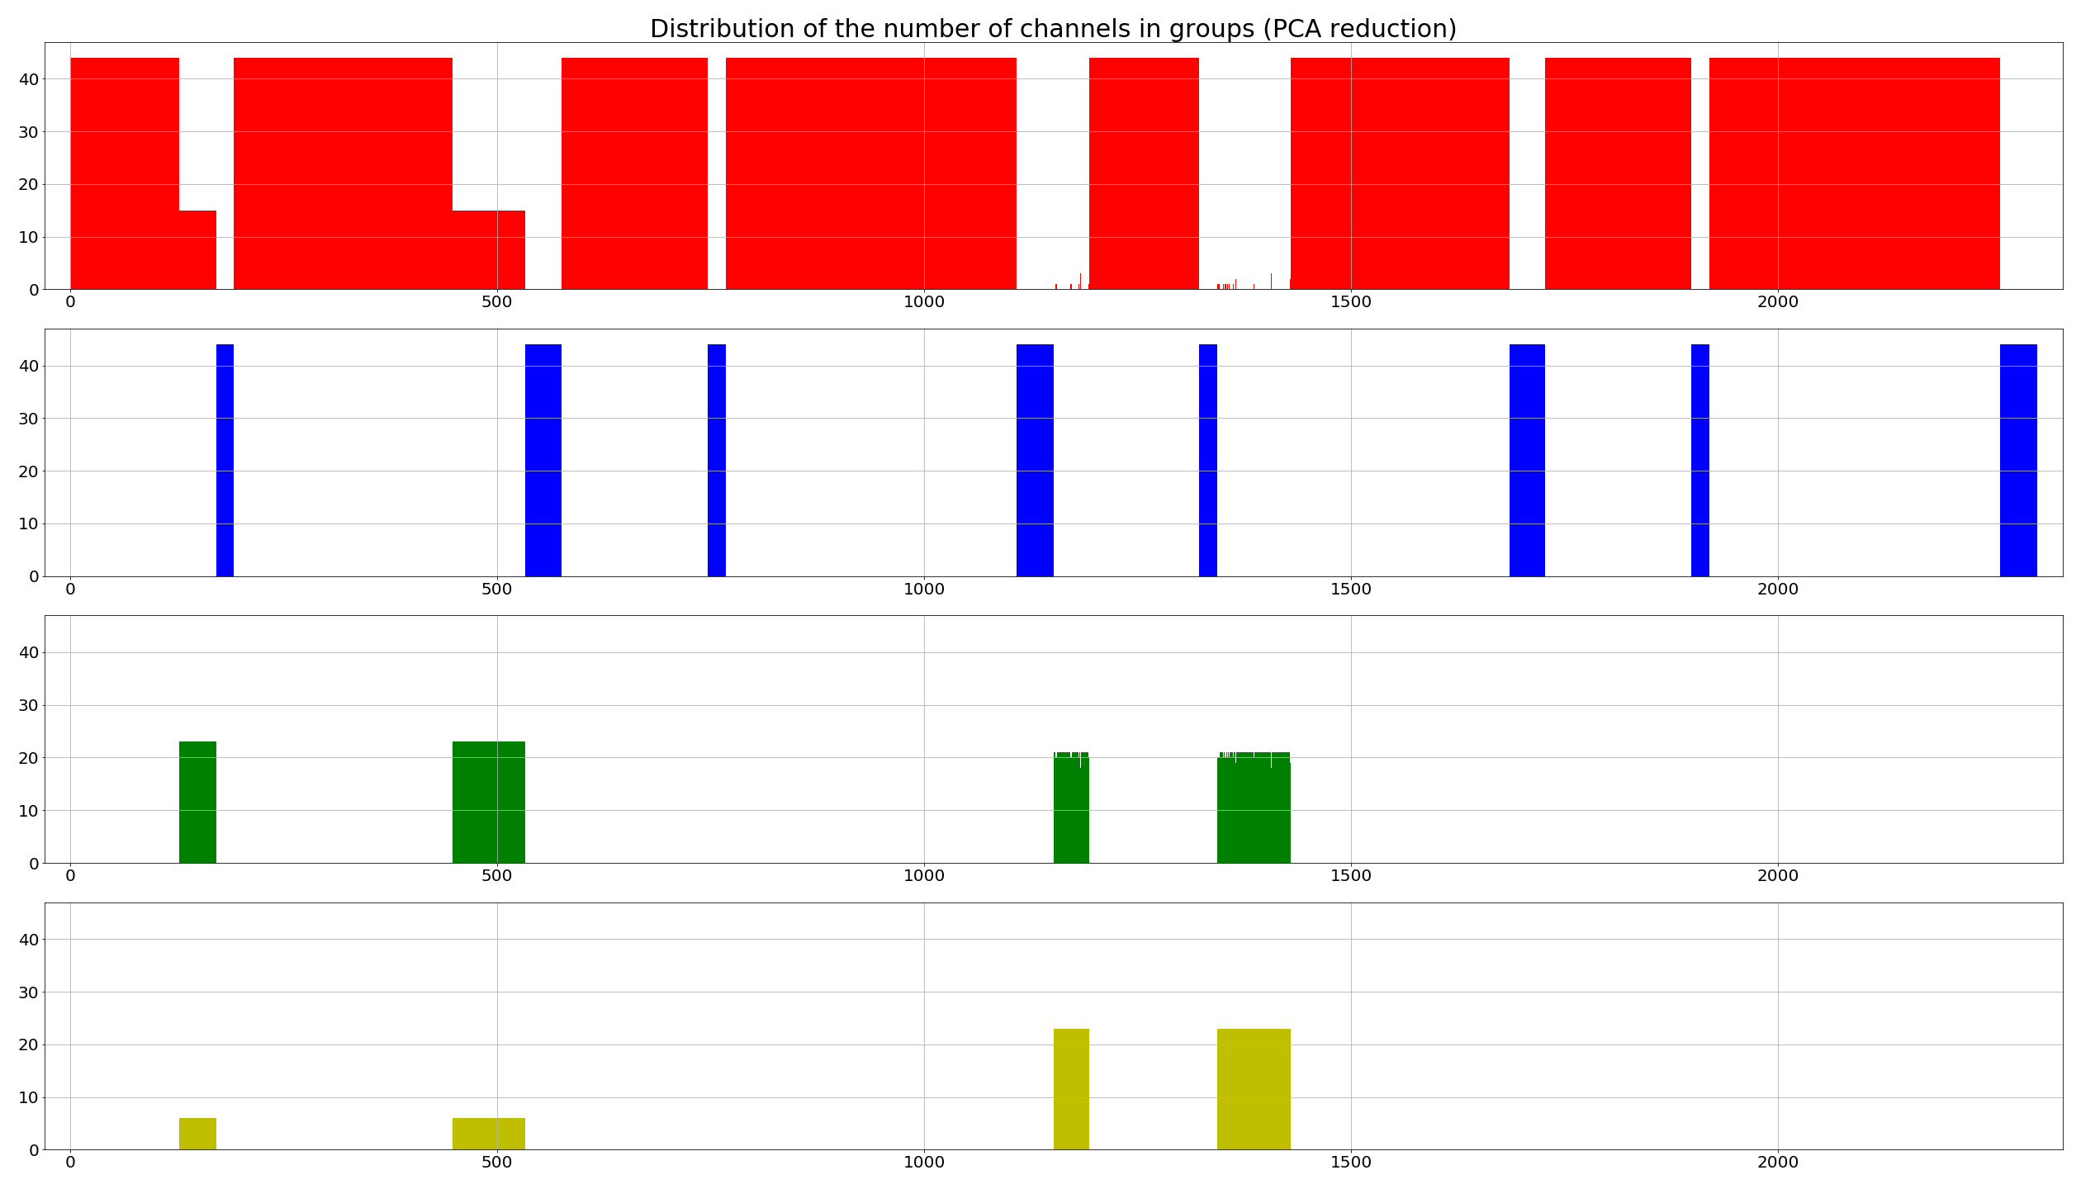
Distribution of the number of channels in groups

Slide 17
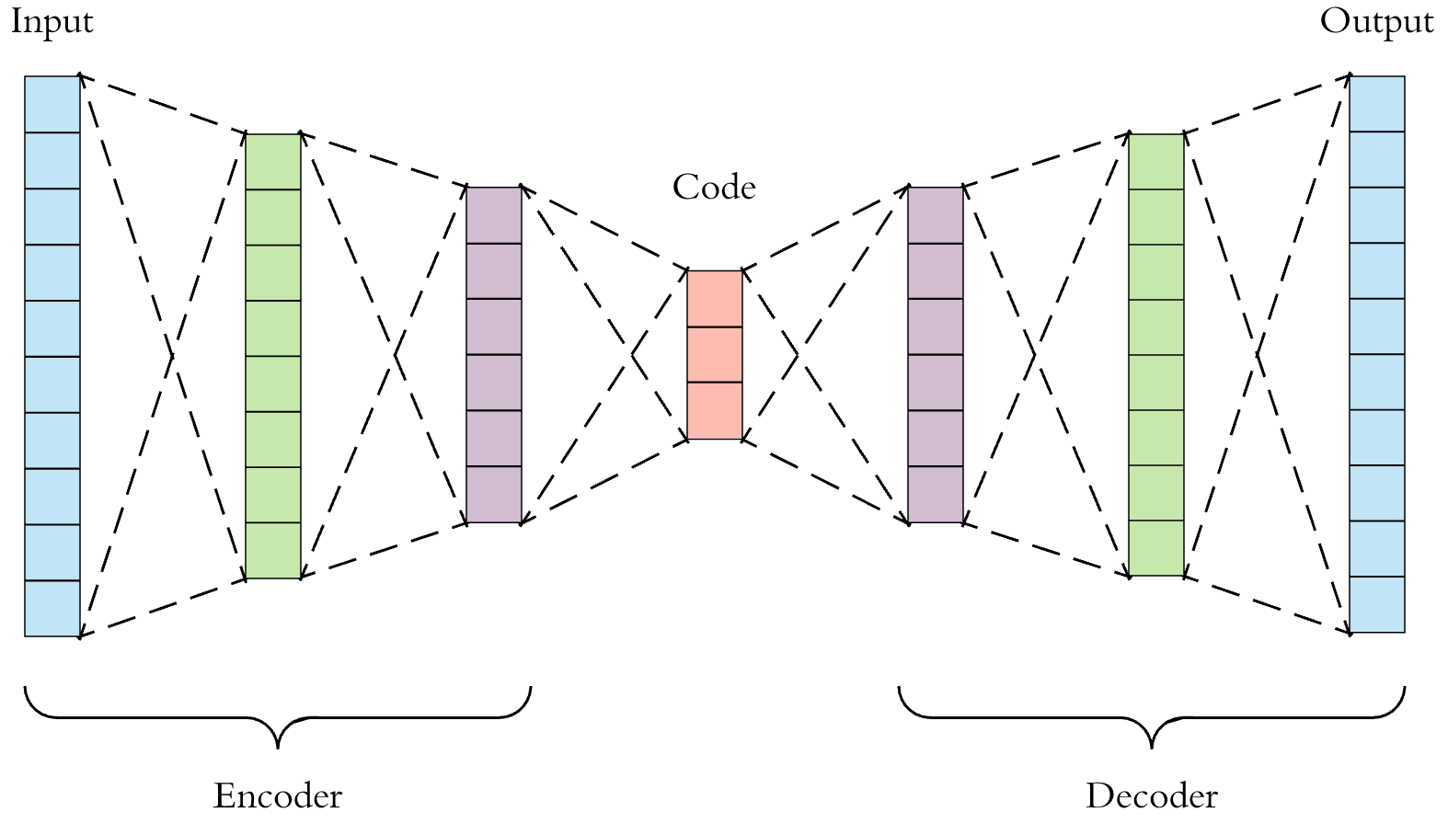
Autoencoder
Notes:
Second idea to dimension reduction was reduction by autoencoder. Autoencoder model was created by using Keras library. Autoencoder have few layers with „relu” function activation for encoding and for decoding. In the midle of autoencoder we have layer caled „bottleneck” and in this layer we have data reduced to two dimensions. The picture is only demonstrative of how the autoencoder works. Giving the next calibration data to the autoenoder input, the eutoenkoder learned how to reduce them and tried to reproduce them. In final rezults we use only encoder part to reduction.

Slide 18
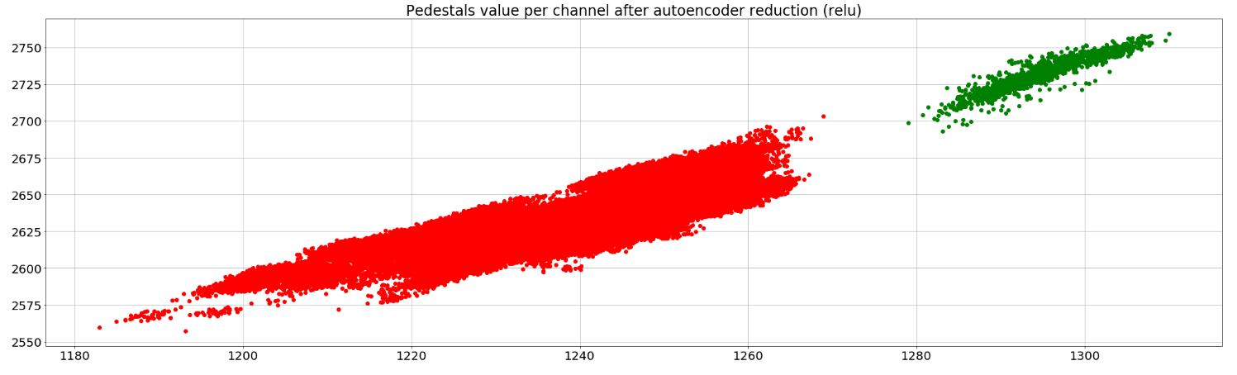
Pedestals all modules (autoencoder)
Notes:
All modules reduction by autoencoder. Very distinc groups.

Slide 19

Distribution of the number of channels in groups
Notes:
Very clear bars. No trash. Good to compare with 5 slide.

Slide 20
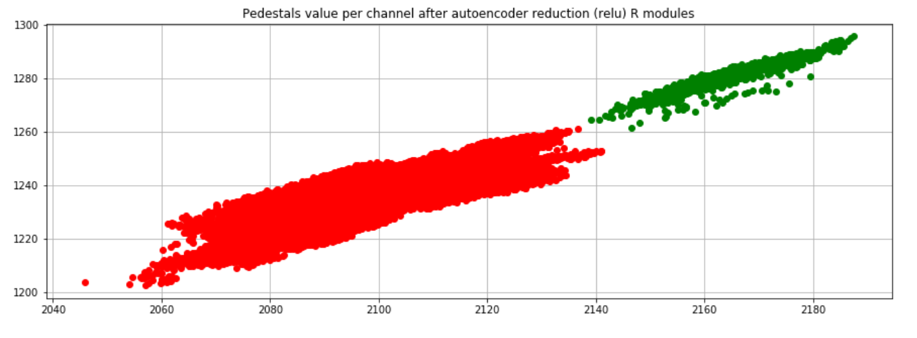
Pedestals R modules (autoencoder)

Slide 21

Distribution of the number of channels in groups
Notes:
Very clear bars. No grin barr splited into two bars. Good to compare with 7 slide.

Slide 22
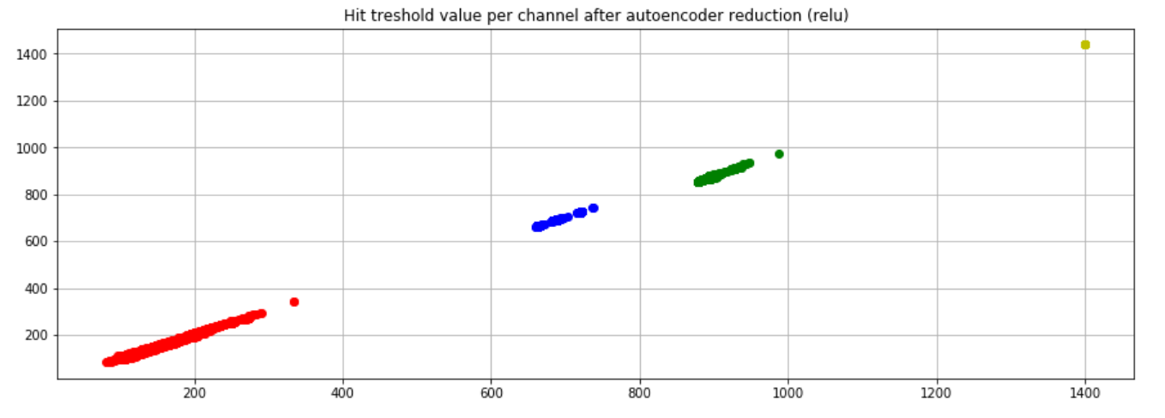
Hit tresholds all modules (autoencoder)
Notes:
Reduction all modules into four grups. Like PCA (slide 10)

Slide 23
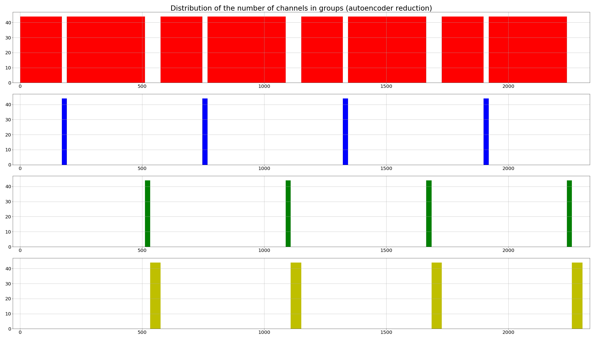
Distribution of the number of channels in groups
Notes:
Very clear bars. No small bars in green and blue groups. Good to compare with 11 slide.

Slide 24
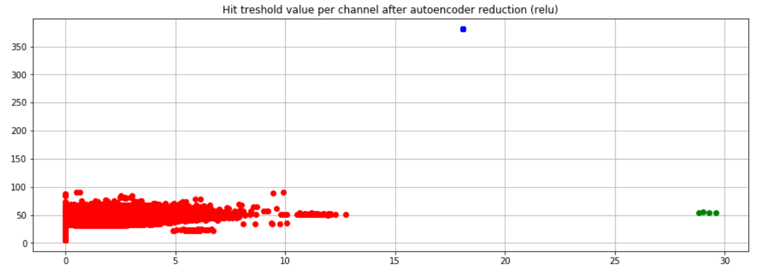
Hit tresholds R modules (autoencoder)

Slide 25
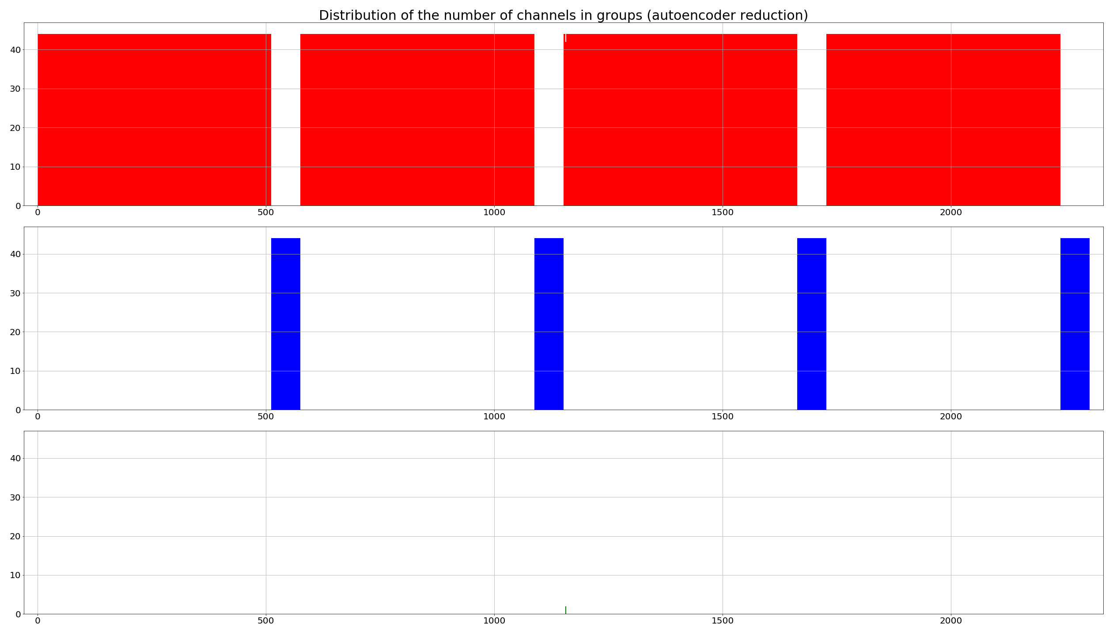
Distribution of the number of channels in groups

Slide 26
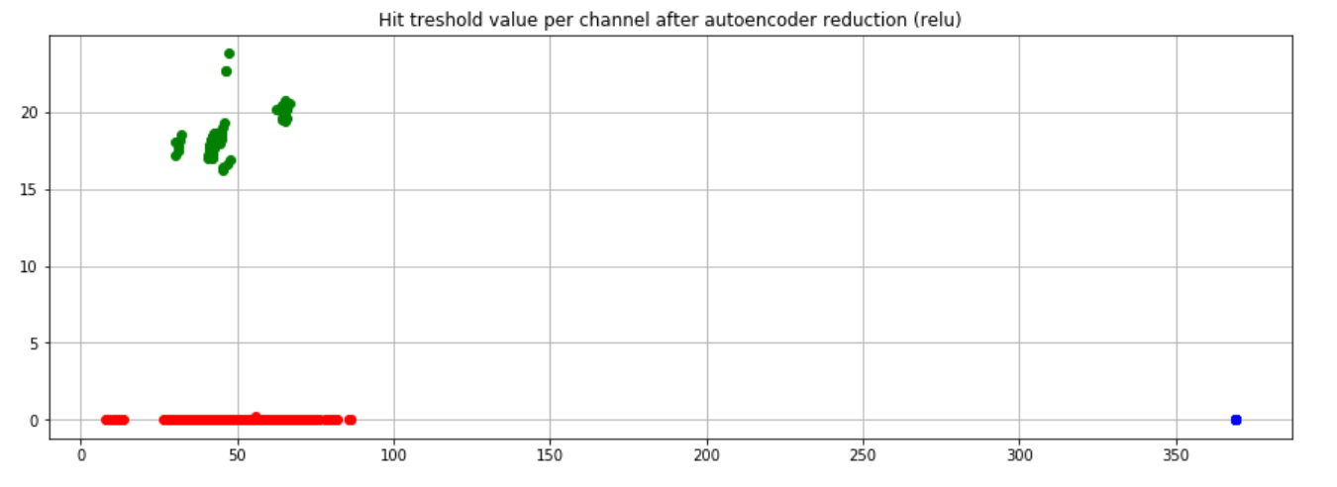
Hit tresholds Phi modules (autoencoder)

Slide 27

Distribution of the number of channels in groups

