Slide 1
Operating Systems
Hu Xiaopeng
xphu@swjtu.edu.cn
School of Information Science and Technology
SWJTU, Chengdu, Sichuan

Slide 2
Reference Books
William Stalling, Operating Systems-Internals and Design Principles(5th Edition), Prentice Hall. Press,2004
Andrew S. Tanenbaum, Operating Systems-Design and implementation(3rd Edition), Prentice Hall. Press,2006

Slide 3
Reference Books
Maurice J.Bach, The Design of the Unix Operating System, Prentice Hall & CMP, 2000
于渊著. Orange's : 一个操作系统的实现. 电子工业出版社. 2009

Slide 4
Prerequisite
Computer Principles
Data Structures
Programming Languages(C, Assembly language)

Slide 5
Try to Answer following Questions
Why do many programs can be run in a computer with uniprocessor simultaneously?
If we ran a program with bugs, other programs will be destroyed?
How can we ran several instances of a program？
Small main memory, big programs?
How does a program save the running results ？
Why does a program developed on one computer can be run on another computer?
How does a computer manage a lot of devices ？

Slide 6
Process (进程) - Interleaving
Schedule
CPU
Storage
Management
Process
Memory
Allocation
Input
Output

Slide 7
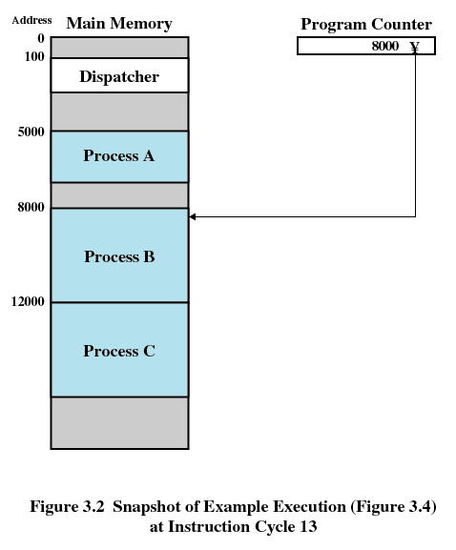
Trace of Processes (1)

Slide 8
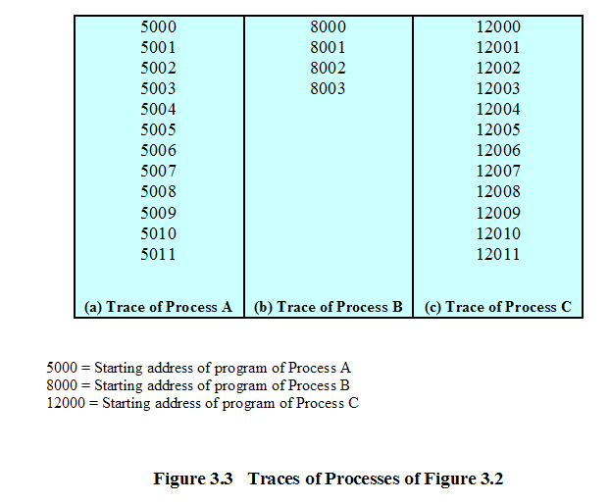
Trace of Processes (2)

Slide 9
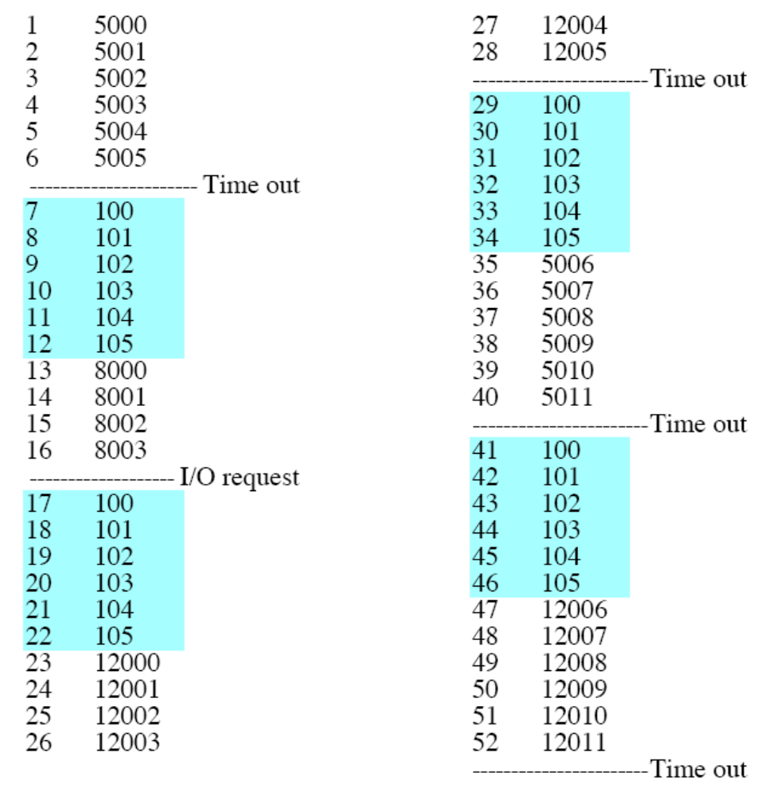
Trace of Processes (3)

Slide 10
Shared Memory Access (1)
Spooler Directory
...
out=4
C
A
4
abc
5
prog.c
in=7
6
prog.n
7
B
...
out - next file will be printed
in - next free slot
c - printer daemon(打印机守护进程)

Slide 11
Shared Memory Access (2)
Process A read in=7, save in next_free_slot, clock interrupt occurs, process A is been switched
Process B is scheduled to run, B read in=7, save the file to slot 7, update in=8, and continue to run
Process A is restored to run, it checks next_free_slot=7, and save the file to slot 7, next_free_slot +1=>in, then in=8。
The file which process B saved in slot 7 is lost，and printer daemon would not find this error

Slide 12
Contents
Process description and control
Multithreading
Concurrency - synchronization and mutual exclusion
Concurrency - deadlock
Memory management
Processor scheduling
I/O management
File systems

