Slide 1
Process Description and Control
Chapter 3

Slide 2
Concepts
Computer platform (平台) consists of a collection of hardware resources
Computer applications (应用程序) are developed to perform some task
Operating system manages execution of applications
Operating system provides a convenient to use, feature rich, secure, and consistent interface (接口) for applications to use
OS provides a uniform, abstract representation of resources that can be requested and accessed by application

Slide 3
Process (进程)
A program in execution
An instance of a program running on a computer
The entity that can be assigned to and executed on a processor
A unit of activity characterized by the execution of a sequence of instructions, a current state (当前状态), and an associated set of system instructions

Slide 4
Process Elements
Identifier
State
Priority
Program counter
Memory pointers
Context data (上下文数据)
I/O status information
Accounting information

Slide 5
Process Control Block (PCB)
Contains the process elements
Created and manage by the operating system
Allows support for multiple processes
Process Entry (进程表项)

Slide 6
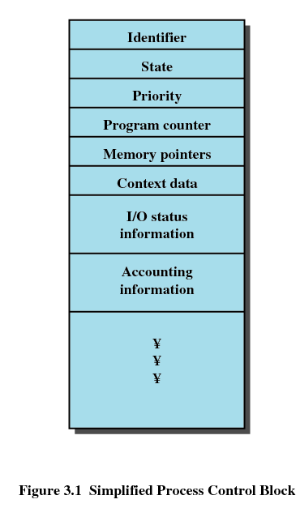
Process Control Block

Slide 7
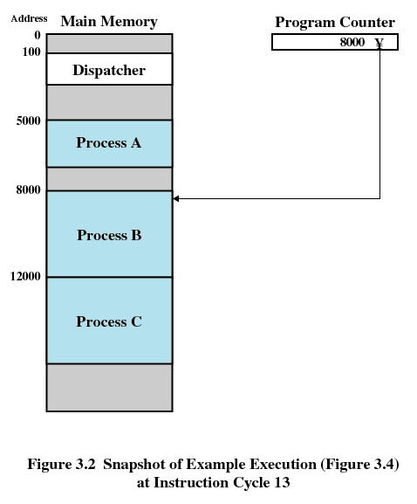
Trace of Processes (1)

Slide 8
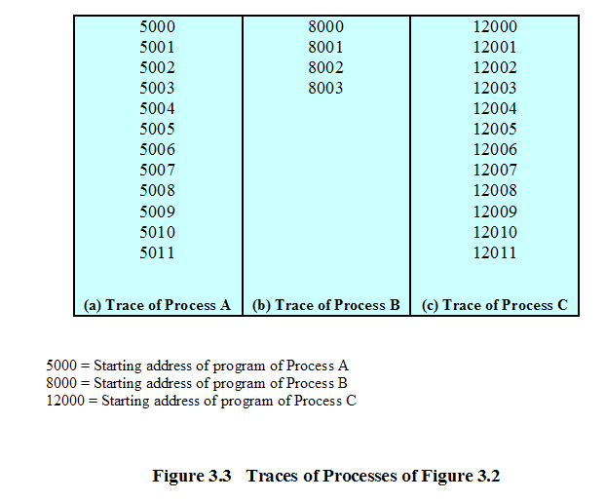
Trace of Processes (2)

Slide 9
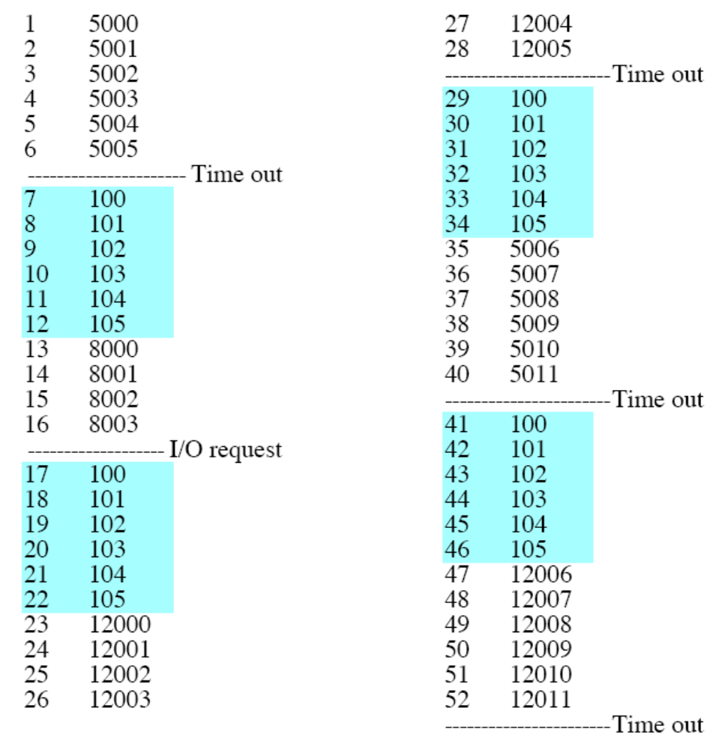
Trace of Processes (3)

Slide 10
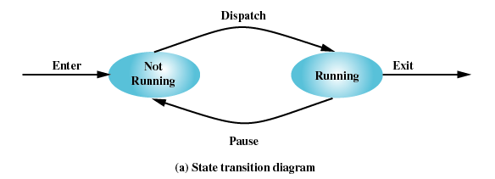
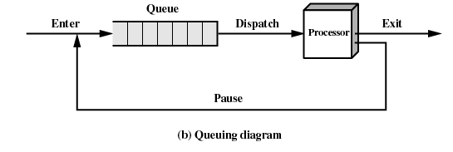
Two-State Process Model
Process may be in one of two states
  Running
  Not-running

Slide 11
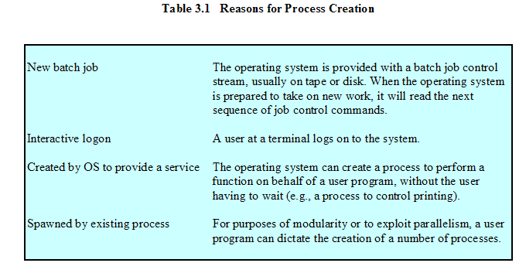
Process Creation (进程创建)

Slide 12
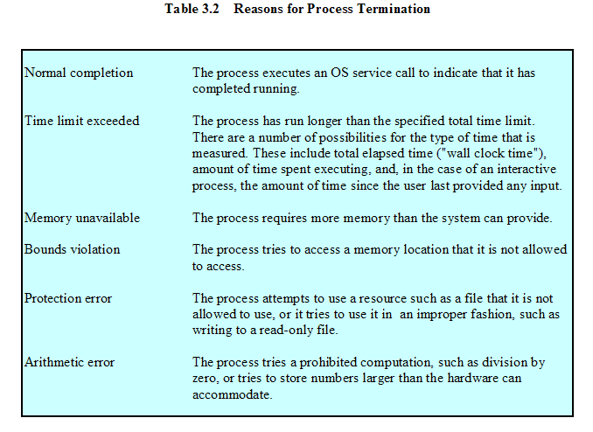
Process Termination (进程终止)

Slide 13
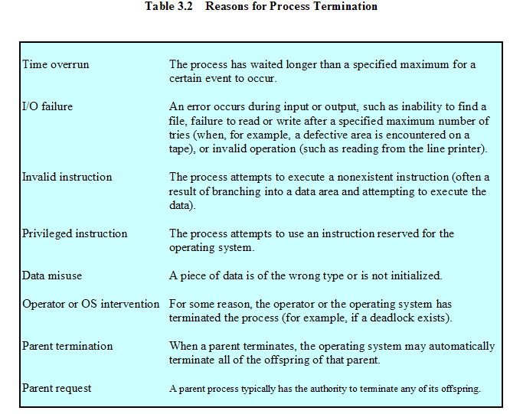
Process Termination (cont.)

Slide 14
Differentiation of Not-running
Not-running
  ready to execute
Blocked
  waiting for I/O
Dispatcher cannot just select the process that has been in the queue the longest because it may be blocked

Slide 15
A Five-State Model
Running
Ready
Blocked
New
Exit

Slide 16
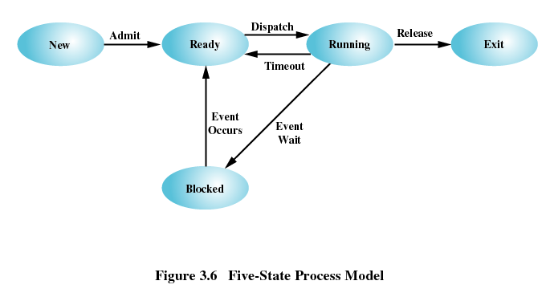
Five-State Process Model

Slide 17
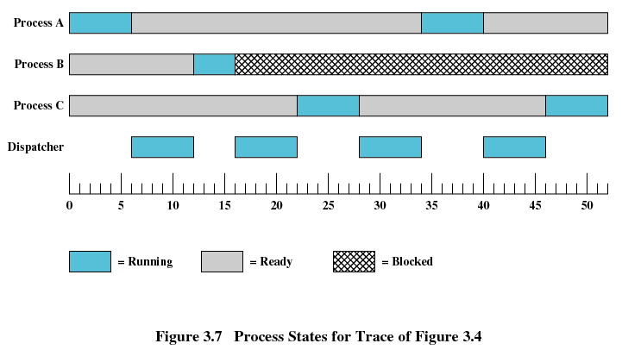
States of the Three Processes

Slide 18
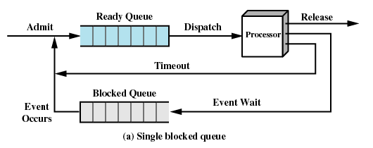
Queues to Implement Five-State Process Model

Slide 19
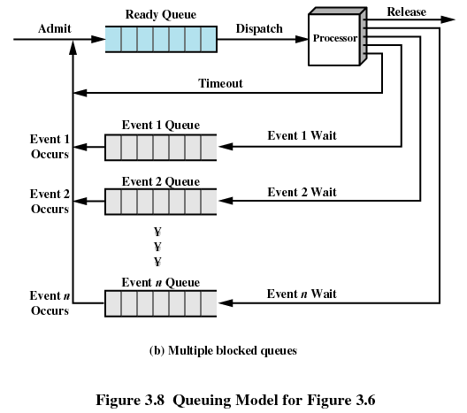
Queues to Implement Five-State Process Model

Slide 20
Process Swap Out/Swap In(换出/换入)
Processor is faster than I/O so all processes could be waiting for I/O
Swap these processes to disk to free up more memory
Blocked state becomes suspend state when swapped to disk
Two new states
  Blocked/Suspend(阻塞/换出)
  Ready/Suspend(就绪/换出)

Slide 21
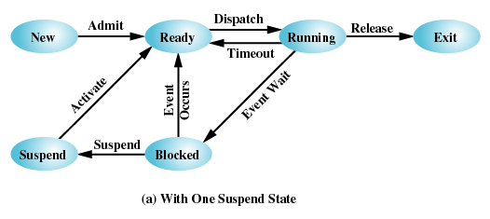
One Suspend State

Slide 22
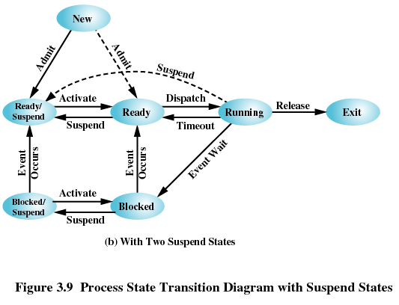
Two Suspend States

Slide 23
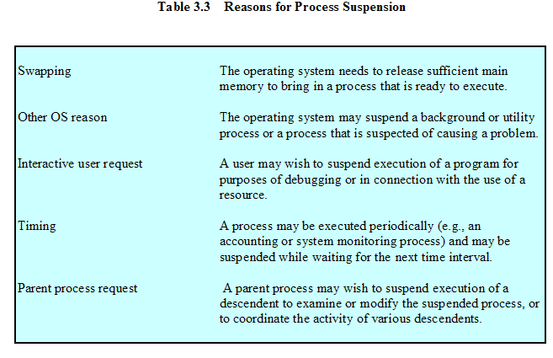
Reasons for Process Suspension

Slide 24
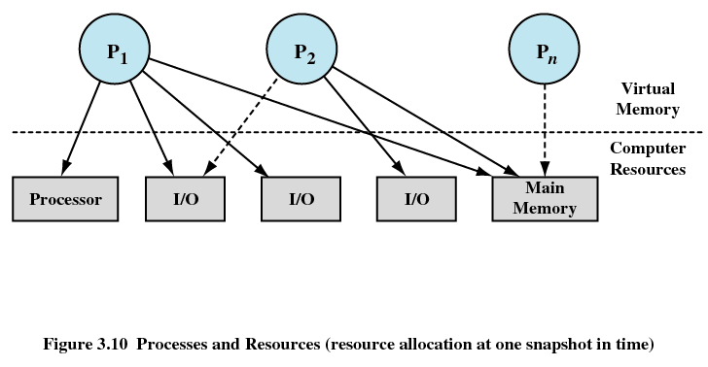
Processes and Resources(进程和资源)

Slide 25
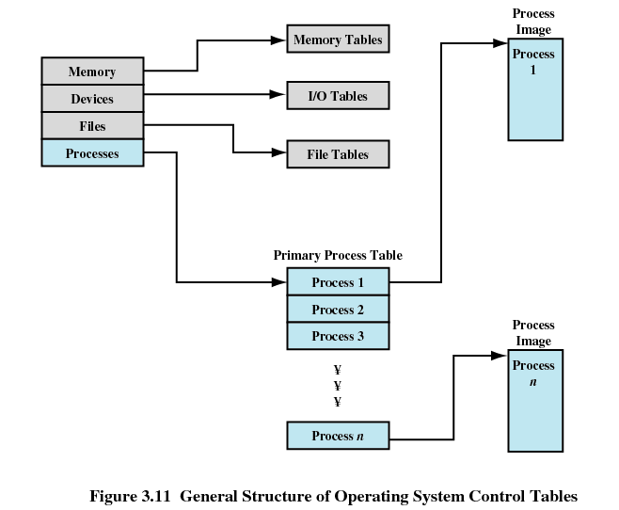
Process Control Structures
Information about the current status of each process and resource
Operating system manages the tables that are constructed for each entity

Slide 26
Process Control Structures
Memory Tables
  Allocation of main memory to processes
  Allocation of secondary memory to processes
  Protection attributes for access to shared memory regions
  Information needed to manage virtual memory

Slide 27
Process Control Structures
I/O Tables
  I/O device is available or assigned
  Status of I/O operation
  Location in main memory being used as the source or destination of the I/O transfer

Slide 28
Process Control Structures
  File Tables
  Existence of files
  Location on secondary memory
  Current Status
  Attributes
  Sometimes this information is maintained by a file management system

Slide 29
Process Control Structures
Process Table
  Where process is located
  Attributes in the process control block
    Program
    Data
    Stack

Slide 30
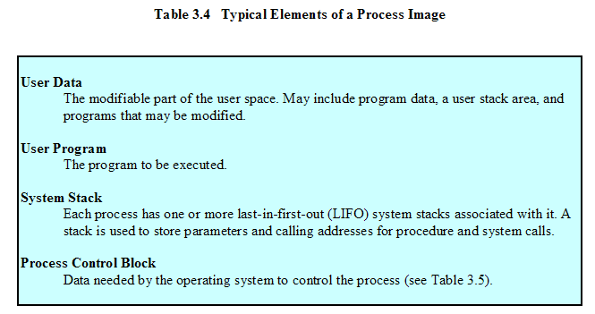
Process Image (进程映像)

Slide 31
Process Control Block
Process identification
  Identifiers
  Numeric identifiers that may be stored with the process control block include
    Identifier of this process
    Identifier of the process that created this process (parent process)
    User identifier

Slide 32
Process Control Block (cont.)
Processor State Information
  User-Visible Registers
    A user-visible register is one that may be referenced by means of the machine language that the processor executes while in user mode. Typically, there are from 8 to 32 of these registers, although some RISC implementations have over 100.

Slide 33
Process Control Block (cont.)
Processor State Information
  Control and Status Registers
    These are a variety of processor registers that are employed to control the operation of the processor. These include
    Program counter: Contains the address of the next instruction to be fetched
    Condition codes: Result of the most recent arithmetic or logical operation (e.g., sign, zero, carry, equal, overflow)
    Status information: Includes interrupt enabled/disabled flags, execution mode

Slide 34
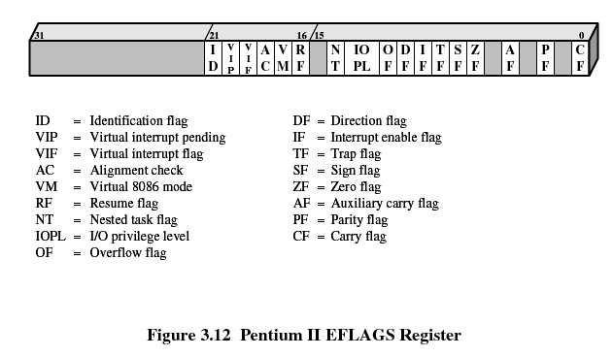
Process Control Block (cont.)
Processor State Information

Slide 35
Process Control Block (cont.)
Processor State Information
  Stack Pointers
    Each process has one or more last-in-first-out (LIFO) system stacks associated with it
    A stack is used to store parameters and calling addresses for procedure and system calls. The stack pointer points to the top of the stack.

Slide 36
Process Control Block (cont.)
Process Control Information
  Scheduling and State Information
    Process state: defines the readiness of the process to be scheduled for execution (e.g., running, ready, waiting, halted).
    Priority: One or more fields may be used to describe the scheduling priority of the process. In some systems, several values are required (e.g., default, current, highest-allowable)
    Scheduling-related information: This will depend on the scheduling algorithm used. Examples are the amount of time that the process has been waiting and the amount of time that the process executed the last time it was running.
    Event: Identity of event the process is awaiting before it can be resumed

Slide 37
Process Control Block (cont.)
Process Control Information
  Data Structuring
    A process may be linked to other process in a queue, ring, or some other structure. For example, all processes in a waiting state for a particular priority level may be linked in a queue. A process may exhibit a parent-child (creator-created) relationship with another process. The process control block may contain pointers to other processes to support these structures.

Slide 38
Process Control Block (cont.)
Process Control Information
  Interprocess Communication
    Various flags, signals, and messages may be associated with communication between two independent processes. Some or all of this information may be maintained in the process control block.
  Process Privileges
    Processes are granted privileges in terms of the memory that may be accessed and the types of instructions that may be executed. In addition, privileges may apply to the use of system utilities and services.

Slide 39
Process Control Block (cont.)
Process Control Information
  Memory Management
    This section may include pointers to segment and/or page tables that describe the virtual memory assigned to this process.
  Resource Ownership and Utilization
    Resources controlled by the process may be indicated, such as opened files. A history of utilization of the processor or other resources may also be included; this information may be needed by the scheduler.

Slide 40
Process Creation
Assign a unique process identifier
Allocate space for the process
Initialize process control block
Set up appropriate linkages
  Ex: add new process to linked list used for scheduling queue
Create of expand other data structures
  Ex: maintain an accounting file

Slide 41
When to Switch a Process
Clock interrupt
  process has executed for the maximum allowable time slice
I/O interrupt
Memory fault
  memory address is in virtual memory so it must be brought into main memory
Trap
  error or exception occurred
  may cause process to be moved to Exit state
Supervisor call
  such as file open

Slide 42
Change of Process State
Save context of processor including program counter and other registers
Update the process control block of the process that is currently in the Running state
Move process control block to appropriate queue – ready; blocked; ready/suspend
Select another process for execution
Update the process control block of the process selected
Update memory-management data structures
Restore context of the selected process

Slide 43
Execution of the Operating System
Non-process Kernel
  Execute kernel outside of any process
  Operating system code is executed as a separate entity that operates in privileged mode
Execution Within User Processes
  Operating system software within context of a user process
  Process executes in privileged mode when executing operating system code
Process-Based Operating System
  Implement operating system as a collection of system processes
  Useful in multi-processor or multi-computer environment

Slide 44
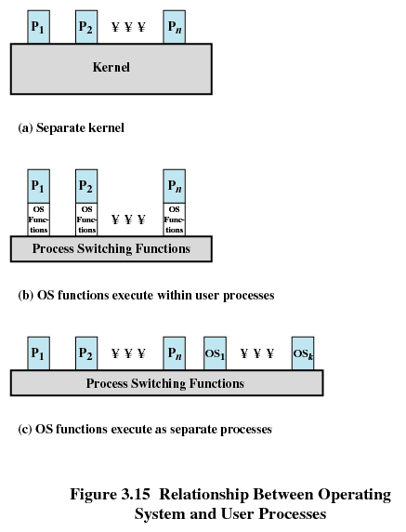
Relationship Between OS and User Processes

Slide 45
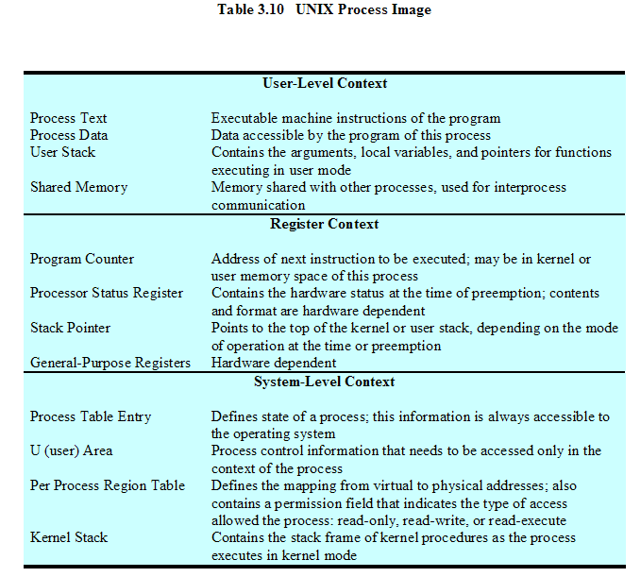
UNIX SVR4 Process Image

Slide 46
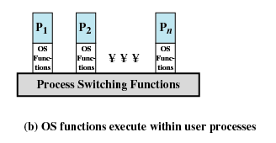
UNIX SVR4 Process Management
The operating system executes within the environment of a user process

Slide 47
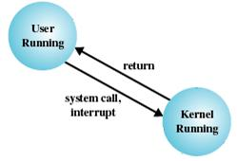
Two Modes of UNIX Process Execution
User mode (用户态)
  Less-privileged mode
  User programs typically execute in this mode
kernel mode(核心态)
  More-privileged mode
  Execution of the operating system

Slide 48
UNIX SVR4 Process States
Process State | Description
User Running | Executing in user mode
Kernel Running | Executing in kernel mode
Ready to Run, in Memory (内存中就绪) | Ready to run as soon as the kernel schedules it
Asleep in Memory (内存中睡眠) | Unable to execute until an event occurs; process is in main memory
Ready to Run, Swapped (磁盘上就绪) | Process is ready to run, but the swapper must swap the process into main memory before the kernel can schedule it to execute

Slide 49
UNIX SVR4 Process States (cont.)
Process State | Description
Sleeping, swapped (磁盘上睡眠) | The process is awaiting an event and has been swapped to secondary storage
Preempted (被抢占) | Process is returning from kernel to user mode, but the kernel preempts (抢占) it and does a process switch to schedule another process
Created | Process is newly created and not yet ready to run
Zombie(僵尸) | Process no longer exists, but it leaves a record for its parent process to collect

Slide 50
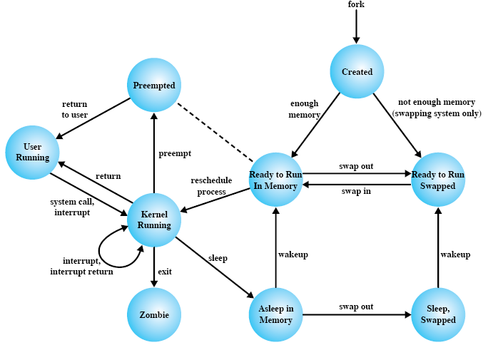
Unix SVR4 Process State Transition

Slide 51
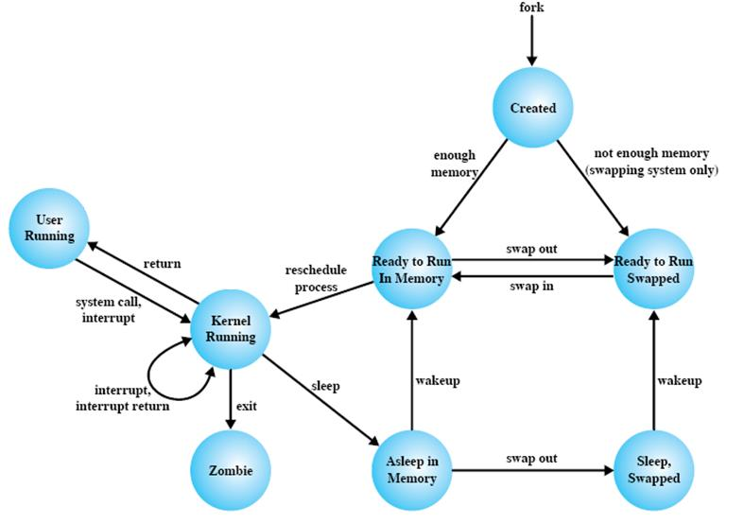
Unix SVR4 Process State Transition

Slide 52
Preemptive and Preempted

Slide 53
Unix System Call: fork
#include <sys/types.h>
#include <unistd.h>
void main()
{
int x = 0;
fork();
x = 1;
return;
}

Slide 54
Unix System Call: fork
#include <stdio.h>
#include <sys/types.h>
#include <unistd.h>
void main()
{
pid_t pid;
if ((pid = fork()) == 0) {
fprintf(stderr, “I am the child, id = %ld\n”, (long)getpid());
}
else {
fprintf(stderr, “I am the parent, id = %ld\n”, (long)getpid());
};
return;
}

Slide 55
Unix System Call: fork
#include <stdio.h>
#include <sys/types.h>
#include <unistd.h>
void main()
{
pid_t pid;
for (int i = 1; i < 4; i++)
if (pid = fork()) break;
fprintf(stderr, “This is process %ld with parent %ld\n”, (long)getpid(), (long)getppid());
return;
}

Slide 56
Unix Shell Skeleton (代码框架)
while(TRUE){
read-command(command, parameters);
if (fork() != 0) {
/* parent code */
waitpid(-1, &status, 0);
}
else {
/* child code */
execve(command, parameters, 0);
}
}

Slide 57
SVR4 Process State Transition Review

Slide 58
Zombie: mytest.c
#include <sys/types.h>
#include <sys/stat.h>
#include <fcntl.h>
int main(int argc , char *argv[] )
{
int fd;
if (argc<2) {
printf( ”Arguments too few!\n” );
exit(1);
}
fd = open(argv[1], …);
…
close(fd);
return 0;
}

Slide 59
mytest.c compilation and running
$gcc mytest.c –o mytest
$./mytest
Arguments too few!
$
$./mytest readme.txt
……
$

