Slide 1
Threads, SMP and Microkernels
Chapter 4

Slide 2
Process
Scheduling/execution- follows an execution path that may be interleaved with other processes
Resource ownership - process includes a virtual address space to hold the process image
These two characteristics are treated independently by the operating system

Slide 3
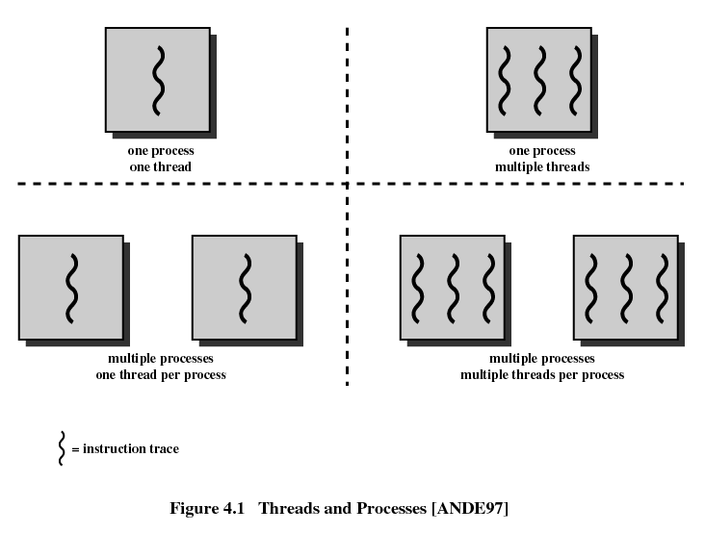
Multithreading
Modern operating system supports multiple threads of execution within a single process

Slide 4
Multithreading (contd.)
In a multithreaded environment, a process is defined as the unit of resource allocation and a unit of protection:
  Have a virtual address space which holds the process image
  Protected access to processors, other processes (for interprocess communication), files, and I/O resources (devices and channels)

Slide 5
Multithreading (contd.)
Within a process, there may be one or more threads, each with the following:
  An execution state (running, ready, etc.)
  Saved thread context when not running
  Has an execution stack
  Some per-thread static storage for local variables
  Access to the memory and resources of its process

Slide 6
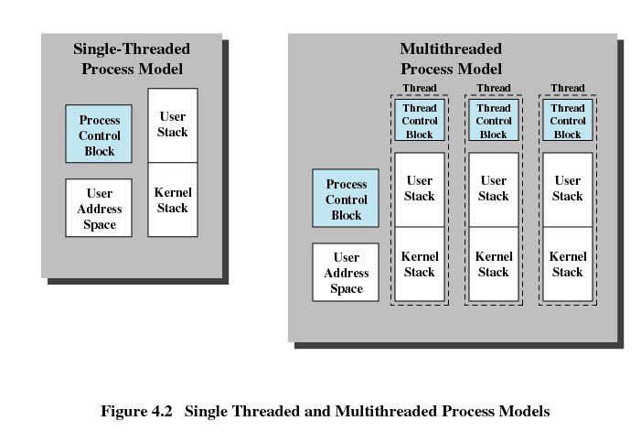
Single Threaded and Multithreaded Process Models

Slide 7
Benefits of Multithreading
Takes less time to create a new thread than a process
Less time to terminate a thread than a process
Less time to switch between two threads within the same process
Since threads within the same process share memory and files, they can communicate with each other without invoking the kernel

Slide 8
Multithreaded Scenarios
Foreground to background work
Asynchronous processing
Speed of execution
Modular program structure

Slide 9
Thread States
States associated with a change in thread state
  Spawn
    Spawn another thread
  Block
  Unblock
  Finish
    Deallocate register context and stacks

Slide 10
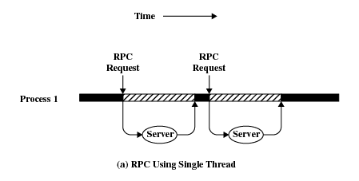
Multithreading Example - RPC
A program that performs two remote procedure calls (RPCs) to two different hosts to obtain a combined result
  RPCs use single thread
  RPCs use multiple threads

Slide 11
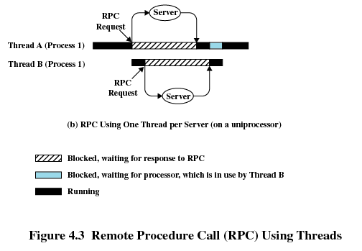
Multithreading Example - RPC

Slide 12
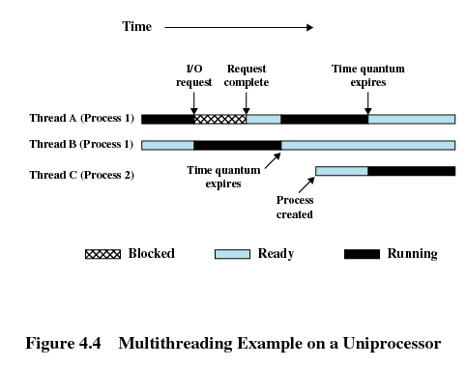
Multithreading Example

Slide 13
Different Threading Implementations
User-level threads (用户级多线程)
Kernel-level threads (核心级多线程)

Slide 14
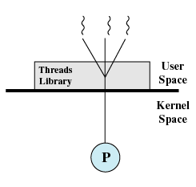
User-Level Threads
All thread management is done by the application
The kernel is not aware of the existence of threads

Slide 15
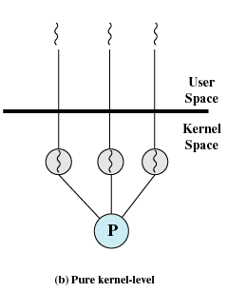
Kernel-Level Threads
Kernel maintains context information for the process and the threads
  Windows is an example of this approach
Scheduling is done on a thread basis

Slide 16
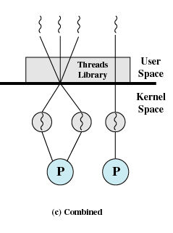
Combined Approaches
Thread creation done in the user space
Bulk of scheduling and synchronization of threads within application
  Example is Solaris

Slide 17
Categories of Computer Systems
Single Instruction Single Data (SISD) stream
  Single processor executes a single instruction stream to operate on data stored in a single memory
Single Instruction Multiple Data (SIMD) stream
  Each instruction is executed on a different set of data by the different processors

Slide 18
Categories of Computer Systems
Multiple Instruction Single Data (MISD) stream
  A sequence of data is transmitted to a set of processors, each of which executes a different instruction sequence. Never implemented
Multiple Instruction Multiple Data (MIMD)
  A set of processors simultaneously execute different instruction sequences on different data sets

Slide 19
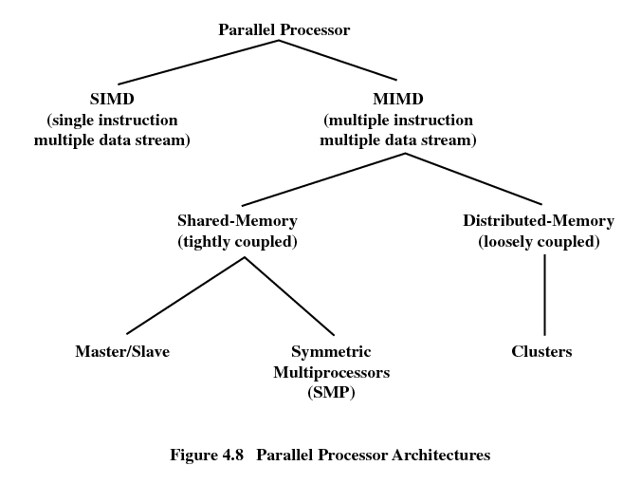
Categories of Computer Systems

Slide 20
Symmetric Multiprocessing(对称多处理)
Kernel can execute on any processor
Typically each processor does self-scheduling from the pool of available process or threads

Slide 21
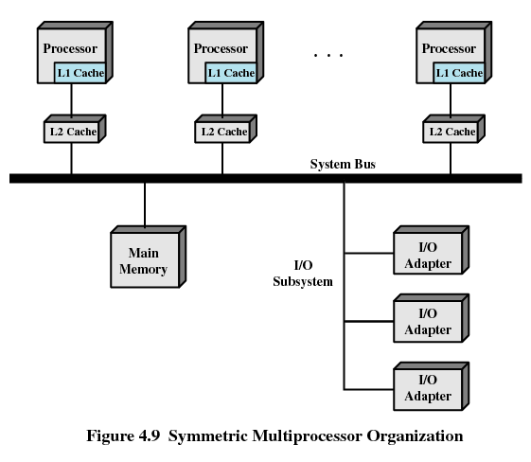
Symmetric Multiprocessor Organization

Slide 22
Multiprocessor Operating System Design Considerations
Simultaneous concurrent processes or threads
Scheduling
Synchronization
Memory management
Reliability and fault tolerance

Slide 23
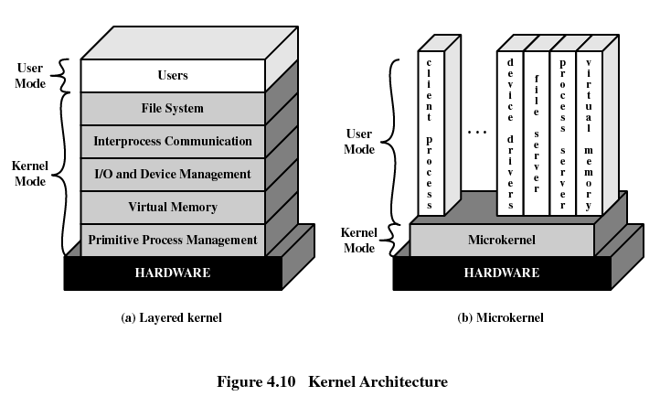
Kernel Architecture
Monolithic Architecture(整体式体系结构)
Layered Architecture (分层体系结构)
Microkernel Architecture (微内核体系结构)

Slide 24
Microkernels (微内核)
Small operating system core
Contains only essential core operating systems functions
Many services traditionally included in the operating system are now external subsystems
  Device drivers
  File systems
  Virtual memory manager
  Windowing system
  Security services

Slide 25
Benefits of Microkernel Organization
Uniform interface on request made by a process
  Don’t distinguish between kernel-level and user-level services
  All services are provided by means of message passing
Extensibility
  Allows the addition of new services
Flexibility
  New features added
  Existing features can be subtracted

Slide 26
Benefits of Microkernel Organization
Portability
  Changes needed to port the system to a new processor is changed in the microkernel - not in the other services
Reliability
  Modular design
  Small microkernel can be rigorously tested

Slide 27
Benefits of Microkernel Organization
Distributed system support
  Message are sent without knowing what the target machine is
Object-oriented operating system
  Components are objects with clearly defined interfaces that can be interconnected to form software

Slide 28
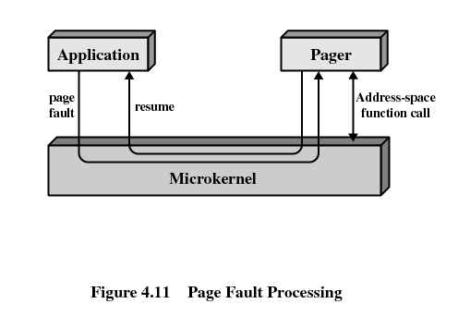
Microkernel Design
Interprocess communication
I/O and interrupt management
Low-level memory management
  Mapping each virtual page to a physical page frame

Slide 29
Windows Thread And SMP
Windows process are implemented as objects
An executable process may contain one or more threads
Both processes and thread objects have built-in synchronization capabilities

Slide 30
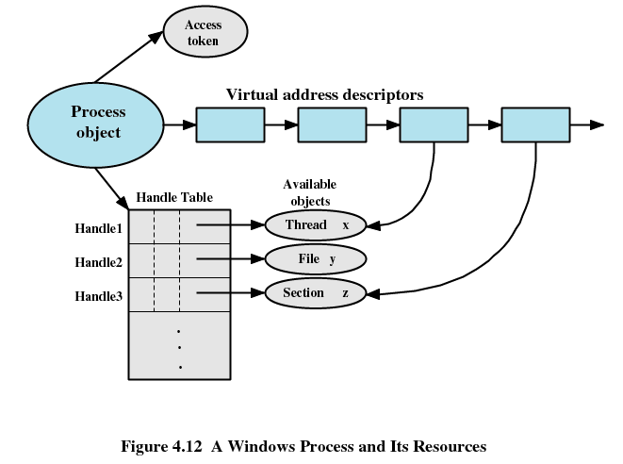
Windows Process and its Resources

Slide 31
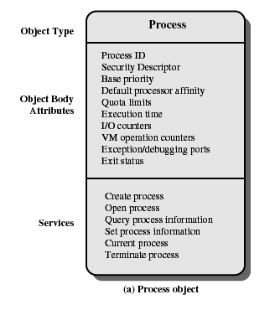
Windows Process Object

Slide 32
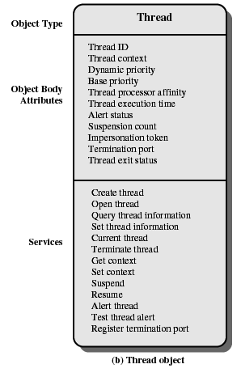
Windows Thread Object

Slide 33
Windows 2000 Thread States
Ready
Standby
Running
Waiting
Transition
Terminated

Slide 34
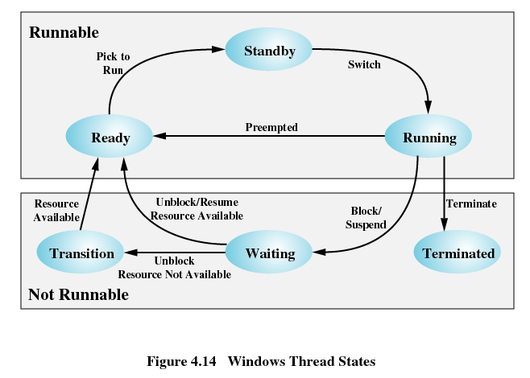
Windows Thread States

Slide 35
Solaris
Process includes the user’s address space, stack, and process control block
User-level threads
Lightweight processes (LWP)
Kernel threads

Slide 36
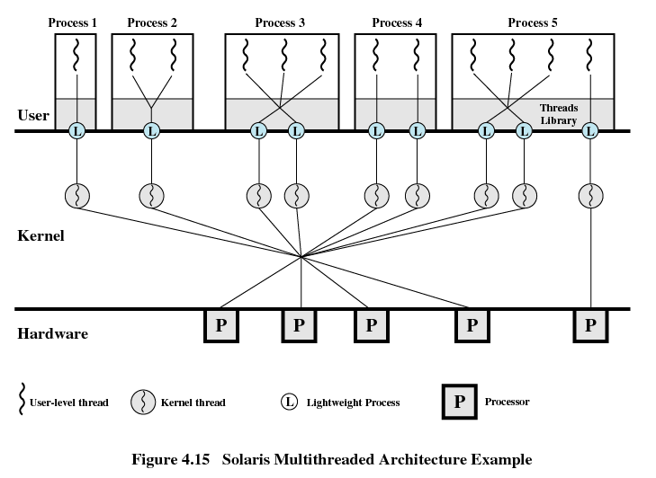
Solaris Multithreaded Architecture

Slide 37
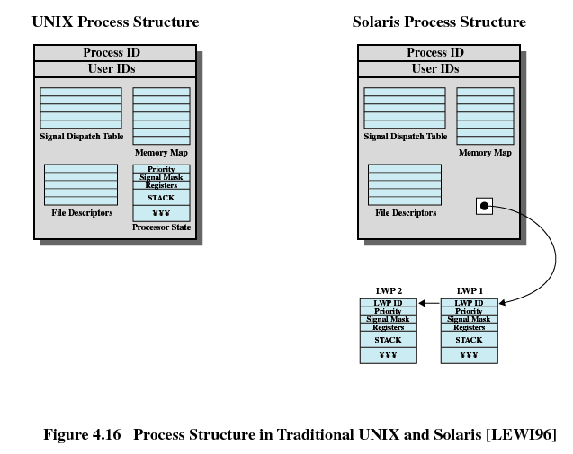
Process Structure in Traditional Unix

Slide 38
Solaris Lightweight Data Structure
Identifier
Priority
Signal mask
Saved values of user-level registers
Kernel stack
Resource usage and profiling data
Pointer to the corresponding kernel thread
Pointer to the process structure

Slide 39
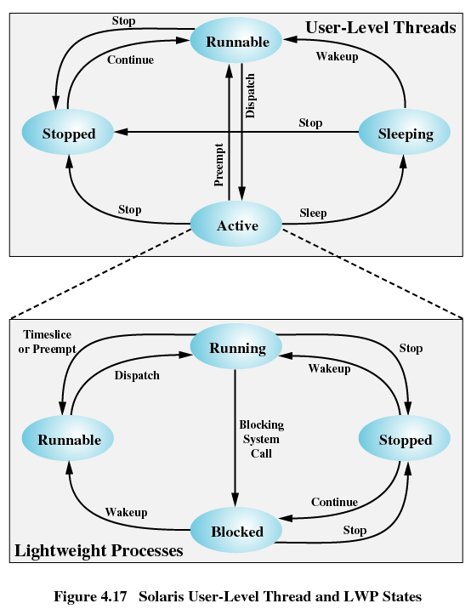
Solaris User-level Thread

Slide 40
Linux Task Data Structure
State
Scheduling information
Identifiers
Interprocess communication
Links
Times and timers
File system
Address space
Processor-specific context

Slide 41
Linux States of a Process
Running
Interruptable
Uninterruptable
Stopped
Zombie

Slide 42
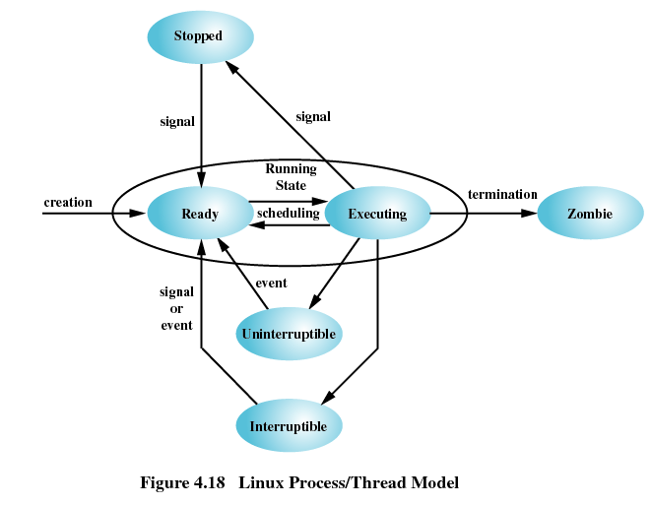
Linux States of a Process

