Slide 1
Concurrency: Mutual Exclusion and Synchronization
Chapter 5

Slide 2
Concurrency Overview
The central themes of operating system design are all concerned with the management of processes and threads:
  Multiprogramming
  Multiprocessing
  Distributed processing
Fundamental to operating system design is concurrency(并发)
The Basic requirement for support of concurrency is the ability to enforce mutual exclusion(互斥)

Slide 3
Concurrency Contexts(并发上下文)
Concurrency arises in three different contexts:
  Multiple applications
    Multiprogramming
  Structured application
    Application can be a set of concurrent processes or threads
  Operating-system structure
    Operating system is a set of processes or threads

Slide 4
Design Issues of Concurrency
Communication among processes
Sharing and competing(竞争) of resources
Synchronization of the activities of multiple processes
Allocation of processor time to processes

Slide 5
Principles of Concurrency
Interleaving
Overlapping
Basic characteristic of multiprogramming systems: relative speed of execution of processes cannot be predicted

Slide 6
Difficulties of Concurrency
Sharing of global resources
  For example: Global variable
Operating system managing the allocation of resources optimally
  For example: I/O channel
Difficult to locate programming errors
  Program results are not deterministic and reproducible(再现)

Slide 7
A Simple Example
void echo()
{
chin = getchar();
chout = chin;
putchar(chout);
}
Process P1 Process P2
. .
chin = getchar(); .
. chin = getchar();
chout = chin; chout = chin;
putchar(chout); .
. putchar(chout);
. .

Slide 8
Race Condition(竞争条件)
When multiple processes or threads access shared resource so that the final result depends on the order of execution of instructions in the multiple processes
Murphy Law
  If Something can go wrong, it will.
Solution to Race Condition:
  Control access to the shared resource
Mutual Exclusion(互斥)

Slide 9
Process Interaction
Three possible degrees of awareness among processes:
  Processes unaware of each other
    Competition
  Processes indirectly aware of each other
    Cooperation
  Process directly aware of each other
    Cooperation

Slide 10
Competition Among Processes for Resources
Critical sections(临界区)
  Portion of the program that access shared resource
    Only one program at a time is allowed in its critical section
    Example only one process at a time is allowed to send command to the printer
Enforcement of mutual exclusion incurs two additional problems:
  Deadlock(死锁)
  Starvation(饥饿)

Slide 11
Mutual Exclusion
/*program mutualexclusion */
const int n=/*number of processes*/;
void P(int i)
{
while (true)
    {
    entercritical (i);
        /*critical section */;
        exitcritical (i);
        /*remainder*/
      }
}
void main()
{
parbegin(P(1), P(2)…, P(n));
}

Slide 12
Requirements for Mutual Exclusion
Only one process at a time is allowed in the critical section for a resource
A process that halts in its noncritical section(非临界区) must do so without interfering with other processes
No deadlock or starvation

Slide 13
Requirements for Mutual Exclusion(Cont.)
A process must not be delayed access to a critical section when there is no other process using it
No assumptions are made about relative process speeds or number of processes
A process remains inside its critical section for a finite time only

Slide 14
Lock Variables(锁变量)
The simplest approach we can imagine
How does it work?

Slide 15
Mutual Exclusion:Hardware Support
Interrupt Disabling(关中断)
  A process runs until it invokes an operating system service or until it is interrupted
  Disabling interrupts guarantees mutual exclusion
  Processor is limited in its ability to interleave programs
  Multiprocessing
    disabling interrupts on one processor will not guarantee mutual exclusion

Slide 16
Mutual Exclusion:Hardware Support
Special Machine Instructions
  Performed in a single instruction cycle
  Access to the memory location is blocked for any other instructions
Test and Set Instruction
Exchange Instruction

Slide 17
Test and Set Instruction
boolean testset (int i)
{
if (i == 0) {
i = 1;
return true;
}
else {
return false;
}
}

Slide 18
Exchange Instruction
void exchange(int register, int memory)
{
int temp;
temp = memory;
memory = register;
register = temp;
}

Slide 19
Test and Set for Mutual Exclusion
/*program mutualexclusion*/
const int n = /* number of processes */;
int bolt;
void P(int i)
{
while (true)
{
while (!testset (bolt)) /* do nothing */;
/* critical section */;
bolt = 0;
/* remainder */
}
}
void main()
{
bolt = 0;
parbegin (P(1), P(2), . . . ,P(n));
}

Slide 20
Exchange for Mutual Exclusion
/*program mutualexclusion*/
const int n = /* number of processes */;
int bolt;
void P(int i)
{
int keyi = 1;
while (true)
{
do exchange(keyi, bolt) while (keyi != 0);
/* critical section */;
exchange(keyi, bolt);
/* remainder */
}
}
void main()
{
bolt = 0;
parbegin (P(1), P(2), . . . ,P(n));
}

Slide 21
Exchange for Mutual Exclusion
/*program mutualexclusion*/
const int n = /* number of processes */;
int bolt;
void P(int i)
{
int keyi = 1;
while (true)
{
while (keyi != 0) exchange(keyi, bolt);
/* critical section */;
exchange(keyi, bolt);
/* remainder */
}
}
void main()
{
bolt = 0;
parbegin (P(1), P(2), . . . ,P(n));
}

Slide 22
Advantages of Machine-instruction Approach
Applicable to any number of processes on either a single processor or multiple processors sharing main memory
It is simple and therefore easy to verify
It can be used to support multiple critical sections

Slide 23
Disadvantages of Machine-instruction Approach
Busy-waiting(忙等待) consumes processor time
Starvation is possible when a process leaves a critical section and more than one process is waiting.
Deadlock
  If a low priority process has the critical region and a higher priority process needs, the higher priority process will obtain the processor to wait for the critical region
  Priority Inversion Problem(优先级翻转问题)

Slide 24
Semaphores(信号量)
1965, Dijkstra
Special variable called a semaphore is used for signaling
Two primitives(原语) are defined:
  Wait operation decrements the semaphore value
  Signal operation increments semaphore value
  P/V operations
  Down/Up operations
Two kinds of semaphores:
  counting semaphores: can take on any non-negative value
  binary semaphores: take on only the values 0 and 1.(Von a binary semaphore with value 1 has no effect.)

Slide 25
Semaphore Primitives
struct semaphore {
int count;
queueType queue;
}
void semWait (semaphore s)
{
s.count--;
if (s.count < 0) {
place this process in s.queue;
block this process
}
}
void semSignal (semaphore s)
{
s.count++;
if (s.count <= 0) {
remove a process P from s.queue;
place process P on ready list;
}
}

Slide 26
Example of Semaphore Mechanism
Processes A, B and C depend on the result of process D
Initially semaphore count is 1, indicating that only one of D’s results is available

Slide 27
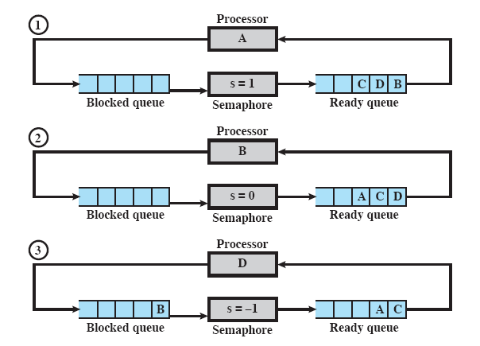
Example of Semaphore Mechanism

Slide 28
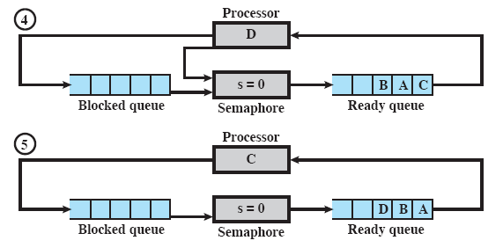
Example of Semaphore Mechanism

Slide 29
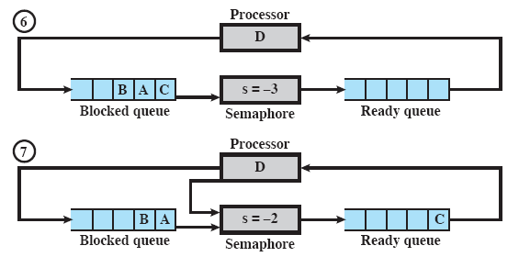
Example of Semaphore Mechanism

Slide 30
Mutual Exclusion Using Semaphores
/* program mutualexclusion */
const int n = /* number of processes */;
semaphore mutex = 1;
void P (int i)
{
while (true)
{
semWait (mutex);
/* critical section */;
semSignal (mutex);
/* remainder */;
}
}
void main()
{
parbegin (P(1), P(2), . . ., P(n));
}

Slide 31
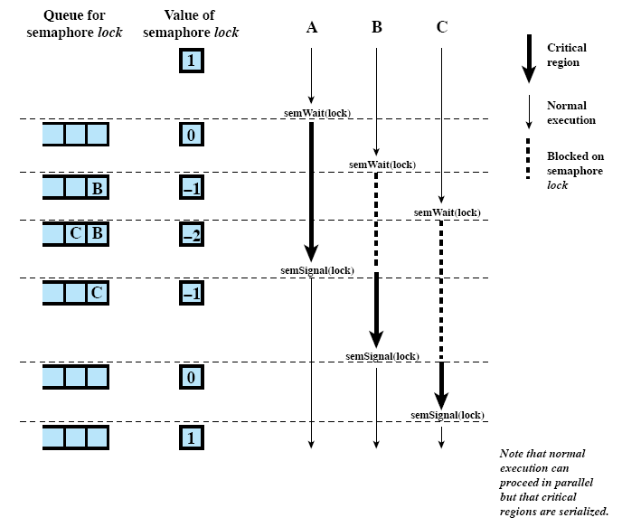
Processes Accessing Shared Data Protected by a Semaphore

Slide 32
Producer/Consumer Problem
One or more producers are generating data and placing these in a buffer
A single consumer is taking items out of the buffer one at time
Only one producer or consumer may access the buffer at any one time
Buffer Pool
Producer
Consumer
….

Slide 33
Producer/Consumer Problem
#define N 100
semaphore mutex = 1;
semaphore empty = N;
semaphore full = 0;
void producer(void)
{
int item;
while(true){
produce_item(&Item);
semWait(&empty);
semWait(&mutex);
enter_item(item);
semSignal(&mutex);
semSignal(&full);
}
}
void consumer(void)
{
int item;
while(true){
semWait(&full);
semWait(&mutex);
remove_item(&item);
semSignal(&mutex);
semSignal(&empty)
consume_item(item);
}
}

Slide 34
Producer/Consumer Problem
#define N 100
semaphore mutex = 1;
semaphore empty = N;
semaphore full = 0;
void producer(void)
{
int item;
while(true){
produce_item(&Item);
semWait(&mutex);
semWait(&empty);
enter_item(item);
semSignal(&mutex);
semSignal(&full);
}
}
void consumer(void)
{
int item;
while(true){
semWait(&full);
semWait(&mutex);
remove_item(&item);
semSignal(&mutex);
semSignal(&empty)
consume_item(item);
}
}

Slide 35
Monitors(管程)
Monitor is a software module consisting of one or more procedures, an initialization sequence, and local data
Chief characteristics
  Local data variables are accessible only by the monitor’s procedures and not by any external procedure
  Process enters monitor by invoking one of its procedures
  Only one process may be executing in the monitor at a time

Slide 36
Condition Variables
Condition variable are a special data type in monitors, which are operated on by two operations:
  cwait(c): suspend execution of the calling process on condition c. The monitor is now available for use by another process
  csignal(c): resume execution of some process blocked after a cwait on the same condition. If there are several such processes, choose one of them; if there is no such process, do nothing.

Slide 37
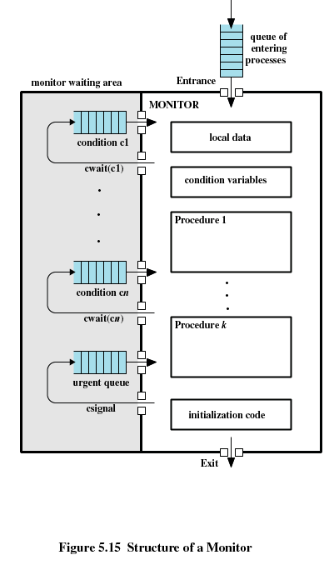
Structure of a Monitor

Slide 38
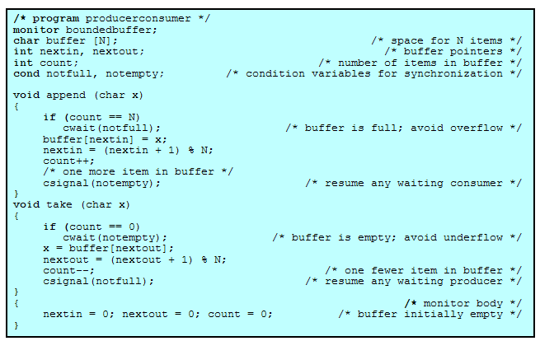
Producer/Consumer Problem

Slide 39
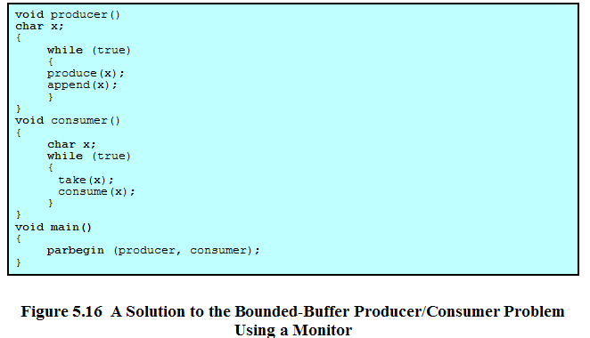
Producer/Consumer Problem

Slide 40
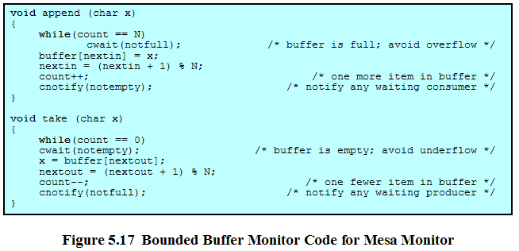
Mesa Monitor

Slide 41
Message Passing(消息传递)
Enforce mutual exclusion
Exchange information
A pair of primitives is provided for message passing:
  send(destination, message)
  receive(source, message)

Slide 42
Design Issues Relating to Message-passing
Synchronization
Addressing
Message Format
Queuing Discipline

Slide 43
Synchronization
Sender and receiver may or may not be blocking (waiting for message)
Blocking send, blocking receive
  Both sender and receiver are blocked until message is delivered
  Called a rendezvous (会合)
Nonblocking send, blocking receive
  Sender continues on
  Receiver is blocked until the requested message arrives
Nonblocking send, nonblocking receive
  Neither party is required to wait

Slide 44
Addressing
Direct addressing
  Send primitive includes a specific identifier of the destination process
  Receive primitive could know ahead of time which process a message is expected
  Receive primitive could use source parameter to return a value when the receive operation has been performed

Slide 45
Addressing (cont.)
Indirect addressing
  Messages are sent to a shared data structure consisting of queues
  Queues are called mailboxes
  One process sends a message to the mailbox and the other process picks up the message from the mailbox

Slide 46
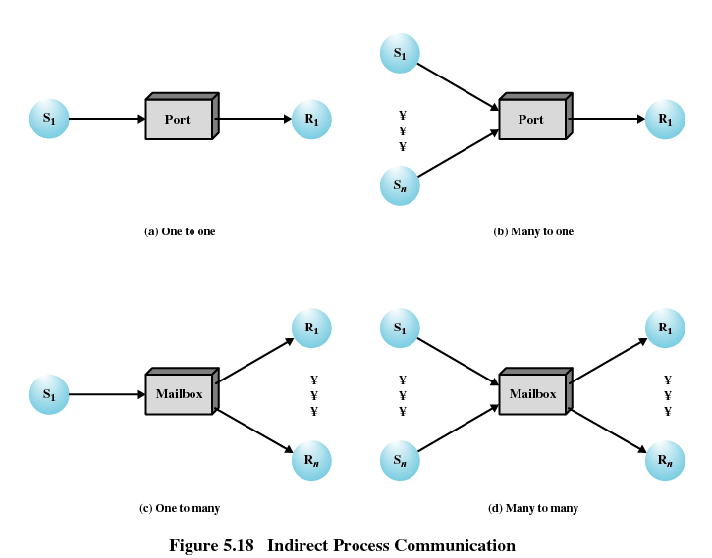
Indirect Process Communication

Slide 47
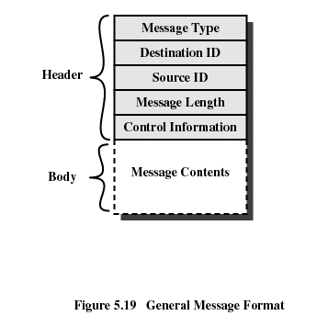
Message Format

Slide 48
Queuing Discipline
FIFO
Priority-based strategies

Slide 49
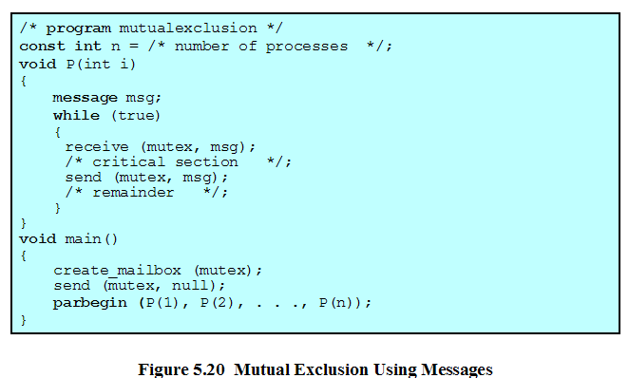
Mutual Exclusion Using Messages

Slide 50
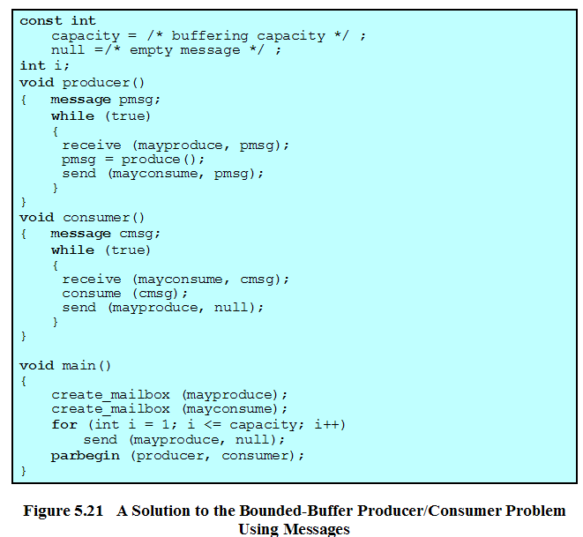
Solution to Producer/Consumer

Slide 51
Readers/Writers Problem
Any number of readers may simultaneously read the file
Only one writer at a time may write to the file
If a writer is writing to the file, no reader may read it

Slide 52
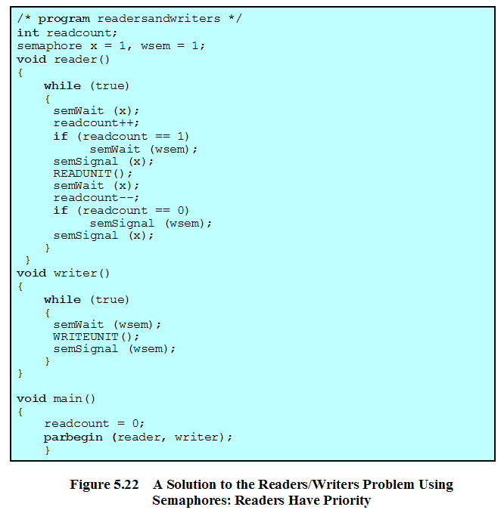
Readers/Writers Problem

Slide 53
