Slide 1
Concurrency: Deadlock and Starvation
Chapter 6

Slide 2
Deadlock (死锁)
Permanent blocking(永久阻塞) of a set of processes that either compete for system resources or communicate with each other
No efficient solution
  Involve conflicting needs for resources by two or more processes

Slide 3
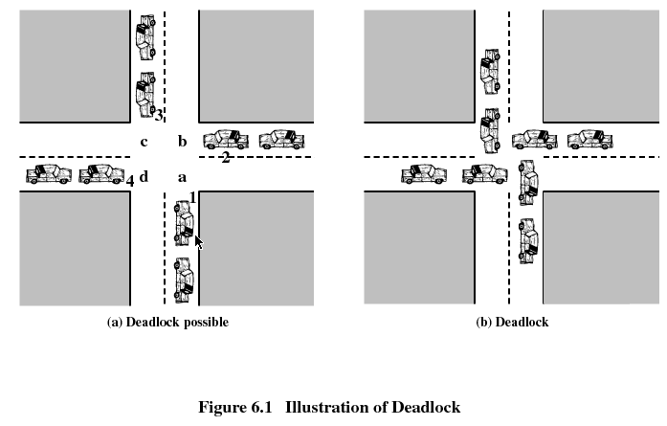
Illustration of Deadlock

Slide 4
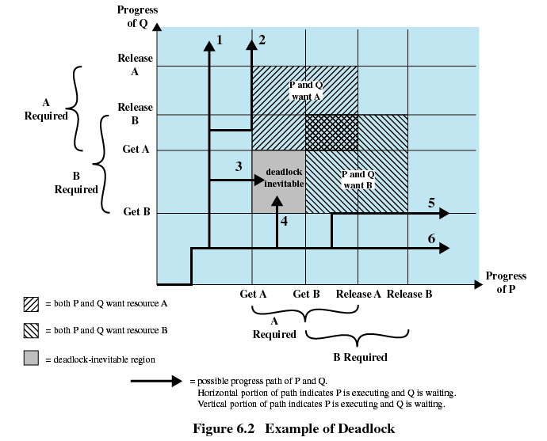
Example of Deadlock

Slide 5
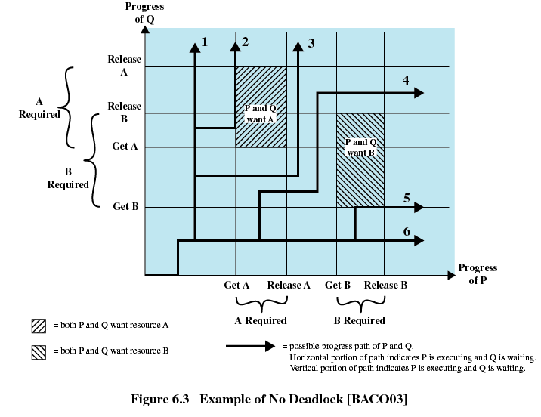
Example of Deadlock

Slide 6
Reusable Resources (可重用资源)
Used by only one process at a time and not depleted(耗尽) by that use
Processes obtain resources that they later release for reuse by other processes
Deadlock occurs if each process holds one resource and requests the other
Possible Reusable Resources: processors, I/O channels, main and secondary memory, devices, and data structures such as files, databases, and semaphores

Slide 7
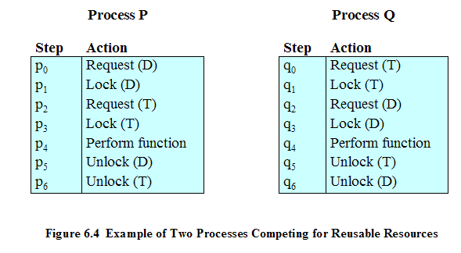
Example of Deadlock

Slide 8
Another Example of Deadlock
Space is available for allocation of 200Kbytes, and the following sequence of events occur
Deadlock occurs if both processes progress to their second request
P1
P2
. . .
. . .
Request 80 Kbytes;
Request 70 Kbytes;
. . .
. . .
Request 60 Kbytes;
Request 80 Kbytes;

Slide 9
Consumable Resources (可消耗的资源)
Can be created (produced) and destroyed (consumed)
When a resource is acquired by a consuming process, the resource ceased to exist
Examples of consumable resources: interrupts, signals, messages, and information in I/O buffers

Slide 10
Example of Deadlock
P1
P2
. . .
. . .
Receive(P2);
Receive(P1);
. . .
. . .
Send(P2, M1);
Send(P1, M2);
Deadlock occurs if receive is blocking
May take a rare combination of events to cause deadlock
No single effective strategy that can deal with all types of deadlock
  Prevention
  Avoidance
  Detection

Slide 11
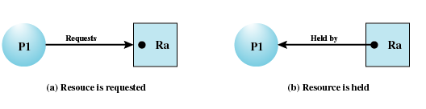
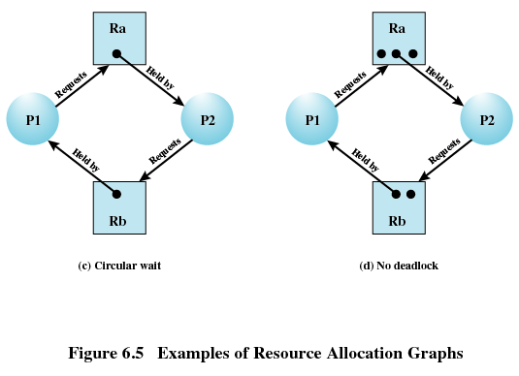
Resource Allocation Graphs
Directed graph that depicts a state of the system of resources and processes

Slide 12
Conditions for Deadlock
Mutual exclusion
  Only one process may use a resource at a time (一个资源在某个时间只能被一个进程使用)
Hold-and-wait
  A process may hold allocated resources while awaiting assignment of others
No preemption
  No resource can be forcibly removed from a process holding it
Circular wait
  A closed chain of processes exists, such that each process holds at least one resource needed by the next process in the chain

Slide 13
Possibility and Existence of Deadlock
Possibility of Deadlock
  Mutual Exclusion
  No preemption
  Hold and wait
Existence of Deadlock
  Mutual Exclusion
  No preemption
  Hold and wait
  Circular wait
Necessary Conditions
Sufficient Conditions

Slide 14
Deadlock Prevention (死锁预防)
The strategy of deadlock prevention is to design a system in such a way that the possibility of deadlock is excluded
Indirect method
  prevent the occurrence of one of the three necessary conditions
Direct method
  prevent the occurrence of a circular wait

Slide 15
Deadlock Prevention (死锁预防)
Mutual Exclusion
  Spooling
  File read and write (must be supported by the operating system)
Hold and Wait
  Require a process request all of its required resources at one time and blocking the process until all requests can be granted simultaneously
    Inefficient
    impractical

Slide 16
Deadlock Prevention (死锁预防)
No Preemption
  Process must release resource and request again
  Operating system may preempt a process to require it releases its resources
  Practical only when applied to resources whose state can be easily saved and restored later
Circular Wait
  Define a linear ordering of resource types

Slide 17
Deadlock Prevention (死锁预防)
Constrain resource requests to prevent at least one of the four conditions of deadlock
Leads to inefficient use of resources and inefficient execution of processes

Slide 18
Deadlock Avoidance (死锁避免)
Allows the three necessary conditions but makes judicious choices to assure that the deadlock point is never reached
Avoidance allows more concurrency than prevention
A decision is made dynamically whether the current resource allocation request will, if granted, potentially lead to a deadlock
Requires knowledge of future process request

Slide 19
Approaches to Deadlock Avoidance
Do not start a process if its demands might lead to deadlock
  Process initiation denial
Do not grant an incremental resource request to a process if this allocation might lead to deadlock
  Resource allocation denial

Slide 20
Resource Allocation Denial
Referred to as the banker’s algorithm(银行家算法)
State of the system is the current allocation of resources to process
Safe state is where there is at least one sequence that does not result in deadlock
Unsafe state is a state that is not safe

Slide 21
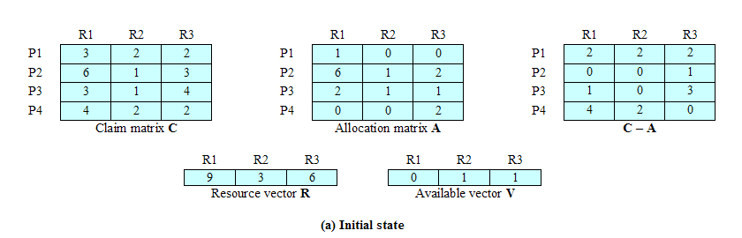
Determination of a Safe State

Slide 22
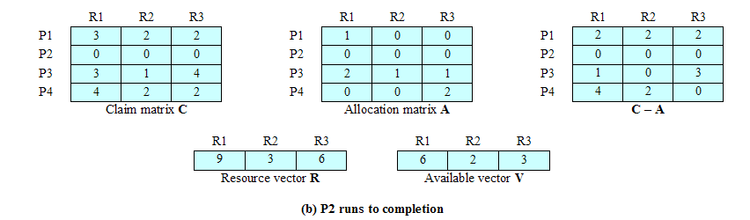
Determination of a Safe State

Slide 23
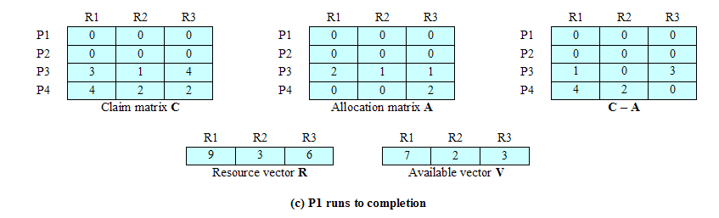
Determination of a Safe State

Slide 24
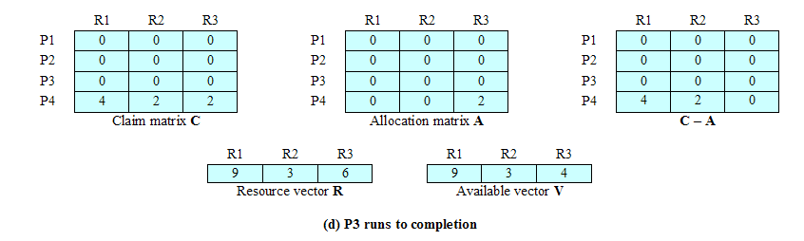
Determination of a Safe State

Slide 25
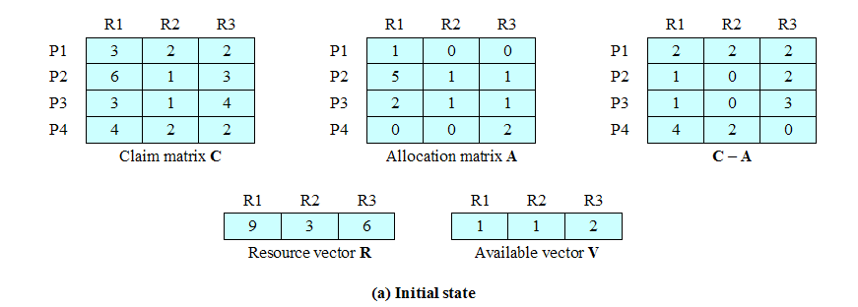
Determination of an Unsafe State

Slide 26
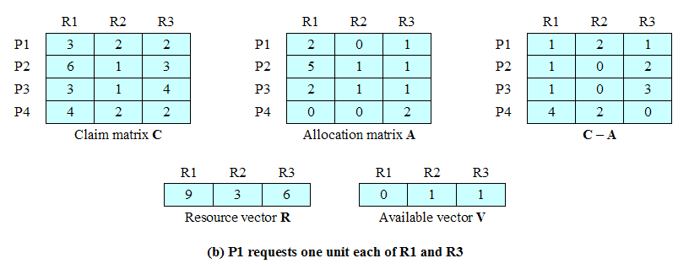
Determination of an Unsafe State

Slide 27
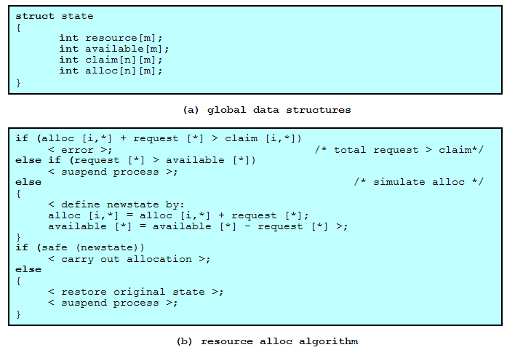
Deadlock Avoidance Logic

Slide 28
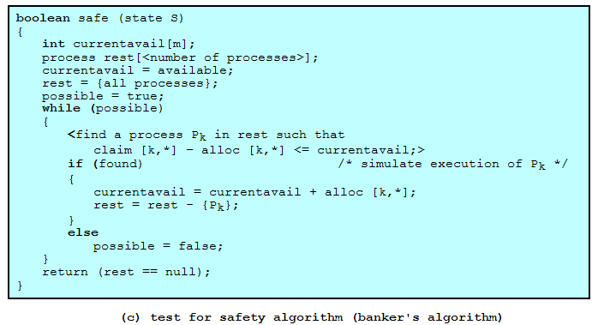
Deadlock Avoidance Logic

Slide 29
Restrictions to Deadlock Avoidance
Maximum resource requirement must be stated in advance
Processes under consideration must be independent; no synchronization requirements
There must be a fixed number of resources to allocate
No process may exit while holding resources

Slide 30
Deadlock Detection
Deadlock prevention strategies are very conservative(保守)
Deadlock detection strategies do not limit resource access or restrict process actions
  Requested resources are granted to processes whenever possible
Operating system performs an algorithm that allows it to detect the circular wait condition

Slide 31
Deadlock Detection Algorithm
Allocation matrix A, Available vector and Request matrix Q
Coff 71 algorithm:
  Mark each process that has a row in the allocation matrix of all zeros
  Initialize a temporary vector W to equal to Available vector
  Find an index i such that process i is currently unmarked and the ith row of Q is less then or equal to W. If no such row is found, terminate the algorithm
  If such a row is found, mark process i and add the corresponding row of the allocation matrix to W. Return to step 3

Slide 32
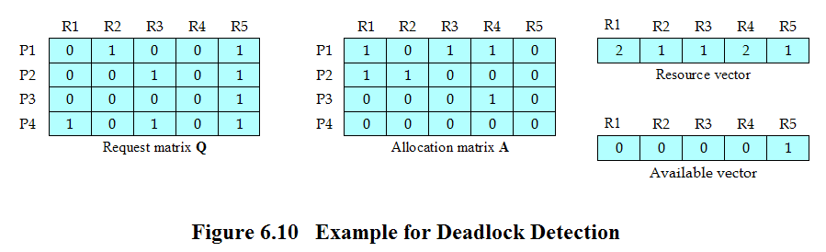
Deadlock Detection

Slide 33
Strategies once Deadlock Detected
Abort all deadlocked processes
Back up each deadlocked process to some previously defined checkpoint, and restart all process
  Original deadlock may occur
Successively abort deadlocked processes until deadlock no longer exists
Successively preempt resources until deadlock no longer exists

Slide 34
Selection Criteria Deadlocked Processes
Least amount of processor time consumed so far
Least number of lines of output produced so far
Most estimated time remaining
Least total resources allocated so far
Lowest priority

Slide 35
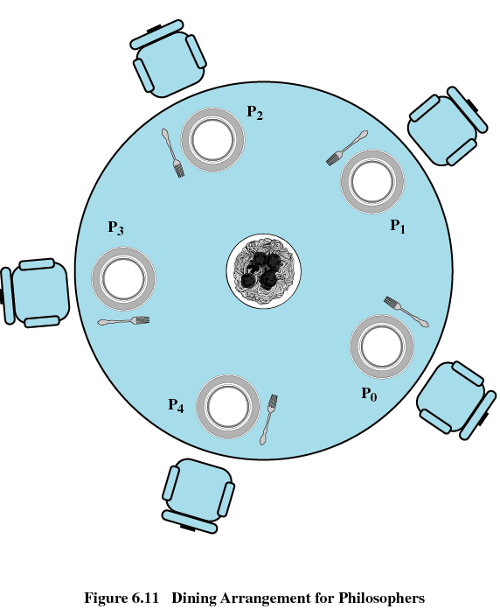
Dining Philosophers Problem

Slide 36
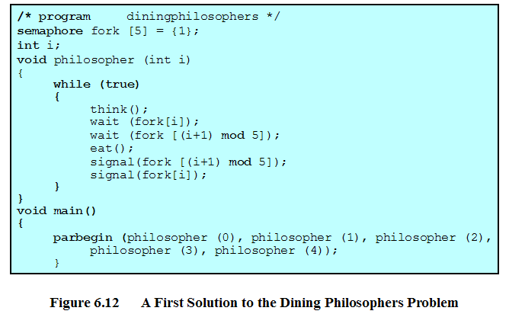
Dining Philosophers Problem

Slide 37
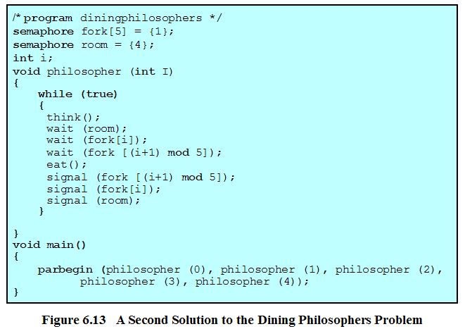
Dining Philosophers Problem

Slide 38
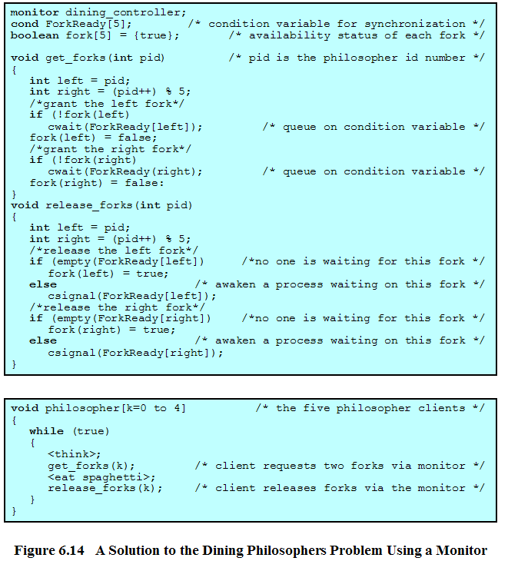
Dining Philosophers Problem

Slide 39
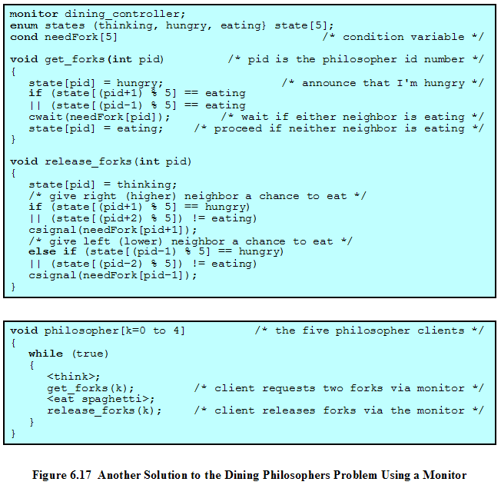
Dining Philosophers Problem

Slide 40
Dining Philosophers Problem
#define N 5
#define LEFT (i-1)%N
#define RIGHT (i+1)%N
#define THINKING 0
#define HUNGRY 1
#define EATING 2
int state[N];
semaphore mutex = 1;
semaphore s[N];
void philosopher(int i)
{
think();
take_forks(i);
eat();
put_forks(i);
}

Slide 41
Dining Philosophers Problem
void take_forks(int i)
{
down(&mutex);
state[i] = HUNGRY;
test(i);
up(&mutex);
down(&s[i]);
}
void put_forks(int i)
{
down(&mutex);
state[i] = THINKING;
test(LEFT);
test(RIGHT);
up(&mutex);
}

Slide 42
Dining Philosophers Problem
void test(int i)
{
if(state[i] == HUNGRY &&state[LEFT] != EATING
&& state[RIGHT] != EATING)
{
state[i] = EATING;
up(&s[i]);
}
}

Slide 43
UNIX Concurrency Mechanisms
Pipes
Messages
Shared memory
Semaphores
Signals

Slide 44
Linux Kernel Concurrency Mechanisms
Includes all the mechanisms found in UNIX
Atomic operations execute without interruption and without interference

Slide 45
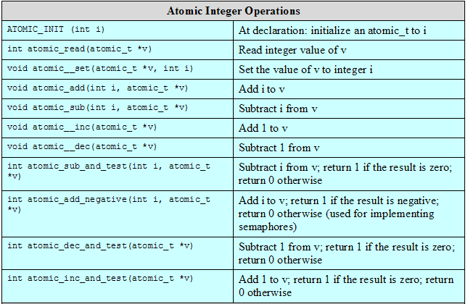
Linux Atomic Operations

Slide 46
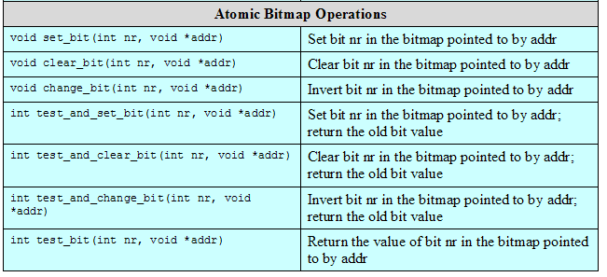
Linux Atomic Operations

Slide 47
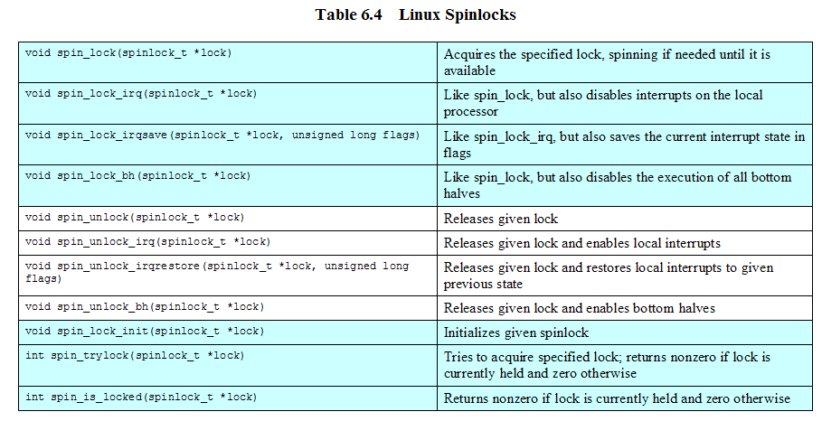
Linux Kernel Concurrency Mechanisms
Spinlocks
  Used for protecting a critical section

Slide 48
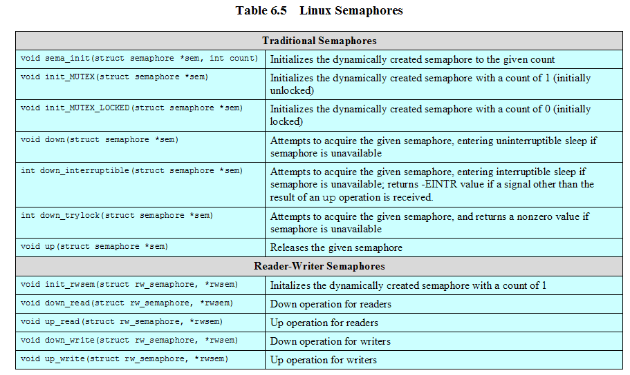
Linux Semaphores

Slide 49
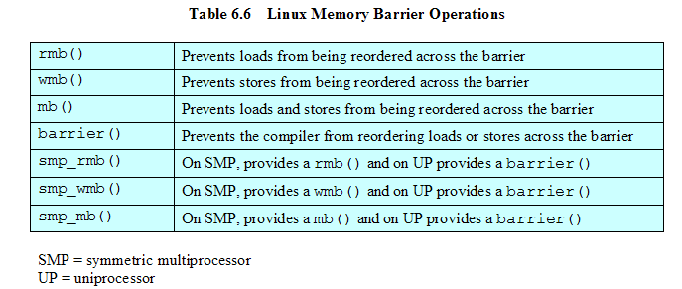
Linux Kernel Concurrency Mechanisms

Slide 50
Solaris Thread Synchronization Primitives
Mutual exclusion (mutex) locks
Semaphores
Multiple readers, single writer (readers/writer) locks
Condition variables

Slide 51
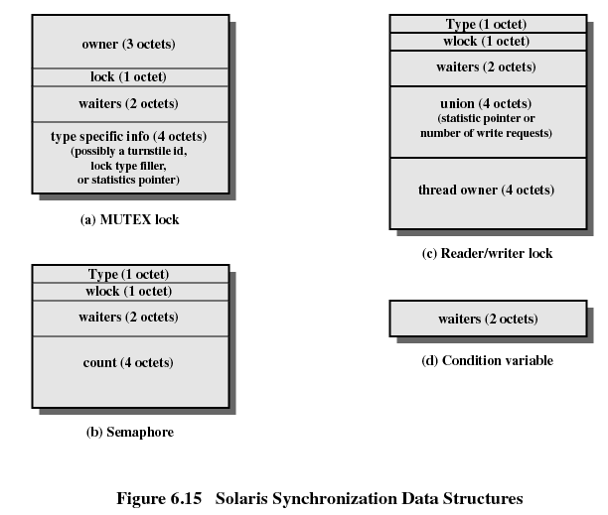
Solaris Synchronization Data Structures

Slide 52
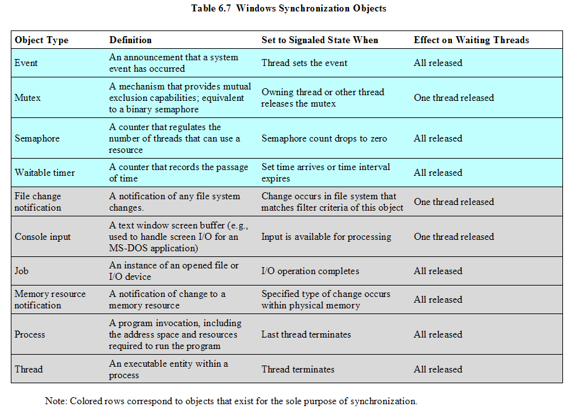
Windows Synchronization Objects

