Slide 1
Memory Management
Chapter 7

Slide 2
Basic Idea of Memory Management
Subdividing memory to accommodate multiple processes
Memory needs to be allocated to ensure a reasonable supply(合理供应) of ready processes to consume available processor time

Slide 3
Memory Management Requirements
Relocation(重定位)
Protection(保护)
Sharing(共享)
Logical Organization
Physical Organization

Slide 4
Relocation
Programmer does not know where the program will be placed in memory when it is executed
While the program is executing, it may be swapped to disk and returned to main memory at a different location (relocated)
Memory references must be translated in the code to actual physical memory address

Slide 5
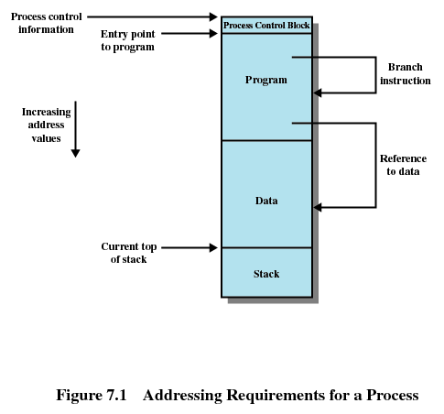
Addressing Requirements for a Process

Slide 6
Protection
Processes should not be able to reference memory locations in another process without permission
Impossible to check absolute addresses at compile time
Address reference must be checked at run time
Memory protection requirement must be satisfied by the processor (hardware) rather than the operating system (software)
  Operating system cannot anticipate all of the memory references a program will make

Slide 7
Sharing
Allow several processes to access the same portion of memory
  Better to allow each process access to the same copy of the program rather than have their own separate copy

Slide 8
Logical Organization
Programs are written in modules
Modules can be written and compiled independently
Different degrees of protection given to modules (read-only, execute-only)
Share modules among processes

Slide 9
Physical Organization
Memory available for a program plus its data may be insufficient
  Overlaying allows various modules to be assigned the same region of memory
Programmer does not know how much space will be available

Slide 10
Fixed Partitioning
Equal-size partitions
  Any process whose size is less than or equal to the partition size can be loaded into an available partition
  If all partitions are full, the operating system can swap a process out of a partition
  A program may not fit in a partition. The programmer must design the program with overlays(覆盖)
Main memory use is inefficient. Any program, no matter how small, occupies an entire partition. This is called internal fragmentation(内零头/内部碎片).

Slide 11
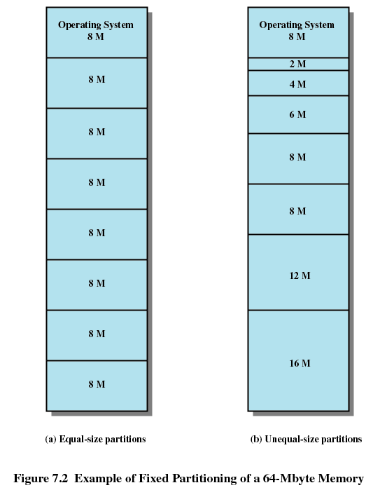
Example of Fixed Partitioning

Slide 12
Placement Algorithm with Partitions
Equal-size partitions
  Because all partitions are of equal size, it does not matter which partition is used
Unequal-size partitions
  Can assign each process to the smallest partition within which it will fit
  Queue for each partition
  Processes are assigned in such a way as to minimize wasted memory within a partition

Slide 13
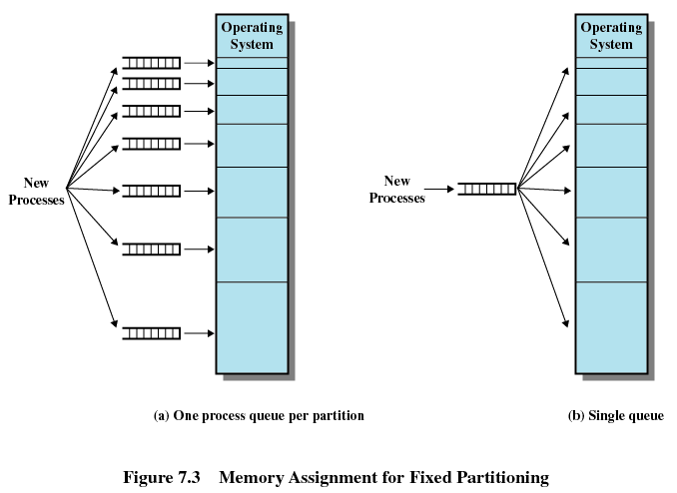
Memory Assignment for Fixed Partitioning

Slide 14
Dynamic Partitioning
Partitions are of variable length and number
Process is allocated exactly as much memory as required
Eventually get holes in the memory. This is called external fragmentation (外零头/外部碎片)
Must use compaction(紧缩) to shift processes so they are contiguous and all free memory is in one block

Slide 15
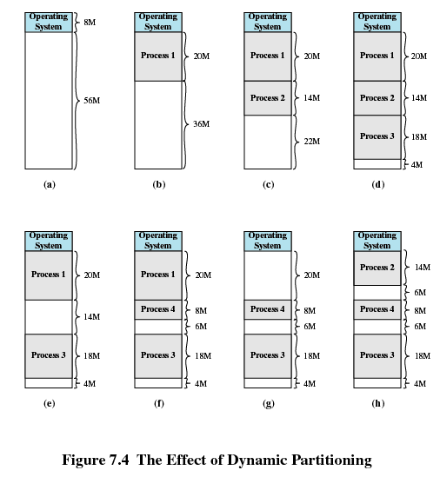
The Effect of Dynamic Partitioning

Slide 16
Dynamic Partitioning Placement Algorithm
Best-fit(最佳适配) algorithm
  Chooses the block that is closest in size to the request
  Worst performer overall
  Since smallest block is found for process, the smallest amount of fragmentation is left
  Memory compaction must be done more often

Slide 17
Dynamic Partitioning Placement Algorithm
First-fit(首次适配) algorithm
  Scans memory from the beginning and chooses the first available block that is large enough
  May have many process loaded in the front end of memory that must be searched over when trying to find a free block

Slide 18
Dynamic Partitioning Placement Algorithm
Next-fit(下次适配)
  Scans memory from the location of the last placement
  More often allocate a block of memory at the end of memory where the largest block is found
  The largest block of memory is broken up into smaller blocks
  Compaction is required to obtain a large block at the end of memory

Slide 19
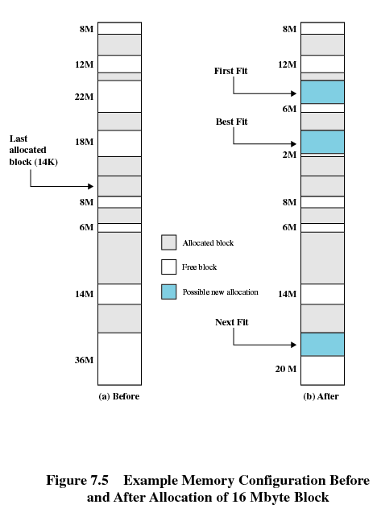
Example of Placement Algorithms

Slide 20
Buddy System
Entire space available is treated as a single block of 2^{U}
If a request of size s such that 2^{U-1} < s <= 2^{U}, entire block is allocated
  Otherwise block is split into two equal buddies
  Process continues until smallest block greater than or equal to s is generated

Slide 21
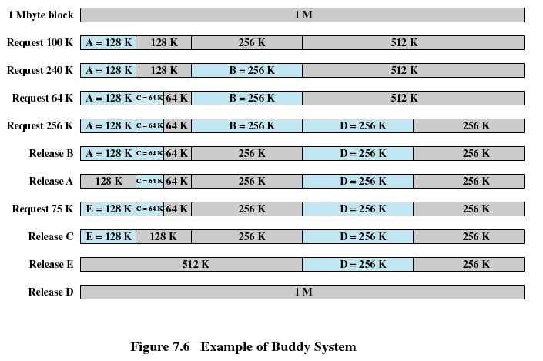
Example of Buddy System

Slide 22
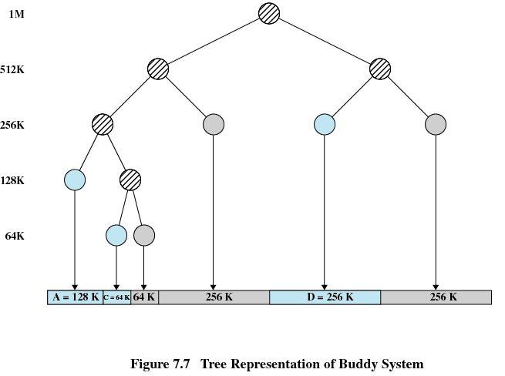
Tree Representation of Buddy System

Slide 23
Addresses
Logical
  Reference to a memory location independent of the current assignment of data to memory
  Translation must be made to the physical address
Relative
  Address expressed as a location relative to some known point
Physical
  The absolute address or actual location in main memory

Slide 24
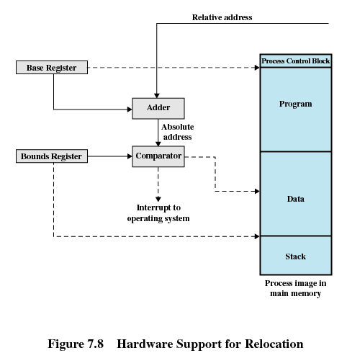
Hardware Support for Relocation

Slide 25
Registers Used during Execution
Base register
  Starting address for the process
Bounds register
  Ending location of the process
These values are set when the process is loaded or when the process is swapped in

Slide 26
Registers Used during Execution
The value of the base register is added to a relative address to produce an absolute address
The resulting address is compared with the value in the bounds register
If the address is not within bounds, an interrupt is generated to the operating system

Slide 27
Paging(分页)
Partition memory into small equal fixed-size chunks and divide each process into the same size chunks
The chunks of a process are called pages(页) and chunks of memory are called frames(页框)
Operating system maintains a page table for each process
  Contains the frame location for each page in the process
  Memory address consist of a page number and offset within the page

Slide 28
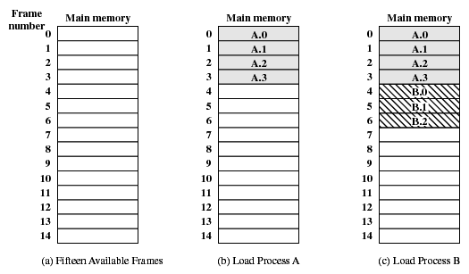
Assignment of Process Pages to Free Frames

Slide 29
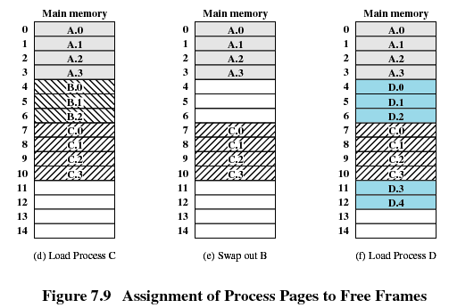
Assignment of Process Pages to Free Frames

Slide 30
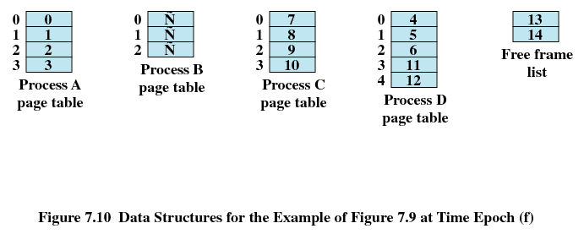
Page Tables for Example

Slide 31
Segmentation(分段)
All segments of all programs do not have to be of the same length
There is a maximum segment length
Addressing consist of two parts - a segment number and an offset
Since segments are not equal, segmentation is similar to dynamic partitioning

Slide 32
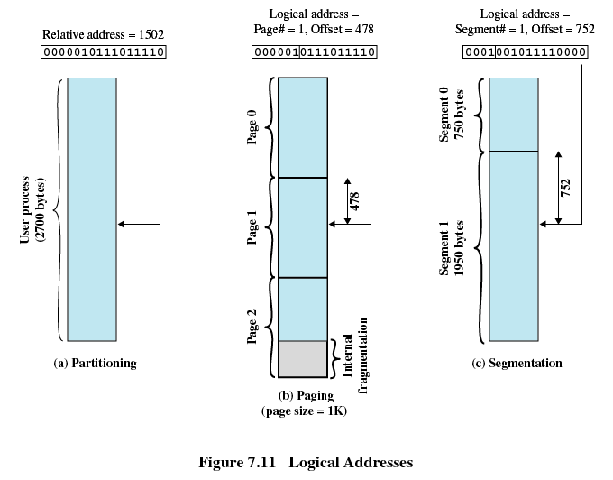
Logical Addresses

Slide 33
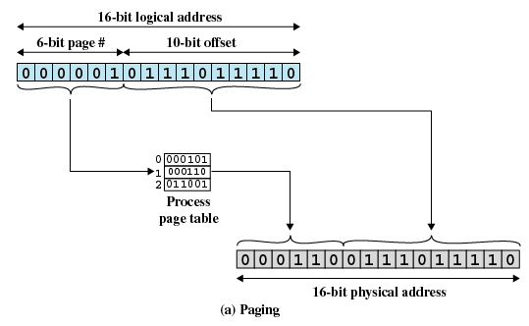
Paging

Slide 34
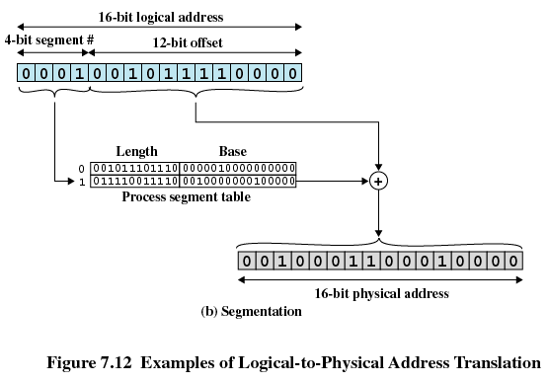
Address Translation

