Slide 1
Virtual Memory
Chapter 8

Slide 2
Basic Idea of Virtual Memory Management
A process may be swapped in and out of main memory such that it occupies different regions.
Memory references are dynamically translated into physical addresses at run time
A process may be broken up into pieces that do not need to located contiguously(连续的) in main memory
All pieces of a process do not need to be loaded in main memory during execution

Slide 3
Execution of a Program
Operating system only brings into main memory a few pieces of the program
Resident set(驻留集) - portion of process that is in main memory
An interrupt(Page Fault, 页面故障) is generated when an address is needed that is not in main memory. Operating system places the process in blocking state

Slide 4
Execution of a Program (Cont.)
Piece of process that contains the logical address is brought into main memory
  Operating system issues a disk I/O Read request
  Another process is dispatched to run while the disk I/O takes place
  An interrupt is issued when disk I/O complete which causes the operating system to place the affected process in the Ready state

Slide 5
Advantages of Breaking up a Process
More processes may be maintained in main memory
  Only load in some of the pieces of each process
  With so many processes in main memory, it is very likely a process will be in the Ready state at any particular time
A process may be larger than all of main memory

Slide 6
Principle of Locality(局部性原理)
Program and data references within a process tend to cluster
Only a few pieces of a process will be needed over a short period of time
Possible to make intelligent guesses about which pieces will be needed in the future
This suggests that virtual memory may work efficiently

Slide 7
Support Needed for Virtual Memory
Hardware must support paging and segmentation
Operating system must be able to manage the movement of pages and/or segments between secondary memory and main memory

Slide 8
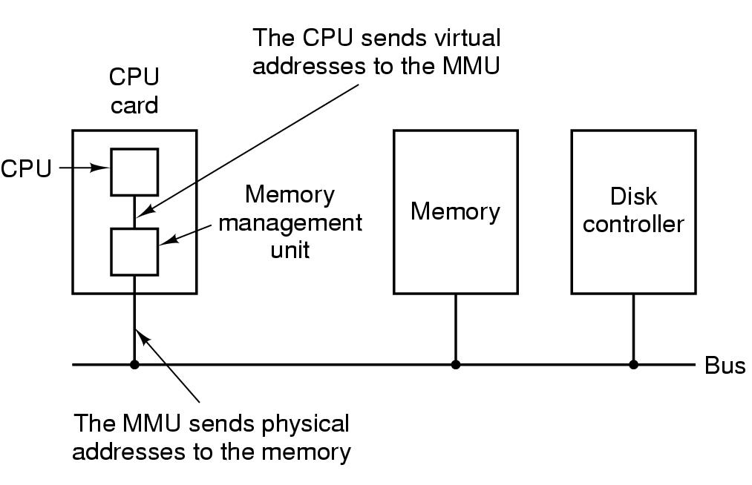
Paging

Slide 9
Paging
Each process has its own page table
Each page table entry contains the frame number of the corresponding page in main memory.
  A bit is needed in PTE to indicate whether the page is in main memory or not
Virtual Address Space

Slide 10
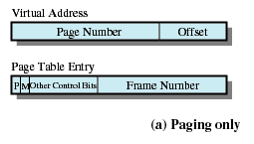

Virtual Address and Page Table Entry

Slide 11
Modify Bit in Page Table
Modify bit is needed to indicate if the page has been altered since it was last loaded into main memory
If no change has been made, the page does not have to be written to the disk when it needs to be swapped out

Slide 12
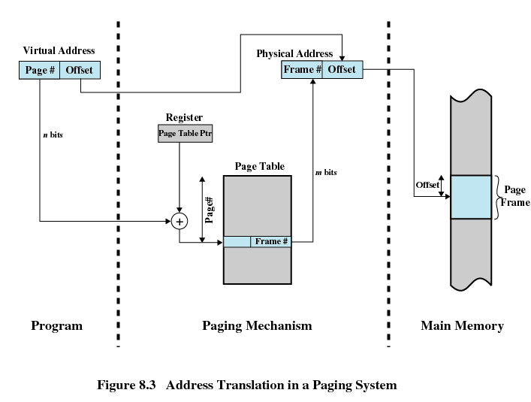
Address Translation(Mapping)

Slide 13
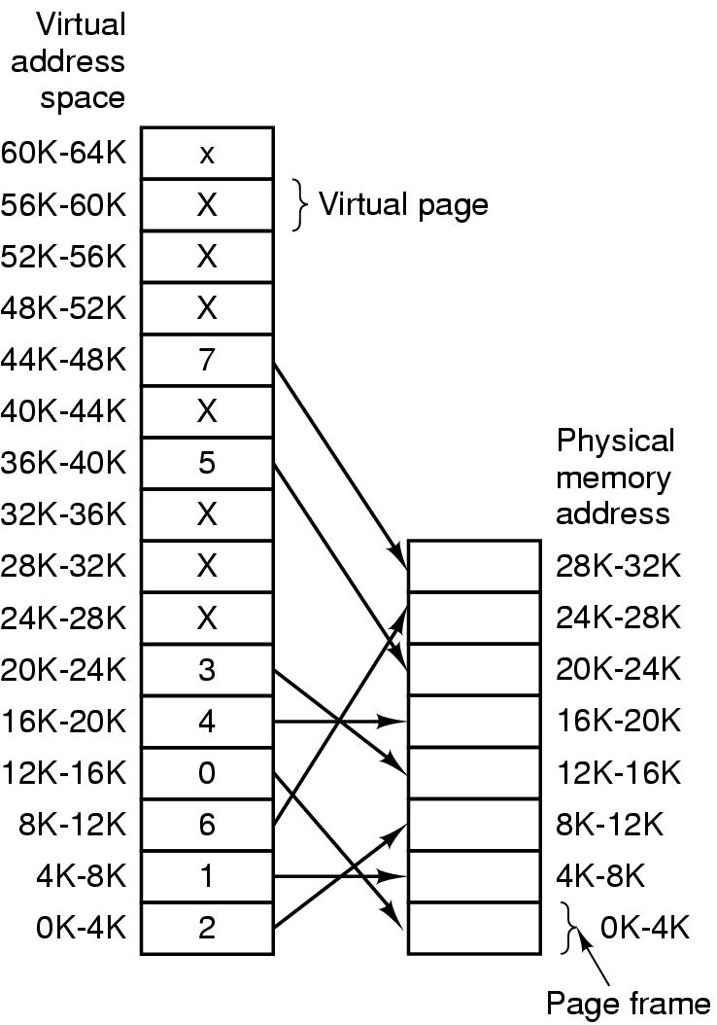
Address Translation (Cont.)

Slide 14

Address Translation (Cont.)

Slide 15
Page Tables
The entire page table may take up too much main memory
Page tables are also stored in virtual memory
When a process is running, part of its page table is in main memory

Slide 16
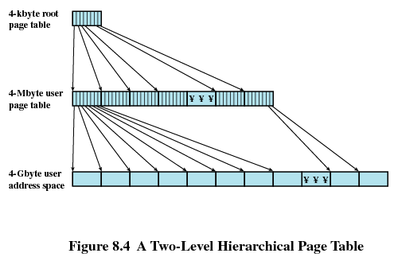
Two-Level Scheme for 32-bit Address

Slide 17

Two-Level Scheme

Slide 18
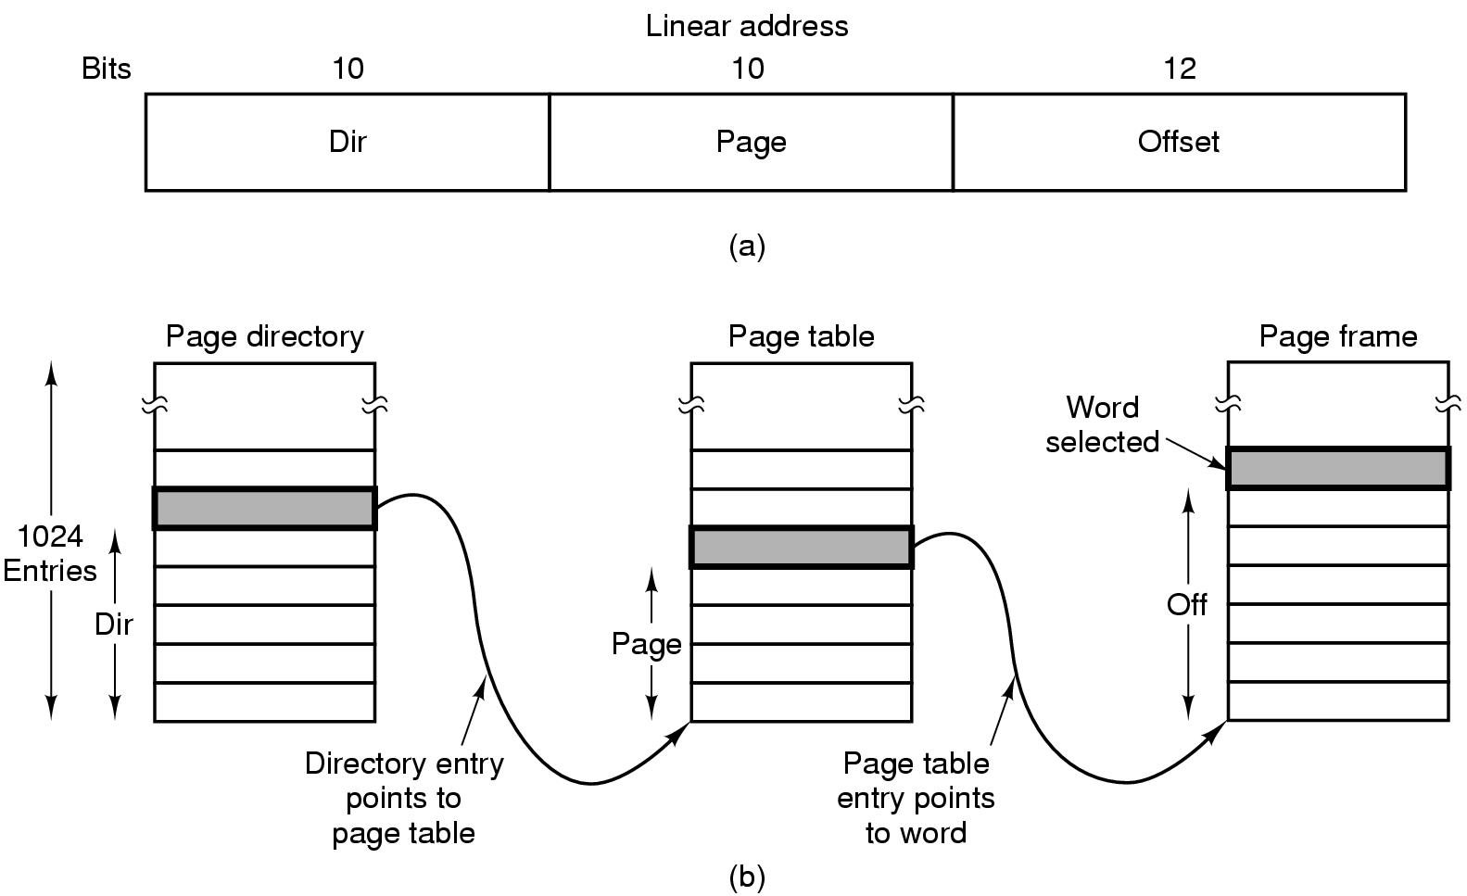
Two-Level Scheme

Slide 19
Inverted Page Table(逆向页表)
Used on PowerPC, UltraSPARC, and IA-64 architecture
Page number portion of a virtual address is mapped into a hash value
Hash value points to inverted page table
Fixed proportion of real memory is required for the tables regardless of the number of processes

Slide 20
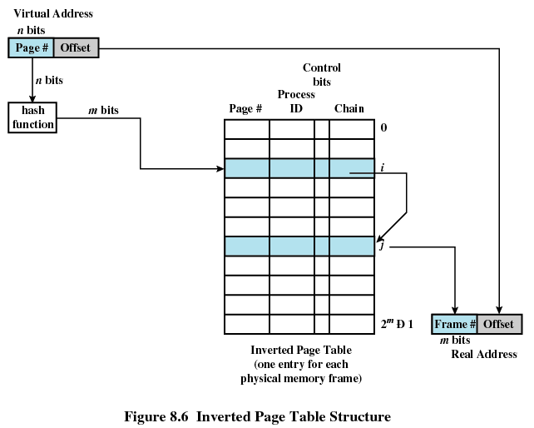
Inverted Page Table
Page number
Process identifier
Control bits
Chain pointer

Slide 21
Translation Lookaside Buffer
Each virtual memory reference can cause two physical memory accesses
  One to fetch the page table
  One to fetch the data
To overcome this problem a high-speed cache is set up for page table entries, called a Translation Lookaside Buffer (TLB)
TLB contains page table entries that have been most recently used

Slide 22
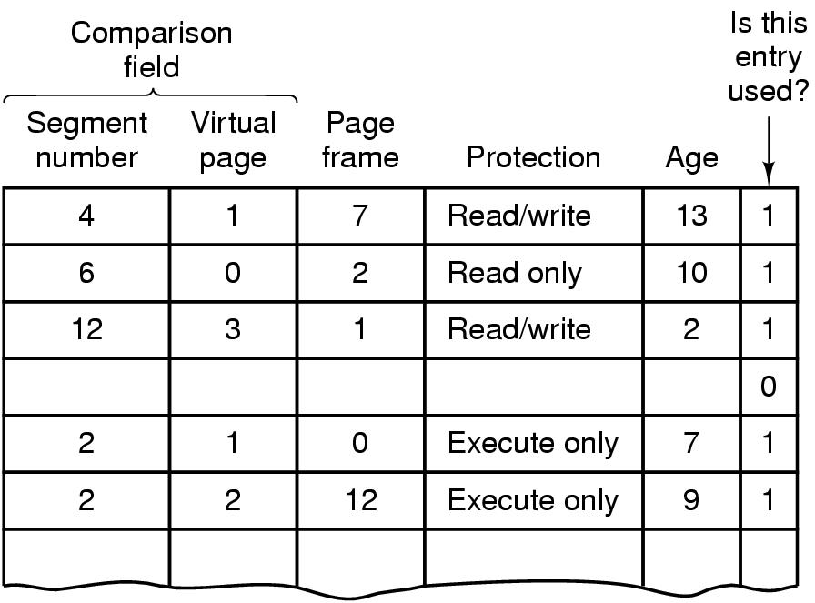
Translation Lookaside Buffer

Slide 23
Translation Lookaside Buffer
Given a virtual address, processor examines the TLB
If page table entry is present (TLB hit), the frame number is retrieved and the real address is formed
If page table entry is not found in the TLB (TLB miss), the page number is used to index the process page table

Slide 24
Translation Lookaside Buffer
First checks if page is already in main memory
  If not in main memory a page fault is issued
The TLB is updated to include the new page entry

Slide 25
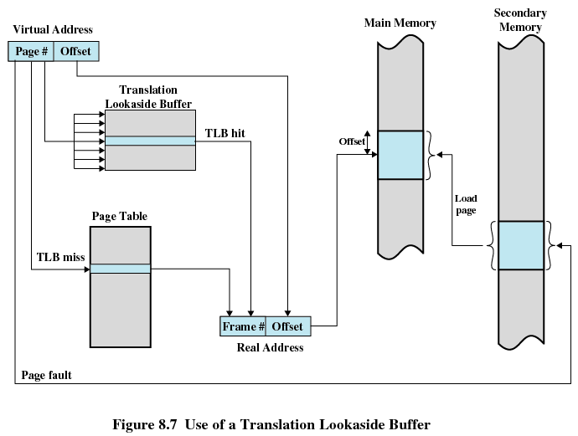
Translation Lookaside Buffer

Slide 26
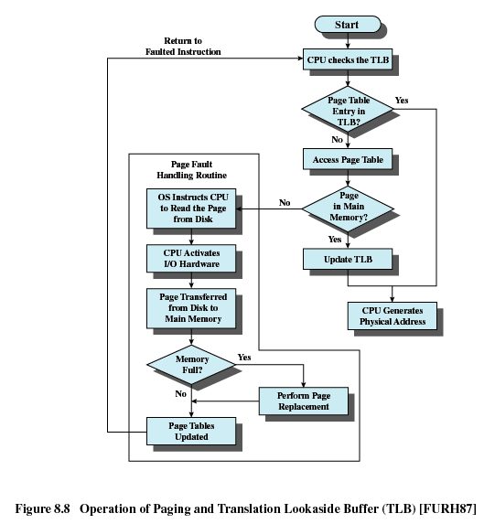
Translation Lookaside Buffer

Slide 27
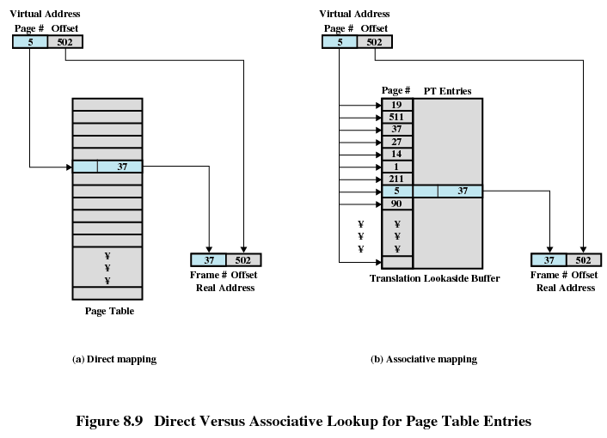
Translation Lookaside Buffer

Slide 28
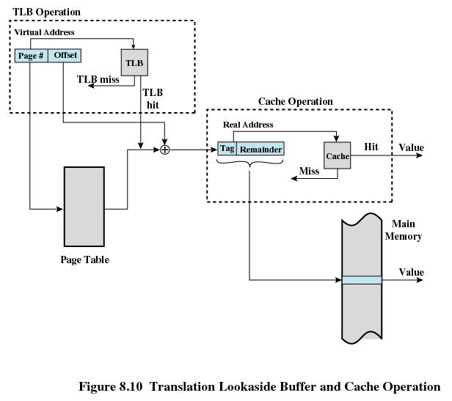
Translation Lookaside Buffer

Slide 29
Page Size
Smaller page size, less amount of internal fragmentation
Smaller page size, more pages required per process
More pages per process means larger page tables
Larger page tables means large portion of page tables in virtual memory
Secondary memory is designed to efficiently transfer large blocks of data so a large page size is better

Slide 30
Page Size
Small page size, large number of pages will be found in main memory
As time goes on during execution, the pages in memory will all contain portions of the process near recent references. Page faults low.
Increased page size causes pages to contain locations further from any recent reference. Page faults rise.

Slide 31
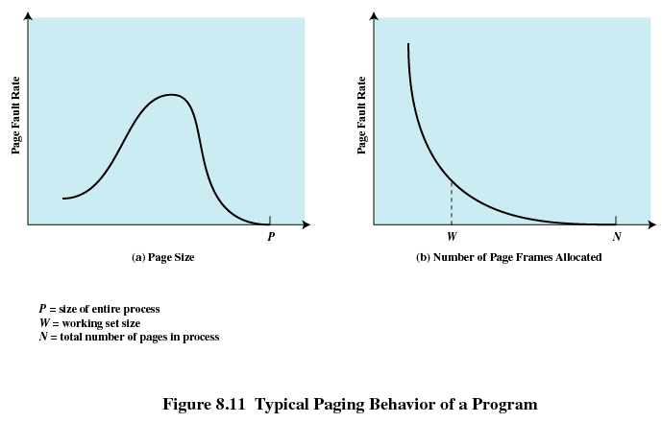
Paging Behavior of a Program

Slide 32
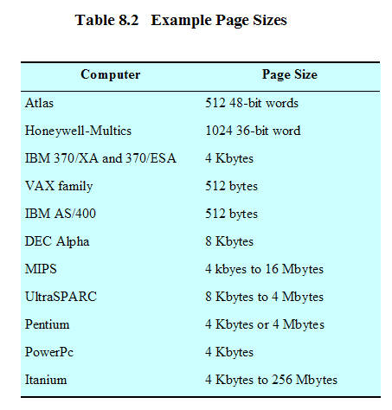
Example Page Sizes

Slide 33
Segmentation(分段)
May be unequal, dynamic size
Simplifies handling of growing data structures
Allows programs to be altered and recompiled independently
Lends itself to sharing data among processes
Lends itself to protection

Slide 34
Segment Tables
Corresponding segment in main memory
Each entry contains the length of the segment
A bit is needed to determine if segment is already in main memory
Another bit is needed to determine if the segment has been modified since it was loaded in main memory

Slide 35
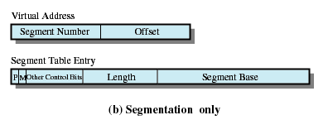
Segment Table Entries

Slide 36
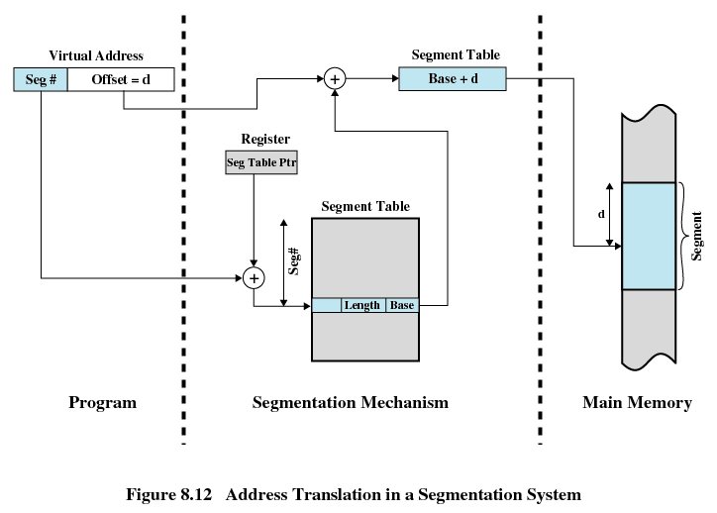
Address Translation in Segmentation System

Slide 37
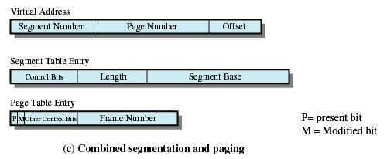
Combined Paging and Segmentation
Paging is transparent(透明) to the programmer
Segmentation is visible to the programmer
Each segment is broken into fixed-size pages

Slide 38
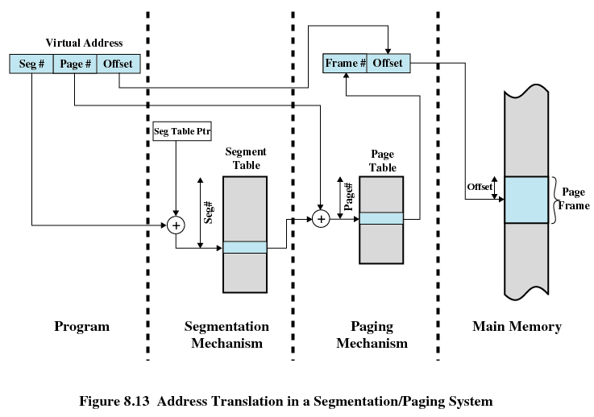
Combined Paging and Segmentation

Slide 39
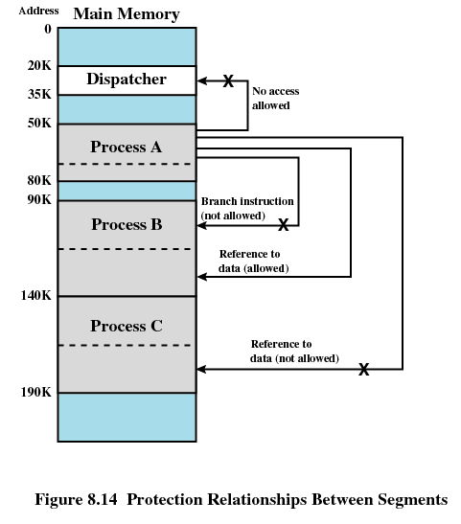
Protection Relationship Between Segments

Slide 40
Fetch Policy(页面何时调入)
Determines when a page should be brought into memory
Demand paging only brings pages into main memory when a reference is made to a location on the page
  Many page faults when process first started
Prepaging(预取) brings in more pages than needed
  More efficient to bring in pages that reside contiguously on the disk

Slide 41
Replacement Policy(替换策略)
Which page is replaced?
Page removed should be the page least likely to be referenced in the near future
Most policies predict the future behavior on the basis of past behavior
Thrashing(颠簸)
  Swapping out a piece of a process just before that piece is needed
  The processor spends most of its time swapping pieces rather than executing user instructions

Slide 42
Frame Locking
Some of the frames in main memory may be locked. When a frame is locked, it may not be replaced
  Kernel of the operating system
  Key control structures
  I/O buffers
Locking is achieved by associating a lock bit with each frame

Slide 43
Basic Replacement Algorithms
Optimal policy
Least Recently Used (LRU)
First-in, first-out (FIFO)
Clock Policy

Slide 44
Optimal Policy
Selects for replacement that page for which the time to the next reference is the longest
Impossible to have perfect knowledge of future events

Slide 45
Least Recently Used(最久未使用)
Replaces the page that has not been referenced for the longest time
By the principle of locality, this should be the page least likely to be referenced in the near future
Each page could be tagged with the time of last reference. This would require a great deal of overhead

Slide 46
First-In First-Out (FIFO)
Treats page frames allocated to a process as a circular buffer
Pages are removed in round-robin style
Simplest replacement policy to implement
Page that has been in memory the longest is replaced

Slide 47
Clock Policy
Additional bit called a use bit
When a page is first loaded in memory, the use bit is set to 1
When the page is referenced, the use bit is set to 1
When it is time to replace a page, the first frame encountered with the use bit set to 0 is replaced.
During the search for replacement, each use bit set to 1 is changed to 0

Slide 48
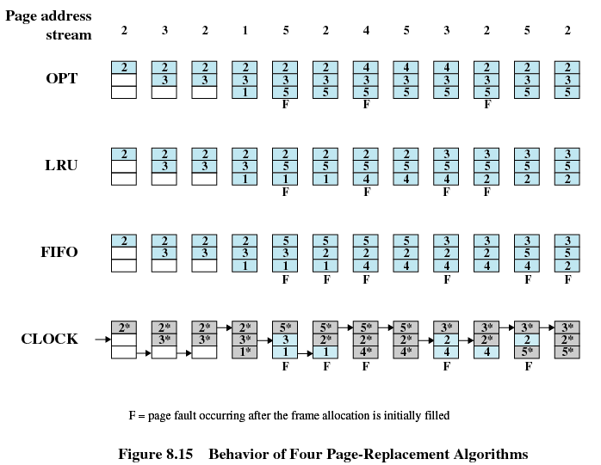
Four Page-Replacement Algorithms

Slide 49
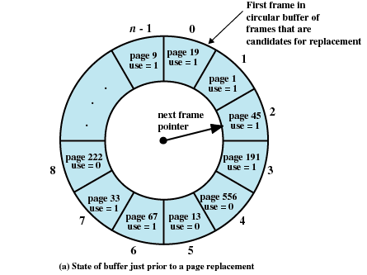
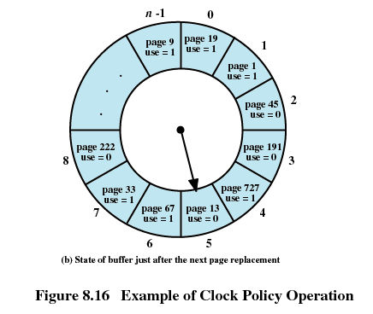
Example of Clock Policy

Slide 50
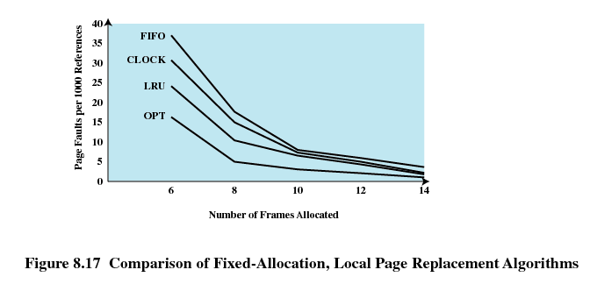
Comparison of Placement Algorithms

Slide 51
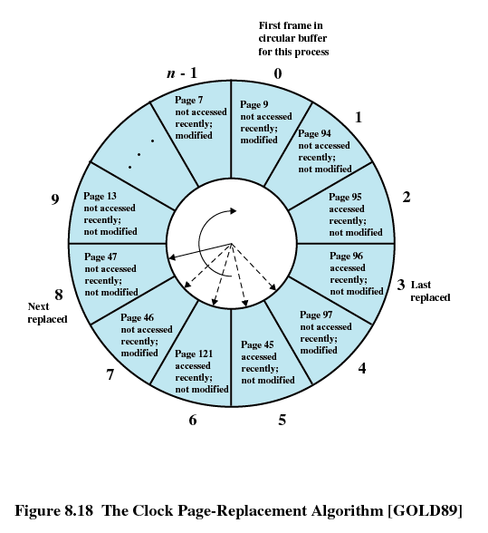
Clock Page-Replacement Algorithm

Slide 52
Page Buffering
Replaced page is added to one of two lists
  Free page list if page has not been modified
  Modified page list

Slide 53
Resident Set Size
Fixed-allocation
  Gives a process a fixed number of pages within which to execute
  When a page fault occurs, one of the pages of that process must be replaced
Variable-allocation
  Number of pages allocated to a process varies over the lifetime of the process

Slide 54
Fixed Allocation, Local Scope
Decide ahead of time the amount of allocation to give a process
If allocation is too small, there will be a high page fault rate
If allocation is too large there will be too few programs in main memory

Slide 55
Variable Allocation,Global Scope
Easiest to implement
Adopted by many operating systems
Operating system keeps list of free frames
Free frame is added to resident set of process when a page fault occurs
If no free frame, replaces one from another process

Slide 56
Variable Allocation,Local Scope
When new process added, allocate number of page frames based on application type, program request, or other criteria
When page fault occurs, select page from among the resident set of the process that suffers the fault
Reevaluate allocation from time to time

Slide 57
Cleaning Policy
Demand cleaning
  A page is written out only when it has been selected for replacement
Precleaning
  Pages are written out in batches

Slide 58
Cleaning Policy
Best approach uses page buffering
  Replaced pages are placed in two lists
    Modified and unmodified
  Pages in the modified list are periodically written out in batches
  Pages in the unmodified list are either reclaimed if referenced again or lost when its frame is assigned to another page

Slide 59
Load Control
Determines the number of processes that will be resident in main memory
Too few processes, many occasions when all processes will be blocked and much time will be spent in swapping
Too many processes will lead to thrashing

Slide 60
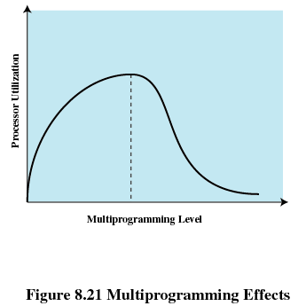
Multiprogramming Effects

Slide 61
Process Suspension
Lowest priority process
Faulting process
  This process does not have its working set in main memory so it will be blocked anyway
Last process activated
  This process is least likely to have its working set resident
Process with smallest resident set
  This process requires the least future effort to reload
Largest process
  Obtains the most free frames
Process with the largest remaining execution window

Slide 62
UNIX and Solaris Memory Management
Paging System
  Page table
  Disk block descriptor
  Page frame data table
  Swap-use table

Slide 63
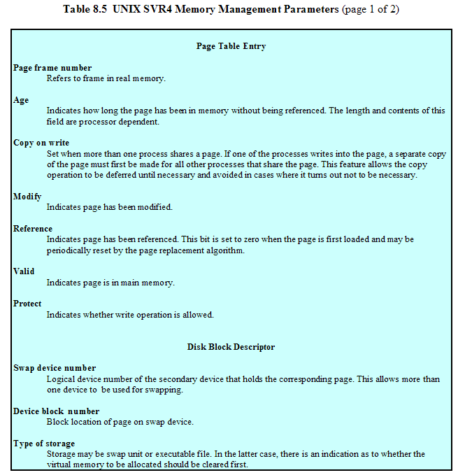

Slide 64
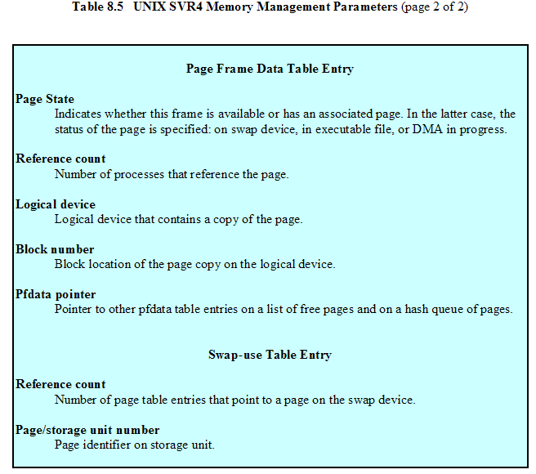

Slide 65
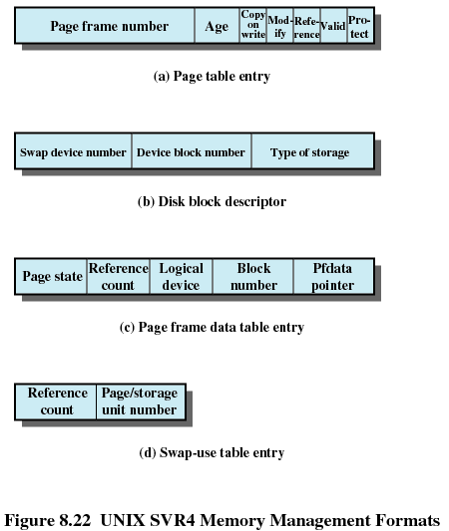

Slide 66
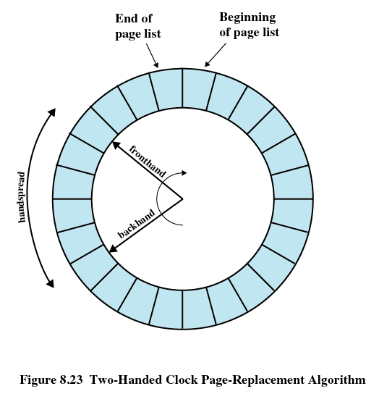
UNIX and Solaris Memory Management
Page Replacement
  Refinement of the clock policy

Slide 67
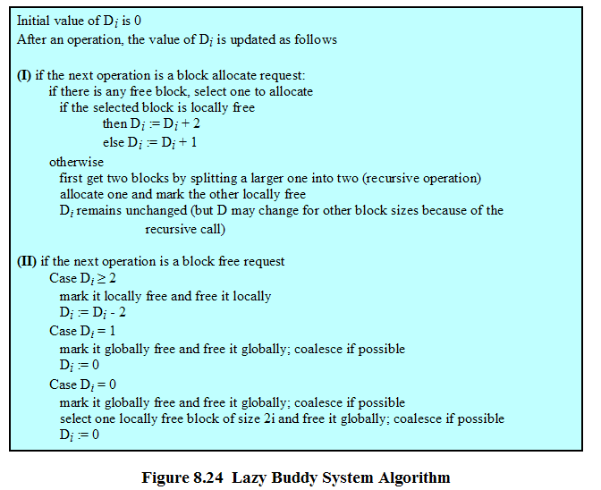
Kernel Memory Allocator
Lazy buddy system

Slide 68
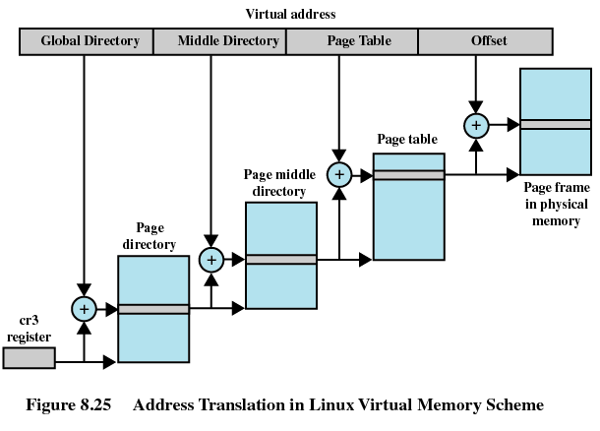
Linux Memory Management
Page directory
Page middle directory
Page table

Slide 69
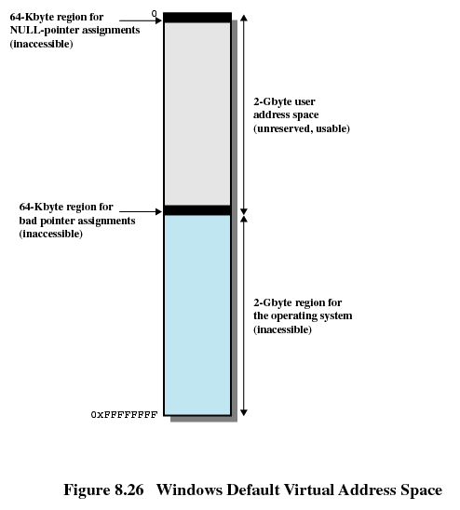
Windows Virtual Address Space

Slide 70
Windows Memory Management
Paging
  Available
  Reserved
  Committed

