Slide 1
File Management
Chapter 12

Slide 2
File Management System
File management system consists of system utility programs that run as privileged applications
Input to applications is by means of a file
Output is saved in a file for long-term storage
Sharable between processes

Slide 3
File Operations
Create
Delete
Open
Close
Read
Write

Slide 4
Objectives for a File Systems
Meet the data management needs and requirements of the user
Guarantee that the data in the file are valid
Optimize performance
Provide I/O support for a variety of storage device types

Slide 5
Objectives for a File Systems
Minimize or eliminate the potential for lost or destroyed data
Provide a standardized set of I/O interface routines
Provide I/O support for multiple users

Slide 6
Minimal Set of Requirements
Each user should be able to create, delete, read, write and modify files
Each user may have controlled access to other users’ files
Each user may control what type of accesses are allowed to the users’ files
Each user should be able to restructure the user’s files in a form appropriate to the problem

Slide 7
Minimal Set of Requirements
Each user should be able to move data between files
Each user should be able to back up and recover the user’s files in case of damage
Each user should be able to access the user’s files by using symbolic names

Slide 8
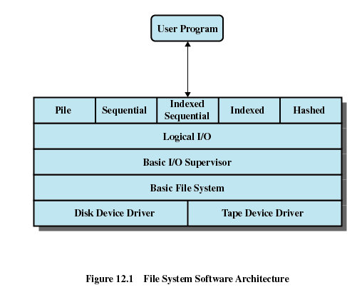
FS Software Architecture

Slide 9
Device Drivers
Lowest level
Communicates directly with peripheral devices
Responsible for starting I/O operations on a device
Processes the completion of an I/O request

Slide 10
Basic File System
Physical I/O
Deals with exchanging blocks of data
Concerned with the placement of blocks
Concerned with buffering blocks in main memory

Slide 11
Basic I/O Supervisor
Responsible for file I/O initiation and termination
Control structures are maintained
Concerned with selection of the device on which file I/O is to be performed
Concerned with scheduling access to optimize performance

Slide 12
Logical I/O
Enables users and applications to access file as a byte stream
Maintains basic data about file

Slide 13
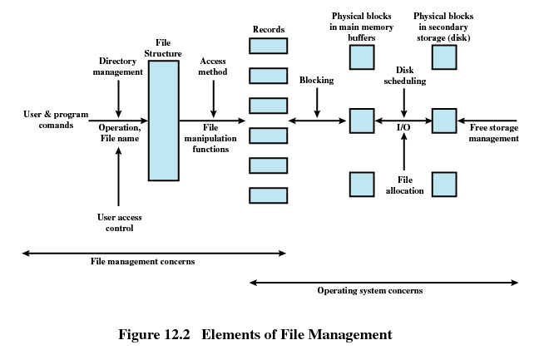
Elements of File Management

Slide 14
File Management Functions
Identify and locate a selected file
Use a directory to describe the location of all files plus their attributes
On a shared system describe user access control
Blocking for access to files
Allocate files to free blocks
Manage free storage for available blocks

Slide 15
Criteria for File Organization
Short access time
  Needed when accessing a single record
  Not needed for batch mode
Ease of update
  File on CD-ROM will not be updated, so this is not a concern

Slide 16
Criteria for File Organization(contd.)
Economy of storage
  Should be minimum redundancy in the data
  Redundancy can be used to speed access such as an index
Simple maintenance
Reliability

Slide 17
File Organization
Pile
Sequential File
Indexed Sequential File
Indexed File
Hashed File

Slide 18
Pile
Data are collected in the order they arrive
Purpose is to accumulate a mass of data and save it
Records may have different fields
No structure
Record access is by exhaustive search

Slide 19
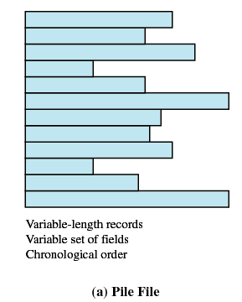
Pile

Slide 20
Sequential File
Fixed format used for records
Records are the same length
All fields the same (order and length)
Field names and lengths are attributes of the file
One field is the key filed
  Uniquely identifies the record
  Records are stored in key sequence

Slide 21
Sequential File (cont.)
New records are placed in a log file or transaction file
Batch update is performed to merge the log file with the master file

Slide 22
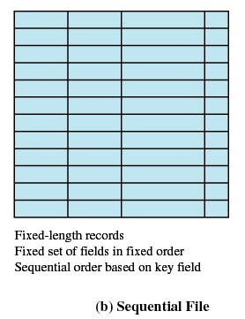
Sequential File (cont.)

Slide 23
Indexed Sequential File
Index provides a lookup capability to quickly reach the vicinity of the desired record
  Contains key field and a pointer to the main file
  Indexed is searched to find highest key value that is equal to or precedes the desired key value
  Search continues in the main file at the location indicated by the pointer

Slide 24
Comparison of two sequential methods
Example: a file contains 1 million records
On average 500,00 accesses are required to find a record in a sequential file
If an index contains 1000 entries, it will take on average 500 accesses to find the key, followed by 500 accesses in the main file. Now on average it is 1000 accesses

Slide 25
Indexed Sequential File (cont.)
New records are added to an overflow file
Record in main file that precedes it is updated to contain a pointer to the new record
The overflow is merged with the main file during a batch update
Multiple indexes for the same key field can be set up to increase efficiency

Slide 26
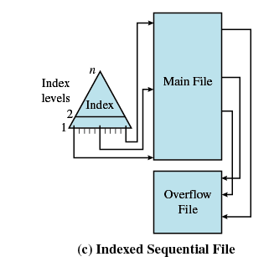
Indexed Sequential File

Slide 27
Indexed File
Uses multiple indexes for different key fields
May contain an exhaustive index that contains one entry for every record in the main file
May contain a partial index

Slide 28
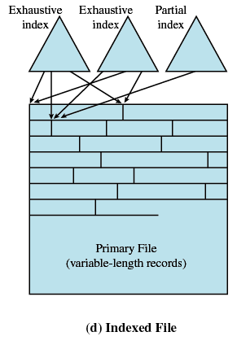
Indexed File

Slide 29
Hashed File
Directly access a block at a known address
Key field required for each record

Slide 30
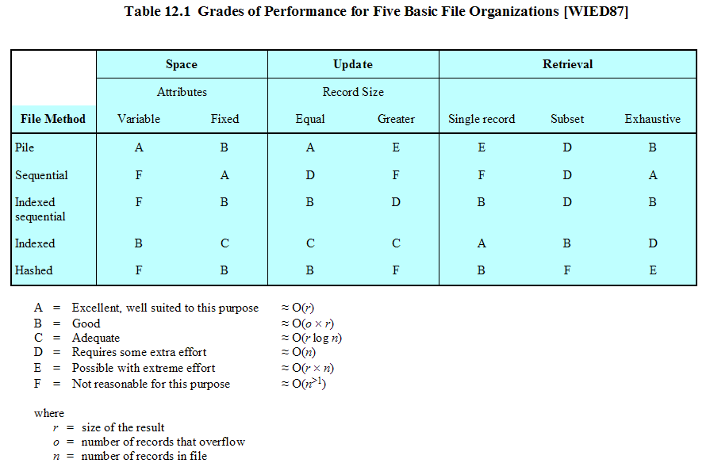

Slide 31
File Directories
Contains information about files
  Attributes
  Location
  Ownership
Directory itself is a file owned by the operating system
Provides mapping between file names and the files themselves

Slide 32
Simple Structure for a Directory
List of entries, one for each file
Sequential file with the name of the file serving as the key
Provides no help in organizing the files
Forces user to be careful not to use the same name for two different files

Slide 33
Two-level Scheme for a Directory
One directory for each user and a master directory
Master directory contains entry for each user
  Provides address and access control information
Each user directory is a simple list of files for that user
Still provides no help in structuring collections of files

Slide 34
Hierarchical, or Tree-Structured Directory
Master directory with user directories underneath it
Each user directory may have subdirectories and files as entries

Slide 35
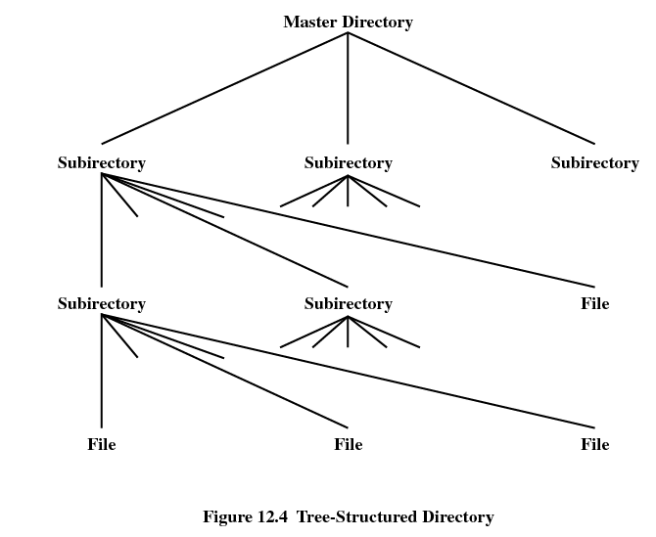
Tree-Structured Directory

Slide 36
Hierarchical, or Tree-Structured Directory
Files can be located by following a path from the root, or master, directory down various branches
  This is the pathname for the file
Can have several files with the same file name as long as they have unique path names

Slide 37
Hierarchical, or Tree-Structured Directory
Current directory is the working directory
Files are referenced relative to the working directory

Slide 38
File Sharing
In multiuser system, allow files to be shared among users
Two issues
  Access rights
  Management of simultaneous access

Slide 39
Access Rights
None
  User may not know of the existence of the file
  User is not allowed to read the user directory that includes the file
Knowledge
  User can only determine that the file exists and who its owner is

Slide 40
Access Rights
Execution
  The user can load and execute a program but cannot copy it
Reading
  The user can read the file for any purpose, including copying and execution
Appending
  The user can add data to the file but cannot modify or delete any of the file’s contents

Slide 41
Access Rights
Updating
  The user can modify, deleted, and add to the file’s data. This includes creating the file, rewriting it, and removing all or part of the data
Changing protection
  User can change access rights granted to other users
Deletion
  User can delete the file

Slide 42
Access Rights
Owners
  Has all rights previously listed
  May grant rights to others using the following classes of users
    Specific user
    User groups
    All for public files

Slide 43
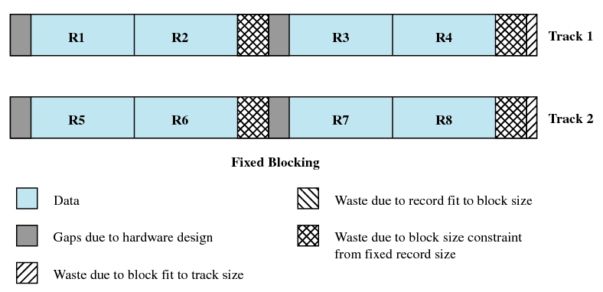
Fixed Blocking

Slide 44
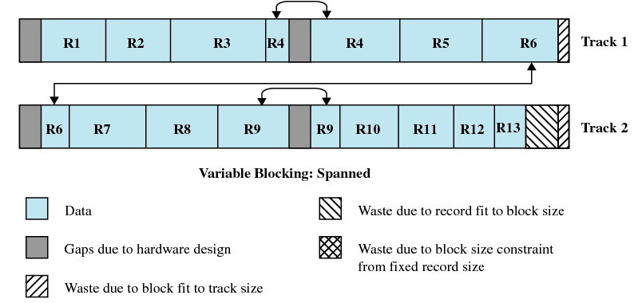
Variable Blocking: Spanned

Slide 45
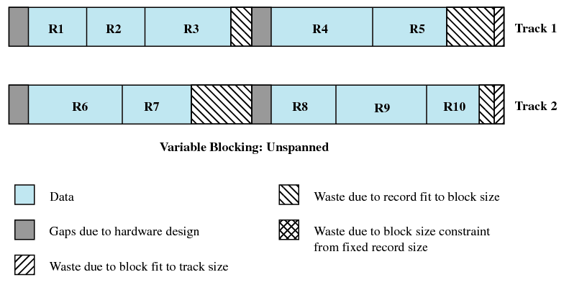
Variable Blocking: Unspanned

Slide 46
Secondary Storage Management
Space must be allocated to files
Must keep track of the space available for allocation

Slide 47
Preallocation(预先分配)
Need the maximum size for the file at the time of creation
Difficult to reliably estimate the maximum potential size of the file
Tend to overestimated file size so as not to run out of space

Slide 48
Contiguous Allocation(连续分配)
Single set of blocks is allocated to a file at the time of creation
Only a single entry in the file allocation table
  Starting block and length of the file
External fragmentation will occur
  Need to perform compaction

Slide 49

Contiguous Allocation

Slide 50
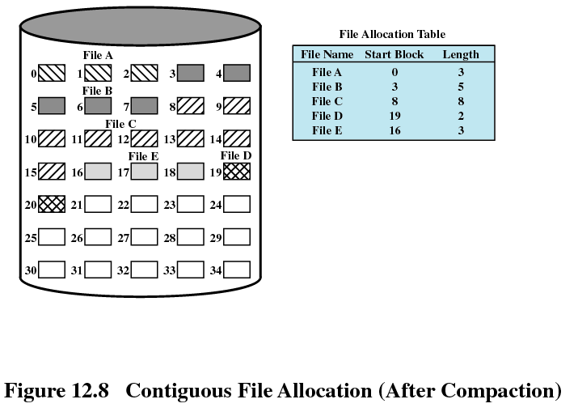
Contiguous Allocation (cont.)

Slide 51
Chained Allocation
Allocation on basis of individual block
Each block contains a pointer to the next block in the chain
Only single entry in the file allocation table
  Starting block and length of file
No external fragmentation
Best for sequential files
No accommodation of the principle of locality

Slide 52
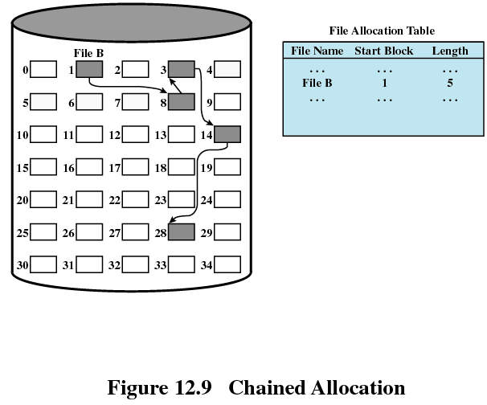
Chained Allocation (cont.)

Slide 53
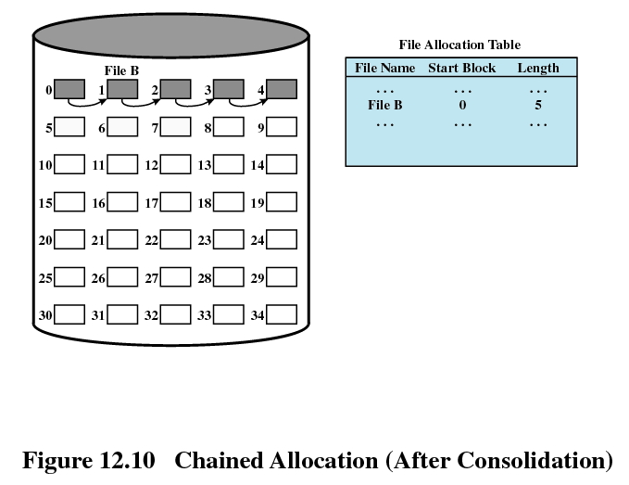
Chained Allocation (cont.)

Slide 54
Indexed Allocation
File allocation table contains a separate one-level index for each file
The index has one entry for each portion allocated to the file
The file allocation table contains block number for the index

Slide 55
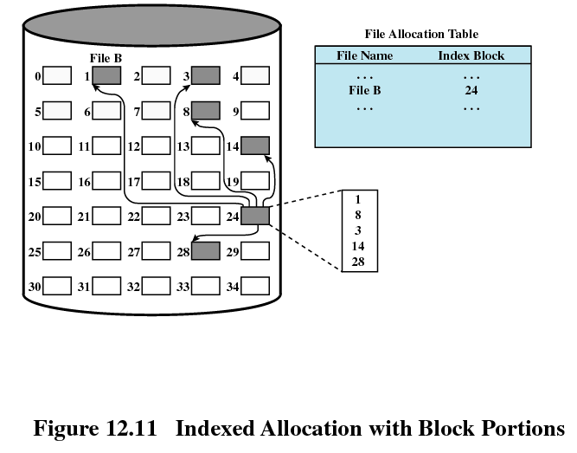
Indexed Allocation (cont.)

Slide 56
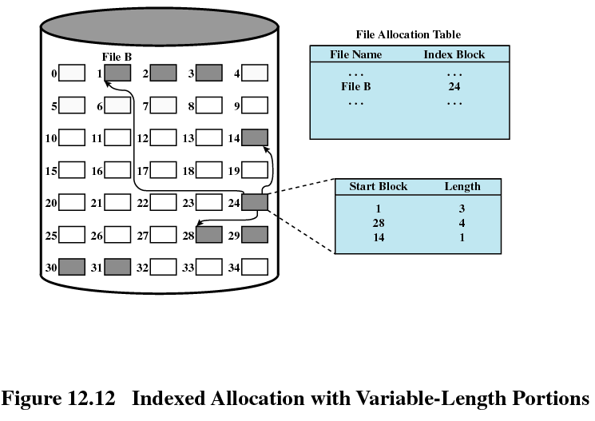
Indexed Allocation (cont.)

Slide 57
UNIX File Management
Types of files
  Regular, or ordinary
  Directory
  Special
  Named pipes
  Links
  Symbolic links

Slide 58
Inodes
Index node (索引节点)
Control structure that contains key information for a particular file

Slide 59
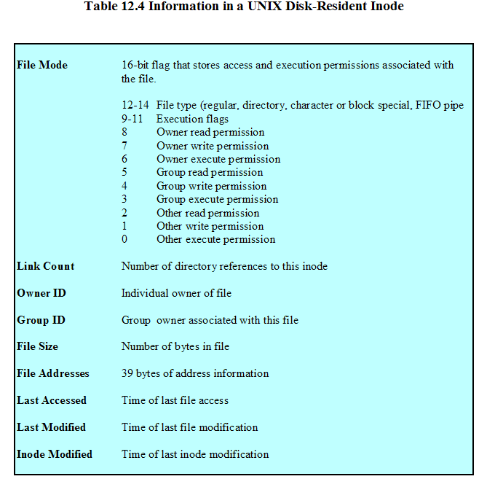
File Attributes of Unix File

Slide 60
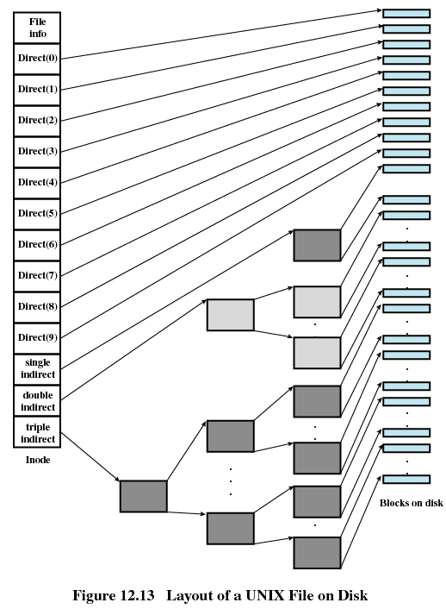
Layout of Unix File on Disk

Slide 61
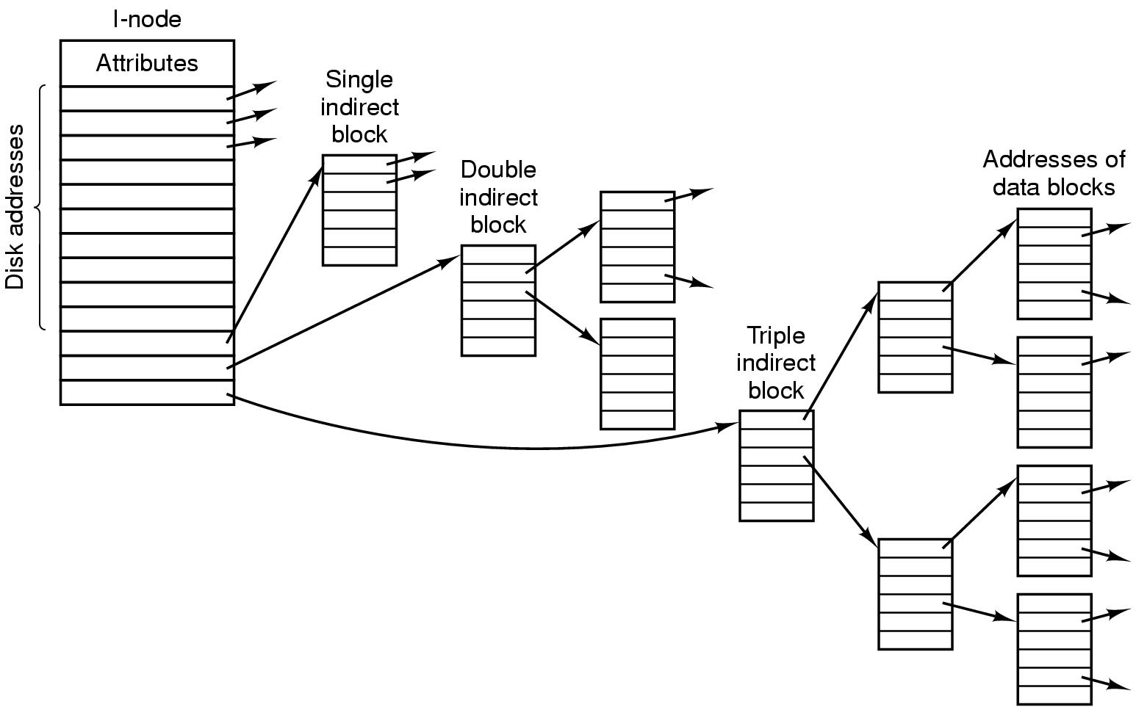
Layout of Unix File on Disk

Slide 62
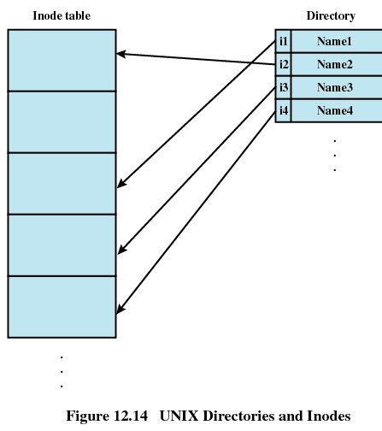
Unix Directory and I-node

Slide 63
Unix Pathname Parsing
/usr/ast/mbox
Root dir
i-node 6
Block 132
i-node 26
Block 406
1
.
Attirb
6
.
Attrib
26
.
1
..
1
..
6
..
4
bin
19
dick
64
grants
7
dev
132
30
erik
406
92
books
14
lib
51
jim
60
mbox
9
etc
26
ast
81
minix
6
usr
45
bal
17
src
8
tmp

Slide 64
Free Space Management
Bitmap
Chained (Linked List)

Slide 65
Free Space Management
42
230
86
196
162
237
210
612
897
97
342
422
41
214
140
63
160
223
21
664
223
48
216
160
262
320
126
…
…
…
310
180
142
516
462
141

Slide 66
Access Rights(Unix)

Slide 67
Simultaneous Access (Unix)
i-node
File table
File descriptor table

Slide 68
Linux Virtual File System
Uniform file system interface to user processes
Represents any conceivable file system’s general feature and behavior
Assumes files are objects that share basic properties regardless of the target file system

Slide 69
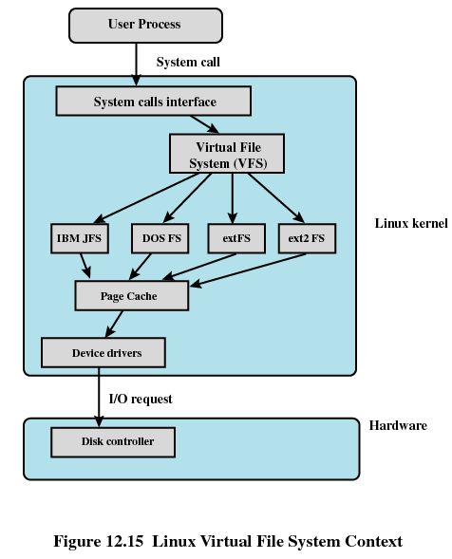
Linux Virtual File System

Slide 70
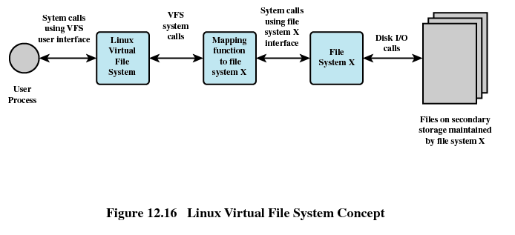
Linux Virtual File System

Slide 71
Primary Objects in VFS
Superblock object
  Represents a specific mounted file system
Inode object
  Represents a specific file
Dentry object
  Represents a specific directory entry
File object
  Represents an open file associated with a process

Slide 72
Windows File System
Key features of NTFS
  Recoverability
  Security
  Large disks and large files
  Multiple data streams
  General indexing facility

Slide 73
NTFS Volume and File Structure
Sector
  The smallest physical storage unit on the disk
Cluster
  One or more contiguous sectors
Volume
  Logical partition on a disk

Slide 74
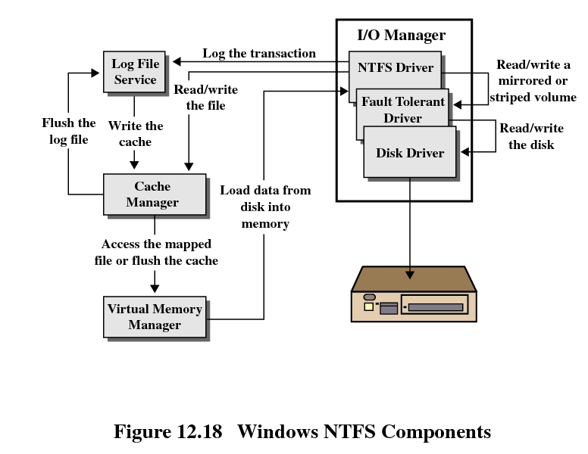
Windows NTFS Components

