Slide 1


PracExtractor: Extracting Configuration Good Practices from Manuals to Detect Server Misconfigurations
Chengcheng Xiang¹, Haochen Huang¹, Andrew Yoo¹, Yuanyuan Zhou¹, Shankar Pasupathy²
1
2

Slide 2
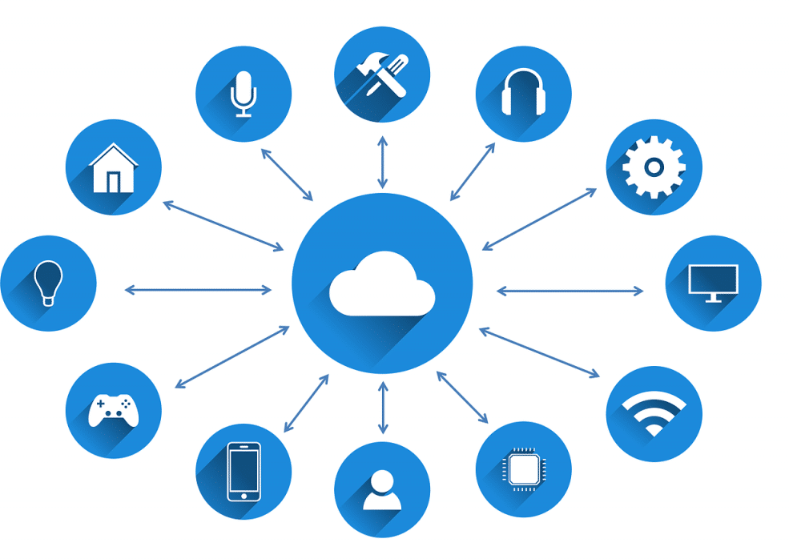
Our lives are largely served by online services today

Slide 3

What serve us are these powerful and complex data center systems

Slide 4




In particular: data center configuration has become highly complex
No. of parameters
1376
940
669
426
Too many config parameters
Parameters are correlated

Slide 5






Software release large manuals to assist sysadmins with configurations
5494
pages
3724
pages
Too long to read
2331
pages
Not easy to navigate
Sysadmin
Unreliable sources
1009
pages
787
pages

Slide 6
Is there any useful information that can be automatically extract from manuals?
Yes! Good Practices
Describe how to set parameters in a good way from usage experiences
Examples
Software | parameter | Good practices | Violation outcomes
Httpd | ExtendedStatus | For highest performance, set ExtendedStatus off. | Performance downgrade
HBase | hbase.regionserv er.thrift.framed | Setting this to false will select the default transport, vulnerable to DoS. | Vulnerable to DoS attack
Cassandra | enable_transient _replication | Transient replication is experimental and is not recommended for production use. | Unreliable service

Slide 7
How useful are the good practices in manuals?
Q1: Are good practices specific or general?
General good practices like “set to a large value” are not helpful.
We collected 261 good practices from six software manuals to answer these questions
Q2: Are good practices already checked in source code? If they are, it is non-necessary to extract them from manuals.
Q3: Are good practices always equivalent to default settings?
If they are, then sysadmins can just leave configurations as default.

Slide 8
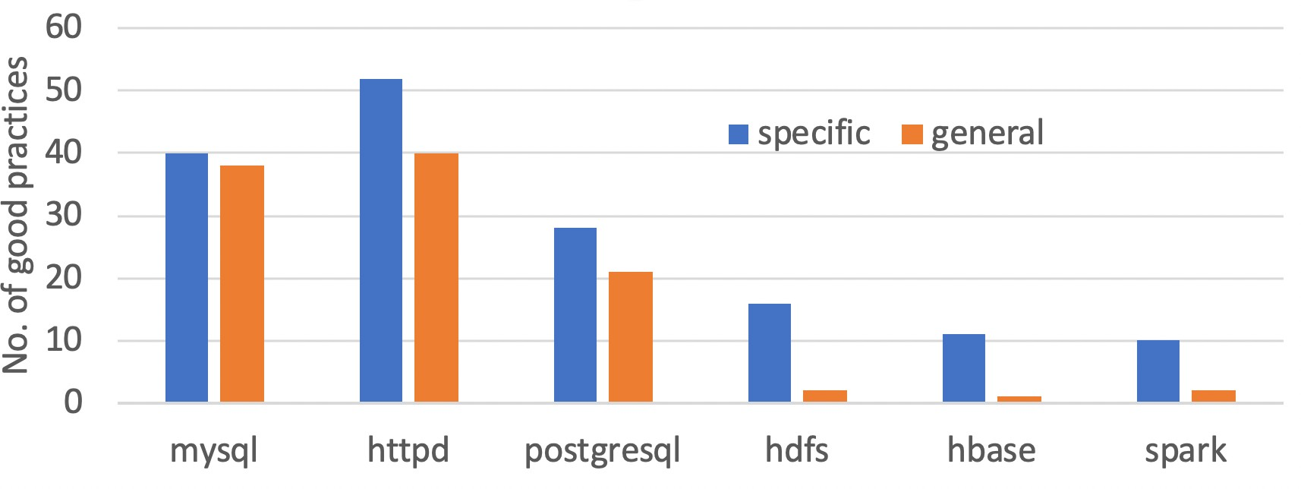
How useful are the good practices in manuals?
Q1: Are good practices specific or general?
General advice like “set to a large value” is not helpful.
Answer: 60% of studied good practices are specific.

Slide 9
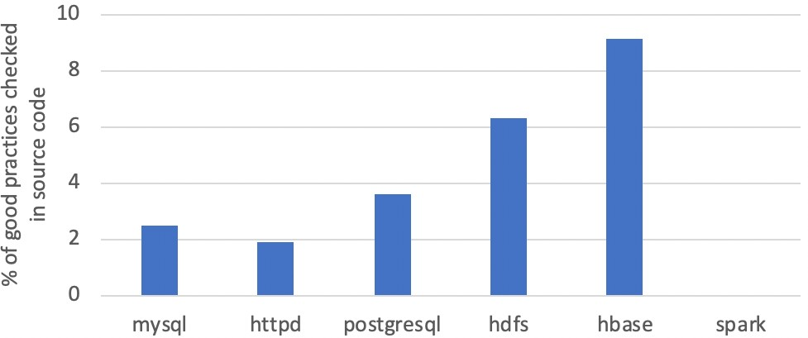
How useful are the good practices in manuals?
Q2: Are good practices already checked in source code?
If they are, it is non-necessary to extract them from manuals.
Answer: only 3% of specific good practices are checked in source code.

Slide 10
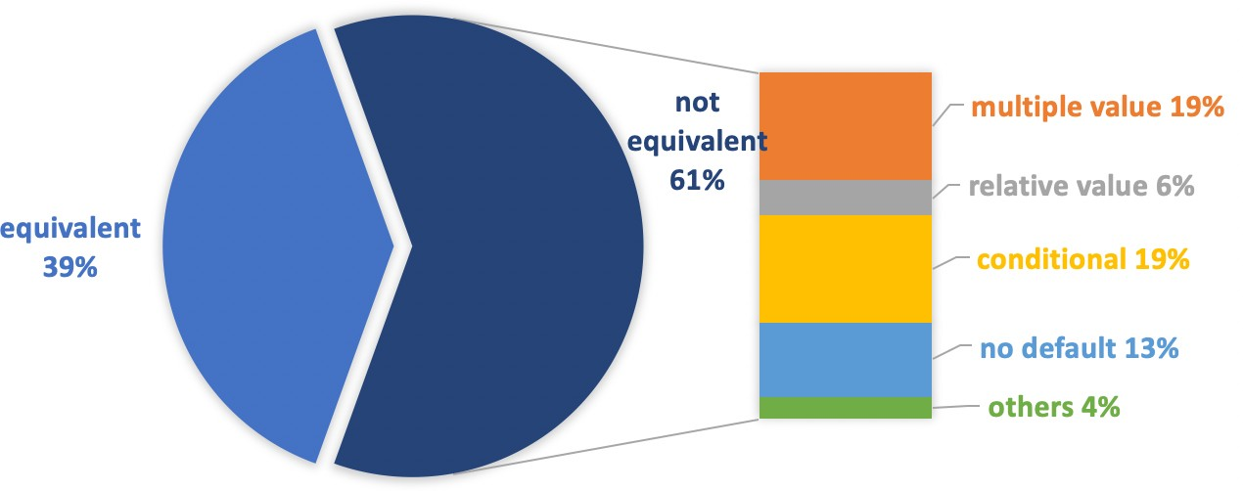
How useful are the good practices in manuals?
Q3: Are good practices always equivalent to default settings?
If they are, then sysadmins can just leave configurations as default.
Answer: 61% of specific good practices are not equivalent to default settings

Slide 11
Based on the study we designed PracExtractor to
Extract
Good practices descriptions
p1: “The crc32 option is recommended."
p2: “A value between 8 to 16 is suggested.”
p3: “We suggest to set it less than ThreadsPerChild.”
Convert
Check
Specifications
p1 == crc32
p2 ∈ [8, 16]
p3 < ThreadsPerChild
Manual
Config files
p2 = 6
…

Slide 12
Two challenges with PracExtractor
How to effective filter noises and extracts only good practice descriptions?
99.6% – 97.3% of sentences in manuals are NOT related to good practices.
How to convert good practice descriptions in free-text into checkable specifications?
Sentences like “the crc32 option is recommended” is not directly checkable

Slide 13
Challenge 1: Extract good practice descriptions
Keyword filtering
Syntactic-pattern filtering

Slide 14
Challenge 1: Extract good practice descriptions
Keyword filtering
Syntactic-pattern filtering
Keyword filtering
Sentences in manuals
“The crc32 option is recommended."
“This is not guaranteed even with the recommended settings”
“Specifies how to generate and verify the checksum stored in the disk blocks”
Good practices candidates
“The crc32 option is recommended."
“This is not guaranteed even with the recommended settings”

Slide 15
Challenge 1: Extract good practice descriptions
Keyword filtering
Syntactic-pattern filtering
Good practices candidates
“The crc32 option is recommended."
“This is not guaranteed even with the recommended settings”

Slide 16

Challenge 1: Extract good practice descriptions
Keyword filtering
Syntactic-pattern filtering
Good practices candidates
Syntactic- pattern filtering
csubj acomp
The crc32 option is recommended .
Good practices descriptions
“The crc32 option is recommended."
nsubj
amod
This is not guaranteed even with the recommended settings.

Slide 17
Challenge 2: Convert descriptions into specifications
Setting entity identification
Semantic pattern matching

Slide 18
Challenge 2: Convert descriptions into specifications
Setting entity identification
Semantic pattern matching
Good practices descriptions
p1: “The crc32 option is recommended.”
p2: “A value between 8 to 16 is suggested.”
p3: “We suggest to set it less than ThreadsPerChild.”
Good practices descriptions
p1: “The crc32 option is recommended.” enum
p2: “A value between 8 to 16 is suggested.” int int
p3: “We suggest to set it less than ThreadsPerChild .” parameter

Slide 19
Challenge 2: Convert descriptions into specifications
Setting entity identification
Semantic pattern matching
Good practices descriptions
p1: “The crc32 option is recommended.” enum
p2: “A value between 8 to 16 is suggested.” int int
p3: “We suggest to set it less than ThreadsPerChild .” parameter
<enum>
between <int> to <int>
less than <parameter>
Specifications
p1 == crc32
p2 ∈ [8, 16]
p3 < ThreadsPerChild

Slide 20
Evaluation of PracExtractor
Extract good practices from software manuals
Detect real-world configuration errors

Slide 21
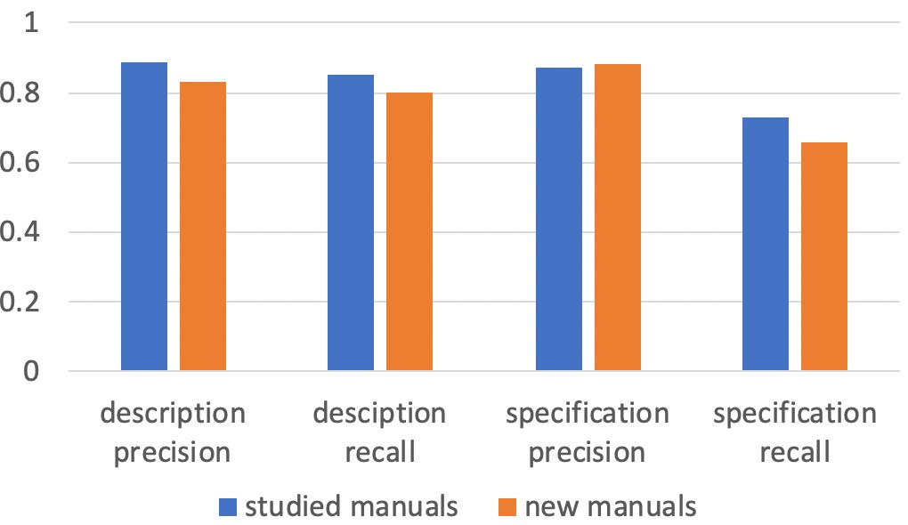
Evaluation of PracExtractor
Accuracy of good practice extraction
Training sets: 6 studied manuals included in our characteristic study
Testing sets: 6 new manuals not included in our study

Slide 22
Evaluation of PracExtractor
Accuracy of good practice extraction
Precision: what percentage of good practices extracted are true
Recall: what percentage of true good practices are extracted

Slide 23
Evaluation of PracExtractor
Accuracy of good practice extraction
Good practice descriptions extraction

Slide 24
Evaluation of PracExtractor
Accuracy of good practice extraction
Good practice specifications extraction

Slide 25
Evaluation of PracExtractor
Detect real-world configuration errors
Downloaded 2200 docker images from docker hub.
Detected 1423 practice violations from 853 unique images.
Got 47 confirmed as real configuration errors (325 reported in total).

Slide 26
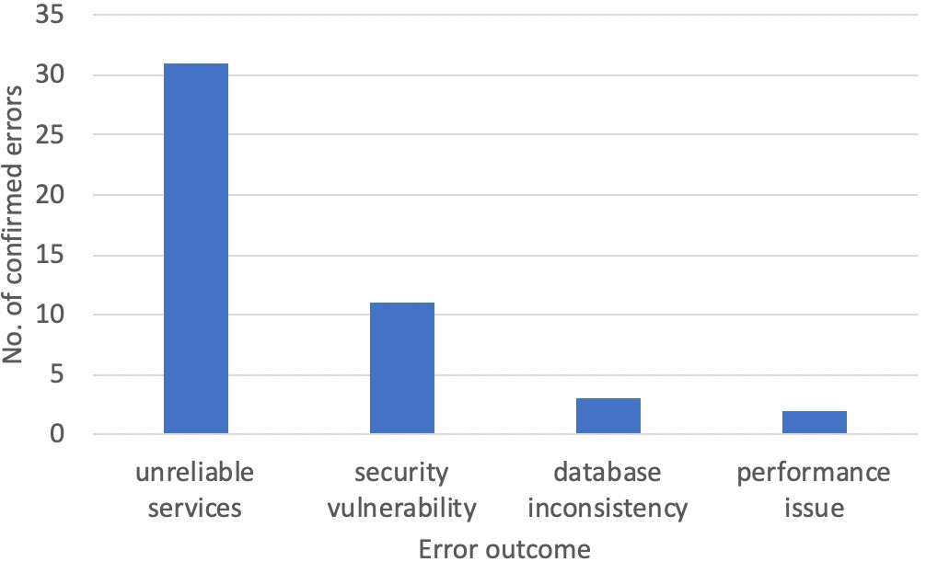
Evaluation of PracExtractor
Outcome of the confirmed configuration errors

Slide 27
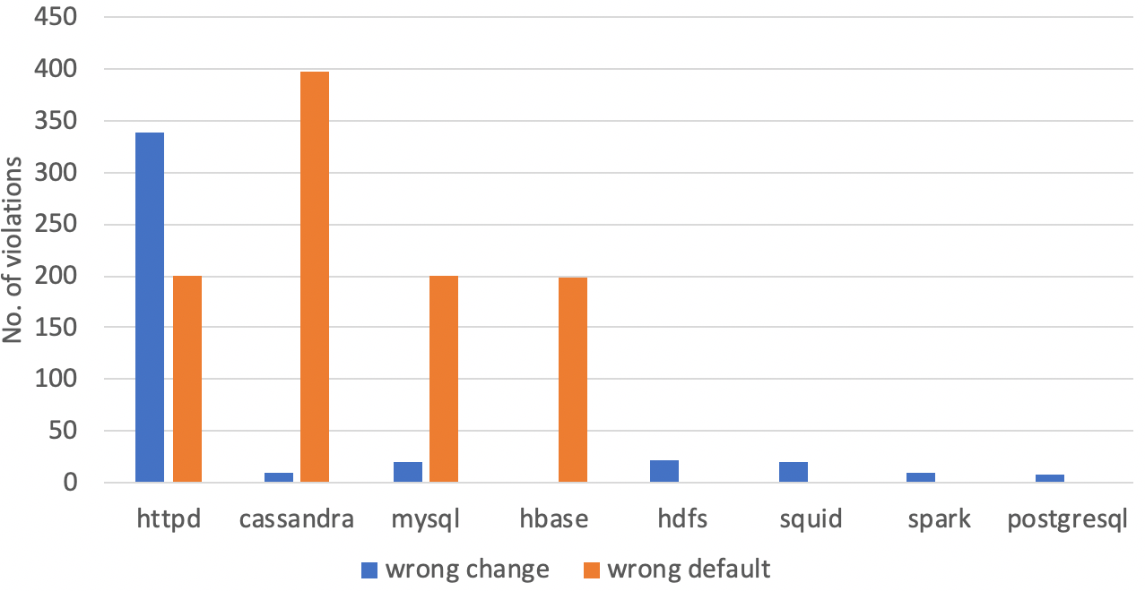
Evaluation of PracExtractor
Analysis of the detected violations
Wrong change: a parameter is changed to a value violating good practices
Wrong default: a parameter’s default violate good practices but is not changed

Slide 28
Evaluation of PracExtractor
Analysis of the detected violations
Wrong change: a parameter is changed to a value violating good practices
Wrong default: a parameter’s default violate good practices but is not changed

Slide 29
Evaluation of PracExtractor
Analysis of the detected violations
Wrong change: a parameter is changed to a value violating good practices
Wrong default: a parameter’s default violate good practices but is not changed

Slide 30
Summary of PracExtractor
Identified good practices as useful information from manuals for configuration validation.
Studied 261 good practices from six software manuals to prove usefulness.
Built PracExtractor to automatically extract good practices from manuals.
PracExtractor achieved reasonably high precision and recall.
PracExtractor detected 47 real-world configuration errors.

Slide 31
Thank you!
c4xiang@cs.ucsd.edu
31

