Slide 1

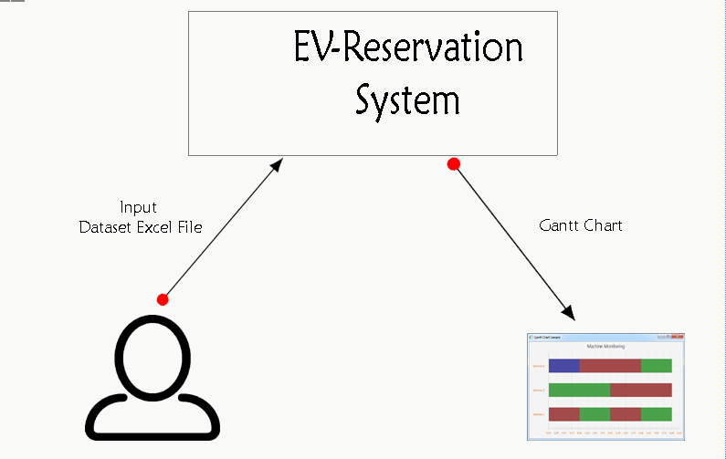
EV-Reservation System
by Nav Singh

Slide 2
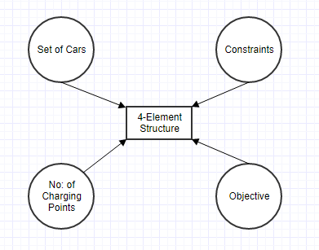
What is it ??

Slide 3

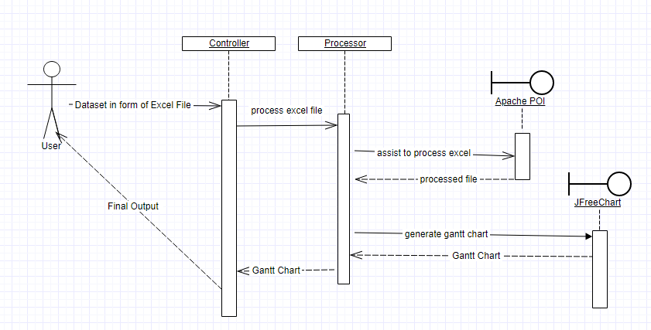
1. How it works..

Slide 4
Algo-Steps
Filter the valid client requests (based on duration)
Lists of Car based on type ( Tesla, Chev, Nissan)
Sorting of all based on Miles (reversed-highest) and Prefer Start Time
Processing all for best option (All tesla first go to Super_Charger)
So on………
Output generated on Gantt Chart
All the valid processed requests stored in excel file.

Slide 5


