Slide 1
Final Project Presentation
Screenshot Capture and Transmit Application
Android Application
By: Charanjit Singh Bhalla

Slide 2
Biggest Question
Which Screenshot we are Capturing ?
What is the base of this application?
How this application was thought out?

Slide 3
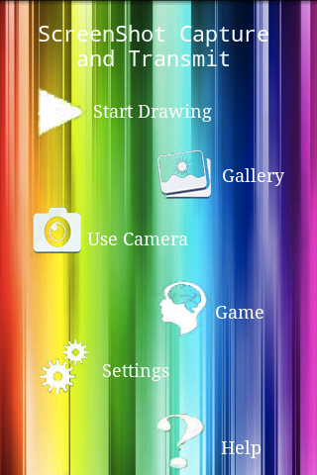
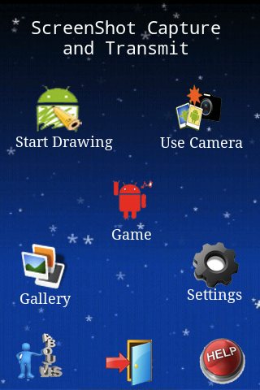
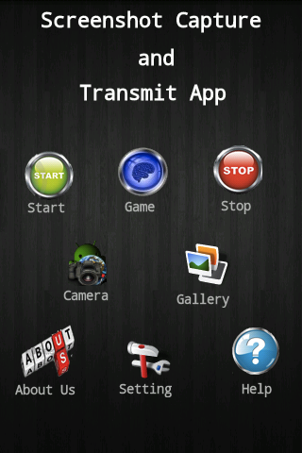
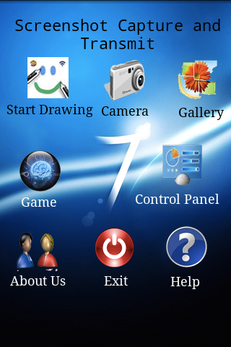
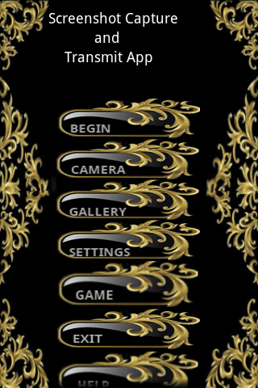
Getting Down to Serious Work!!!
Showing Off Themes!!

Slide 4
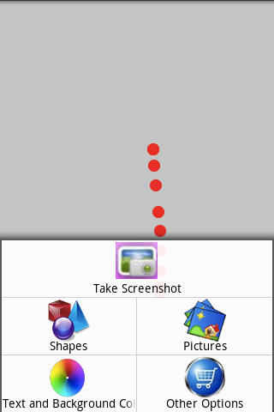
Exploring Start Drawing!!!!
Drawing Screen with Lots of Options to explore!!!
Shapes enhance shape experience.
Predefined pictures with advanced options.
Change the color of Text and Background.
Take Screenshot on the go.
Other options for user customizations.

Slide 5
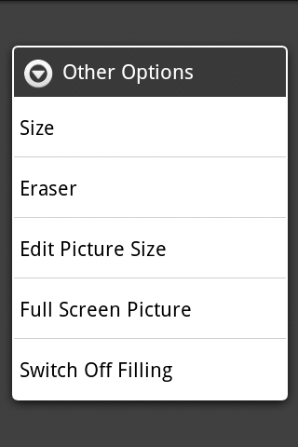
Options In Other Options!!
World is Changing size.
Erasing made fun!
Making collage? try this.
Edit Picture size.
Full screen image.
Fill or not to Fill ?

Slide 6
Use Camera or Gallery!
Take Images From Camera or Gallery.
Crop Image.
Its waiting when u get to drawing screen.

Slide 7
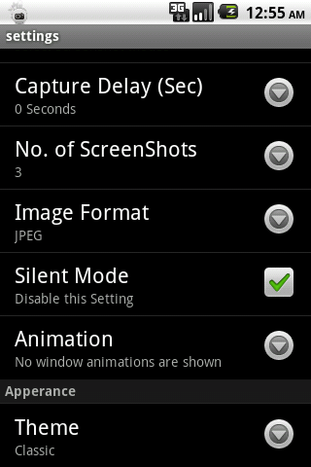
Setting it all up!!
Mode.
Putting the timer here.
Deciding the number of images.
Image Formats.
Silence!!!!
Animating or Not.
Themes are the way to go.

Slide 8
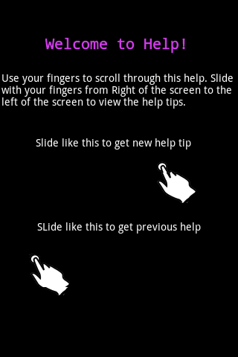
Help yourself !!!
Everything you want to know about the app.
Slide your finger and get new help tip.
All topics for the drawing application covered.

Slide 9

Gaming for Fun!!
Mapping the power of retention.
Help will help people get through.
Keep your mind alert.
Can restart between the game.

Slide 10
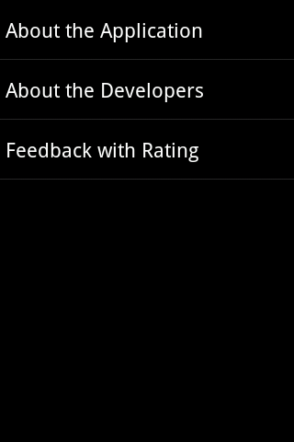
Read, Enjoy and Rate!
About the Application
Version 1.0
No Warranty
About the Developers
Developer information.
Email included.
Rating the App!!
Rate the app.
Send comments straight to developers.

Slide 11
Demo Time!
Application Demo on Android Phone.

Slide 12
Thank You For your time.
Questions and Suggestions Welcomed.

