Slide 1
10.0
v
m.s⁻¹
rider X
5.0
rider Y
0
0
10
20
30
40
t [ s ]

Slide 2
8.0
v
m.s⁻¹
0
0
2
4
6
8
10
t [ s ]

Slide 3
N
45 km
2 hours
W
E
60 km
3 hours
S

Slide 4
Y
X
O(0, 0)
sea level

Slide 5
Y
X

Slide 6
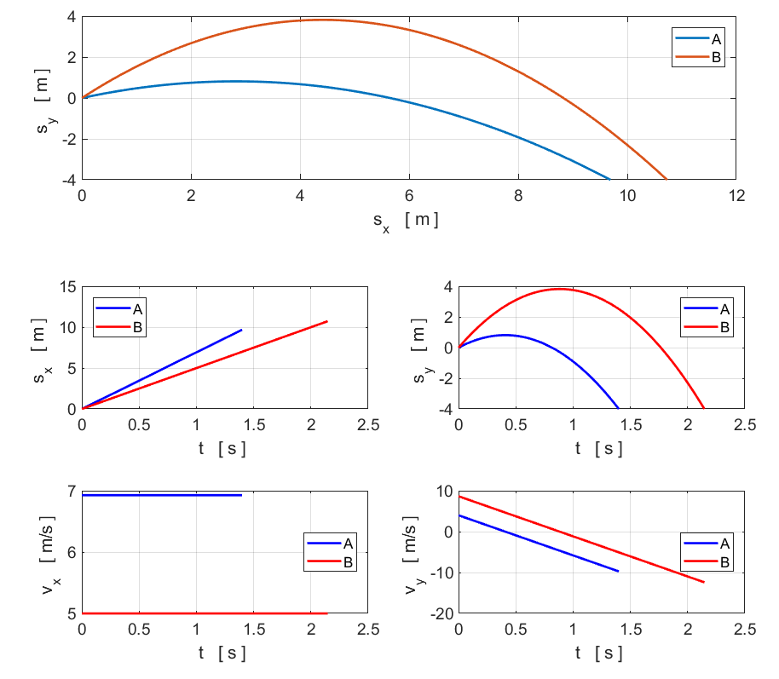

Slide 7

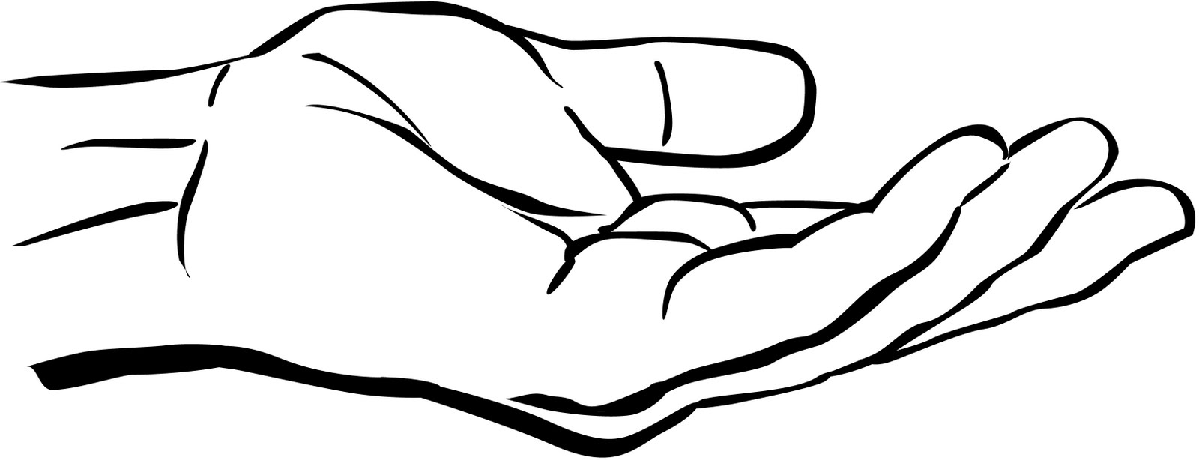
F₁ is the force of hand on ball
F₂ is the force of ball on hand
F₃ is the force of the ball on the Earth
F₄ is the force of the Earth on the ball

Slide 8
Systems
Y
Ball
m a > 0
Hand
Earth
X
F₁
F₃
F₄
F₂
F₁ is the force of hand on ball
F₂ is the force of ball on hand
F₃ is the force of the ball on the Earth
F₄ is the force of the Earth on the ball
Newton’s 3rd Law: action / reaction forces
Ball / Earth F₄ = F₃
Ball / Hand F₁ = F₂
The ball accelerates upward F₁ > F₄

Slide 9
VECTOR
Y
magnitude
X
direction
w.r.t. +X axis
components

Slide 10
N
Y
Y
Y
X
X
X

Slide 12
Airbus A
Boeing B

Slide 13
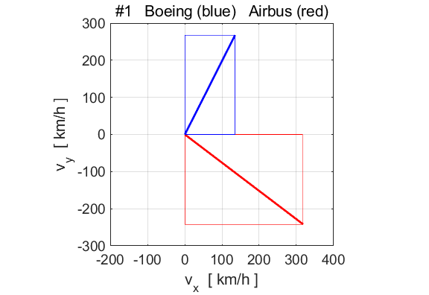

Slide 14
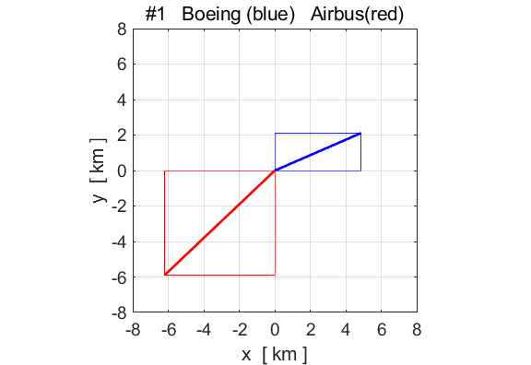

Slide 15
-144º
35.9º

Slide 17
110º
-70º

Slide 19
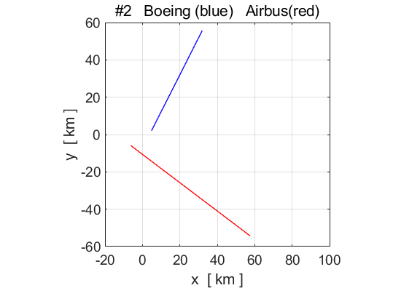
AIRBUS
BOEING
#2
#1
#1
#2

Slide 21
45º
45º
d
2d
d
net force on ball
Y
X

