Slide 1
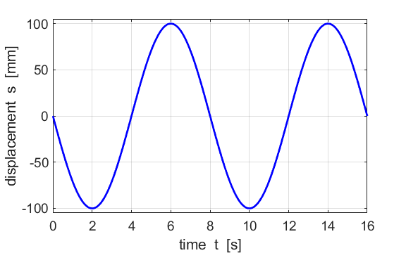
A
T
object stationary
object max speed

Slide 3
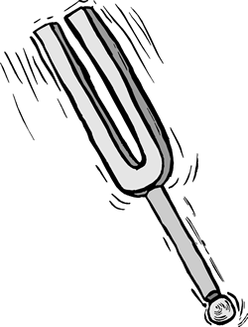
X
Y

Slide 4
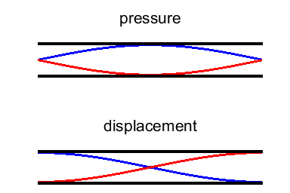
Fundamental mode n = 1
N
A
N
A
N
A

Slide 5
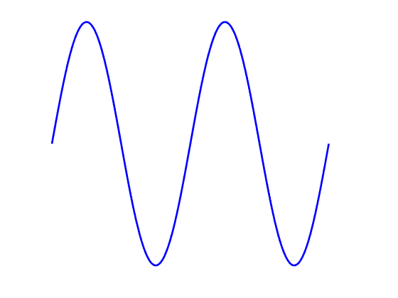
A
B
C
D
E
F
G
H
I
J
K
L
M
Diagram 1
Diagram 2
A
B
C
D
E
F
G
H
I
J
K
L
M

Slide 6
A
B
C
D
E
F
G
H
I
J
K
L
M
Diagram 1
A
B
C
D
E
F
G
H
I
J
K
L
M
Diagram 2
right
C
C
0
R
R
R
left
particles move to the right
particles move to the left
particles move to the right
particles move to the left
10 mm
Particles A D G J M are in their equilibrium positions
Particles A G M are in phase
Particles D J are in phase
The wavelength is 20 mm.
The compression moves forward and not the particles. The particle at the centre of a compression is in its equilibrium position. So, a little later, particle E will be at the centre of the compression and hence in its equilibrium position. In diagram 2 particle E is shifted to the left, hence it then must move to the right to return to its equilibrium position.

Slide 7
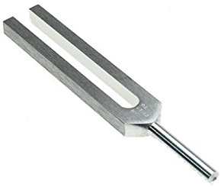
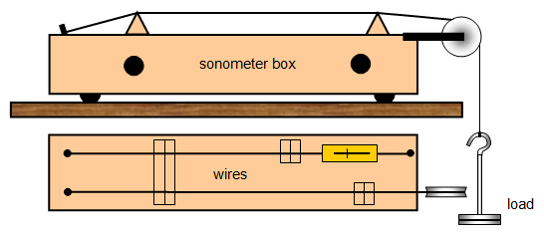
L
sonometer
load

Slide 8
Snell’s Law
water
glass
(A)
(B)
(C)

Slide 9
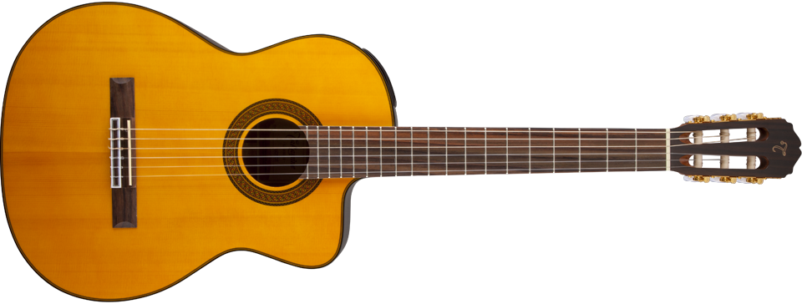
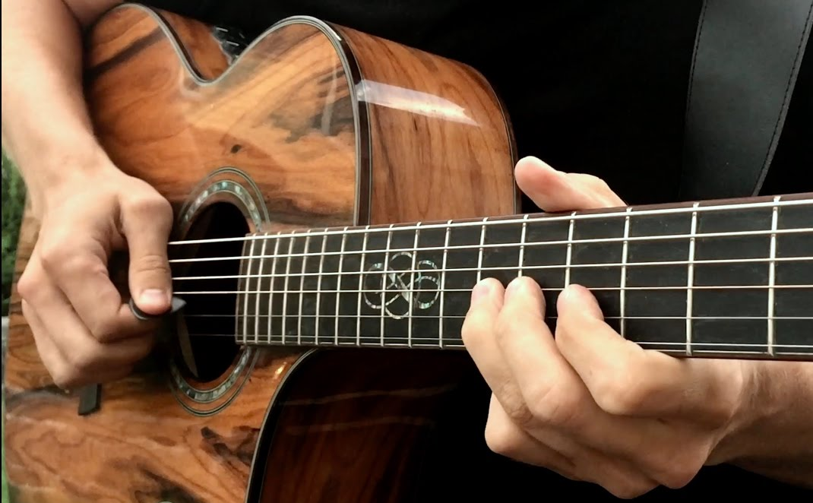
tuning knobs to change the string tension F_{T}
strings have different linear densities μ
position of the fingers changes the length L of the string
The natural frequencies of vibration of the guitar strings is given by

Slide 10
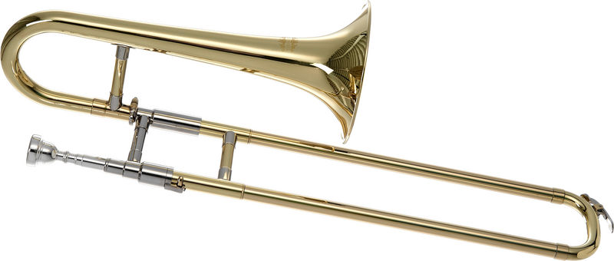
open end: pressure node (displacement antinode)
closed end due to mouth of player: pressure antinode (displacement node)
The length L of the trombone is varied to the change the pitch of the notes
The trombone is an instrument that corresponds to an open and close ended pipe. Therefore, only the odd harmonics can be excited.

Slide 11
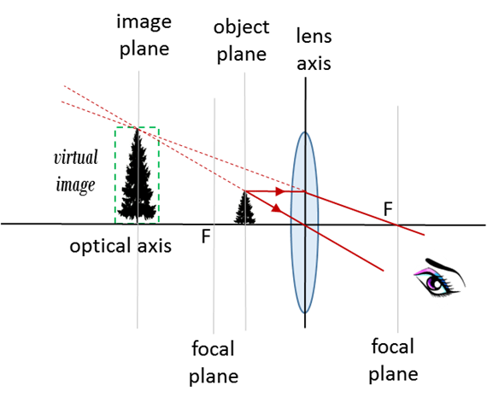

Slide 12
object
image

