Slide 1
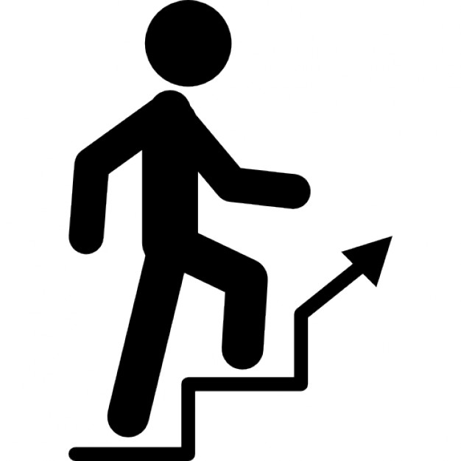
milkshake Q = 2.0 MJ = 2.0x10⁶ J
m = 60 kg
dh = 180 mm =180x10⁻³ m
g = 9.8 m.s⁻²
height h= ? m
number of stairs N = h / dh = ?
Increase in potential energy = energy content of milkshake
m g h = Q
h = Q / m g = 3.4x10³ m = 3.4 km BIG HEIGHT
N = h / dh = 19x10³ stairs
don’t have too many rich milkshakes

Slide 2
V_{W} = 860 mL m_{W} = 860 g = 860x10⁻³ kg
T_{W} = 72 ºC c_{W} = 4186 J.kg⁻¹.K⁻¹
m_{A} = 250 g = 250x10⁻³ kg T_{A} = 22 ºC c_{A} = 900 J.kg⁻¹.K⁻¹
Specific heat capacity Q = m c dT
Zero energy is exchanged between the System of the water and flask to the surroundings. Energy is transferred from the water at the higher temperature to the aluminium flask at the lower temperature until the water and flask reach an equilibrium temperature T. Once the equilibrium temperature is reached, there is zero net energy transfer between the water and flask.
Energy lost by water = Energy gained by flask
m_{W} c_{W} (T_{W} – T) = m_{A} c_{A} (T – T_{A})
Rearranging to make T the subject
T = (m_{W} c_{W} T_{W} + m_{A} c_{A} T_{A}) / (m_{W} c_{W} + m_{A} c_{A})
T = 69 ºC
Water has a very large value for its specific heat capacity, much greater than the specific heat capacity of aluminium. Therefore, the drop in the water temperature of the water (3 ºC) is very small compared with the rise in temperature of the flask (47 ºC).

Slide 3

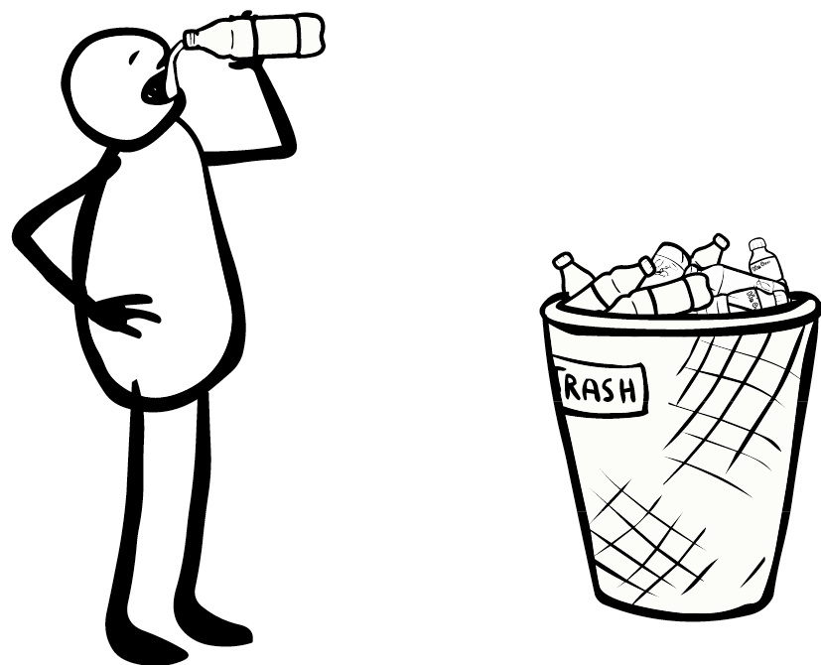

Slide 4
Diagram 1: Systems are rest
Pulley only changes the direction of the string tension
Y
System Block B
X
string tension
gravitational force (weight)
System B: in equilibrium
Newton’s Second Law
Y
System Sphere S
X
System S: in equilibrium
For the System to remain stationary, the mass of the block must equal the mass the mass of the sphere.

Slide 5

Diagram 1
Diagram 2

Slide 6
200 m.s⁻¹
N
30º
30º
200 m.s⁻¹
Y
30º
30º
X

Slide 7
Y
X
+X
initial momentum
final momentum
momentum conservation
Lost in KE

Slide 8
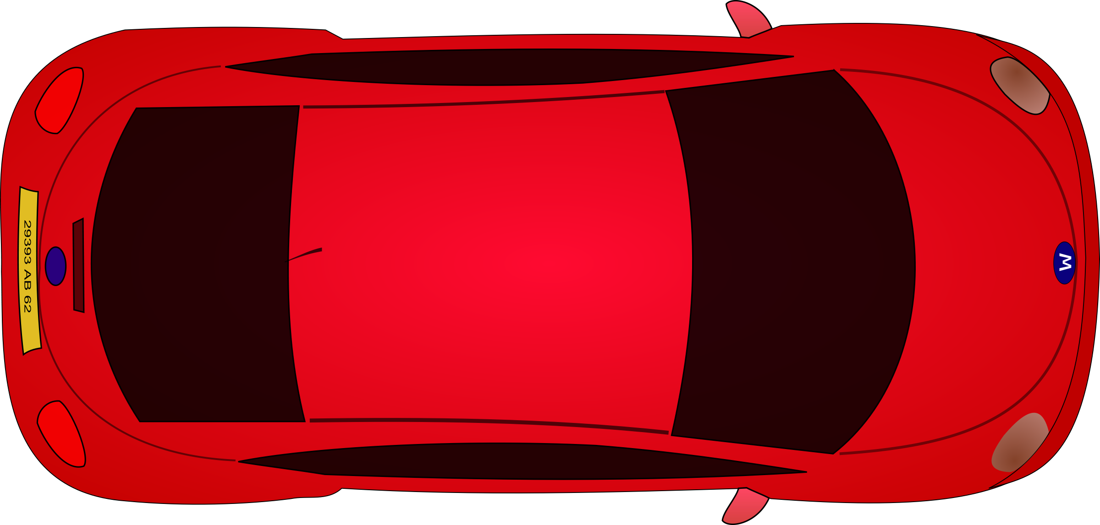


10º
10º
car
tree
Y
X
$$\vec{F}=500 \hat{j} \text{N}$$

Slide 9
Y
10º
10º
X
10º
10º
Equilibrium

Slide 10
Y
Rope pulls on car T
10º
X
Force of rope pulling cat towards tree T_{x}

Slide 12
(A)
(B)

Slide 13
Y
direction of motion of bus
acceleration of bus
X
deflection of ball
Newton’s 2nd Law
Resultant force acting on ball
String tension
11.5º

Slide 14
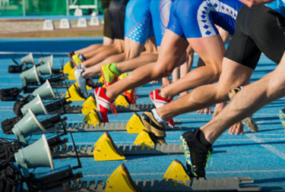
System is a sprinter
Newton’s 2nd Law
Sprinter pushes on ground F_{GS}
Ground pushes on sprinter F_{SG}
Newton’s 3rd Law F_{SG} = - F_{GS}

Slide 15


F₁ is the force of hand on ball
F₂ is the force of ball on hand
F₃ is the force of the ball on the Earth
F₄ is the force of the Earth on the ball

Slide 16
Systems
Y
Ball
m a > 0
Hand
Earth
X
F₁
F₃
F₄
F₂
F₁ is the force of hand on ball
F₂ is the force of ball on hand
F₃ is the force of the ball on the Earth
F₄ is the force of the Earth on the ball
Newton’s 3rd Law: action / reaction forces
Ball / Earth F₄ = F₃
Ball / Hand F₁ = F₂
The ball accelerates upward F₁ > F₄

Slide 17
crash barrier
v
v / 3
Kinetic Energy is a scalar quantity`
Momentum is a vector quantity
Event #1 Just before collision
Event #2 Just before collision
% Loss in kinetic energy during collision
Momentum is a vector quantity, whereas kinetic energy is a scalar. You can not subtract one vector from another without considering the directions of both vectors.

Slide 18
crash barrier
45º
45º
30º
30º
Y
Impulse = change in momentum
momentum
X

Slide 19
Event #1 Just before collision
Event #2 after collision
Impulse and change in momentum
4.92x10³
6.55x10³

Slide 20
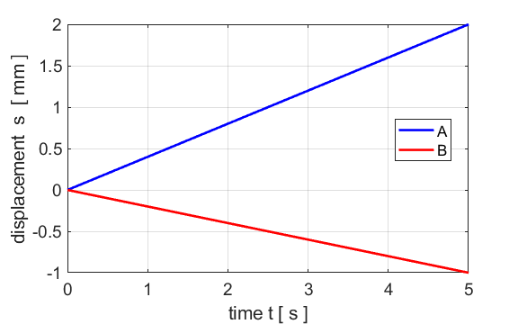
14
slope v_{A} = + 0.400 m.s⁻¹
slope v_{B} = -0.200 m.s⁻¹
Y
Event #1
X
Event #2

Slide 21
14

Slide 22
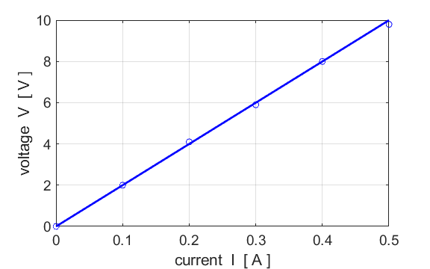

Slide 23
15
pulley
4.00 kg
hinge A
3.00 kg
Y
Newton’s 2nd Law
X

Slide 24
Newton’s 2nd Law
Y
System A
System B
X
From Newton’s 2nd Law applied to systems A and B and just before the objects start to move, we can take a = 0
15

Slide 25
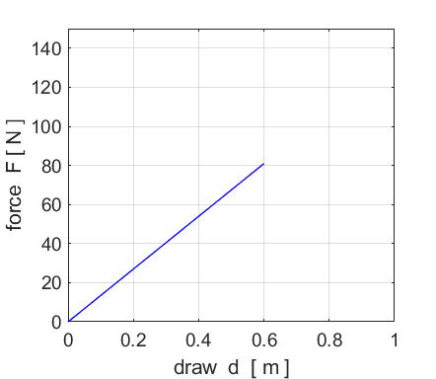

Slide 26
Work done by archer increases the potential energy of the bow. The work done is equal to the area under the force / displacement graph. Therefore, the stored potential energy U of the bow when the draw distance is 0.600 m is
area of triangle = ½ (base) (height)
When the bow is released, we assume that all the stored potential energy is converted into the kinetic energy of the arrow
speed at which arrow leaves bow
work done equals area of triangle

Slide 27
Y
X

Slide 28
45º
45º
net force on ball
Y
X
impulsive force acts on object
impulsive force acts on object
45º
45º
constant acceleration down slope
a_{x} > 0 a_{y} < 0
zero acceleration along horizontal path path
a_{x} = 0 a_{y} = 0
constant acceleration up slope
a_{x} < 0 a_{y} < 0

Slide 29
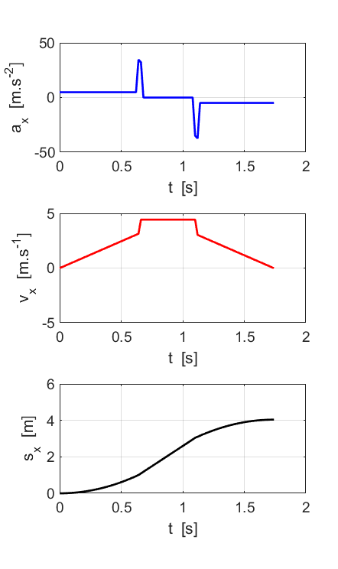
impulsive forces
a_{x} > 0
a_{x} = 0
a_{x}< 0
parabola
parabola
Initial total energy
E = U = m g h
K = 0
straight line
(slope = velocity)
total energy
E = K = m g h
U = 0
final total energy
E = U = m g h
K = 0

Slide 30
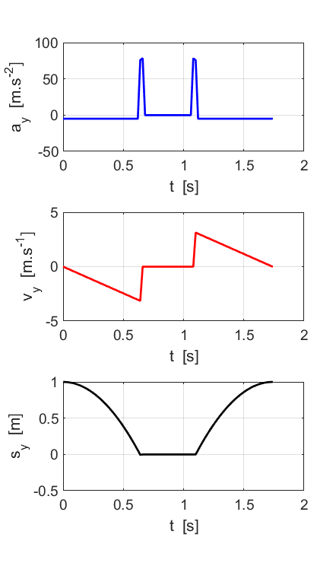
impulsive forces
a_{y} < 0
a_{y} = 0
a_{y} < 0
parabola
parabola
Initial total energy
E = U = m g h
K = 0
straight line
(slope = velocity)
final total energy
E = U = m g h
K = 0
total energy
E = K = m g h
U = 0

Slide 31
A
B
a
a
t
t
a
C
a
D
t
t

Slide 32
+X
momentum p = m v
impulse F dt = dp
m_{A} = 3.00 kg m_{B} = 1.00 kg
(a)
At time t = 3.00 s p_{A} = 8.00 N.s
v_{A} = p_{A} / m_{A} = (8/3) m.s⁻¹ = 2.67 m.s⁻¹
(b) Retarding force F = ? N dt = 6.00 s dp_{A} = 4.00 N.s
F = dp_{A} / dt = (-4/6) N = -0.67 N
same value before and after the collision
Retarding force acts in the negative X direction
(c)
Momentum is conserved in the collision
Loss of momentum of object A = Gain in momentum of object B
Loss of momentum of object A (time t = 6.00 s) = 2.00 N.s
Gain in momentum of object B = m_{B} v_{B} = 2.00 N.s
Velocity of object B immediately after the collision is
v_{B} = 2.00 / m_{B} = (2.00/1.00) m.s⁻¹ = 2.00 m.s⁻¹

