Slide 1
R
A
R
ε
R
R
2.0 A
The three resistive arms of the circuit are connected in parallel to the battery. So, the same potential difference exists across each arm.
The current through an arm of the circuit is
R
2.0 A
A
R
ε
1.0 A
R
R
Kirchhoff’s Current Law:
current from battery equals current through the three resistive arms of the circuit

Slide 4
Diagram 1: Systems are rest
Pulley only changes the direction of the string tension
Y
System Block B
X
string tension
gravitational force (weight)
System B: in equilibrium
Newton’s Second Law
Y
System Sphere S
X
System S: in equilibrium
For the System to remain stationary, the mass of the block must equal the mass the mass of the sphere.

Slide 5

Diagram 1
Diagram 2

Slide 6
200 m.s⁻¹
N
30º
30º
200 m.s⁻¹
Y
30º
30º
X

Slide 7
Y
X
+X
initial momentum
final momentum
momentum conservation
Lost in KE

Slide 8
Ideal battery
I
ε
R
Real battery
I
R_{int}
R
ε

Slide 9
I = 50 A
R_{battery}
V_{battery} = 11.4 V
R_{motor}
V_{motor} = 8.4 V
R_{cable}
V_{cable} = 3.0 V

Slide 11
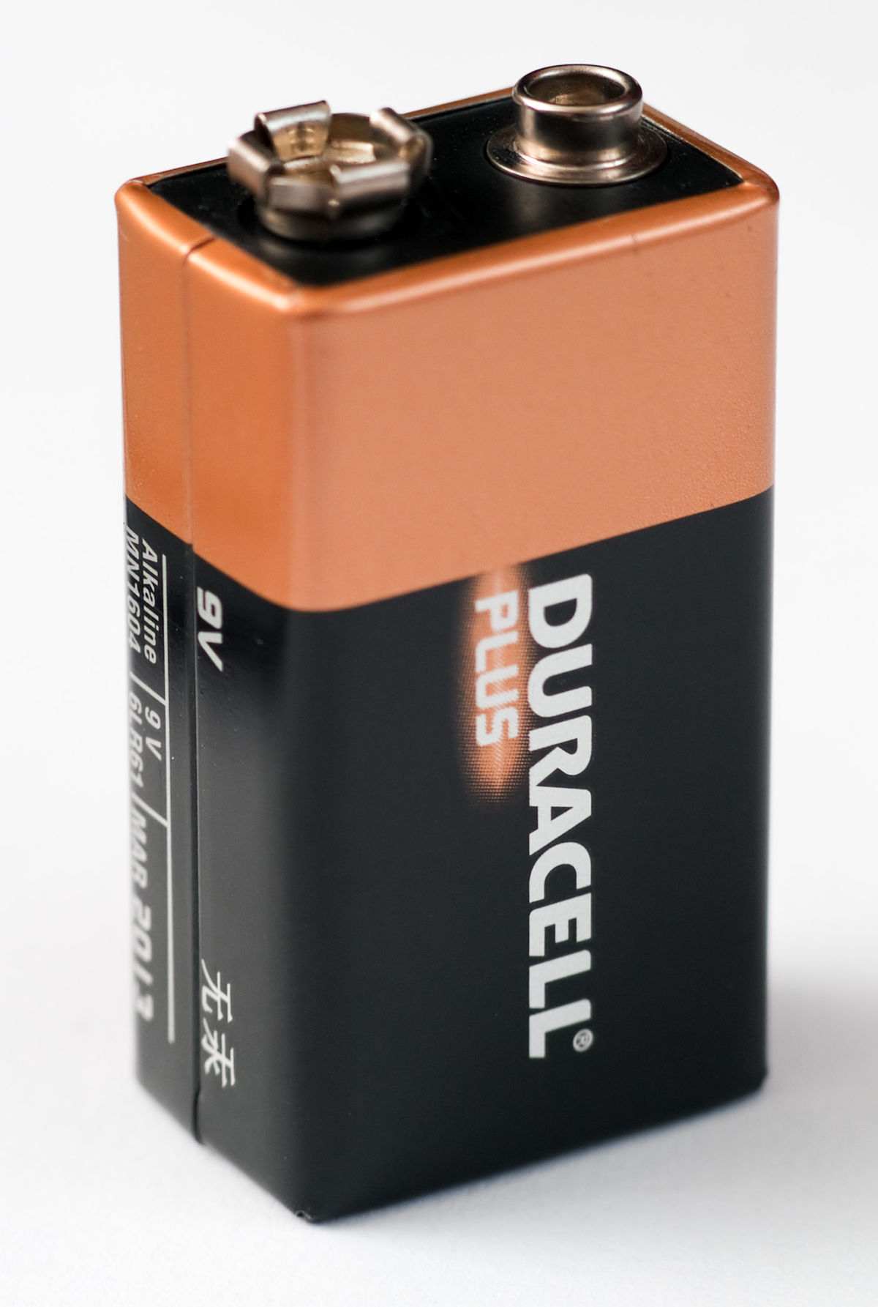
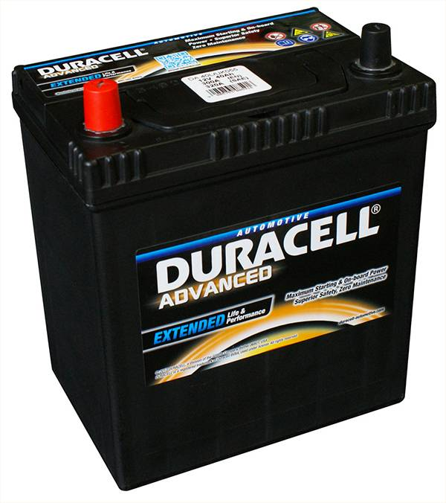

Slide 12
ε
R_{INT}
A
V
P
Q
R₁
R₂

Slide 13
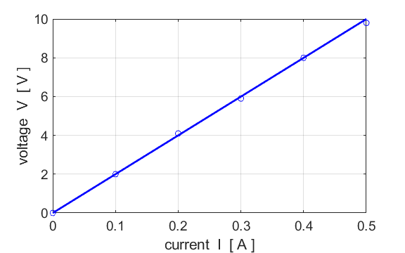

Slide 14
- - -
+ + + + + +
---
---
- - -
- - -
- - -
- -
+ + + + + +
- - -
leaves start to collapse as positive rod attracts the negavitive charges from leaves
- -
- -
- - -
- -
+ + + + + +
- - -
leaves start to collapse as positive rod attracts the negavitive charges from leaves
- -
- -

Slide 15
- - -
- -
+ + + + + +
---
---
leaves start to collapse as positive rod attracts the negative charges from leaves
- -
- -
------
------
+ + + + + +
---
---
leaves fully collapsed as positive rod attracts more negative charges from leaves, leaving them neutral
------
------
------
+ + + + + +
---
---
leaves move apart as positive rod attracts more negative charges from leaves, leaving them now with a positive charge
+
+

