Slide 1
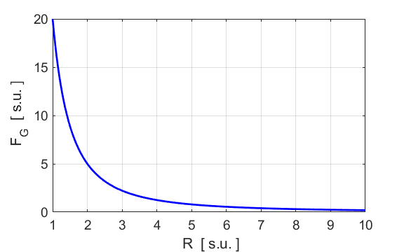
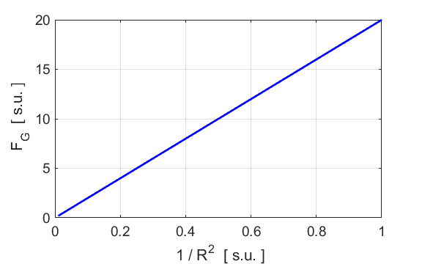

Slide 2
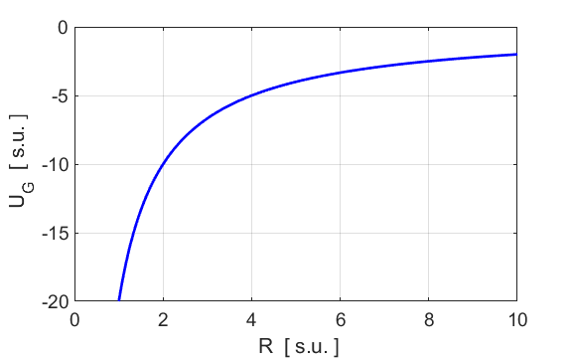
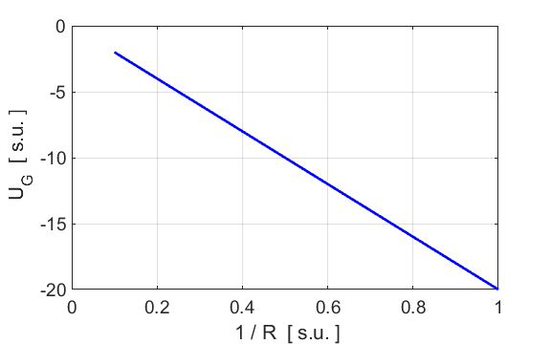

Slide 5
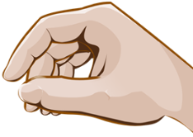
Diagram 1
Diagram 2

Slide 6
200 m.s⁻¹
N
30º
30º
200 m.s⁻¹
Y
30º
30º
X

Slide 7
Y
X
+X
initial momentum
final momentum
momentum conservation
Lost in KE

Slide 8

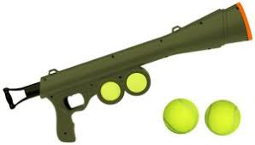
max height
launch
max range
arrow same length as launch

Slide 9
+Y
+X
launch
max
height
just before
hitting ground
for max height reached by ball
for max range by ball

Slide 10
+Y
+X
max height
At maximum height
range
If the initial velocity is doubled, the ball will rise 4 times higher
Range
If the initial velocity is doubled, the range will increase by a factor 4

