Slide 1
X
Y
Z
60 A
20 A
10 A
X
Y
Z
Y
2d
d
3d
X
60 A
20 A
10 A

Slide 2
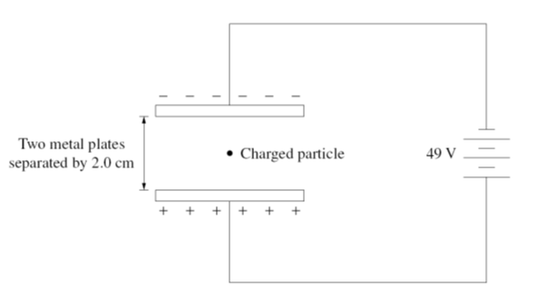
d=20.0 mm
49 V
charged particle
- - - - - - - - - - - - -
+ + + + + + + + + +

Slide 4
Motor
Motor

Slide 5
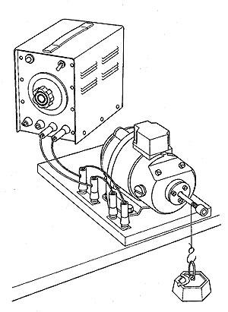
Model parameters
battery emf V = 12.0 V
resistance of motor’s coil
R = 1.00 Ω
magnetic field B = 0.10 T
area of coil A = 0.040 m²
radius of shaft lifting load
d = 0.010 m
mass of load m [kg]
B, A , R
V
d
m

Slide 6
200 m.s⁻¹
N
30º
30º
200 m.s⁻¹
Y
30º
30º
X

Slide 7
Y
X
+X
initial momentum
final momentum
momentum conservation
Lost in KE

Slide 8
Z
N
Y
W
E
S
X
An emf is generated through a changing magnetic flux
The wire moving downward generates a changing magnetic flux as it cuts through the Earth’s magnetic field
The direction of the induced emf can be determined from the right hand palm rule
Force on free electrons in wire as they move down is towards the –Y direction (West). Therefore, the East end of the wire will be positive.
+
E
W
Magnetic flux is constant, zero induced emf and zero current in the wire loop

Slide 9
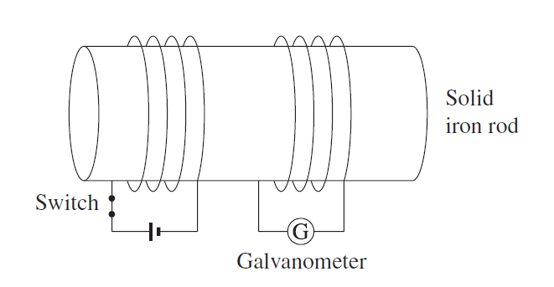
solid
iron core
switch
battery
galvanometer
(A) switch permanently closed
(B) switch opened
I
I
0
0
t
t
(C) switch closed
(D) switch permanently open
I
I
0
0
t
t

