Slide 1
Newton’s Particle Model
Wave Model
#1 air
45º
light speeds up
light slows down
32º
#2 water
#2 water

Slide 2
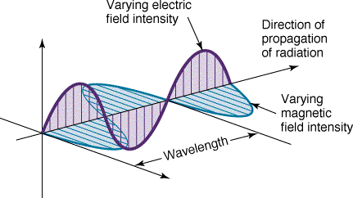
Light is an electromagnetic wave. The diagram shows a linear polarized wave

Slide 3
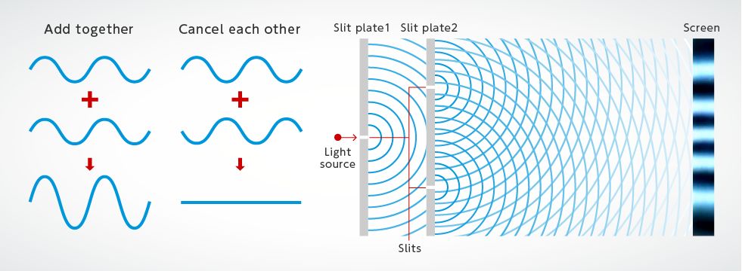
Waves exhibit diffraction and interference effects

Slide 4
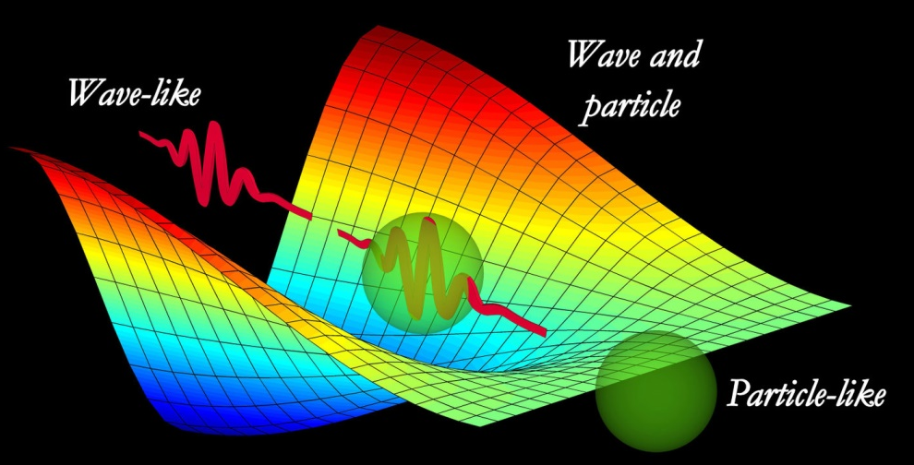
Mystery of light: dual nature particle / wave

Slide 5
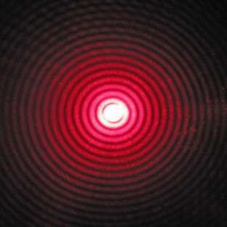
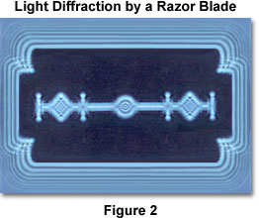

Diffraction
circular aperture
razor blade
rectangular grid

Slide 6
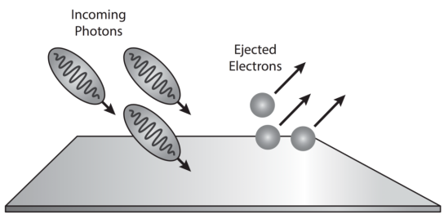
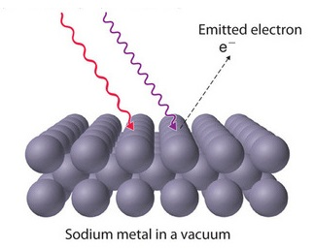
red light does did result in the emission of electrons from the surface of sodium
metal surface
Particle nature of light: photoelectric effect

Slide 7
Zn
photoelectrons ejected
Mg
no photoelectrons ejected
Li
Cs
infrared
visible
ultra-
violet

Slide 8
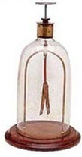
ultra-violet light causes electrons to be ejected from the electroscope
the leaves become negatively charge and hence repel each

Slide 9

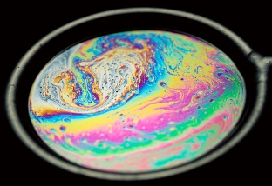
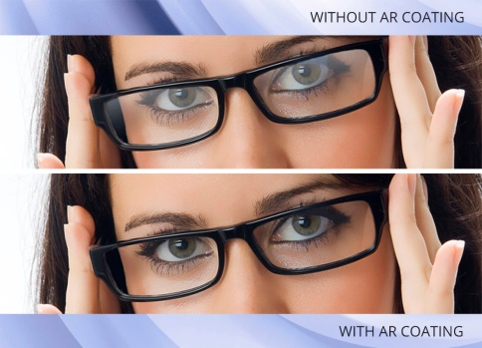
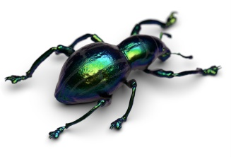
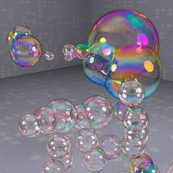
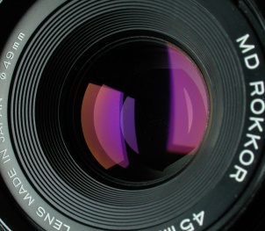

without coating
The colour is due to a thin film covering.
The colours are due to a thin layer of oil of varying thickness on water.
with coating
Thin films are used to reduce reflections on glass.
soap bubbles

Slide 10
incident light λ = 420 nm
air: refractive index 1
oil: refractive index 1.40
oil: thickness 225 nm
glass refractive index 1.54

Slide 11
incident wave
reflected wave: π rad change in phase on reflection since n₁ < n₂
1: air
reflected wave: π rad change in phase on reflection since n₂ < n₃
2: oil
3: glass
The two reflected waves interfere with each other:
in phase ⇒ constructive interference
out of phase ⇒ destructive interference

Slide 12
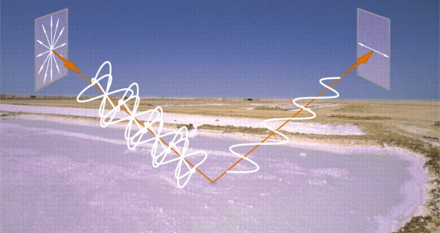
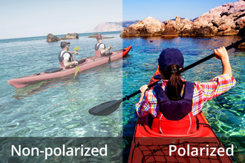
light reflected off water is polarised

Slide 13
λ [m]
λ [m]
(0, 0)
T [K]
1/T [K⁻¹]

Slide 14
