Slide 1
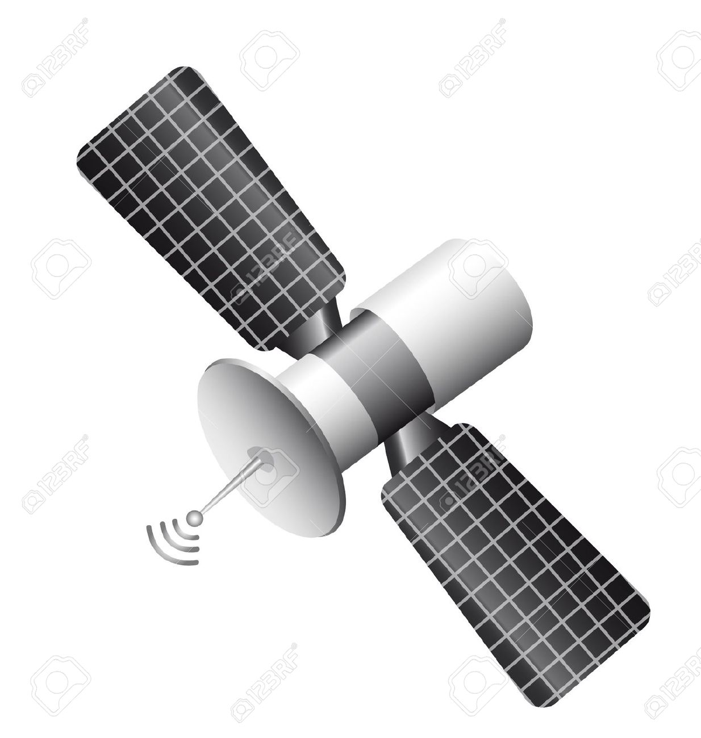

A
B
Earth

Slide 2
Pat’s frame of reference on earth
10 light years
Earth
0.8 c
star
Chris’s frame of reference on spaceship
0.8 c
0.8 c
Earth
star
contracted length

Slide 3

inertial observer
mass of object m
momentum of object p
v
energy of object E
m

Slide 4
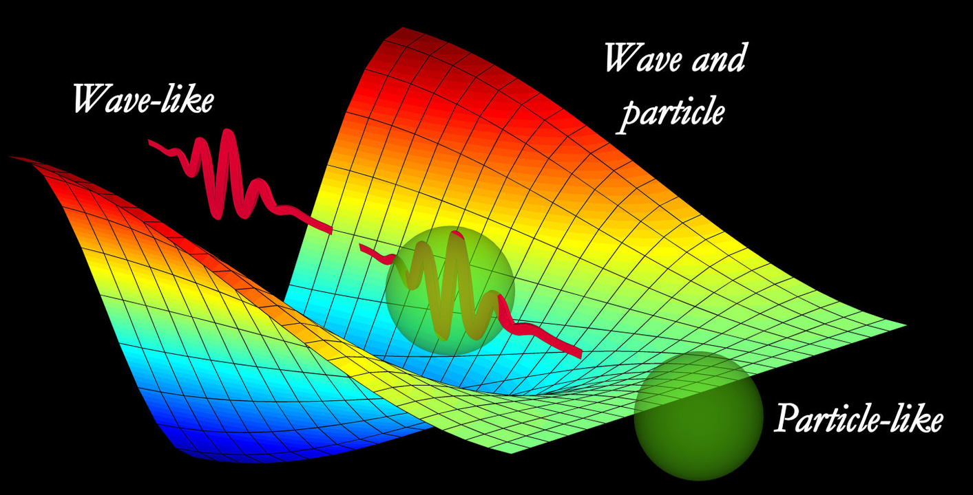
Mystery of light: dual nature particle / wave

Slide 5
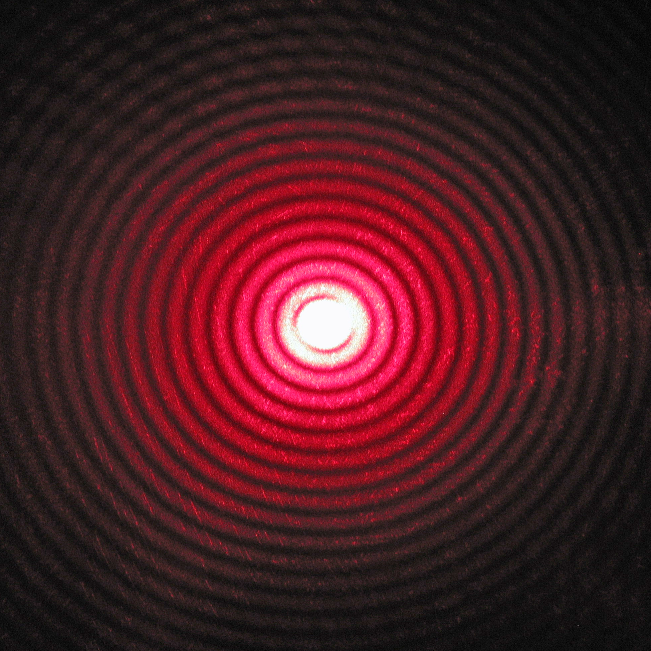
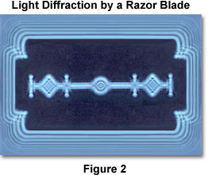

Diffraction
circular aperture
razor blade
rectangular grid

Slide 6
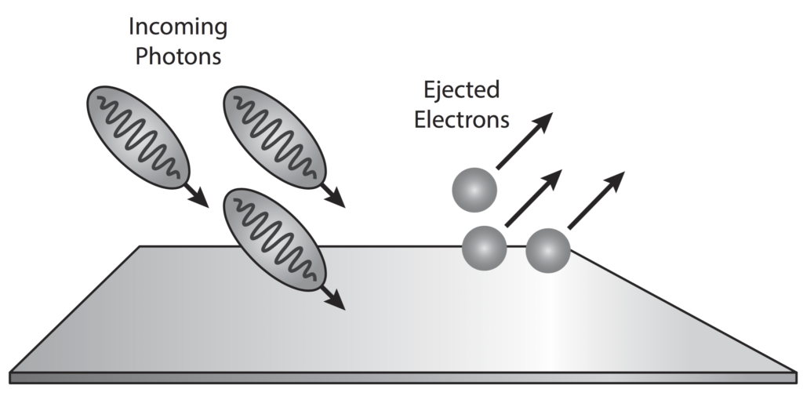
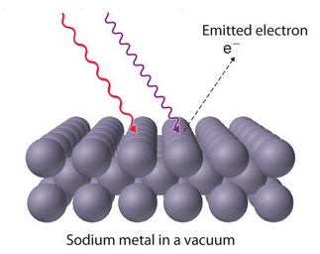
red light does did result in the emission of electrons from the surface of sodium
metal surface
Particle nature of light: photoelectric effect

Slide 7
Zn
photoelectrons ejected
Mg
no photoelectrons ejected
Li
Cs
infrared
visible
ultra-
violet

Slide 8
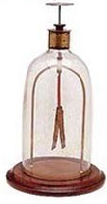
ultra-violet light causes electrons to be ejected from the electroscope
the leaves become negatively charge and hence repel each

