Slide 1
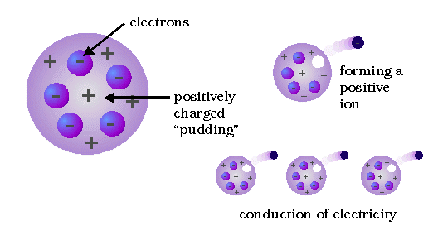
electron
spherical cloud (“pudding”) of positive charge
formation of a positive ion
~ 10⁻¹⁰ m
conduction by “free” electrons”

Slide 2
positive
nucleus
orbiting
electrons

Slide 3


Slide 4
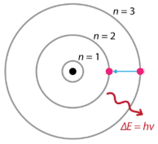
stable orbits (electrons in specific orbits with specific energy)
photon

Slide 5
absorption
emission
n₃ E₃
E₃₂
E₂₃
f₂₃
n₂ E₂
E₃₁
E₁₃
E₁₂
f₁₃
E₂₁
f₁₂
n₁ E₁
E₃₁ = E₂₁ + E₃₂
E₁₂ = E₁₃ - E₂₃
The frequency of any spectral line is always equal to the sum or difference of the frequencies of other spectral lines for the same gas
f₁₂ = f₁₃ - f₂₃
f₁₃ = f₁₂ + f₂₃

Slide 6
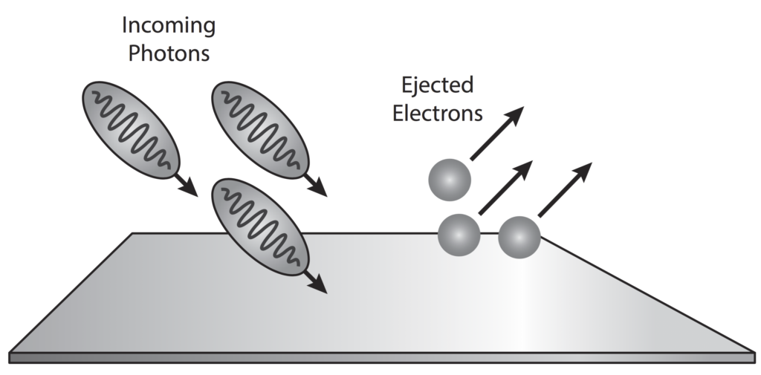
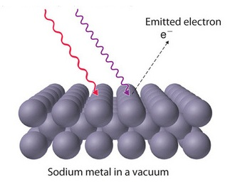
red light does did result in the emission of electrons from the surface of sodium
metal surface
Particle nature of light: photoelectric effect

Slide 7
Zn
photoelectrons ejected
Mg
no photoelectrons ejected
Li
Cs
infrared
visible
ultra-
violet

Slide 8

ultra-violet light causes electrons to be ejected from the electroscope
the leaves become negatively charge and hence repel each

