Slide 1
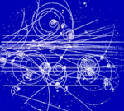

Energy and mementum conservation
in
nuclear and particle physics
Gil Refael

Slide 2

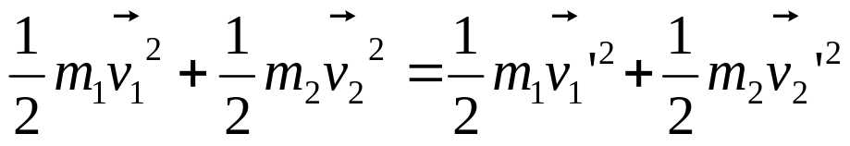
Conservation laws:
Momentum conservation:
Energy conservation:
(Elastic collision)
1
2

Slide 3
Conservation laws:
Momentum conservation:
Energy conservation:
(Elastic collision)
2
1

Slide 4

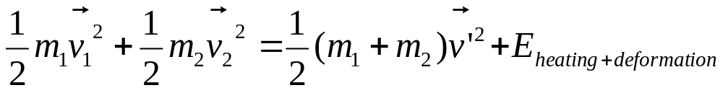
Conservation laws:
Momentum conservation:
Energy conservation:
(inelastic collision)
2
2
1
1

Slide 5


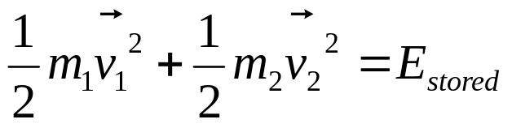
‘Explosion type’ collision
2
1
Momentum conservation:
Energy conservation:

Slide 6
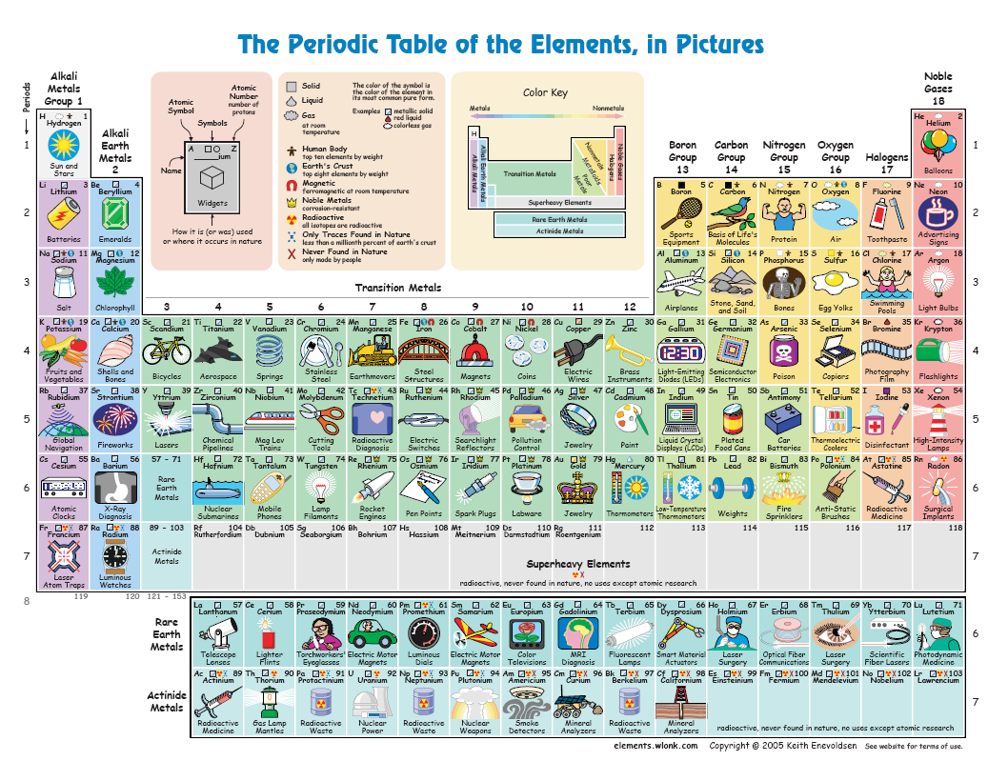
Radioactivity

Slide 7
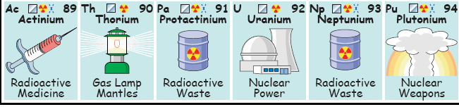

Radioactivity and Elementary particles
Uranium (238):
Thorium
+
+
+
+
92 protons
+
+
+
+
+
+
+
+
+
+
+
+
+
146 neutrons
+
+
+
+
+
+
+
+
+
Very crowded!
+
Alpha particle
=Helium nuclei
Radioactive “alpha” decay

Slide 8

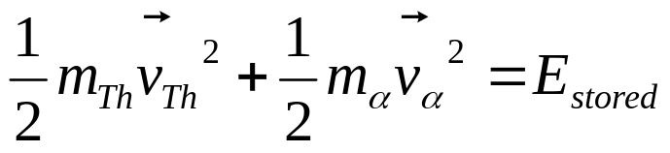

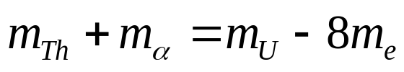
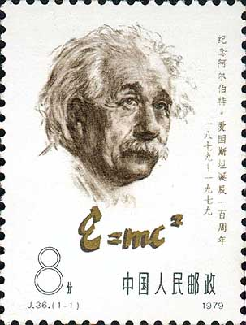
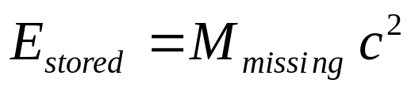
Uranium Decay
(half time: 4.46 billion years)
Thorium (234)
Uranium (238)
+
+
+
+
+
Alpha (4)
+
+
+
+
+
+
+
+
Momentum conservation:
Energy conservation:
What is ?
Clue:
Some mass disappears in the transition!
8 electron masses missing!
c=speed of light=300,000,000 m/s

Slide 9

Another example: Plutonium
(half time: 24,100 years)
Uranium (235)
Plutonium (239)
+
+
+
+
+
Alpha (4)
+
+
+
+
+
+
+
+
What is ?
c=speed of light=300,000,000 m/s
What is the recoil speed?

Slide 10
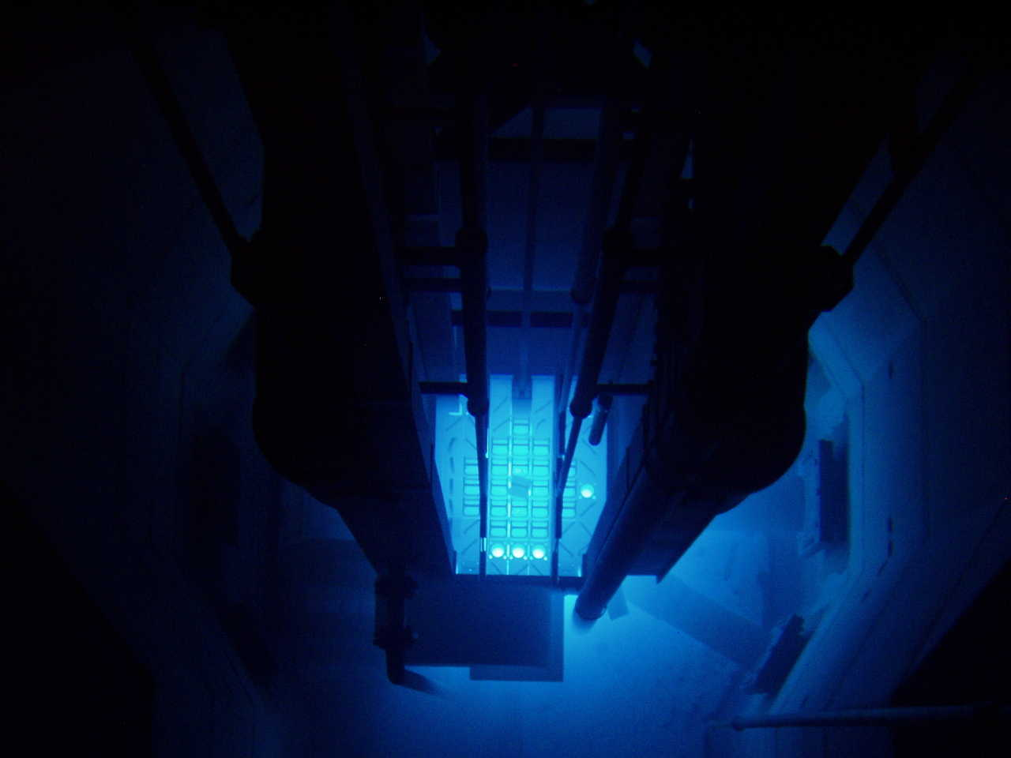
Uses of Uranium and Plutonium
Uranium (235):
Fuel for nuclear reactors.
Uranium (238):
Fuel for nuclear reactors.
Plutonium (239) production.
Plutonium (239):
Fuel for nuclear reactors.
Nuclear weapons…

Slide 11




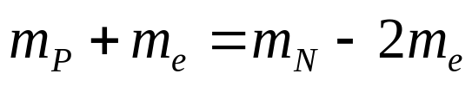
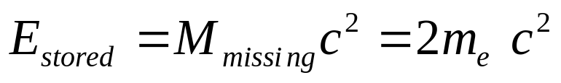

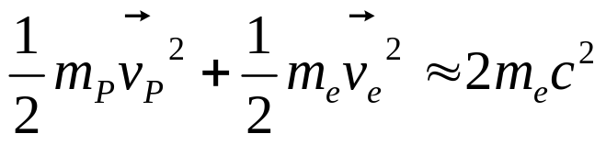
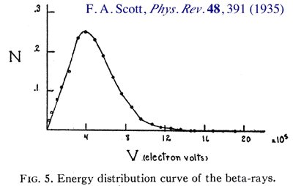
Elementary particles: Neutron decay
Just like Uranium, the neutron itself (outside a nucleaus) is also unstable:
N
+
Expect: electrons have the same energy in the end of the process.
But:
Every experiment
gave a different result!

Slide 12

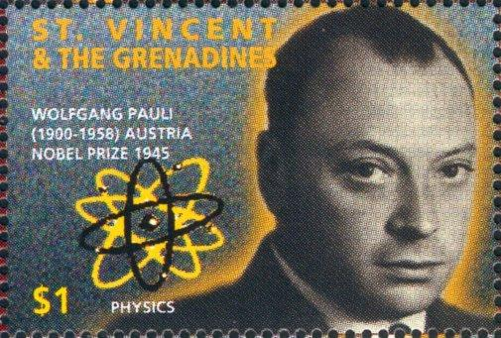
Neutron decay
Just like Uranium, the neutron itself (outside a nucleaus) is also unstable:
N
+
What about momentum and energy conservation ?!?
Answer: There must be another particle!
Neutrino
Very light particle, that can go unscattered
Through the entire galaxy!

Slide 13
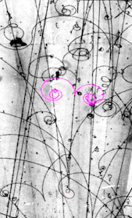
How was this measured?
Bubble chambers
X
Magnetic
Field
X
X
Liquid Hydrogen on the
verge of becoming gas.
Particles leave trail of bubbles!

Slide 14

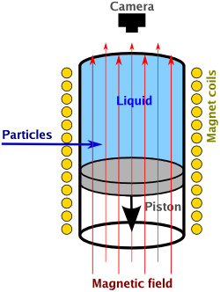

How was this measured?
Bubble chambers
X
Magnetic
Field
X
X
X
Neutron (0)
X
X
+
Proton (+1)
Radius proportional to momentum

Slide 15
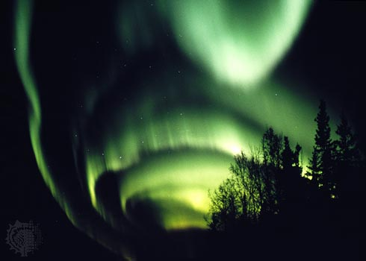
Aurora Borealis – aka, Northern Lights
Fairbanks, Alaska:
© Jack Finch—Science Photo Library/Photo Researchers, Inc.

Slide 16
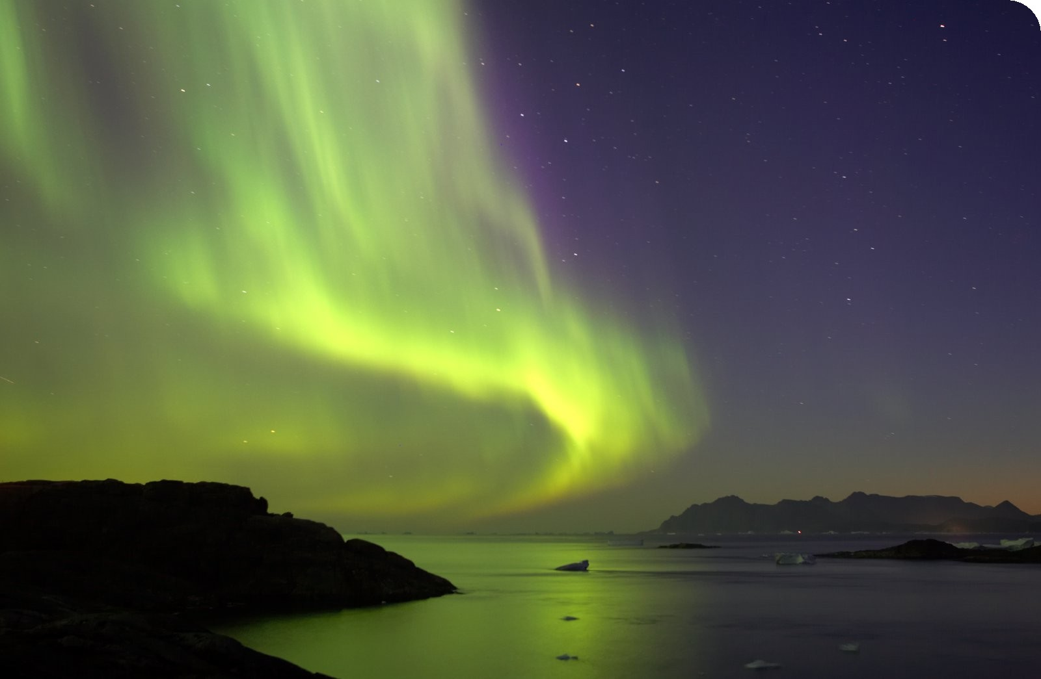
Aurora Borealis – aka, Northern Lights
Kangerlussuaq, Greenland’s west coast:
(www.greenlandholiday.com)

Slide 17
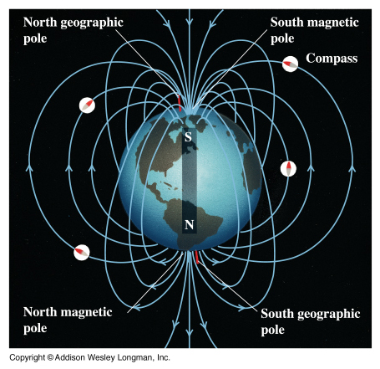
Aurora Borealis – aka, Northern Lights
Fast particles
from the sun:
+
Proton (+1)

Slide 18
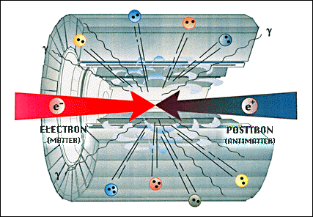
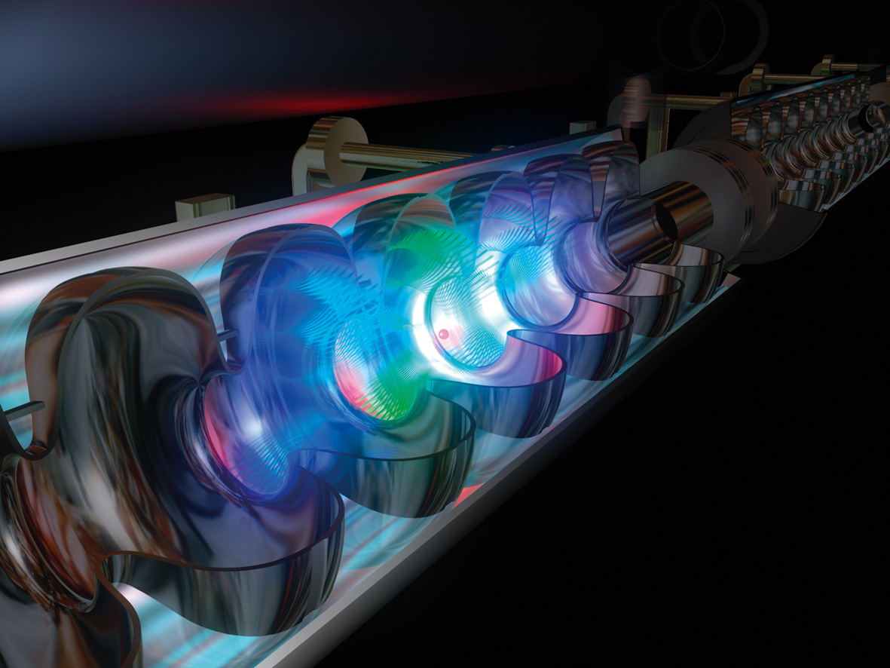
The particle hunters
How to produce new particles like the neutrino?
Make very energetic collisions between them!
This happen in particle accelerators:
Electrons are accelerated
up to near the speed of light!

Slide 19
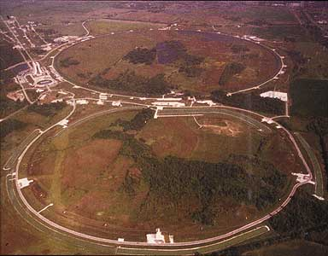
Monster accelerators
Fermilab in Chicago:

Slide 20
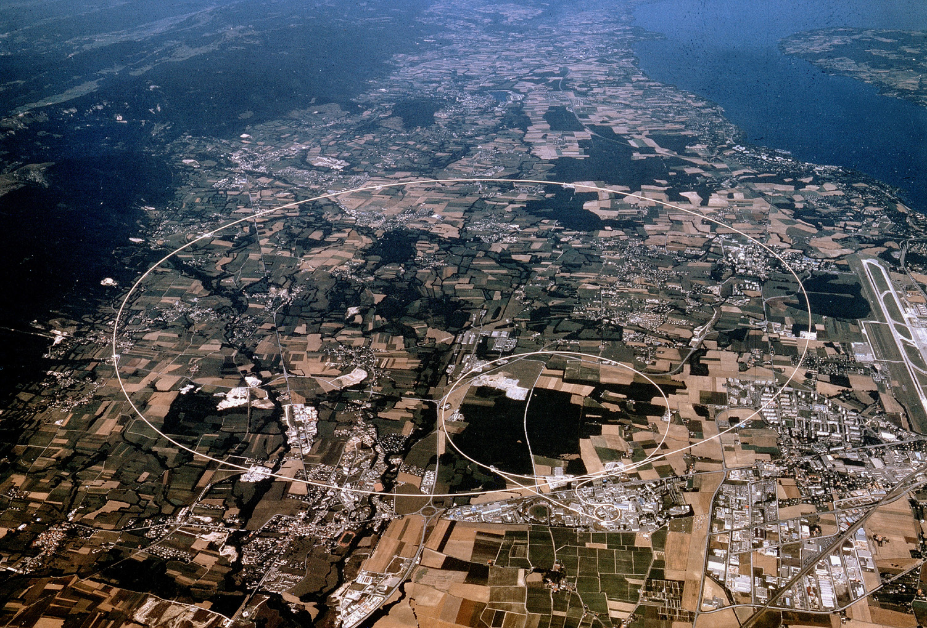
Monster accelerators
Cern in Geneva:

Slide 21
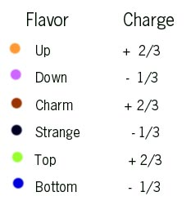
Elementary particles – Quarks and Leptons
So far:
  Protons (+1)
  Neutrons (0)
  Electrons (-1)
+
N
But also: Neutrinos.
Proton itself consists of quarks:
up
- “up” quark (charge: +2/3)
up
+
up
d
d
- “down” quark (charge: -1/3)
Neutron:
More quarks: (!)
up
N
d
d

Slide 22

To discover new quarks and other elementary particles:
Need energy of:
!!!
Right now searching for:
The Higgs
“The particle that gives all particles their masses…”

