Slide 1
Magnetism & Electromagnetism
Unit 10

Slide 2
Sources of Magnetic Fields
The region of space surrounding a moving charge includes a magnetic field
The charge will also be surrounded by an electric field
A magnetic field surrounds a properly magnetized magnetic material

Slide 3
Magnetic Fields
A vector quantity
Symbolized by
Direction is given by the direction a north pole of a compass needle points in that location
Magnetic field lines can be used to show how the field lines, as traced out by a compass, would look

Slide 4
Magnetic Fields
When moving through a magnetic field, a charged particle experiences a magnetic force
This force has a maximum value when the charge moves perpendicularly to the magnetic field lines
This force is zero when the charge moves along the field lines

Slide 5
Magnetic Fields, cont
One can define a magnetic field in terms of the magnetic force exerted on a test charge moving in the field with velocity
Similar to the way electric fields are defined

Slide 6
Units of Magnetic Field
The SI unit of magnetic field is the Tesla (T)
Wb is a Weber
The cgs unit is a Gauss (G)
1 T = 10⁴ G

Slide 7
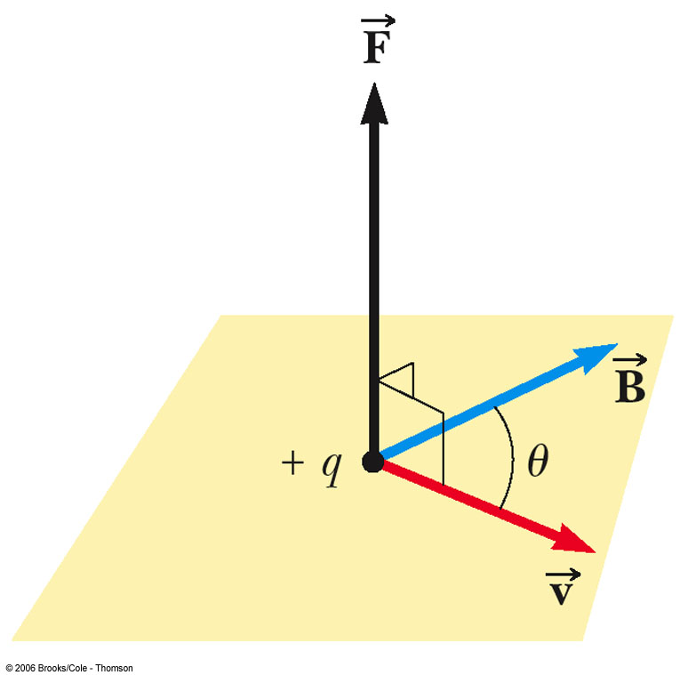
Finding the Direction of Magnetic Force
Experiments show that the direction of the magnetic force is always perpendicular to both and
F_{max} occurs when is perpendicular to
F = 0 when is parallel to

Slide 8
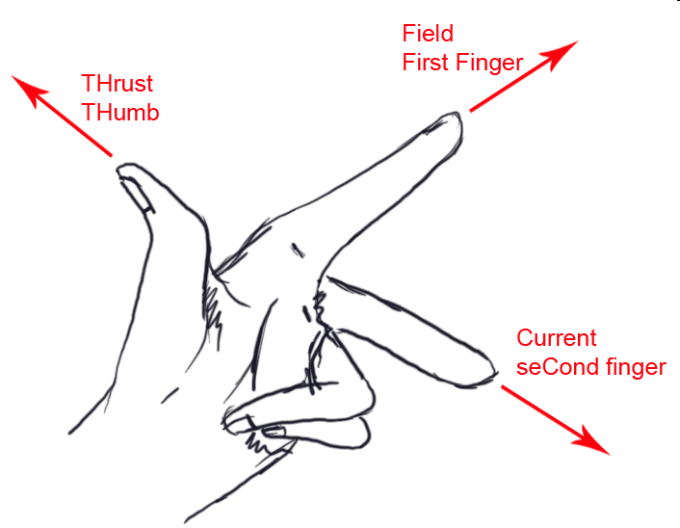
Direction of Force
Fleming’s Left hand motor rule

Slide 9
Caution!
When q is negative, the direction of current is opposite
Force on the charge will be opposite
Try the same with negative charge

Slide 10
Example
A proton moves perpendicular to a uniform magnetic field B at 1.0 x 10⁷ m/s and experiences an acceleration of 2.0 x 10¹³ m/s² in the +x direction when its velocity is in the +z direction. Determine the magnitude and direction of the field.

Slide 11
Magnetic Force on a Current Carrying Conductor
A force is exerted on a current-carrying wire placed in a magnetic field
The current is a collection of many charged particles in motion
The direction of the force is given by Fleming’s left hand motor rule

Slide 12
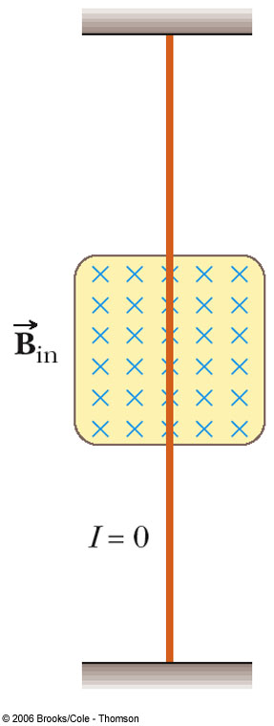
Force on a Wire
The blue x’s indicate the magnetic field is directed into the page
The x represents the tail of the arrow
Blue dots would be used to represent the field directed out of the page
The • represents the head of the arrow
In this case, there is no current, so there is no force

Slide 13
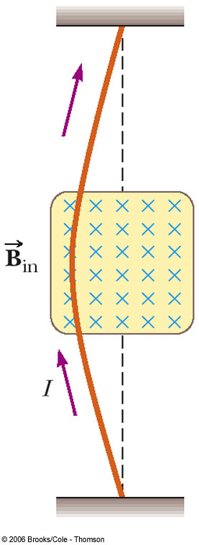
Force on a Wire, cont
B is into the page
The current is up the page
The force is to the left

Slide 14
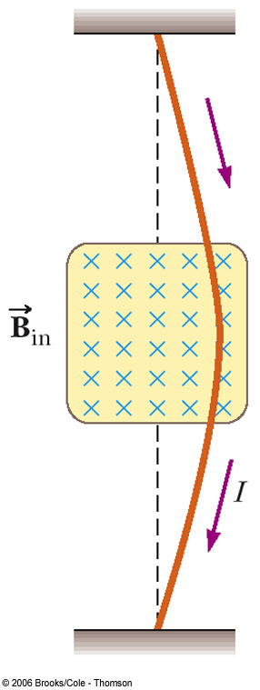
Force on a Wire, final
B is into the page
The current is down the page
The force is to the right

Slide 15
Force on a Wire, equation
The magnetic force is exerted on each moving charge in the wire
The total force is the sum of all the magnetic forces on all the individual charges producing the current
F = B I ℓ sin θ
θ is the angle between and the direction of I
The direction is found by the Fleming’s left hand motor rule.

Slide 16
Example
A 30 m long wire carries a current of 10 A in a 1 T magnetic field.
Find the maximum magnetic force on the wire.

Slide 17

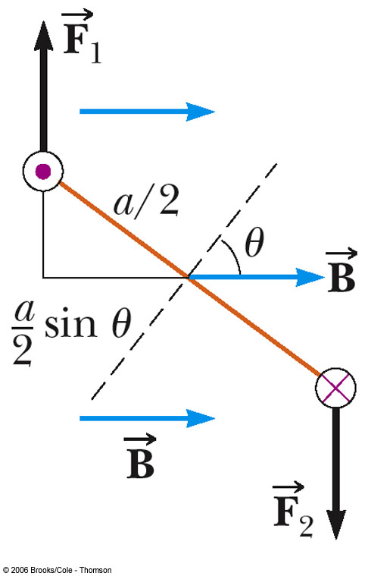
Torque on a Current Loop
Applies to any shape loop
N is the number of turns in the coil
Torque has a maximum value of NBIA
When θ = 90°
Torque is zero when the field is parallel to the plane of the loop
µ

Slide 18
Magnetic Moment
The vector is called the magnetic moment of the coil
Its magnitude is given by μ = IAN
The vector always points perpendicular to the plane of the loop(s)
The angle is between the moment and the field
The equation for the magnetic torque can be written as τ = μB sinθ

Slide 19
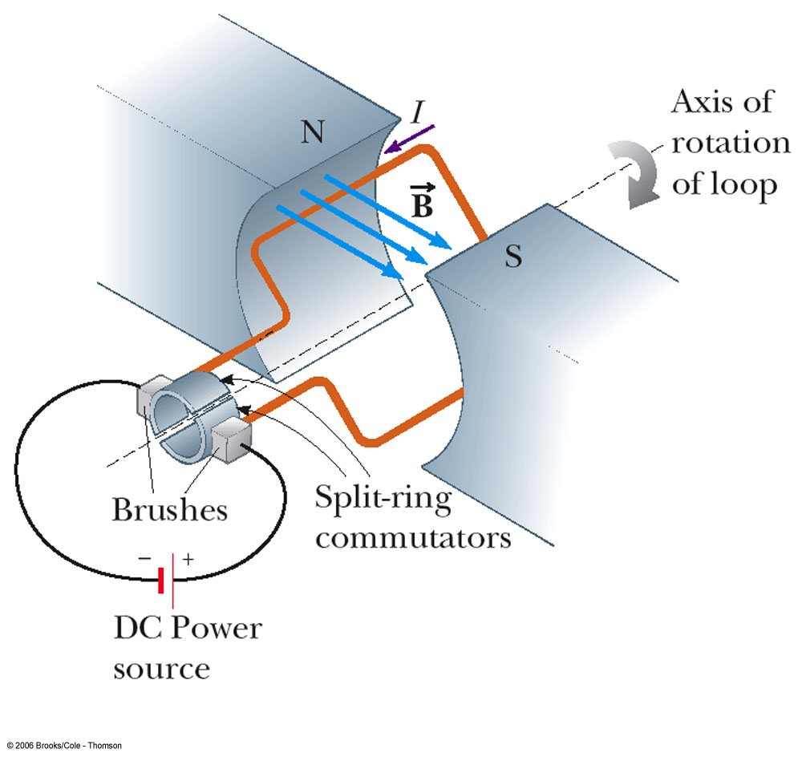
Electric Motor
An electric motor converts electrical energy to mechanical energy
The mechanical energy is in the form of rotational kinetic energy
An electric motor consists of a rigid current-carrying loop that rotates when placed in a magnetic field
Study example 10.3

Slide 20
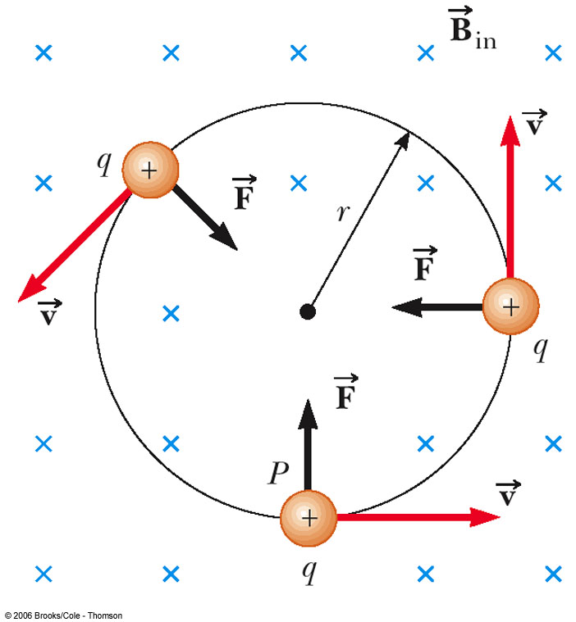
Force on a Charged Particle in a Magnetic Field
Consider a particle moving in an external magnetic field so that its velocity is perpendicular to the field
The force is always directed toward the center of the circular path
The magnetic force causes a centripetal acceleration, changing the direction of the velocity of the particle

Slide 21
Force on a Charged Particle
Equating the magnetic and centripetal forces:
Solving for r:
r is proportional to the momentum of the particle and inversely proportional to the magnetic field
Sometimes called the cyclotron equation

Slide 22
Example
A 1 µC charge of mass 3.0 x 10⁻¹⁵ kg enters a region of magnetic field 0.5 T directed downwards. If the speed of the charge is 200 m/s, what is the turning radius of the charge

Slide 23
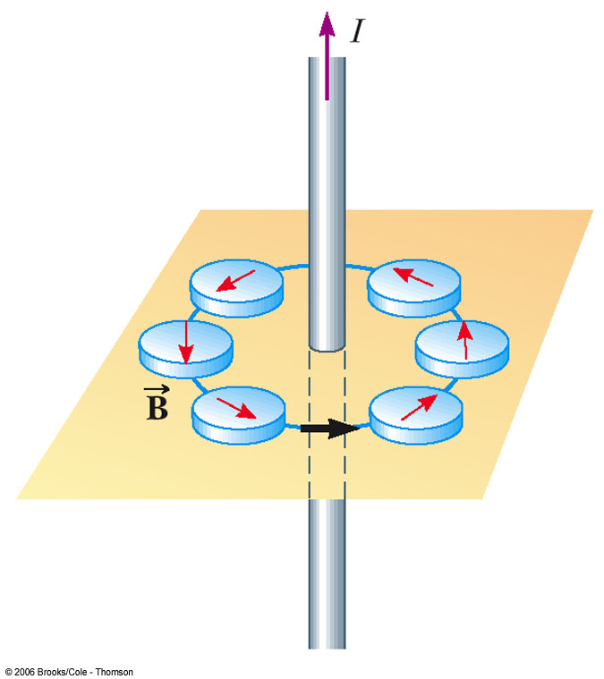
Magnetic Fields – Long Straight Wire
A current-carrying wire produces a magnetic field
The compass needle deflects in directions tangent to the circle
The compass needle points in the direction of the magnetic field produced by the current

Slide 24
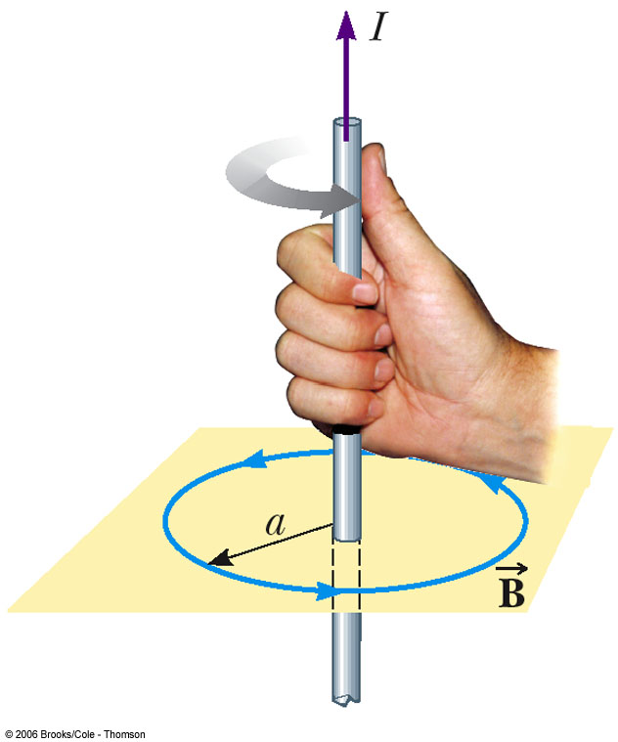
Direction of the Field of a Long Straight Wire
Right Hand Screw Rule
Grasp the wire in your right hand
Point your thumb in the direction of the current
Your fingers will curl in the direction of the field

Slide 25
Magnitude of the Field of a Long Straight Wire
The magnitude of the field at a distance r from a wire carrying a current of I is
µ_{o} = 4 π x 10⁻⁷ T.m / A
µ_{o} is called the permeability of free space

Slide 26
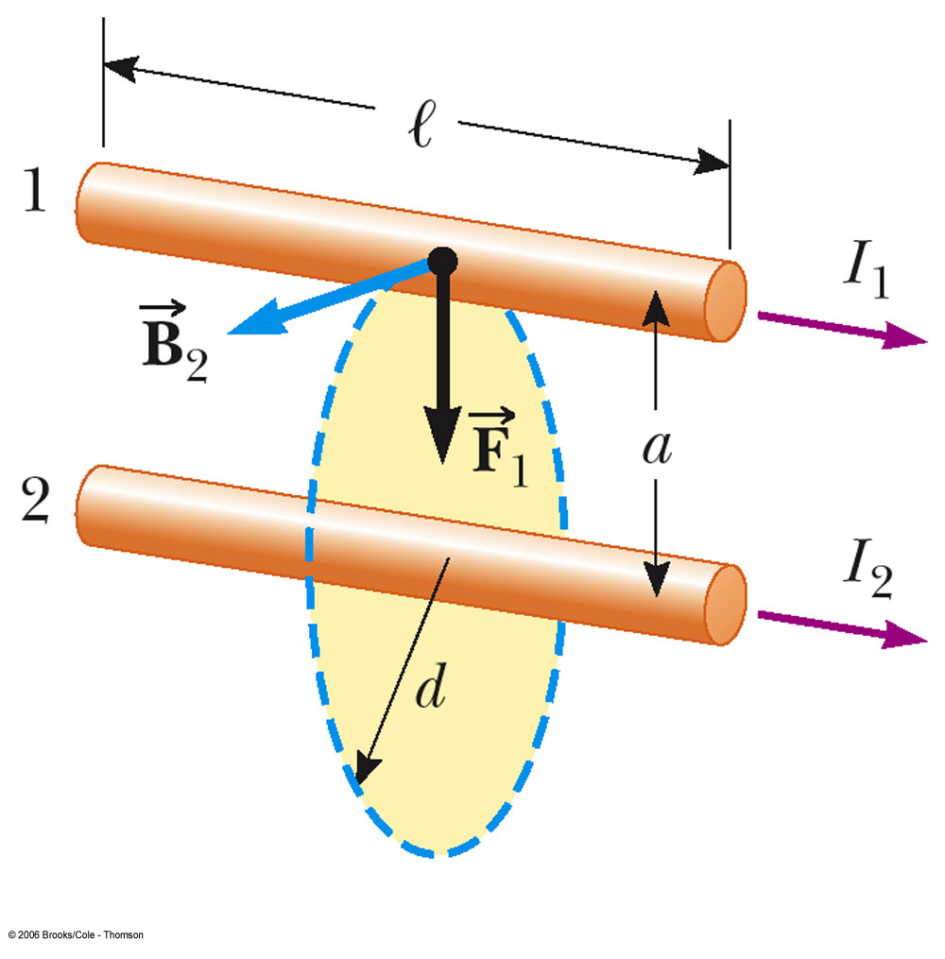
Magnetic Force Between Two Parallel Conductors
The force on wire 1 is due to the current in wire 1 and the magnetic field produced by wire 2
The force per unit length is:

Slide 27
Force Between Two Conductors, cont
Parallel conductors carrying currents in the same direction attract each other
Parallel conductors carrying currents in the opposite directions repel each other

Slide 28
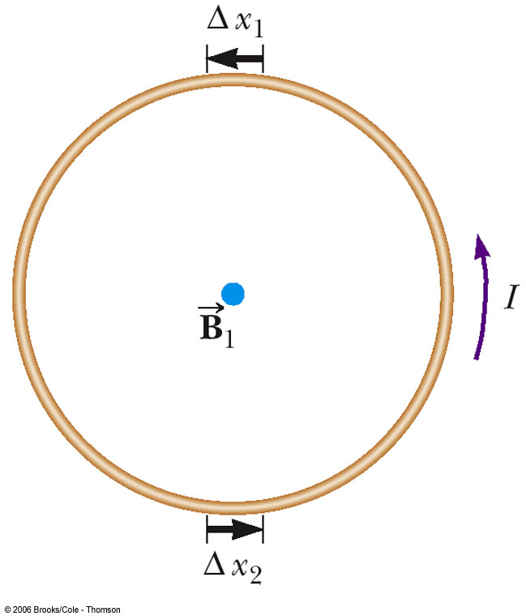
Magnetic Field of a Current Loop
The strength of a magnetic field produced by a wire can be enhanced by forming the wire into a loop
All the segments, Δx, contribute to the field, increasing its strength

Slide 29
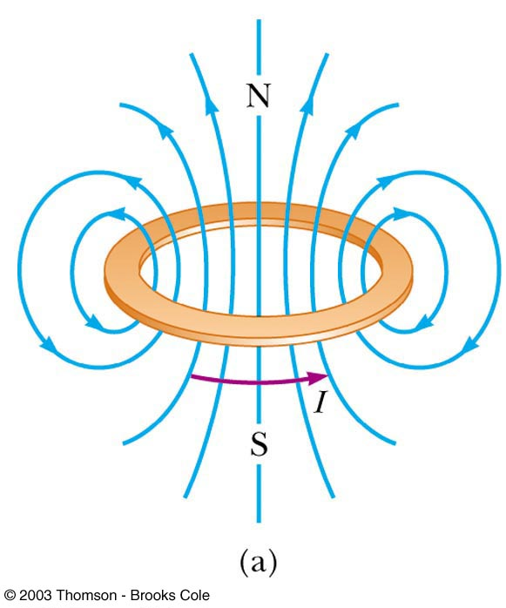
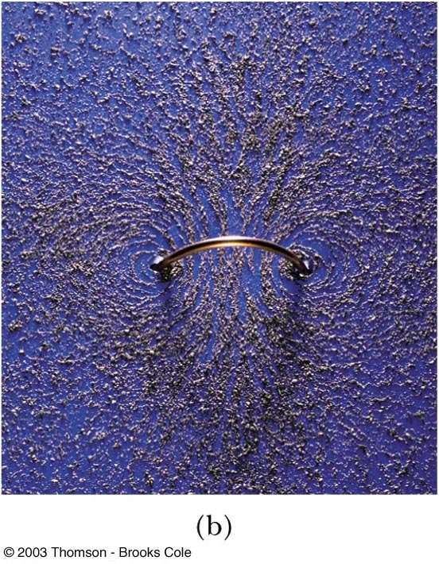
Magnetic Field of a Current Loop – Total Field

Slide 30
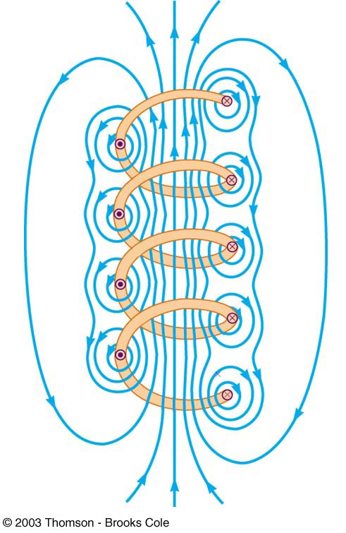
Magnetic Field of a Solenoid
If a long straight wire is bent into a coil of several closely spaced loops, the resulting device is called a solenoid
It is also known as an electromagnet since it acts like a magnet only when it carries a current

Slide 31
Magnetic Field of a Solenoid, 2
The field lines inside the solenoid are nearly parallel, uniformly spaced, and close together
This indicates that the field inside the solenoid is nearly uniform and strong
The exterior field is nonuniform, much weaker, and in the opposite direction to the field inside the solenoid

Slide 32
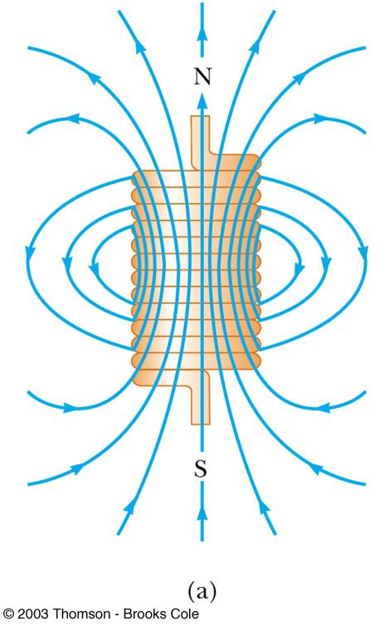
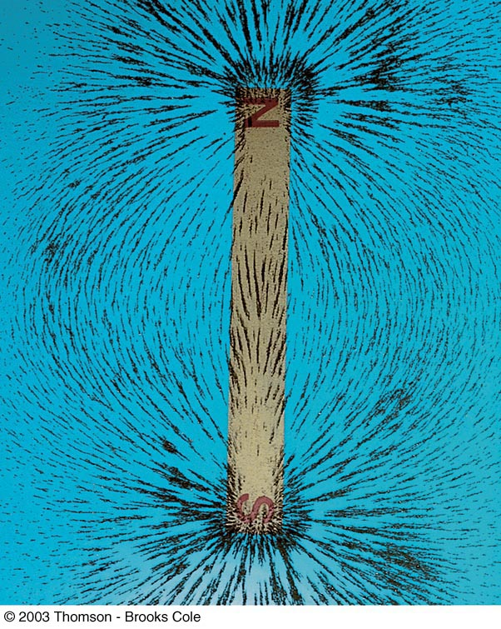
Magnetic Field in a Solenoid, 3
The field lines of the solenoid resemble those of a bar magnet

Slide 33
Magnetic Field in a Solenoid, Magnitude
The magnitude of the field inside a solenoid is constant at all points far from its ends
B = µ_{o} n I
n is the number of turns per unit length
n = N / ℓ
Study example 10.7

Slide 34
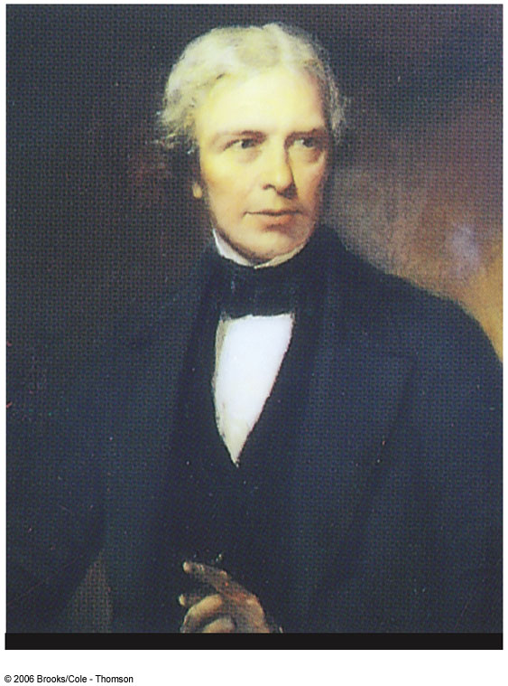
Michael Faraday
1791 – 1867
Great experimental scientist
Invented electric motor, generator and transformers
Discovered electromagnetic induction
Discovered laws of electrolysis

Slide 35
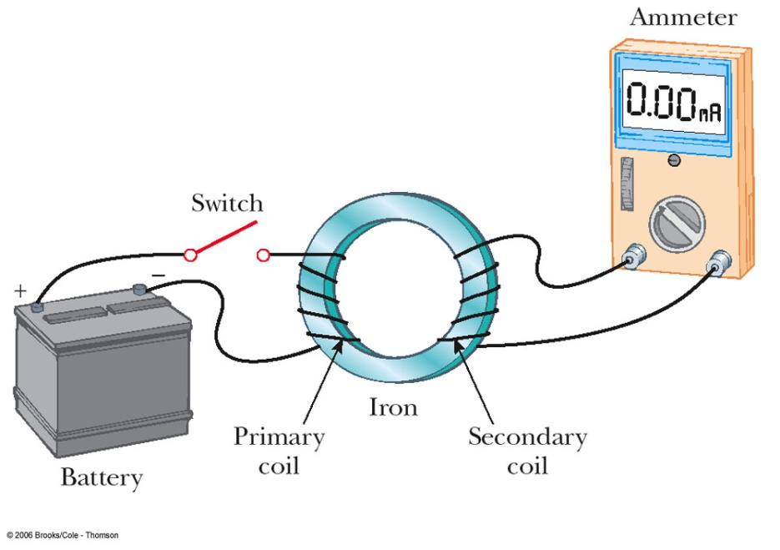
Faraday’s Experiment – Set Up
A current can be produced by a changing magnetic field
First shown in an experiment by Michael Faraday
A primary coil is connected to a battery
A secondary coil is connected to an ammeter

Slide 36
Faraday’s Conclusions
An electrical current is produced by a changing magnetic field
The secondary circuit acts as if a source of emf were connected to it for a short time
It is customary to say that an induced emf is produced in the secondary circuit by the changing magnetic field

Slide 37
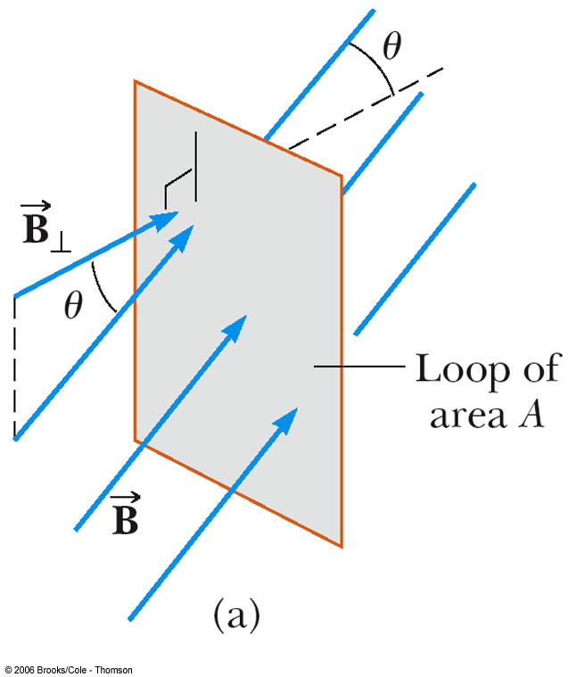
Magnetic Flux
You are given a loop of wire
The wire is in a uniform magnetic field
The loop has an area A
The flux is defined as
Φ_{B} = B⊥A = B A cos θ
θ is the angle between B and the normal to the plane

Slide 38
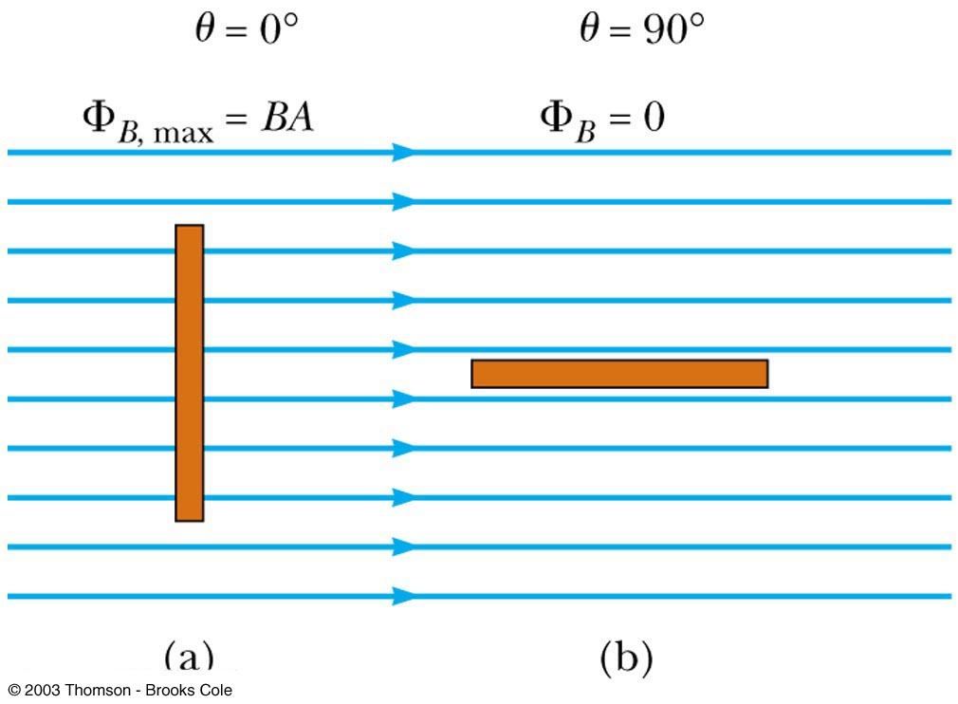
Magnetic Flux, 2
When the field is perpendicular to the plane of the loop, as in a, θ = 0 and Φ_{B} = Φ_{B, max} = BA
When the field is parallel to the plane of the loop, as in b, θ = 90° and Φ_{B} = 0
The flux can be negative, for example if θ = 180°
SI units of flux are T. m² = Wb (Weber)

Slide 39
Magnetic Flux, final
The flux can be visualized with respect to magnetic field lines
The value of the magnetic flux is proportional to the total number of lines passing through the loop
When the area is perpendicular to the lines, the maximum number of lines pass through the area and the flux is a maximum
When the area is parallel to the lines, no lines pass through the area and the flux is 0

Slide 40
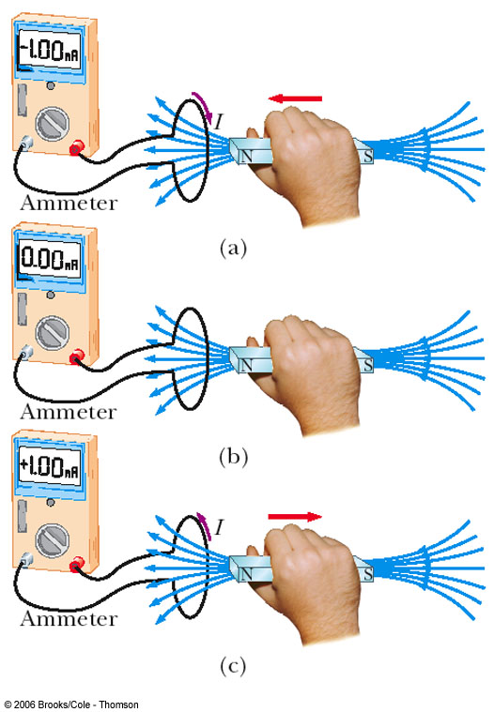
Electromagnetic Induction – An Experiment
When a magnet moves toward a loop of wire, the ammeter shows the presence of a current (a)
When the magnet is held stationary, there is no current (b)
When the magnet moves away from the loop, the ammeter shows a current in the opposite direction (c)
If the loop is moved instead of the magnet, a current is also detected

Slide 41
Faraday’s Law and Electromagnetic Induction
The instantaneous emf induced in a circuit equals the time rate of change of magnetic flux through the circuit
If a circuit contains N tightly wound loops and the flux changes by ΔΦ_{B} during a time interval Δt, the average emf induced is given by Faraday’s Law:
Study example 10.10

Slide 42
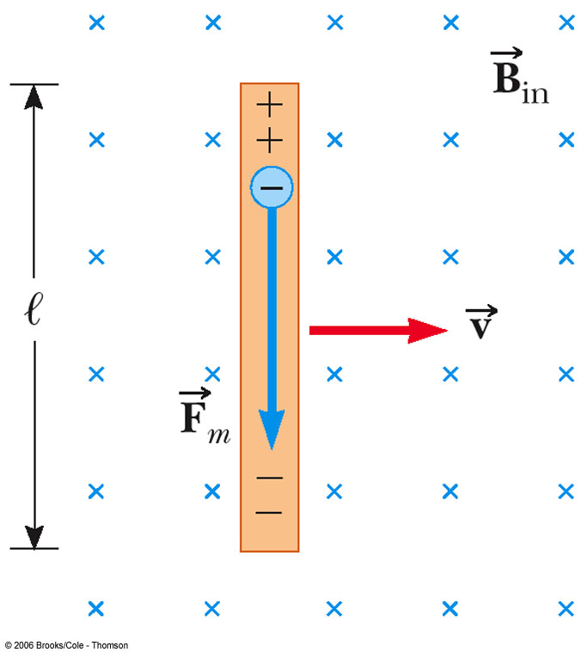
Application of Faraday’s Law – Motional emf
A straight conductor of length ℓ moves perpendicularly with constant velocity through a uniform field
The electrons in the conductor experience a magnetic force
F = q v B
The electrons tend to move to the lower end of the conductor

Slide 43
Motional emf, cont
The potential difference between the ends of the conductor can be found by
ΔV = B ℓ v
The upper end is at a higher potential than the lower end
A potential difference is maintained across the conductor as long as there is motion through the field
If the motion is reversed, the polarity of the potential difference is also reversed

Slide 44
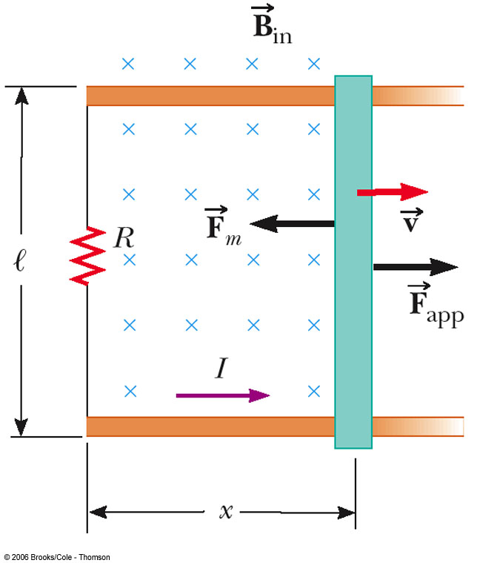
Motional emf in a Circuit
Assume the moving bar has zero resistance
As the bar is pulled to the right with a given velocity under the influence of an applied force, the free charges experience a magnetic force along the length of the bar
This force sets up an induced current because the charges are free to move in the closed path

Slide 45
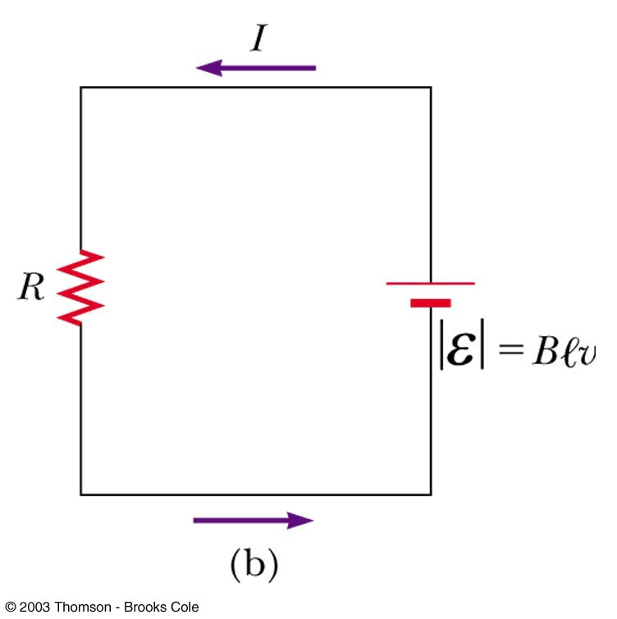
Motional emf in a Circuit, cont
The changing magnetic flux through the loop and the corresponding induced emf in the bar result from the change in area of the loop
The induced, motional emf, acts like a battery in the circuit
Study example 10.11

Slide 46
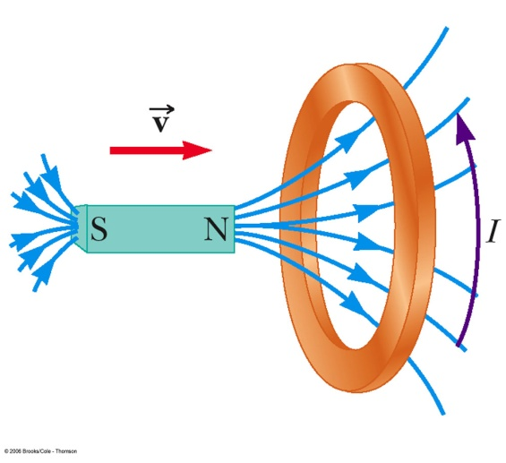
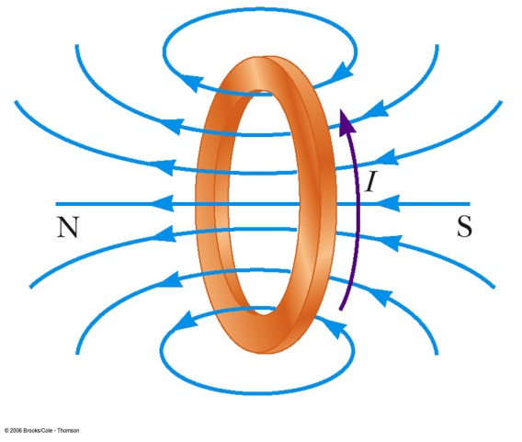
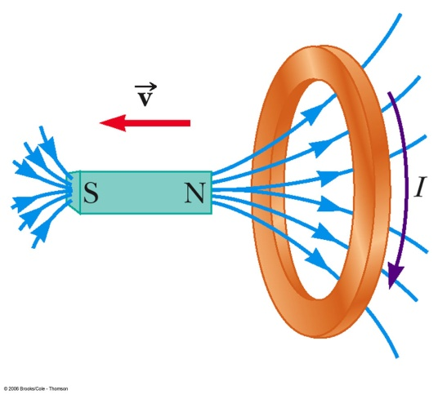
Lenz’ Law – Moving Magnet Example
A bar magnet is moved to the right toward a stationary loop of wire (a)
As the magnet moves, the magnetic flux increases with time
The induced current produces a flux to the left, so the current is in the direction shown (b)

Slide 47
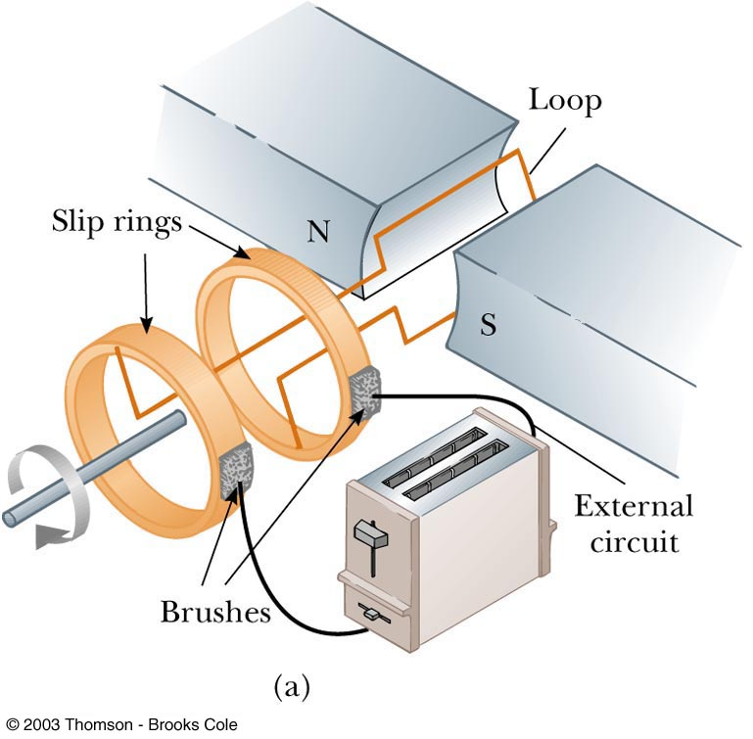
AC Generators, cont
Basic operation of the generator
As the loop rotates, the magnetic flux through it changes with time
This induces an emf and a current in the external circuit
The ends of the loop are connected to slip rings that rotate with the loop
Connections to the external circuit are made by stationary brushes in contact with the slip rings

Slide 48
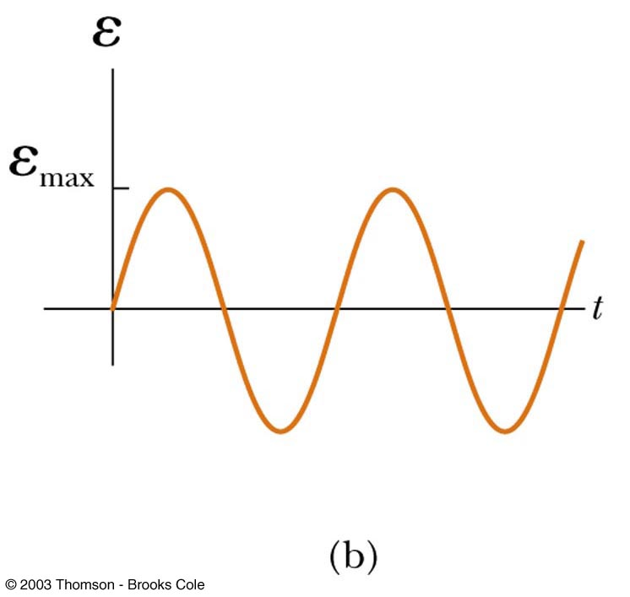
AC Generators, final
The emf generated by the rotating loop can be found by
ε =2 B ℓ v⊥=2 B ℓ sin θ
If the loop rotates with a constant angular speed, ω, and N turns
ε = N B A ω sin ω t
ε = ε_{max} when loop is parallel to the field
ε = 0 when when the loop is perpendicular to the field

Slide 49
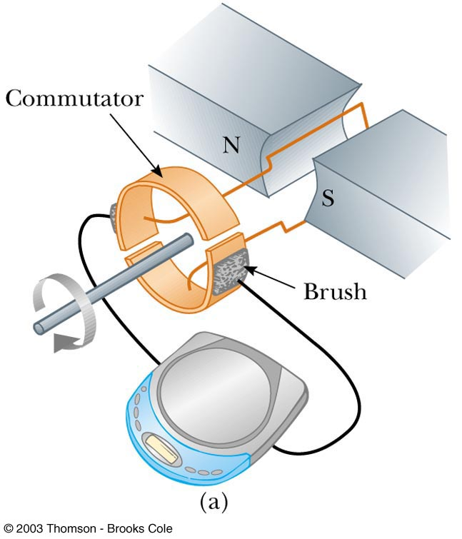
DC Generators
Components are essentially the same as that of an ac generator
The major difference is the contacts to the rotating loop are made by a split ring, or commutator

Slide 50
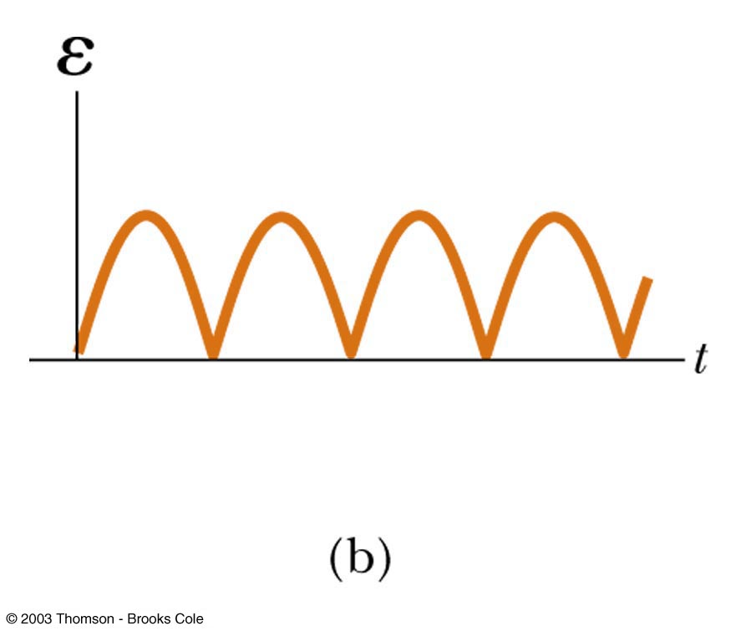
DC Generators, cont
The output voltage always has the same polarity
The current is a pulsing current
To produce a steady current, many loops and commutators around the axis of rotation are used
The multiple outputs are superimposed and the output is almost free of fluctuations

