Slide 1



Complex Situation
Crate as the System
$$m_{crate}$$

Slide 2

complex situation
Tractor as the System
$$m_{tractor}$$

Slide 3
complex situation
Tractor and Crate as the System

Slide 5

Name (optional)
symbol
value (correct number of significant figures)
unit
h
height h = 1.68 incorrect: no unit
height h = 1.6879423 m incorrect: too many signifiant figures
height h = 1.68 mm incorrect: not a sensible value
h = 1.68 m correct

Slide 6



Z
$$\hat{k}$$
O(0,0,0)
$$\hat{j}$$
Y
$$\hat{i}$$
X

Slide 7
N
Y
vertical axis
Y
W
E
X
horizontal axis
X
S

Slide 9
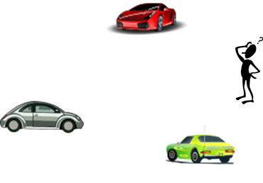

Slide 10
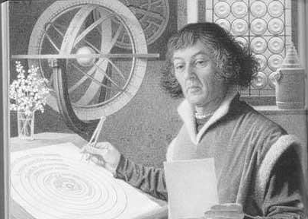
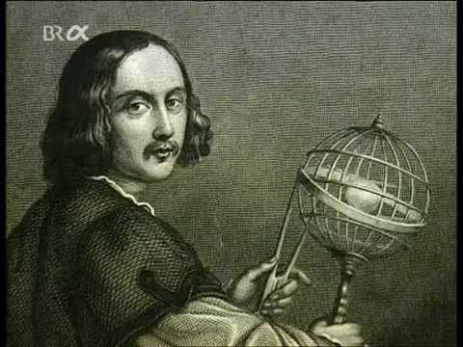
Nicholas Copernicus
Johannes Kepler

Slide 11
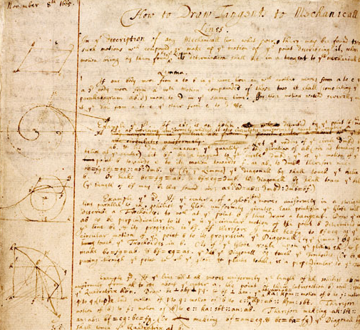
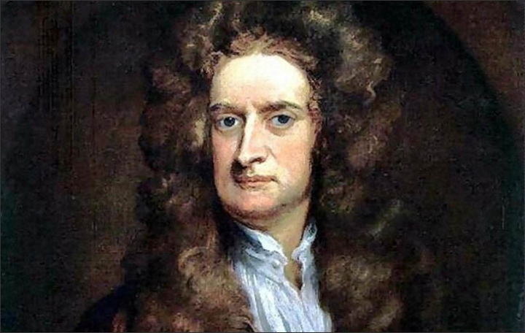

Slide 12
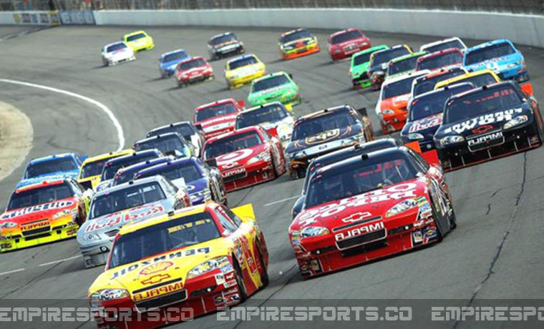
complex simple
A physicist takes a complex situation and replaces it with a simple model

Slide 13
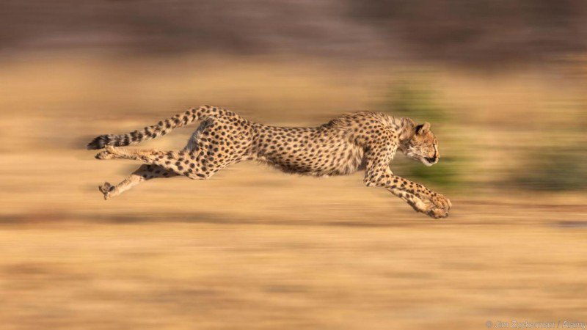
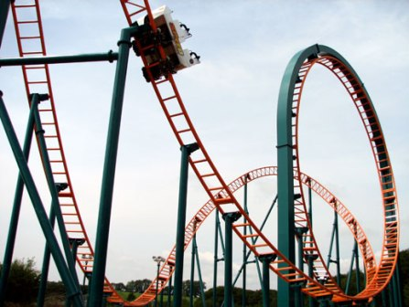

Slide 14



Y
$$\hat{j}$$
$$θ$$
$$\hat{i}$$
O(0, 0)
X

Slide 15
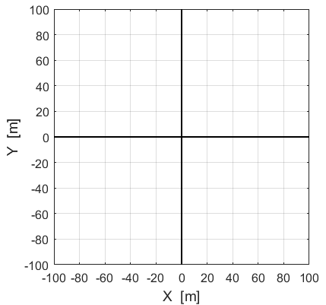



P(60, 80)
$$\hat{j}$$
$$\hat{i}$$
A
O
Q(80, -60)
B

Slide 16
P(60, 80)
$$\hat{j}$$
$$\hat{i}$$
O
A
Q(80, -60)
B

Slide 17
P(60, 80)
O
Q(80, -60)

Slide 18
P(60, 80)
$$\hat{j}$$
$$\hat{i}$$
O
A
Q(80, -60)
B

Slide 19
Y
A
O(0, 0)
X
B

Slide 20
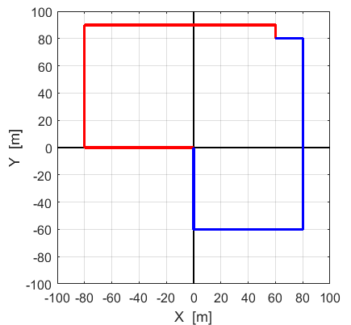
$$\hat{j}$$
$$\hat{i}$$
A
B

Slide 21
Y
O(0, 0)
X
You can not assign a + or – sign to a vector, only the components directed along a coordinate axis can be + or - .

Slide 22
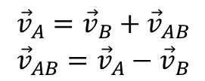
v_{A y} = 4 m.s⁻¹
v_{Ax} = 2 m.s⁻¹
$$\begin{matrix}{\vec{v}}_{A}={\vec{v}}_{B}+{\vec{v}}_{AB} \\ {\vec{v}}_{AB}={\vec{v}}_{A}−{\vec{v}}_{B}\end{matrix}$$
v_{By} = 1 m.s⁻¹
v_{bx} = 3 m.s⁻¹

Slide 23
displacement s
time interval t

Slide 24


Y
O(0, 0)
X
O(0, 0)
Observer standing
on the ground
The boat is the system
and is represented as a dot

Slide 26
Y
X

Slide 27
Y
X

Slide 28
Y
X

Slide 29
Y
X

Slide 30
N
velocity of the plane w.r.t. air
plane (P)
N
E
velocity of the plane w.r.t. ground
S
air - wind (A)
velocity of the air w.r.t. ground
Y
X
observer: ground (G)

Slide 31
N
system A
system B
N
E
Case 1
Y
S
Case 2
X
Case 3
A
B
vectors not to scale

Slide 34
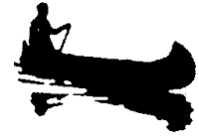
Y
X
C
G
canoe is the system

Slide 35
Y
A
B
O(0, 0)
X
C

Slide 36
displacement s
time interval t

Slide 37
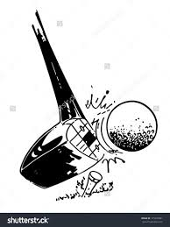
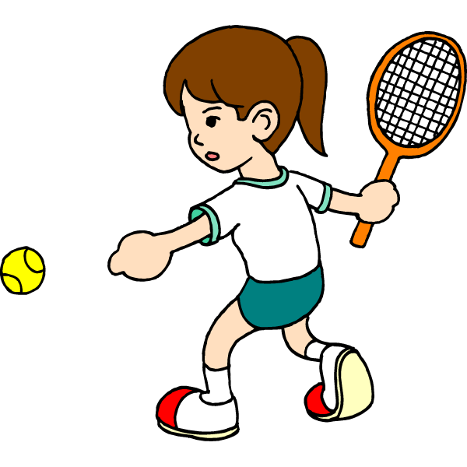
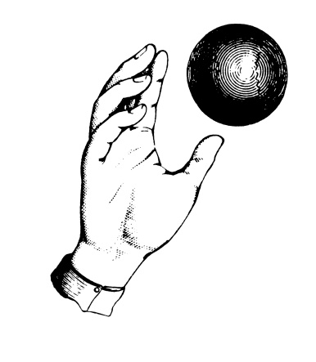

Slide 38

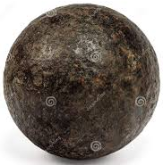



system: truck
system: ball
?
Pat
?
Chris

Slide 39
Event #1: time t₁ = 0 s
ball released from block
Start clock
Event #2: time t₂ = t s
ball hits block
Stop clock
s
ramp set at a small angle so that time intervals can be measured with stop watch

Slide 40
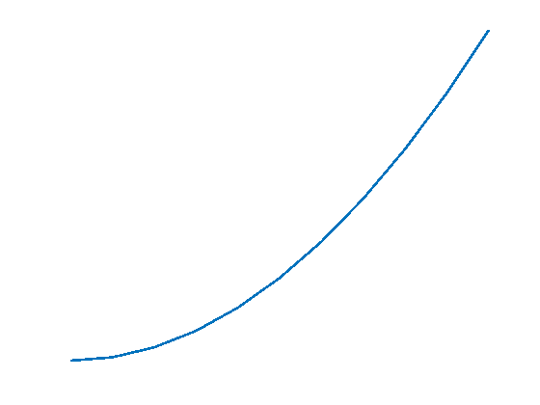
Y
X
O(0, 0) front of ball
s
t

Slide 41
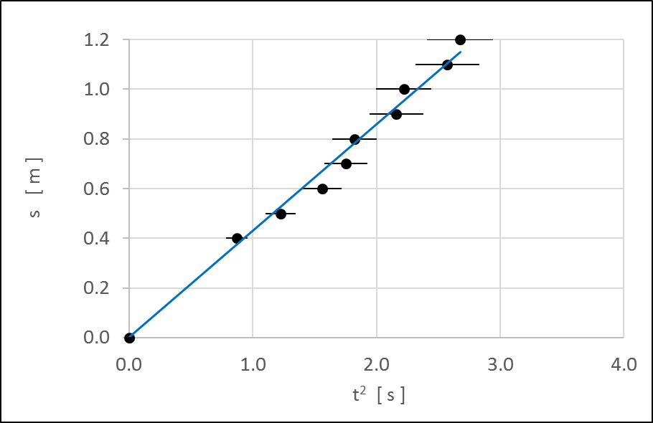
lwf
lbf

Slide 42
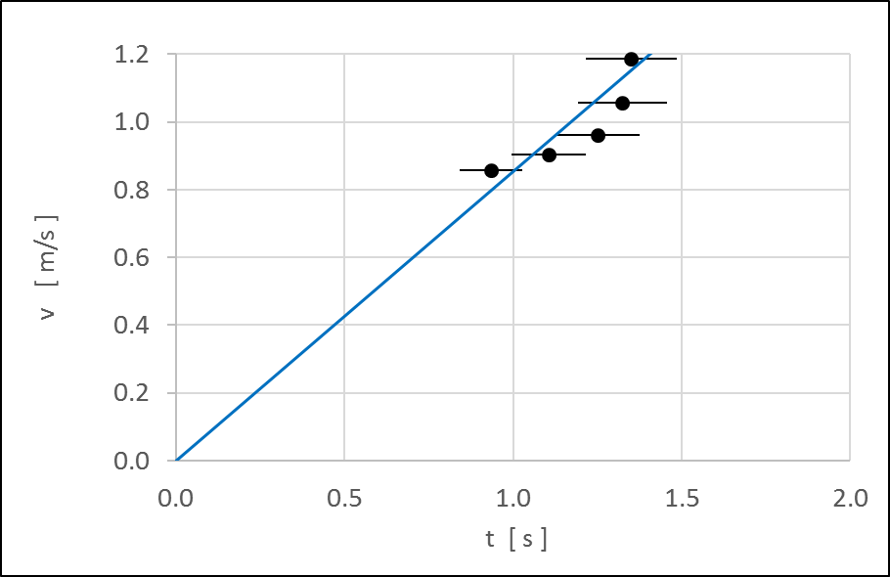
lbf
lwf

Slide 43
lbf
lwf

Slide 45
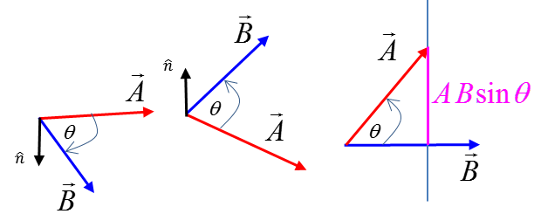
A sinθ

Slide 46
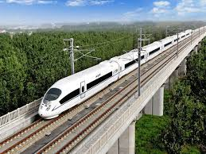
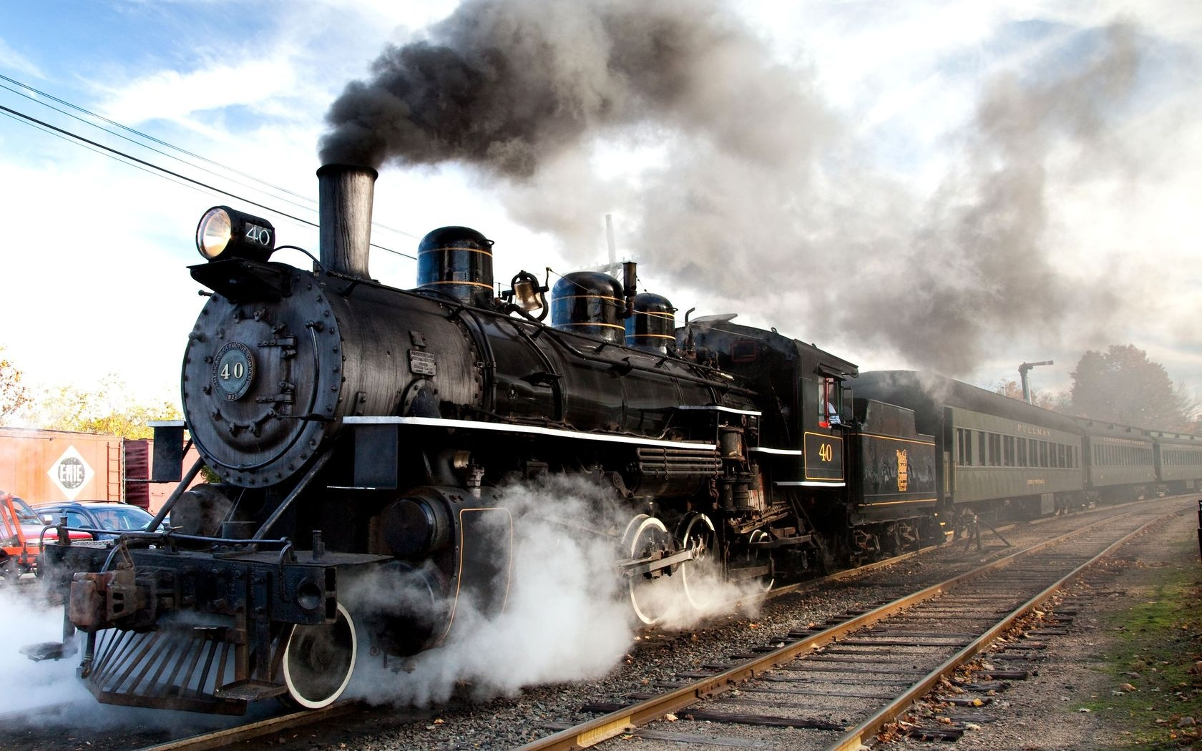
FAST
SLOW
China’s high speed train can cruise at 196 km.h⁻¹
Steam train travelling at 50 km.h⁻¹

Slide 47
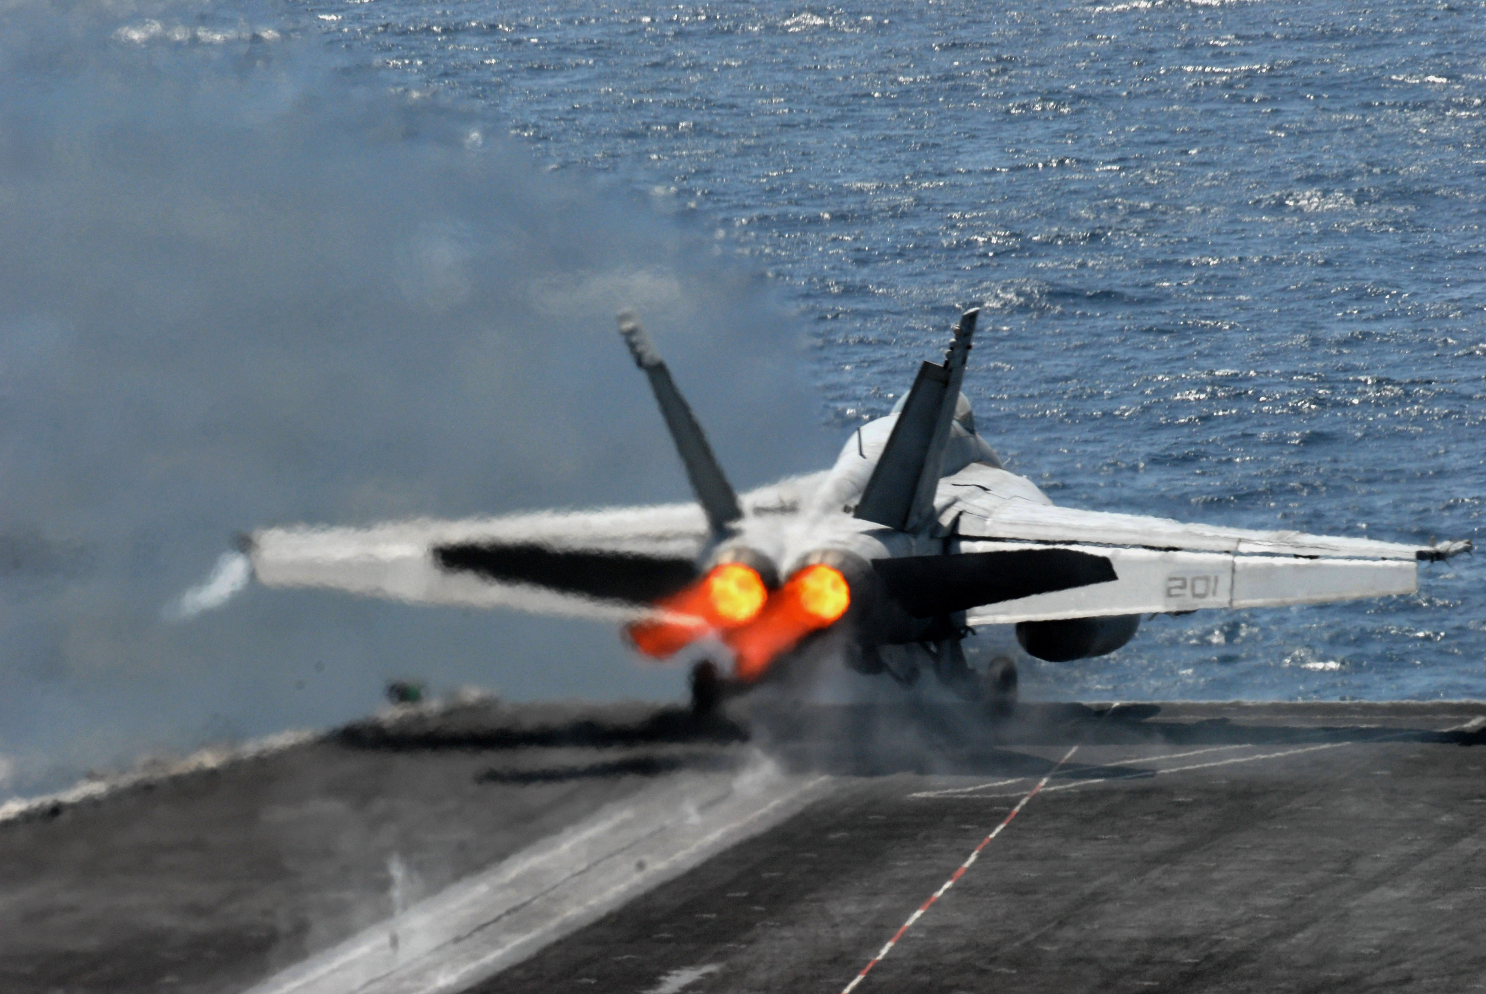
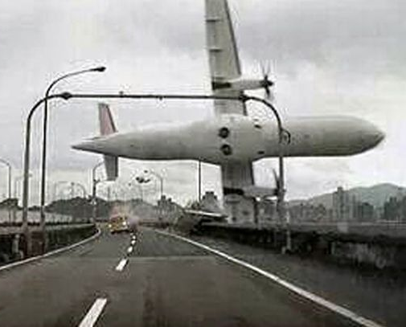
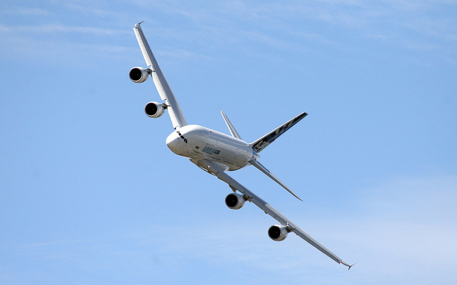
speeding up
slowing down
changing direction
large positive acceleration
plane accelerates because of change in its direction
large negative
acceleration

