Slide 1
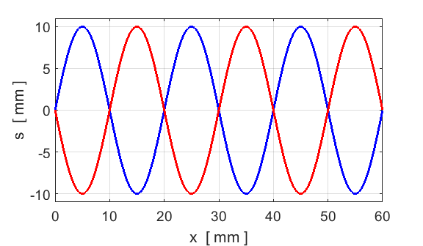
C
C
time
t
time
t + T/2
T
T

Slide 2

compression
rarefaction
A~ 7 mm
0 20 40 60 80 100 120
position x [mm]

Slide 3
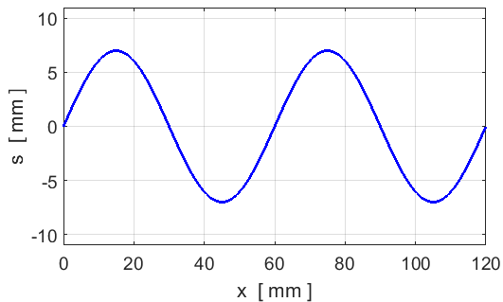
compression
rarefaction

Slide 4
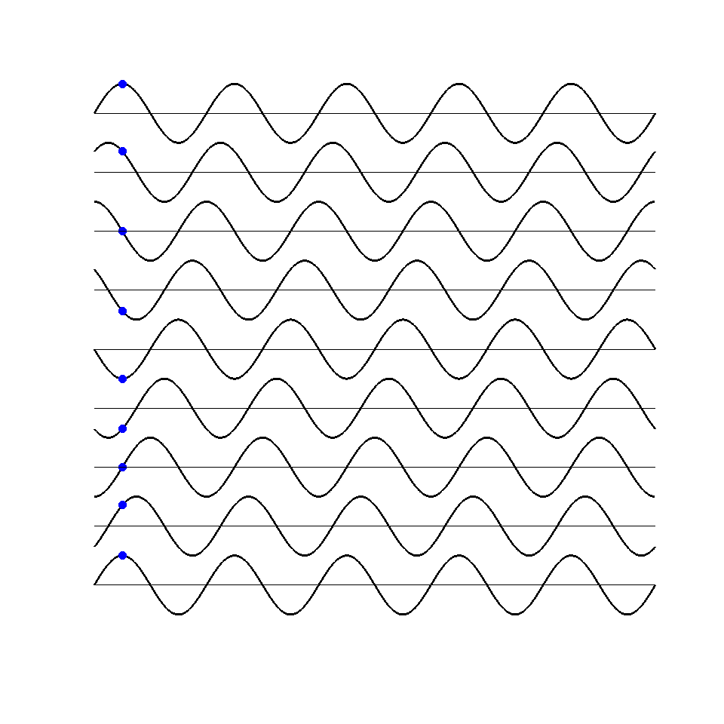
Crests moves to the right
t = T
Crest moves 1 wavelength in a time interval of 1 period
t = 7T/8
t = 6T/8
t = 5T/8
t = 4T/8
t = 3T/8
particle executes SHM
t = 2T/8
t = T/8
t = 0
s

Slide 5
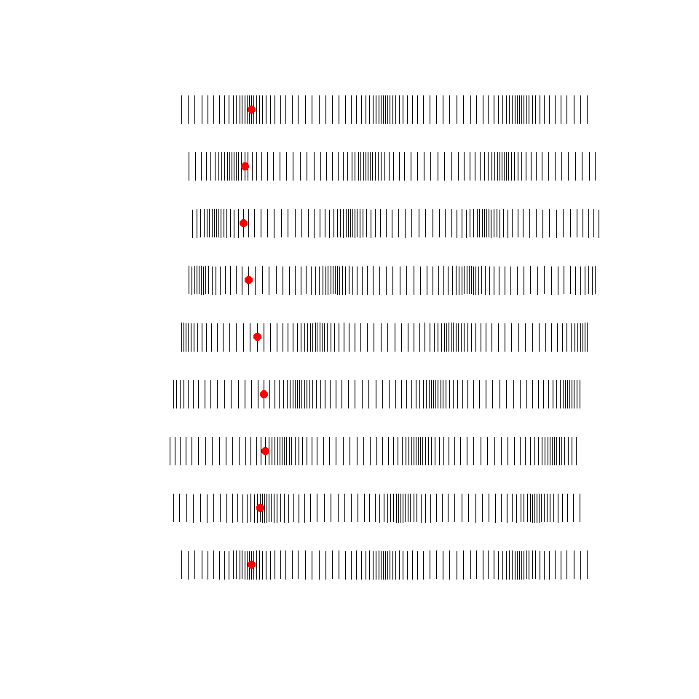
t = T
Compressions moves to the right
Compression moves 1 wavelength in a time interval of 1 period
t = 7T/8
t = 6T/8
t = 5T/8
t = 4T/8
t = 3T/8
t = 2T/8
particle executes SHM
t = T/8
t = 0
2A

Slide 6
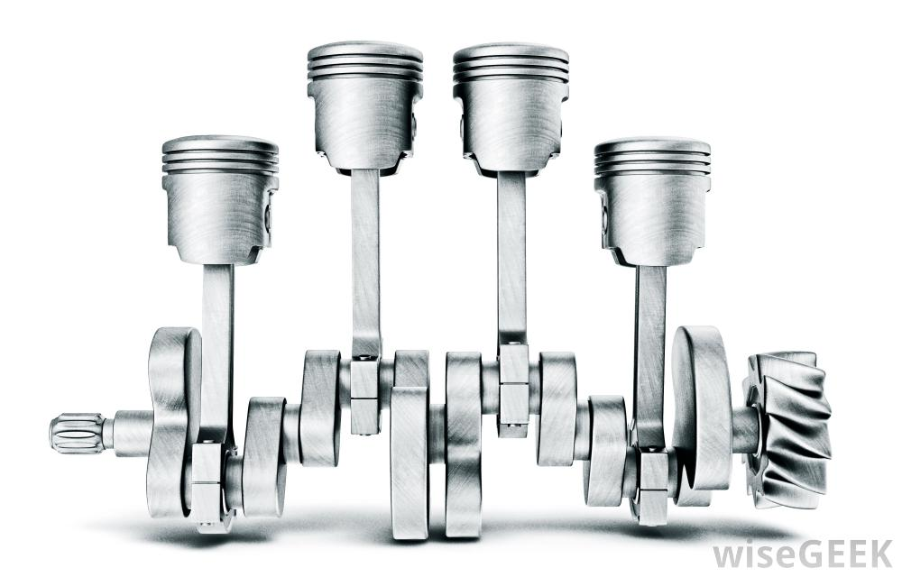
The pistons move up and down executing SHM

Slide 7
waves travelling backward & forward along tube: air molecules vibrate at the driving frequency f_{D}
speed of waves
waves reflected at boundary
waves reflected at boundary
standing waves created only at the natural frequencies of vibration of the air column
speaker vibrates at frequency f_{D}
(driving frequency)
movable microphone measures pressure fluctuations P along length of tube
Open end
pressure
node
P = 0
Closed end
pressure antinode
P = max
Resonance: large amplitude vibrations (loud sound emitted by tube) only when the driving frequency equals a natural frequency of vibration f_{D} = f_{m}

Slide 8
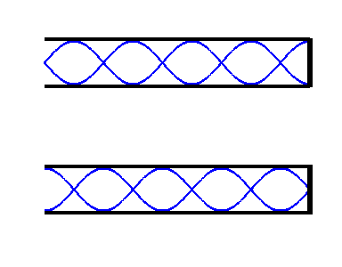
standing wave pattern m =9
A N A N A N A N A N

Slide 9
marked positions of nodes
67 a.u.
68 a.u.

Slide 10
