Slide 1
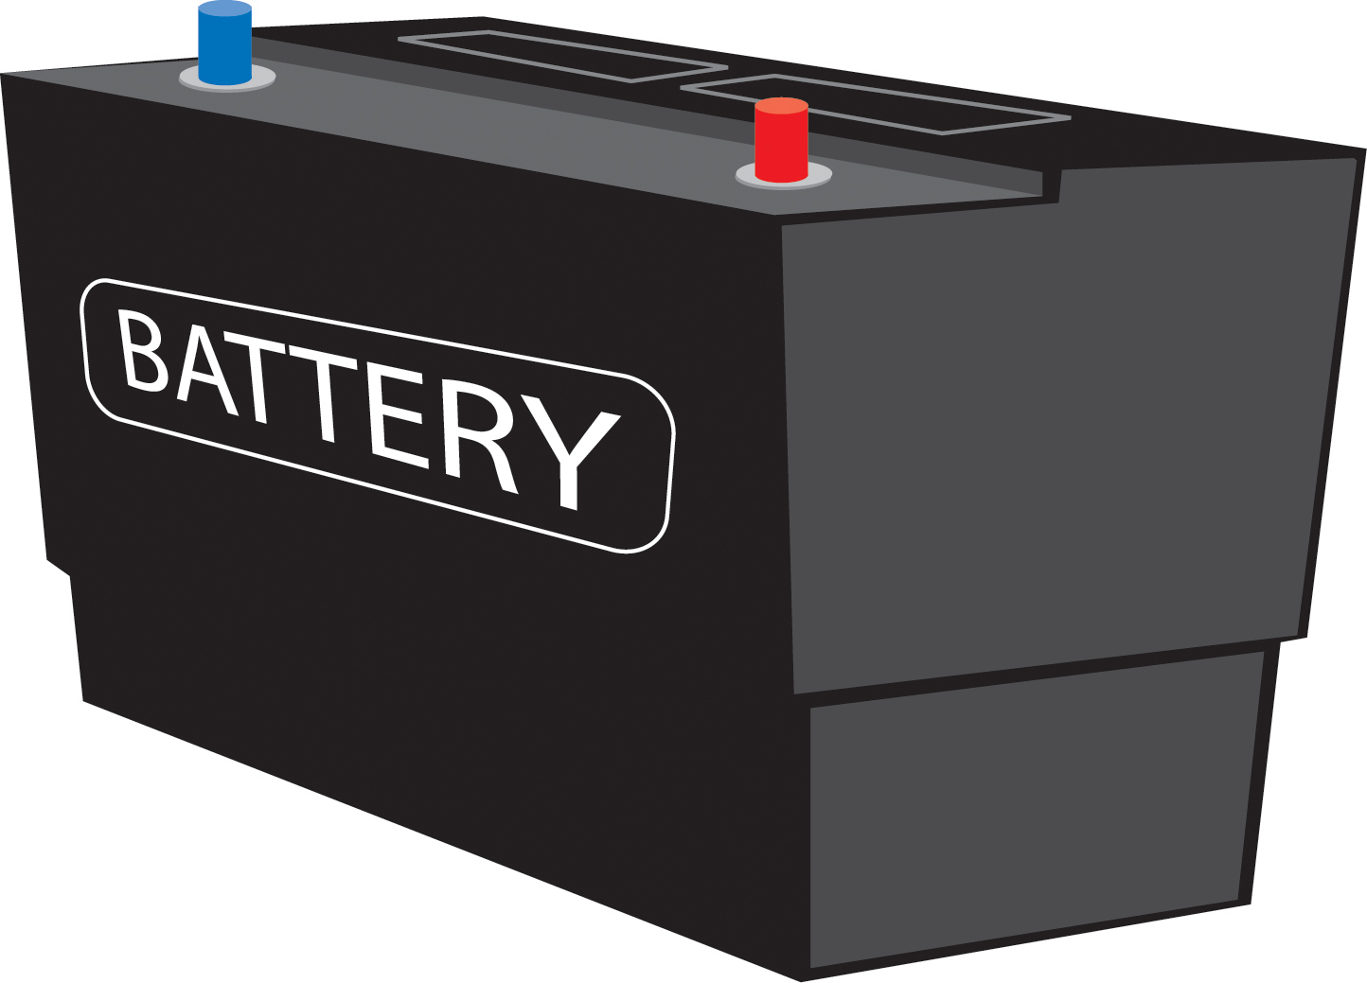
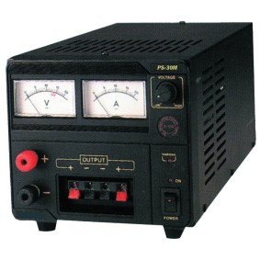
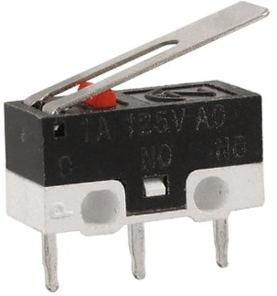
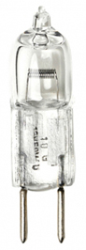

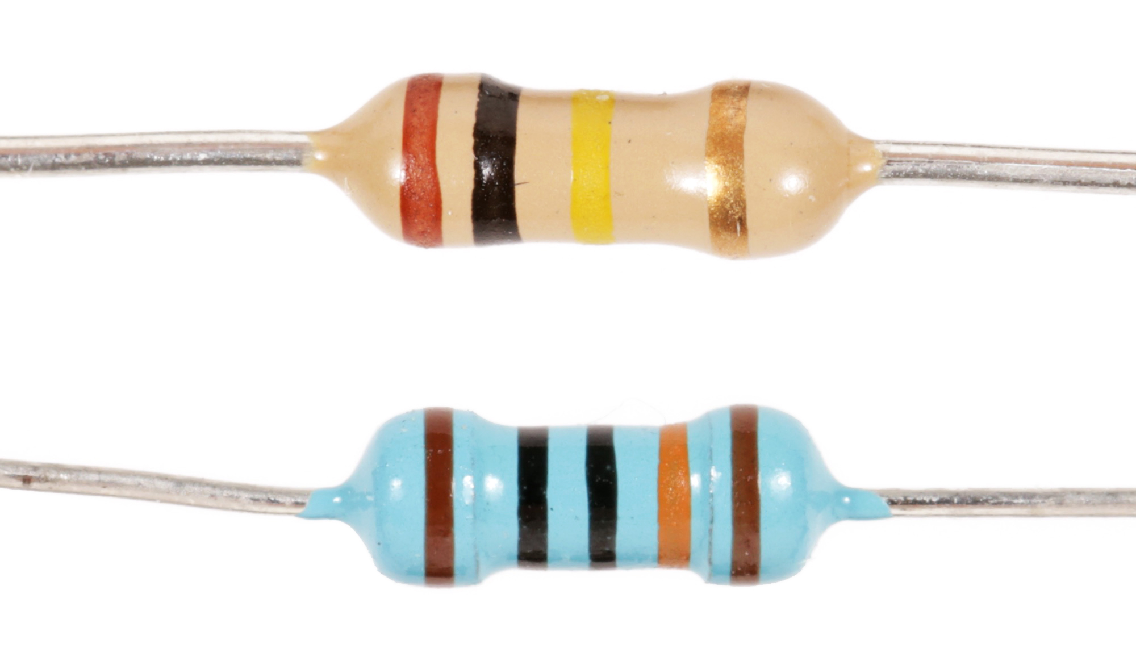
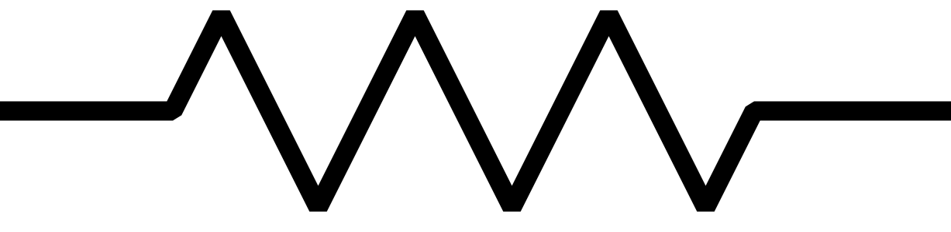
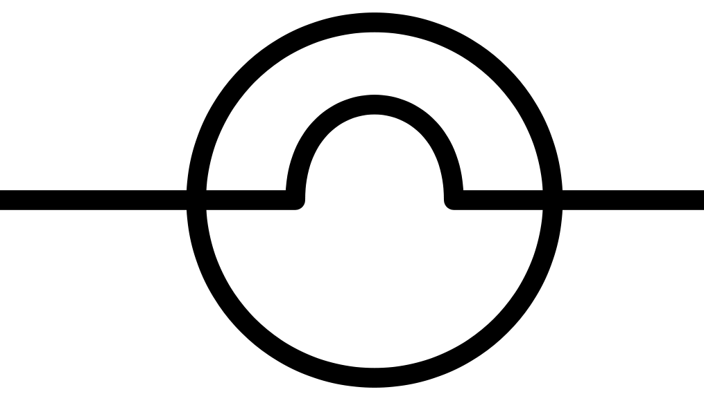
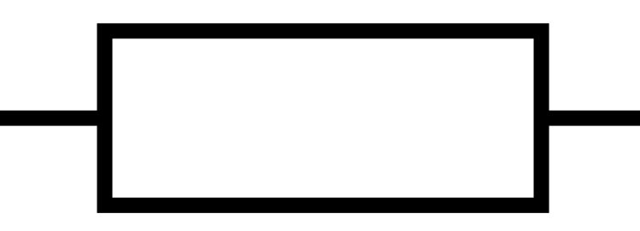
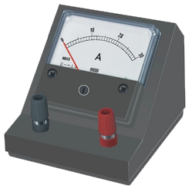
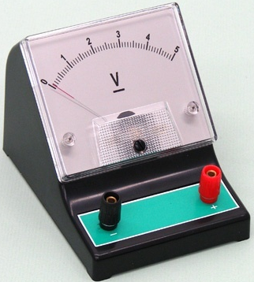
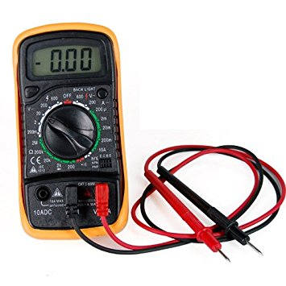
+
+
+
+
switch
battery emf
variable emf
light globe
resistors
multimeter V A Ω
ammeter
voltmeter
+
+
A
V

Slide 2


hot filament
resistance R
current I
electrical energy thermal / light energy
+
+
+
+
battery emf
variable emf

Slide 3
+
A
+
V

Slide 4
large slope
→ large resistance
small slope
→ small resistance

Slide 5
large slope
→ large resistance
small slope
→ small resistance
(0,0)
Equation of straight line through origin
R is the constant of proportionality and corresponds to the slope of the V vs I straight line

Slide 6
B
C
+
A
0 V
D

Slide 7
J
+
at all point around the loop the current is the same
0 V

Slide 8
voltage drop
voltage drop
loop direction
loop direction
emf
emf
loop direction
loop direction

Slide 9
2.00 Ω
18.0 V
6.00 V
1.00 Ω
R₁ = 2.00 Ω
ε₁ = 18.0 V
ε₂ = 6.00 V
R₂ = 1.00 Ω

Slide 10

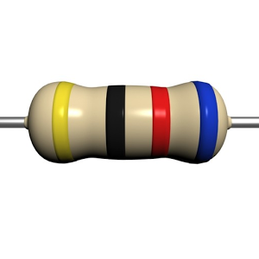
In a circuit many resistors can be replaced by a single equivalent resistor

Slide 12
ε
ε

Slide 13
ε
ε

Slide 14
ε
ε

Slide 15
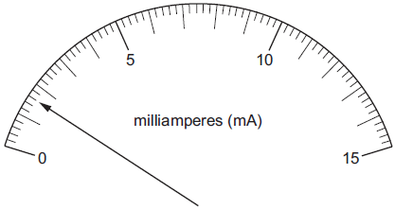
V
A

Slide 16
+
A
+
V

