Slide 1
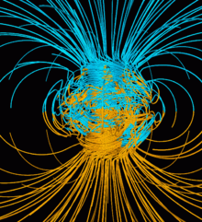
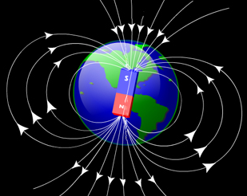
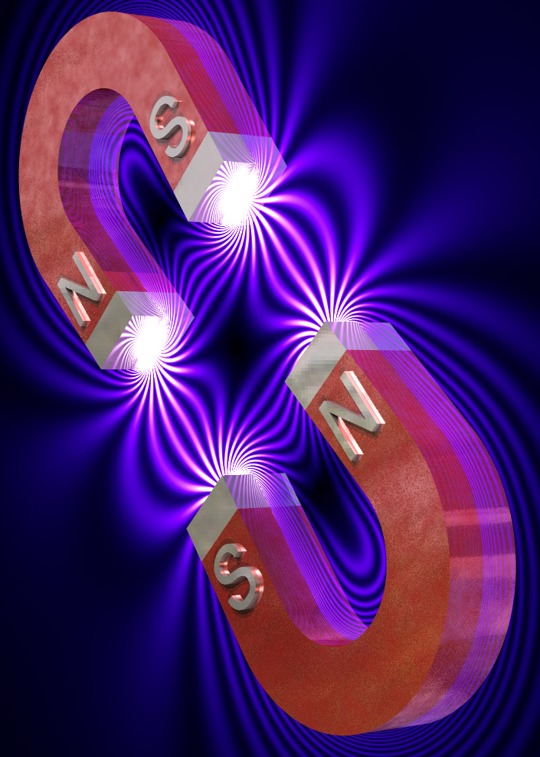

Slide 2
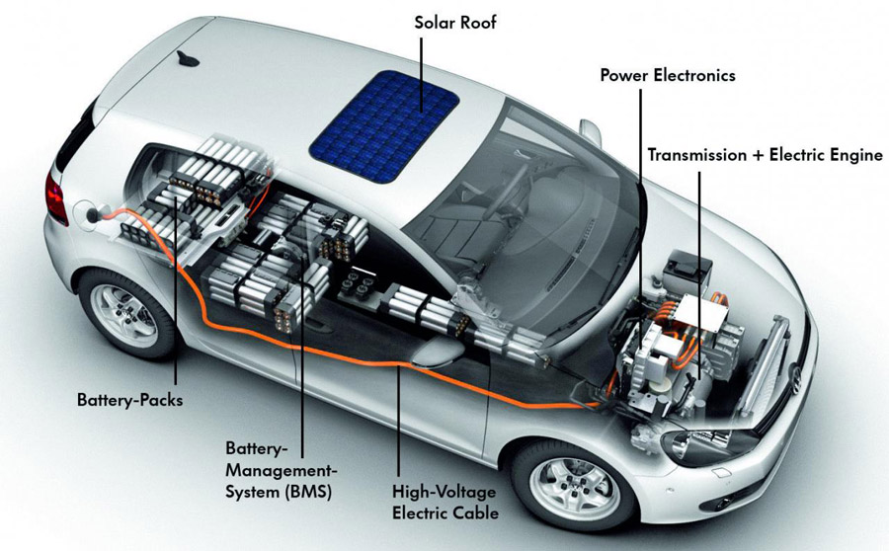
How many magnets are used in a car? Do some research to find out, you will be surprised just how many.

Slide 3
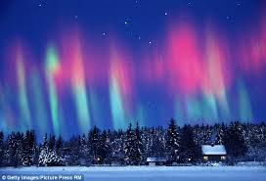
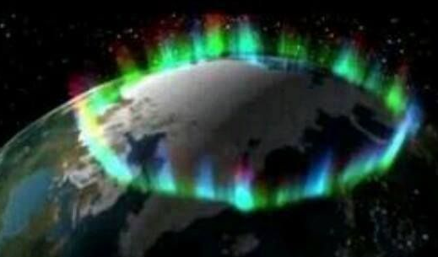
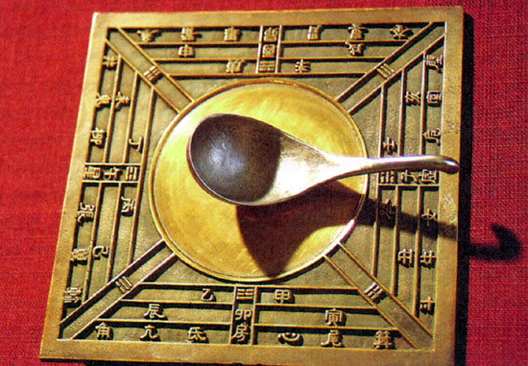

Slide 4
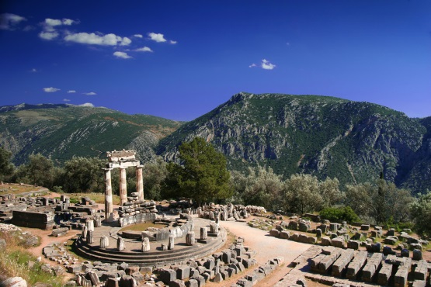
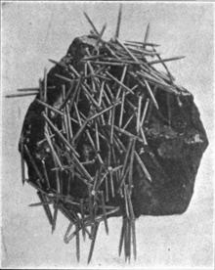


Slide 5
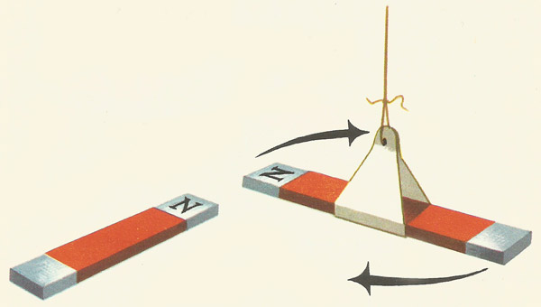
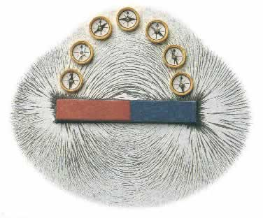
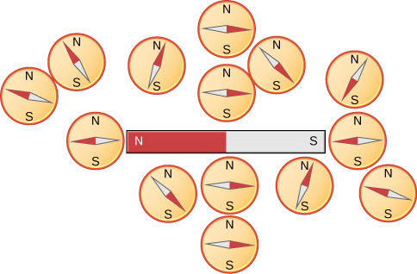
W
S
N
E

Slide 6
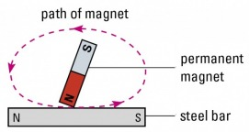
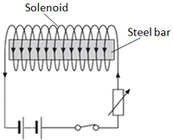
path of magnet
permanent of magnet
N
S
steel rod
solenoid
steel rod

Slide 7
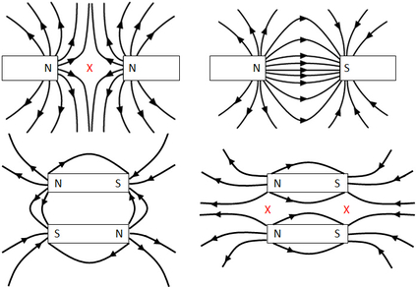
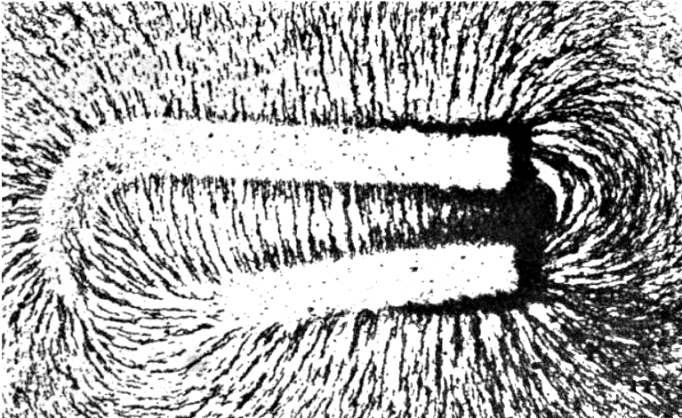
x zero point

Slide 8
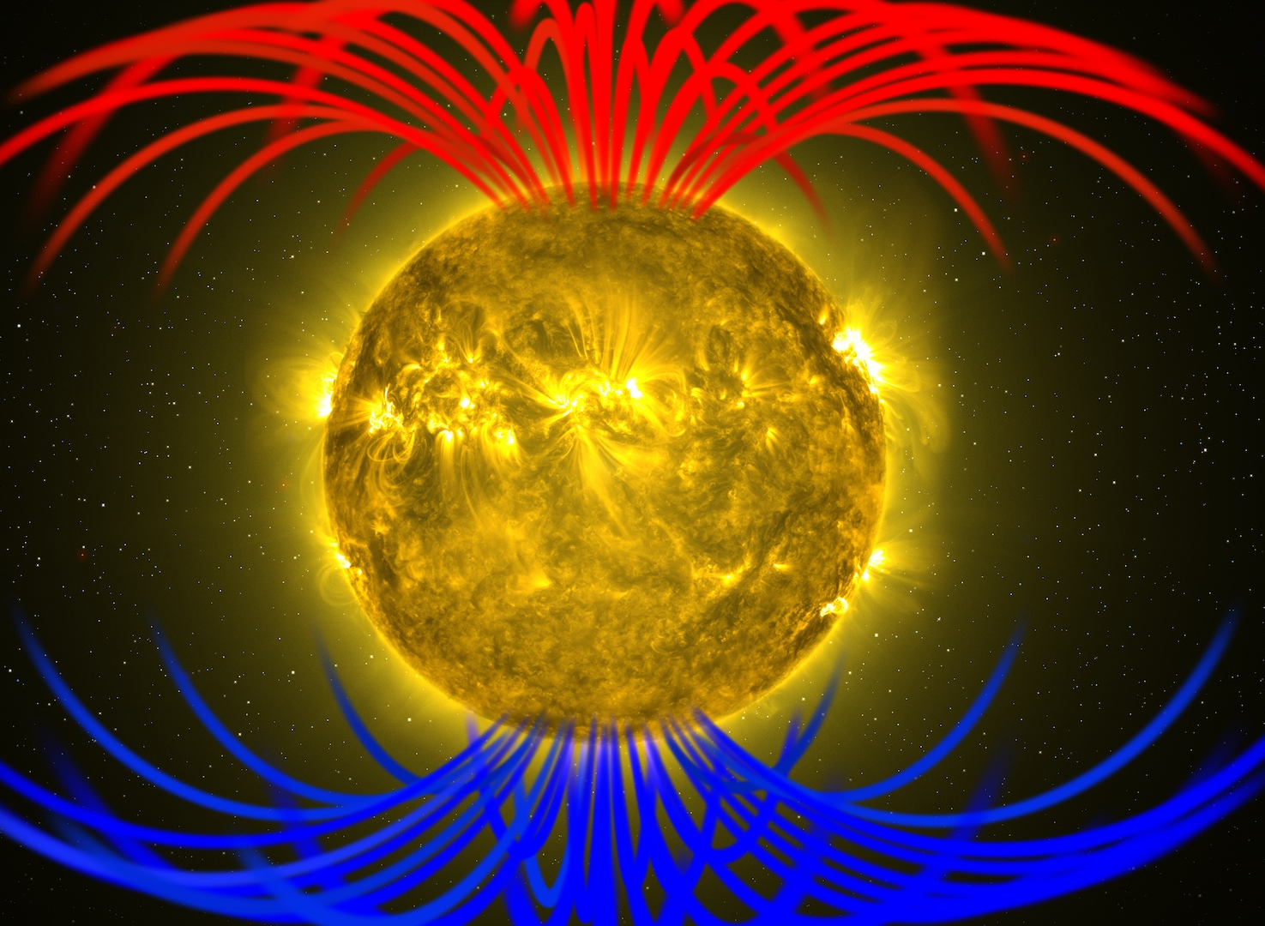
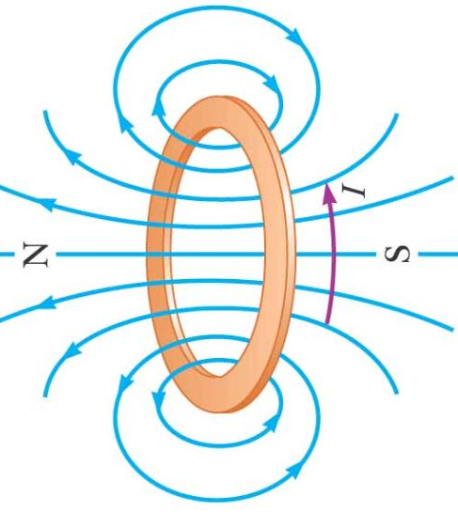
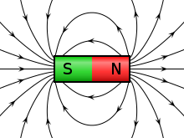
Sun’s magnetic field
I
N
S

Slide 9
spin motion of electron
nucleus
orbital motion of electron

Slide 10
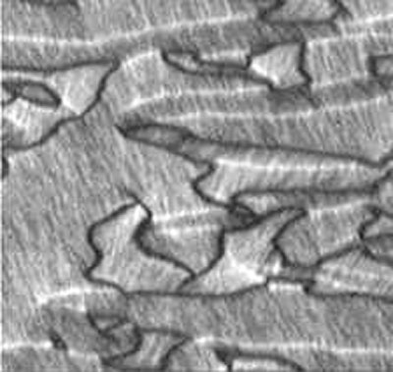

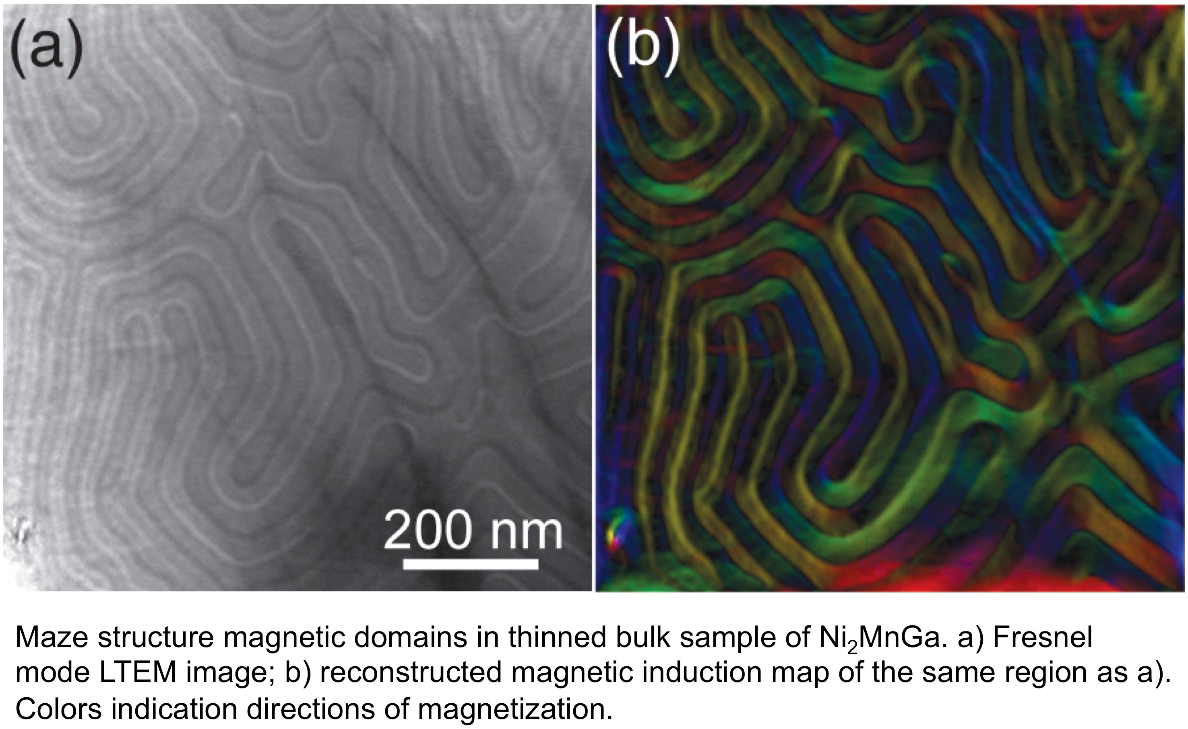

Slide 12
fully magnetized
saturation
S
N
magnetization
magnetizing field
unmagnetized

Slide 13
N
S
N
S
N
S
N
S

Slide 14
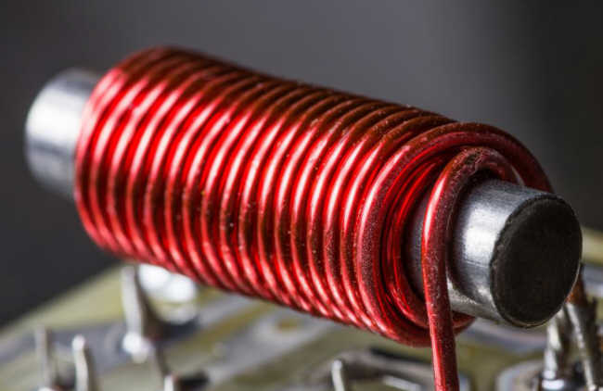
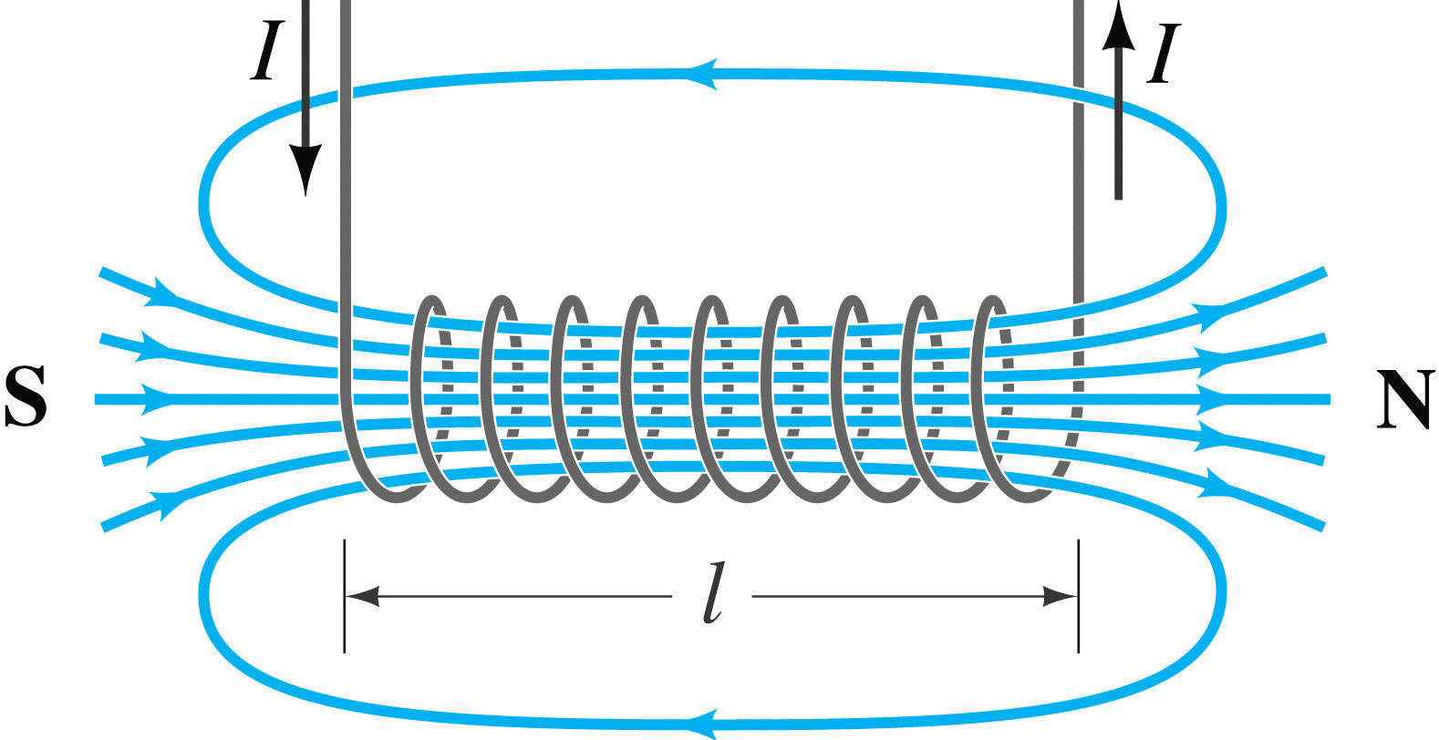

magnetic field of a solenoid
I
I
S
N
solenoid
$$\vec{B}$$
iron rod
I
magnetizing
magnetic field
I
magnetizing current

Slide 15
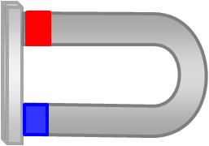
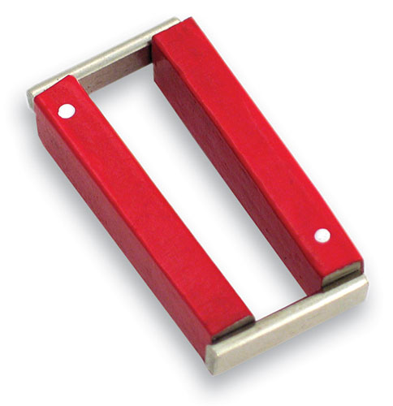
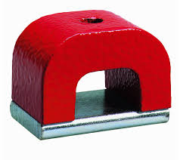
continuous magnetic field loops
look after your magnet:
no dropping
no hitting
no heating
use keepers

Slide 16
Magnetized iron ring showing no poles
“Atomic magnets” are arranged head-to-tail around the ring

Slide 17
N
S
we now have a practical magnet

Slide 18
current same directions: conductors attract each other
+
+
current opposite directions: conductors repel each other
+
+

Slide 19
N
W
E
S
+
+

Slide 20
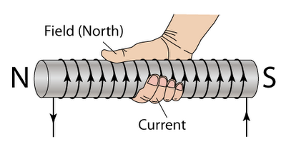
magnetic field
S
N
current
magnetic field of a solenoid
I
I
S
N

Slide 21
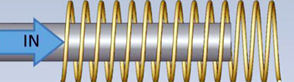
adding the iron core significantly increases the magnetic field

Slide 22
