Slide 1
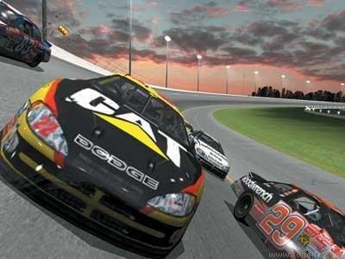
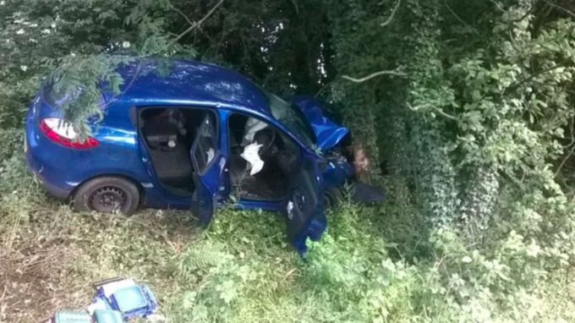
The car became airborne after travelling over a crest of a hill and driver lost control. The car smashed into a tree and the driver and passengers were seriously injured.

Slide 2
Y
Y
X
X

Slide 3

Y
Y
(0,0)
X
X

Slide 4
Y
Y
X
X

Slide 5
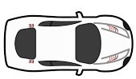
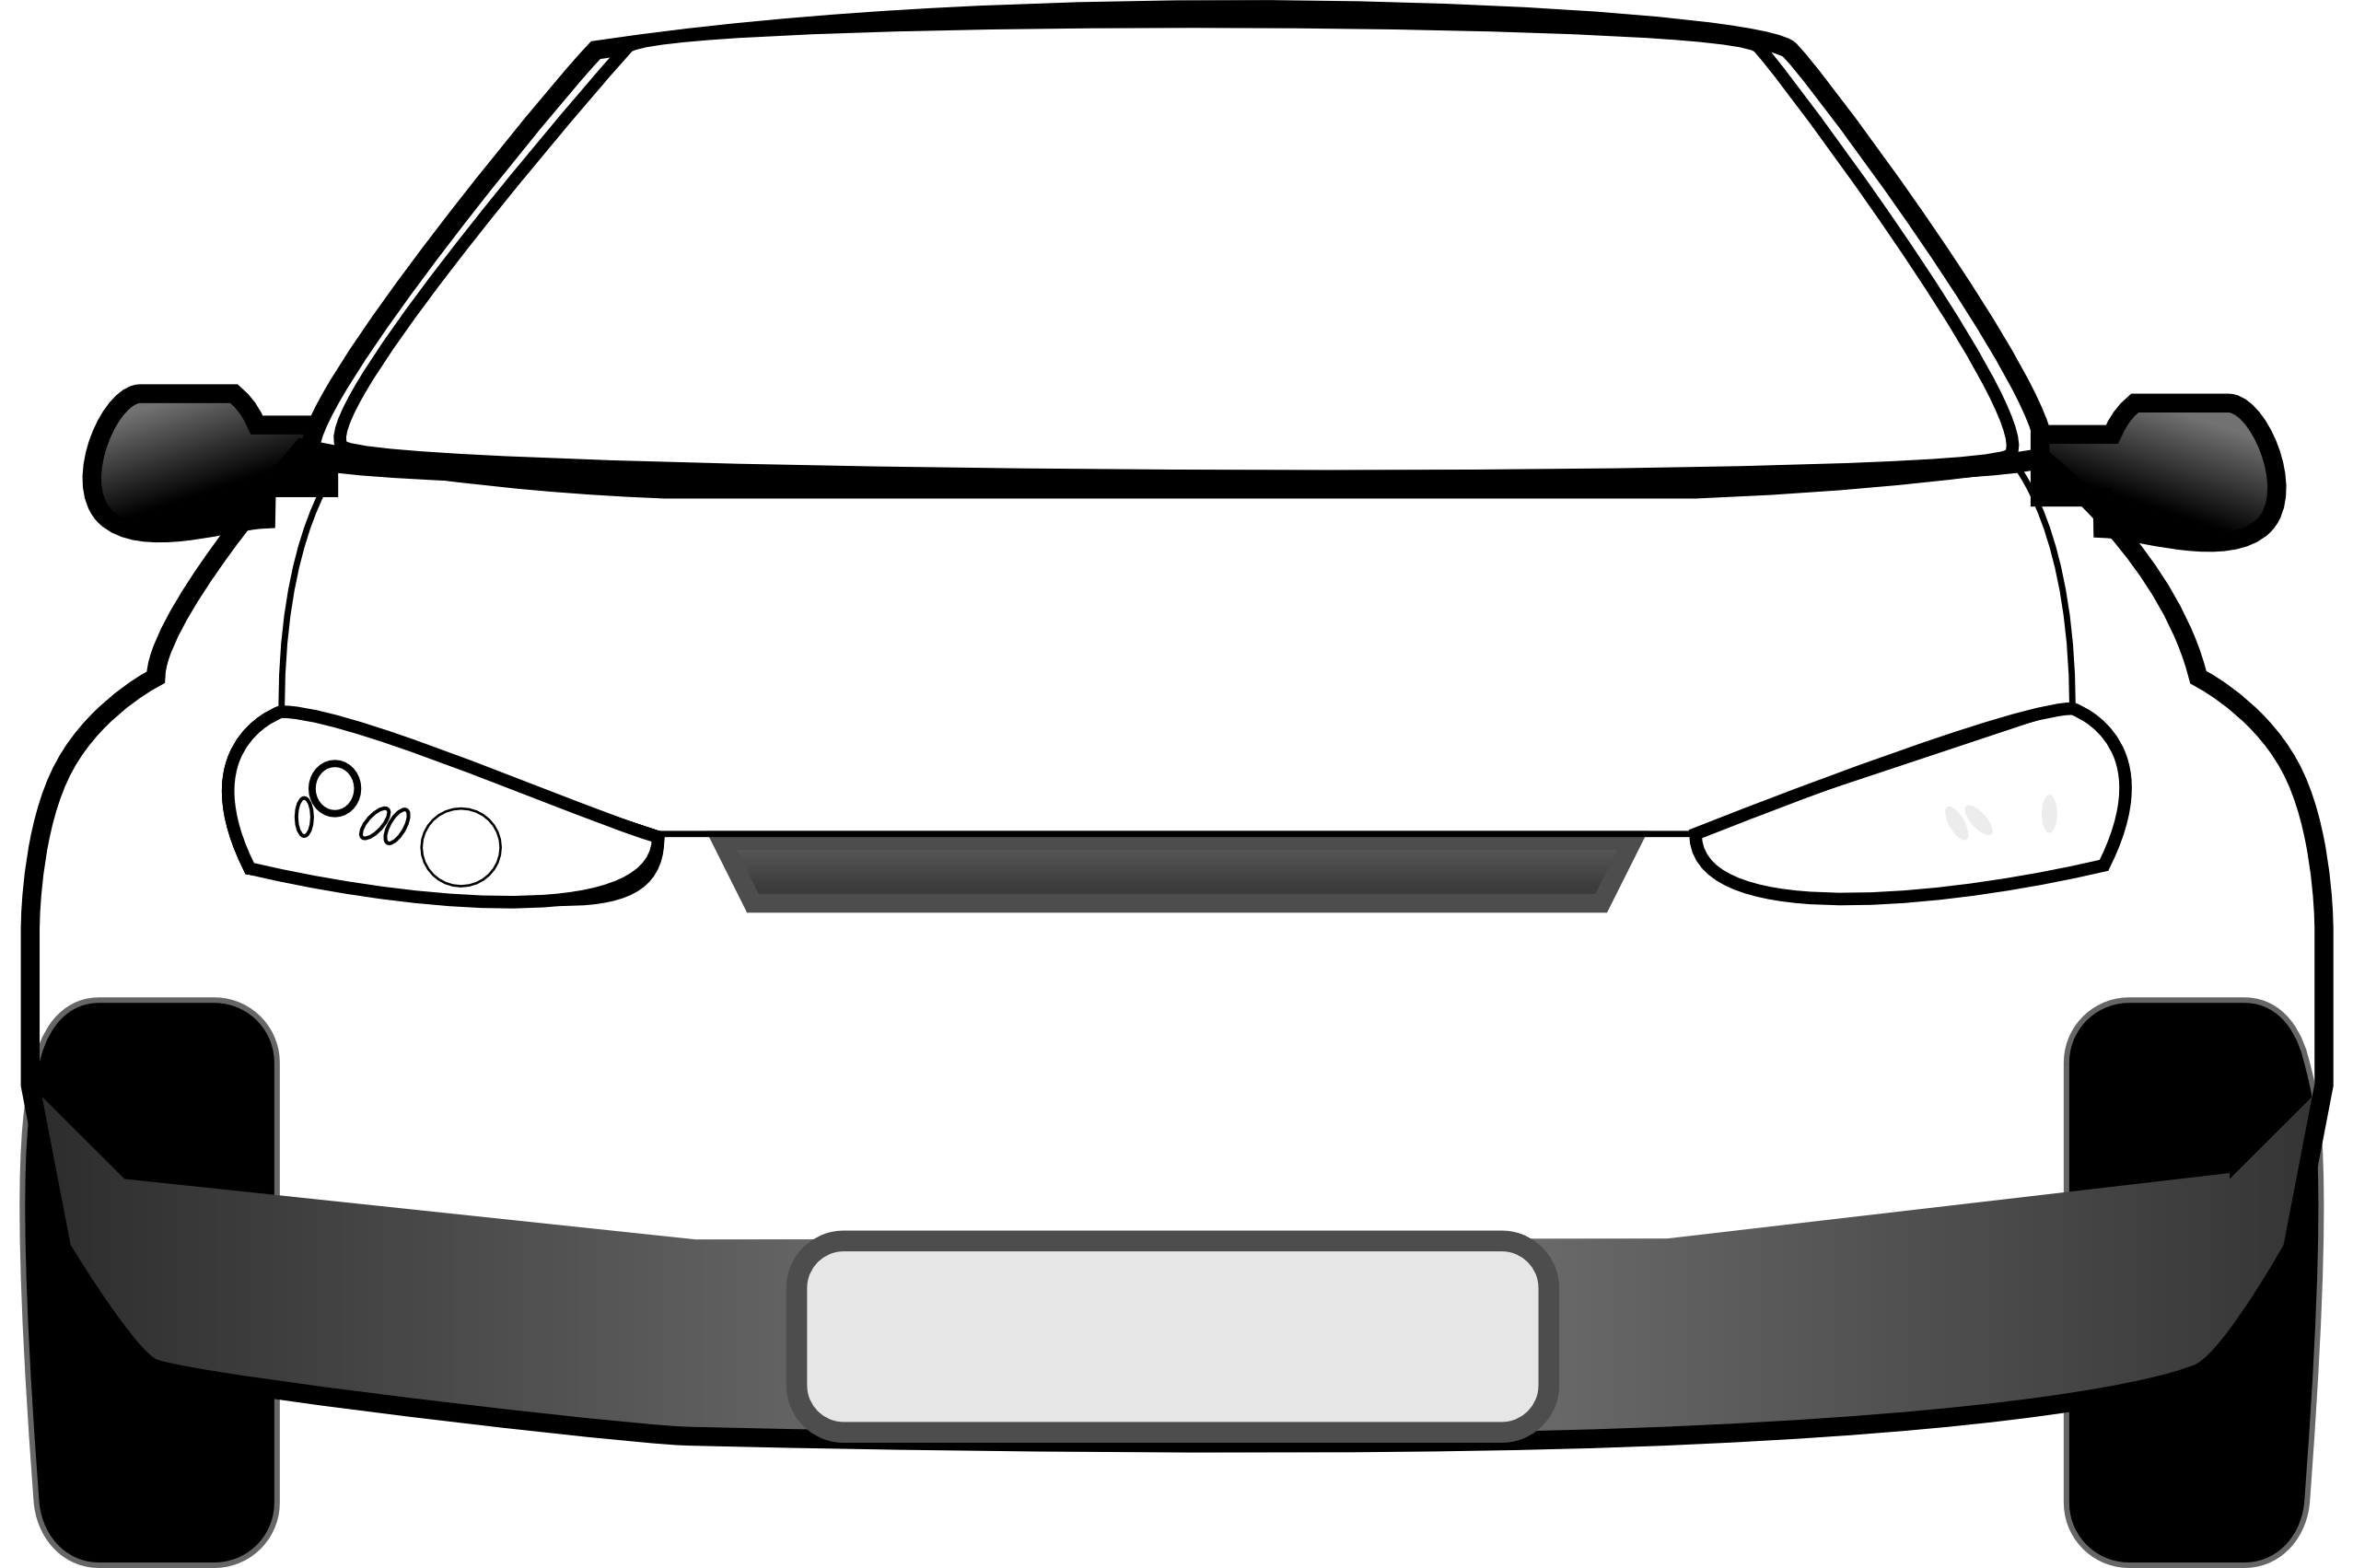
top view
front view
Y
X

Slide 6
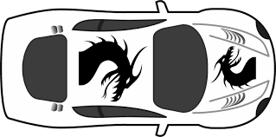
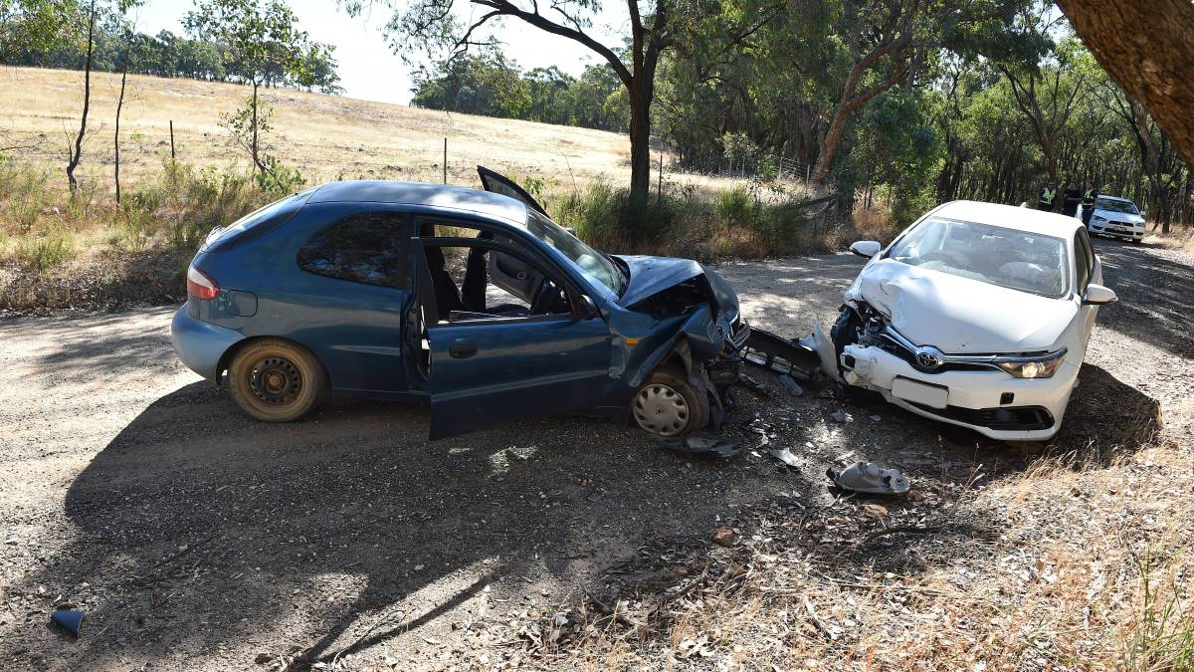
Travelling too fast into a corner can result in a fatal accident
If the speed of the car is less than 19 m.s⁻¹, then the car can move in a circular path

Slide 7
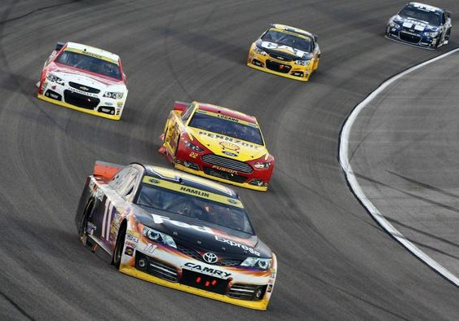
visualize the problem !
banking angle = ? º
system
Y
X

Slide 8
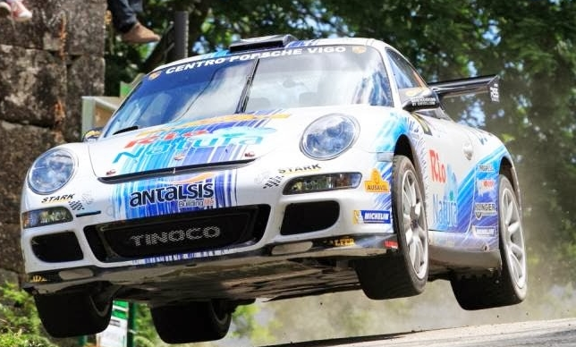
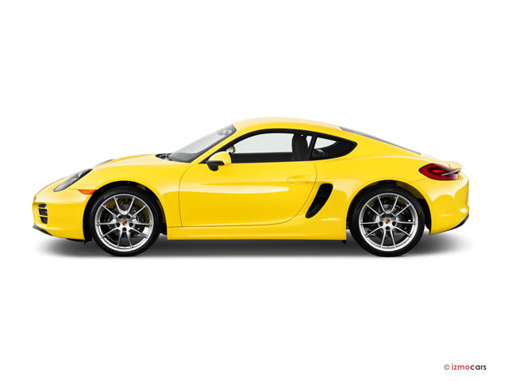
car becomes airborne
car travels over hill
Y
X

Slide 10
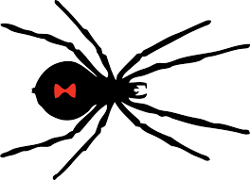
spider B
spider A

Slide 11
Centripetal force:
directed towards the centre
A
B

Slide 12
Uniform circular motion:
tangential speed constant
Non-uniform circular motion:
tangential speed changes
X

Slide 13
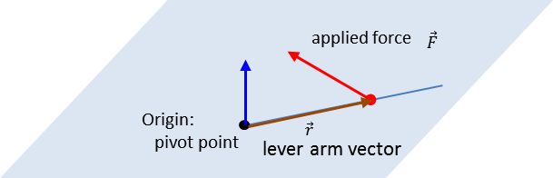

Slide 14
A
Y
X
B

Slide 15
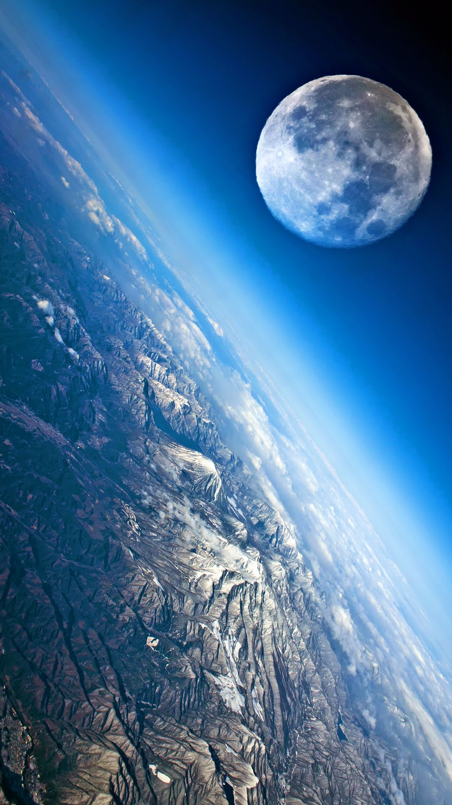

Slide 16
Force on mass m₂ due to the presence of mass m₂
m
2
m
1

Slide 17
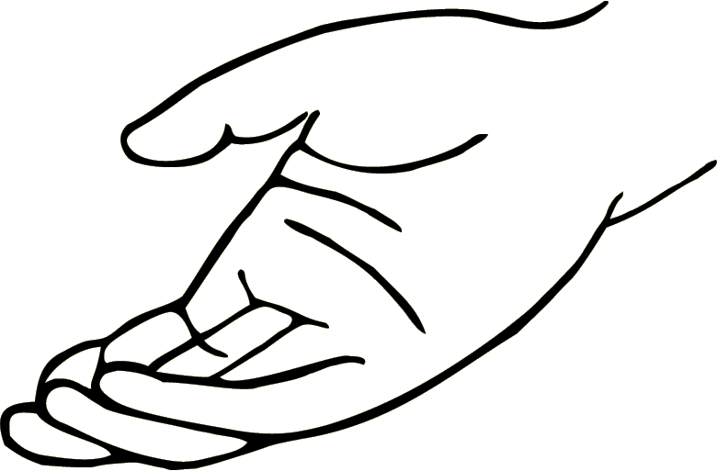
hand F_{H}
Object raised through a vertical displacement h at a constant velocity
m
a = 0 ⇒ F_{H} = F_{G}
weight F_{G}

Slide 18
1: initial event – ball released from rest
+
h₁ = 134 m E_{P1} = m g h₁ E_{K1} = 0 J v₁ = 0 m.s⁻¹
h₂ = 0 E_{P2} = 0 E_{K2} = ½ m v₂² = ? J v₂ = ? m.s⁻¹
2: final event – just before impact with ground
g = 9.8 m.s⁻²
g is only a number, can’t be negative

Slide 23
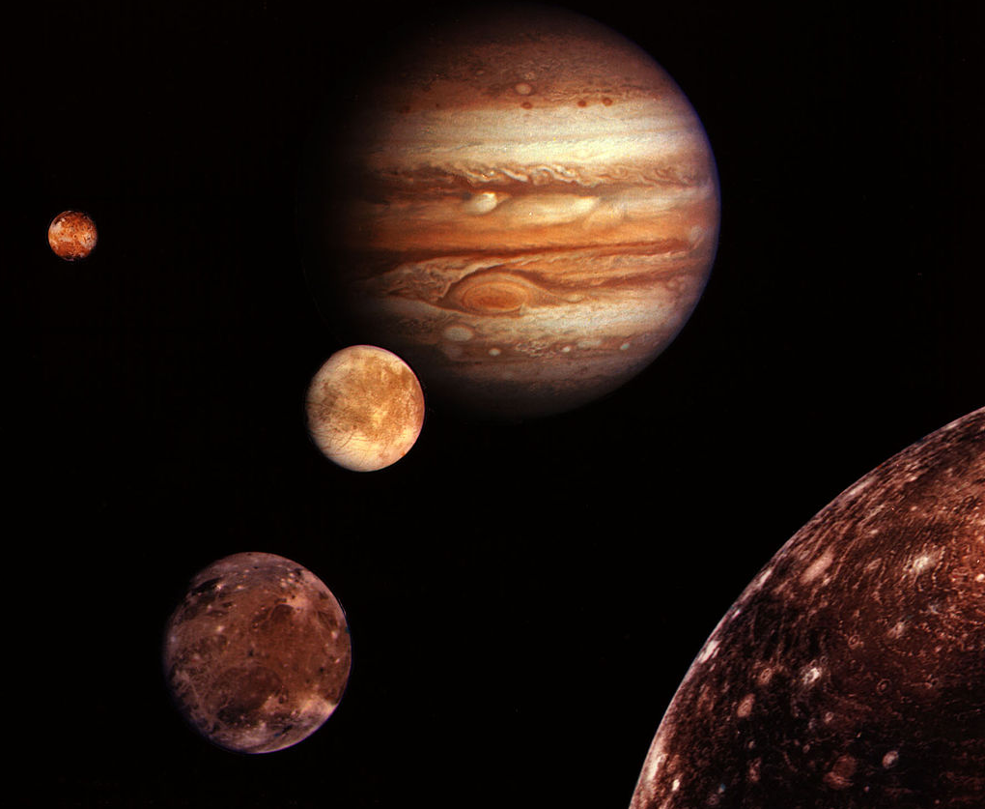
Jupiter’s moons

Slide 24
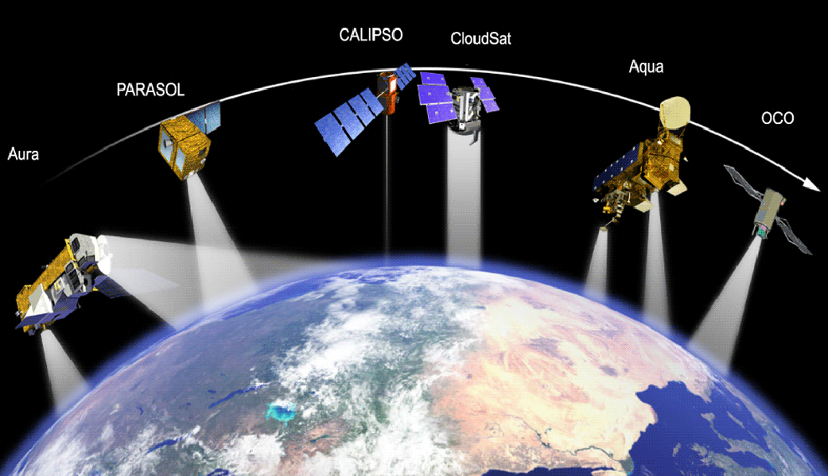
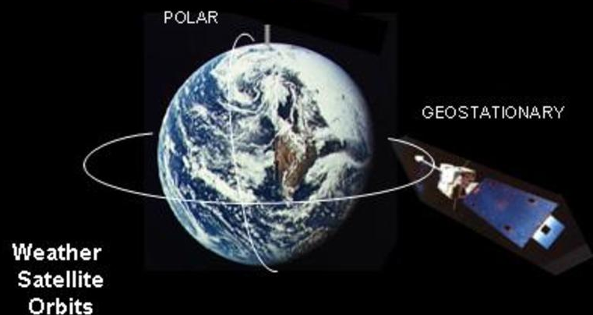
polar orbit
geostationary
orbit
weather satellite orbits

Slide 25
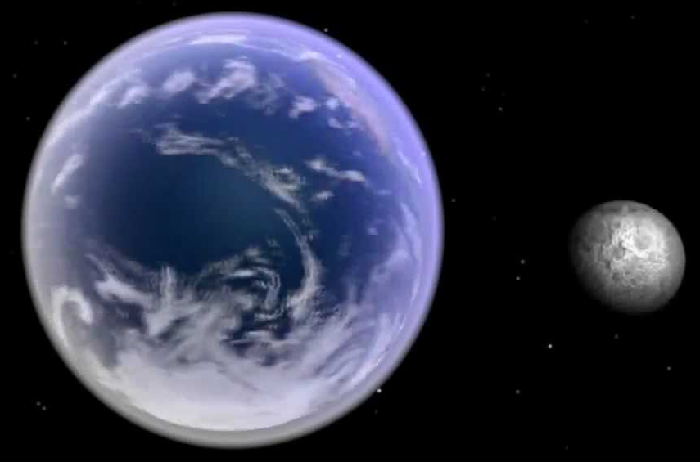
Moon
Earth

Slide 26
ellipse
planet
m
aphelion
r
perihelion
2b
M_{S}
Sun at one focus of ellipse
2a
semi-minor radius b
semi-major radius a

Slide 27
Elliptical path of planet around Sun
in equal time intervals A₁ = A₂
Sun
r
planet
A₁
A₂
equal areas
Perihelion – closest point to the Sun – max speed of planet
Aphelion – furthest point from the Sun – min speed of planet

Slide 28
Sun
perihelion
(large speed)
aphelion
(slow speed)

Slide 29
satellite
#2
#1

Slide 30
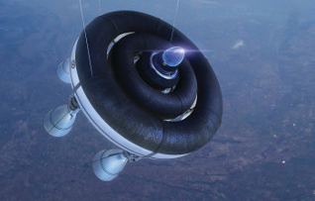
rockets fired to change orbit of satellite

Slide 31


Slide 32
Moon
Sun
Earth

Slide 33
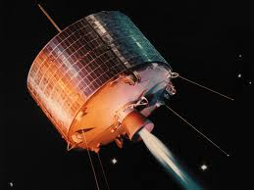
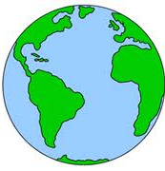
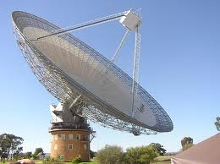
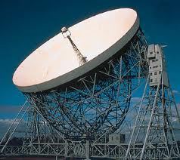
uplink
downlink
Parks, NSW
Jodrell Bank, U.K.

Slide 34
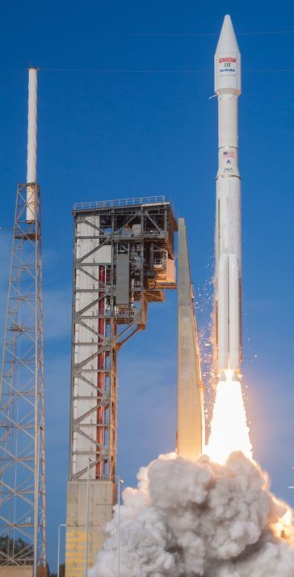
momentum of rocket
p_{rocket}
F_{RG} force on rocket by gas
F_{GR} force on gas by rocket
momentum of exhaust gases
p_{gases}

Slide 35
Earth’s orbital velocity around the Sun ~ 30 km.s⁻¹
Sun
Earth
Earth’s orbit around the Sun

Slide 36
Cannon ball fired with increasing velocities
ball returns to Earth
ball fired at escape velocity
ball orbits around the Earth

Slide 37
escape
v_{esc} ~ 40 000 km.h⁻¹
circular orbit
v_{orbit} ~ 27 000 km.h⁻¹
elliptical orbit
v_{elliptical} 30000 km.h⁻¹

Slide 38
without gravity
m
with gravity

Slide 39
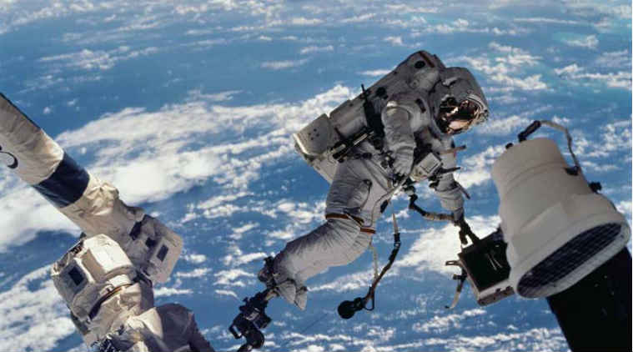
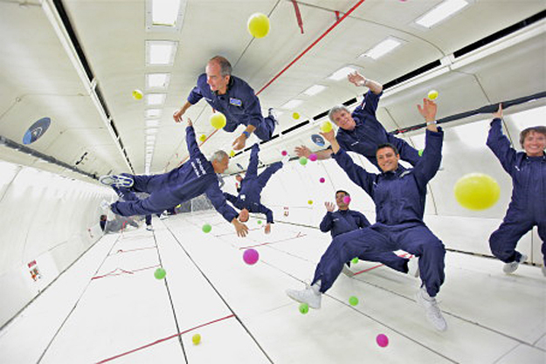
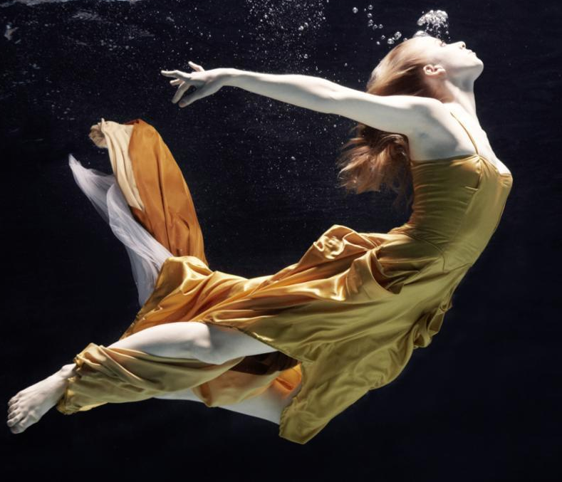
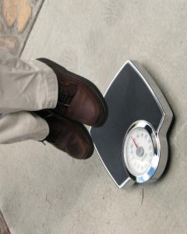
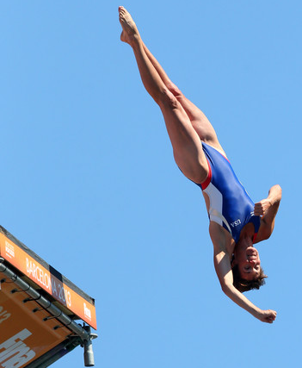
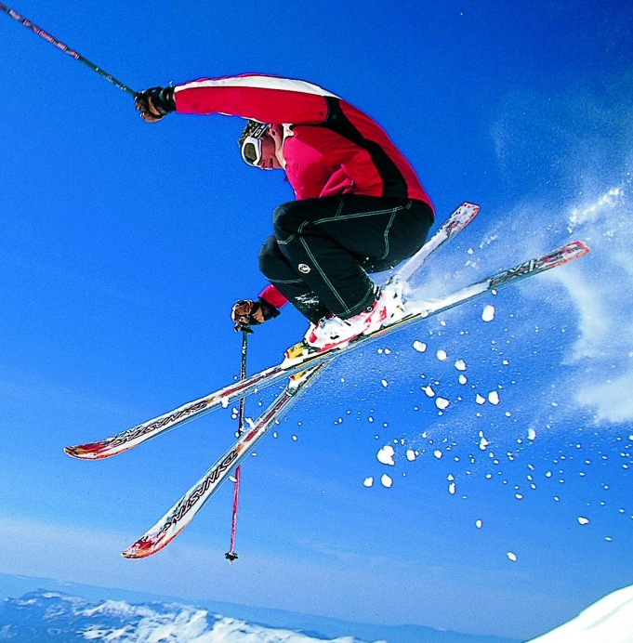

Slide 40

Person standing on scales
Person and scales in free-fall
Y
X
700 N
0 N
weight:
scale reading
F_{N} = 700 N
weight:
scale reading
F_{N} = 0 N

Slide 41
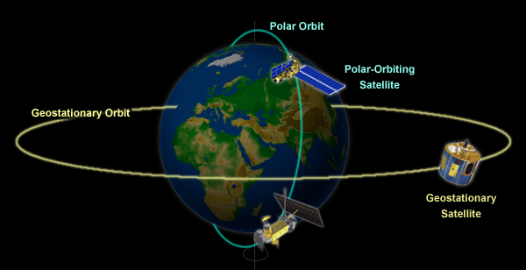
polar orbit
polar orbiting
satellite
geostationary
orbit
geosynchronous
satellite

Slide 42
Moon
satellite
Earth
Kepler’s 3rd Law

Slide 43
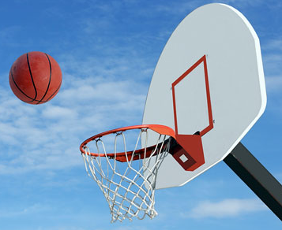

Slide 44
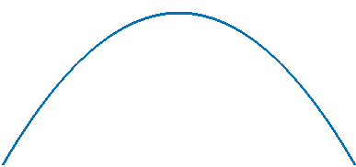
Y
X
trajectory of ball
maximum
height
range
Event #1
Launch of ball
Event #2
Ball at max height
Event #3
Ball hits ground

Slide 45
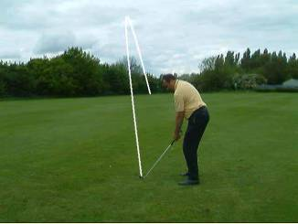
Event #3
ball hitting
ground
Event #2
ball at max height
#2
#3
#1
Event #1
launching the ball

Slide 46
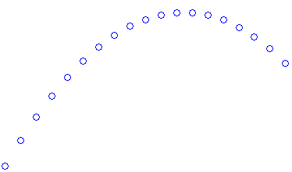

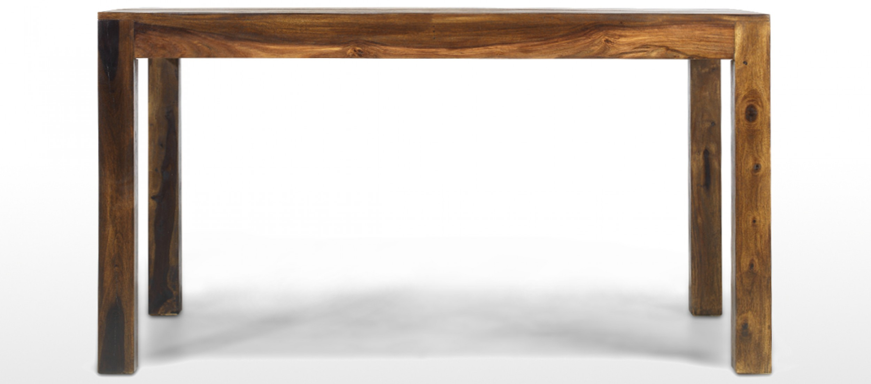
Y
(0,0)
X
1.00 m

Slide 47
1.00 m

Slide 48
Y
X

