Slide 1
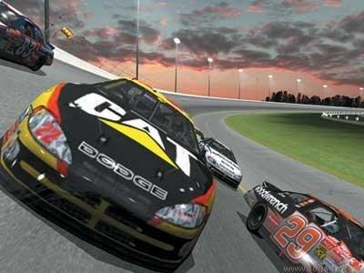
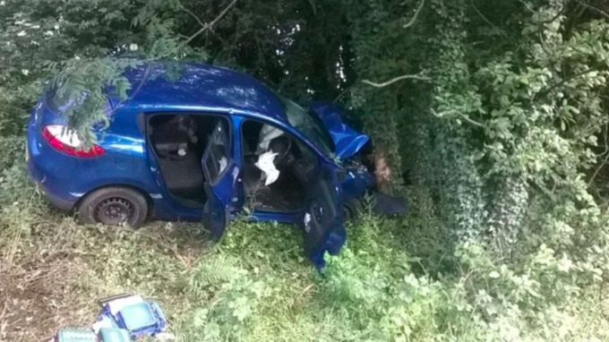
The car became airborne after travelling over a crest of a hill and driver lost control. The car smashed into a tree and the driver and passengers were seriously injured.

Slide 2
Y
Y
X
X

Slide 3

Y
Y
(0,0)
X
X

Slide 4
Y
Y
X
X

Slide 5
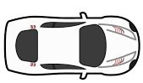
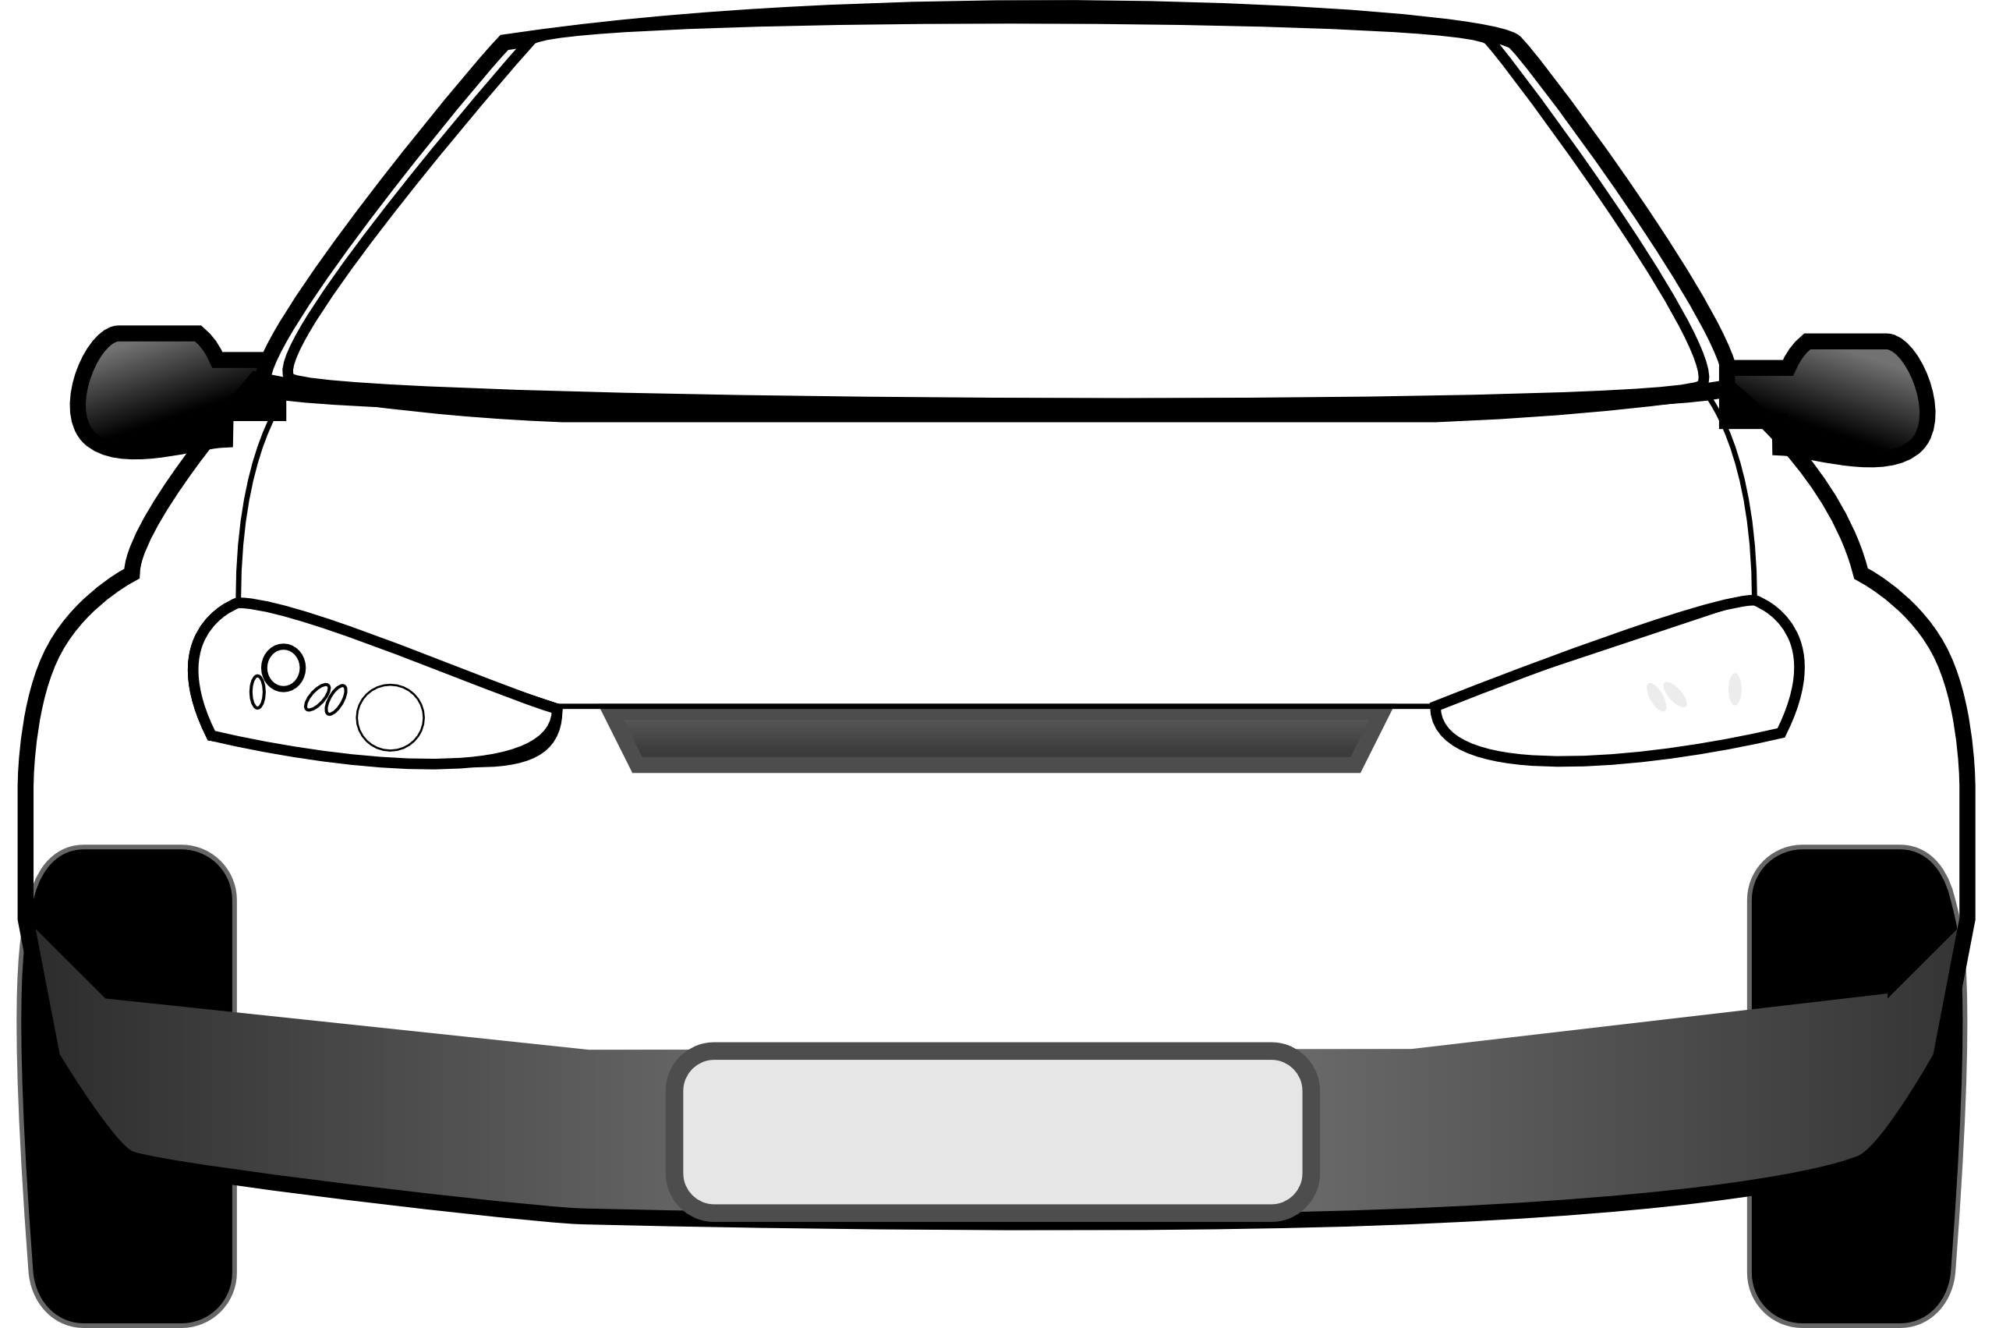
top view
front view
Y
X

Slide 6
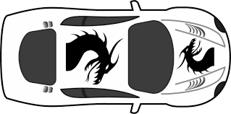
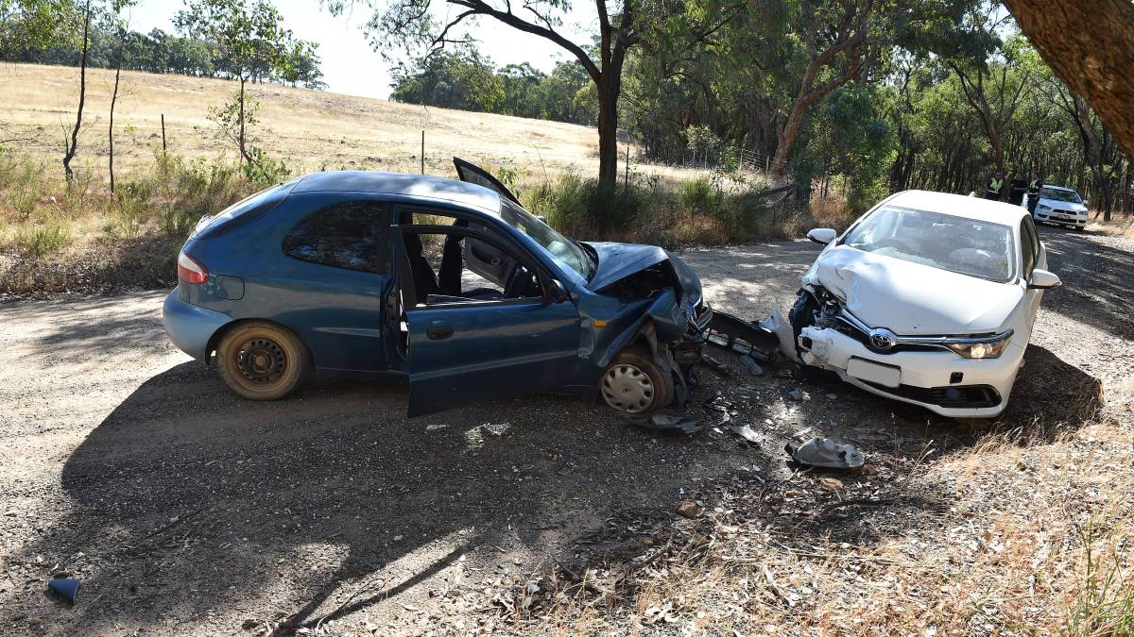
Travelling too fast into a corner can result in a fatal accident
If the speed of the car is less than 19 m.s⁻¹, then the car can move in a circular path

Slide 7
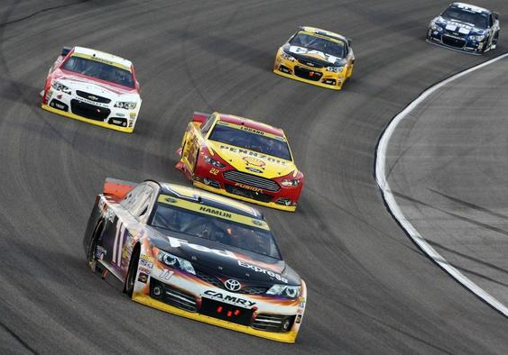
visualize the problem !
banking angle = ? º
system
Y
X

Slide 8
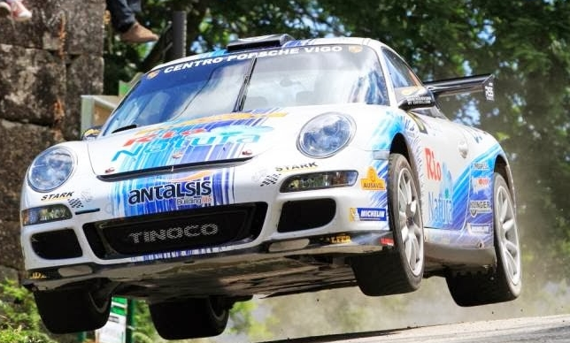
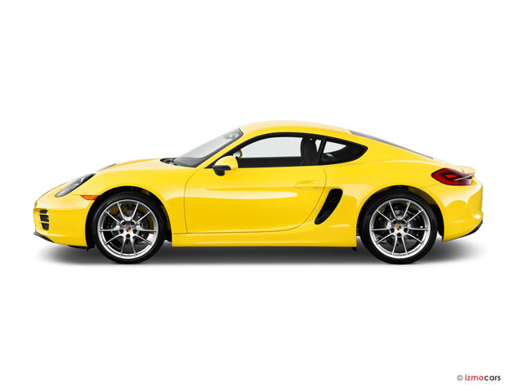
car becomes airborne
car travels over hill
Y
X

Slide 10
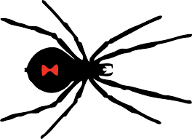
spider B
spider A

Slide 11
Centripetal force:
directed towards the centre
A
B

Slide 12
Uniform circular motion:
tangential speed constant
Non-uniform circular motion:
tangential speed changes
X

Slide 13
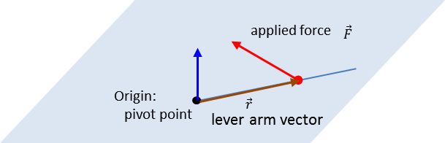

Slide 14
A
Y
X
B

Slide 15
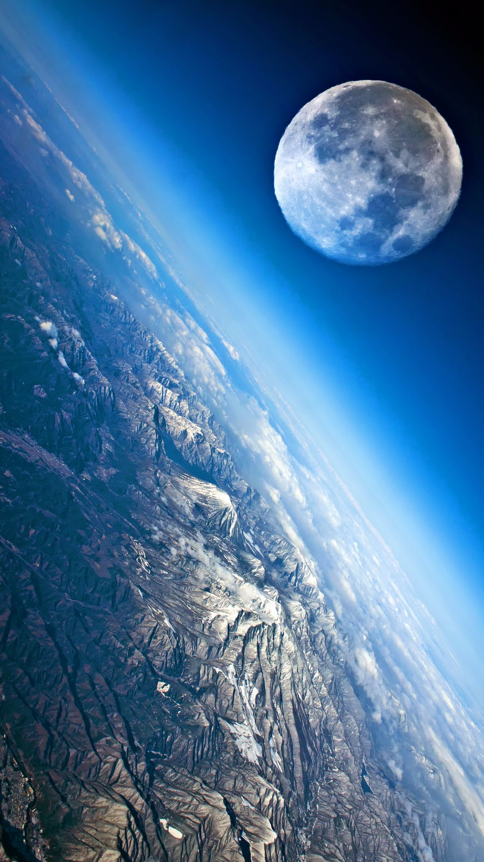

Slide 16
Force on mass m₂ due to the presence of mass m₂
m
2
m₁

Slide 17
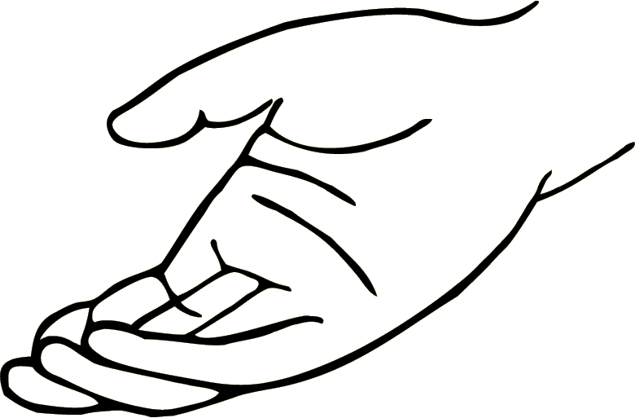
hand F_{H}
Object raised through a vertical displacement h at a constant velocity
m
a = 0 ⇒ F_{H} = F_{G}
weight F_{G}

Slide 18
1: initial event – ball released from rest
+
h₁ = 134 m E_{P1} = m g h₁ E_{K1} = 0 J v₁ = 0 m.s⁻¹
h₂ = 0 E_{P2} = 0 E_{K2} = ½ m v₂² = ? J v₂ = ? m.s⁻¹
2: final event – just before impact with ground
g = 9.8 m.s⁻²
g is only a number, can’t be negative

Slide 21
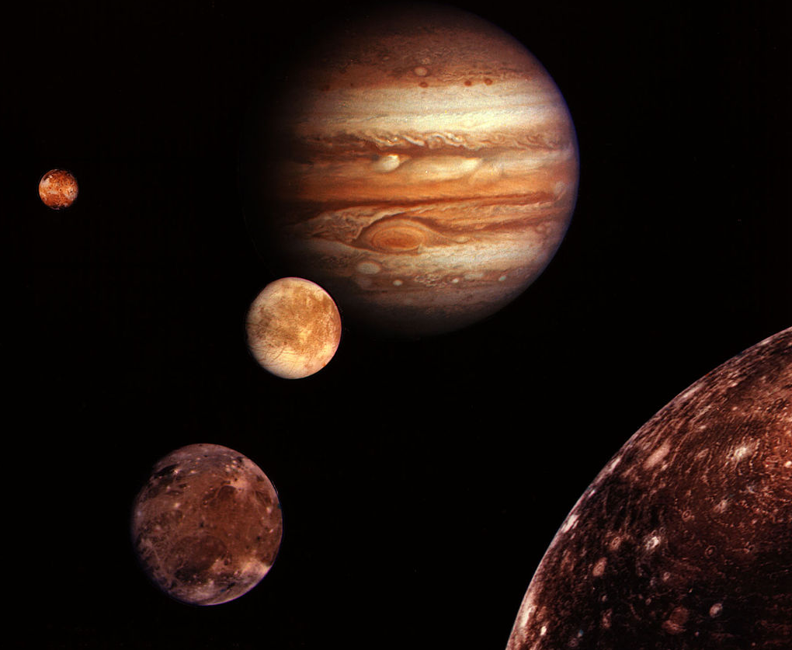
Jupiter’s moons

Slide 22
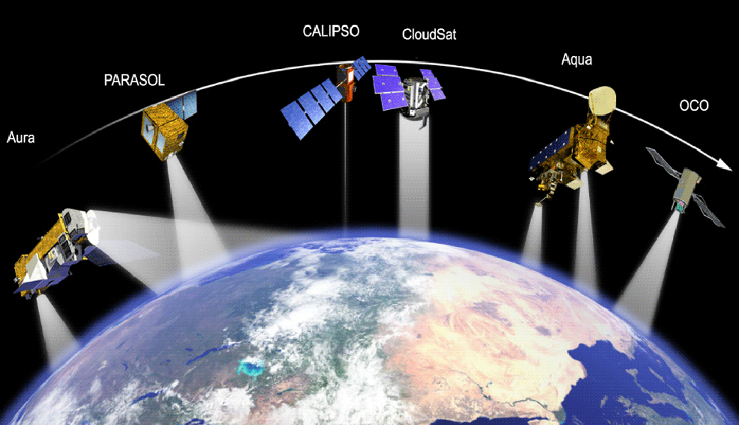
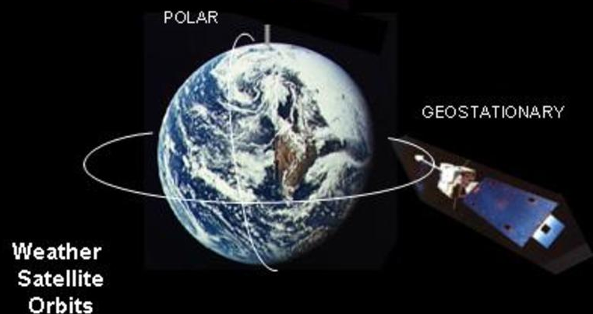
polar orbit
geostationary
orbit
weather satellite orbits

Slide 23
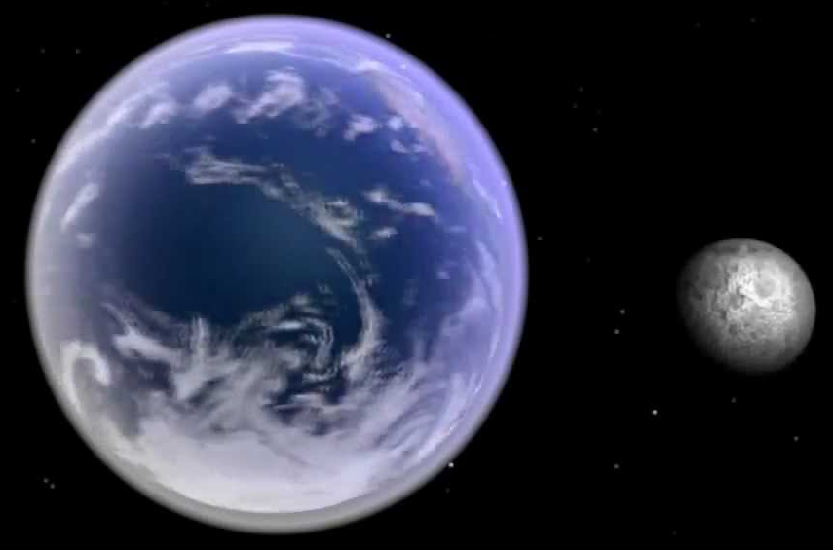
Moon
Earth

Slide 24
ellipse
planet
m
perihelion
r
2b
aphelion
M_{S}
Sun at one focus of ellipse
2a
semi-minor radius b
semi-major radius a

Slide 25
Elliptical path of planet around Sun
in equal time intervals A₁ = A₂
Sun
r
planet
A₁
A₂
equal areas
Perihelion – closest point to the Sun – max speed of planet
Aphelion – furthest point from the Sun – min speed of planet

Slide 26
Sun
perihelion
(large speed)
aphelion
(slow speed)

Slide 27
satellite
#2
#1

Slide 28
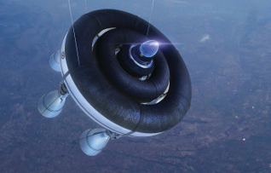
rockets fired to change orbit of satellite

Slide 29


Slide 30
Moon
Sun
Earth

Slide 31
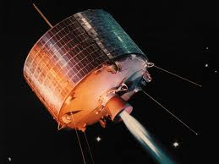
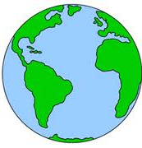
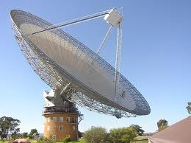
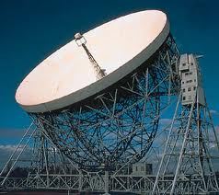
uplink
downlink
Parks, NSW
Jodrell Bank, U.K.

Slide 32
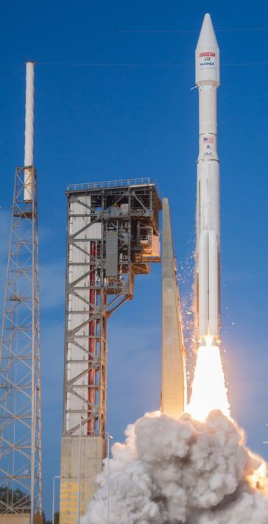
momentum of rocket
p_{rocket}
F_{RG} force on rocket by gas
F_{GR} force on gas by rocket
momentum of exhaust gases
p_{gases}

Slide 33
Earth’s orbital velocity around the Sun ~ 30 km.s⁻¹
Sun
Earth
Earth’s orbit around the Sun

Slide 34
Cannon ball fired with increasing velocities
ball returns to Earth
ball fired at escape velocity
ball orbits around the Earth

Slide 35
escape
v_{esc} ~ 40 000 km.h⁻¹
circular orbit
v_{orbit} ~ 27 000 km.h⁻¹
elliptical orbit
v_{elliptical} 30000 km.h⁻¹

Slide 36
without gravity
m
with gravity

Slide 37
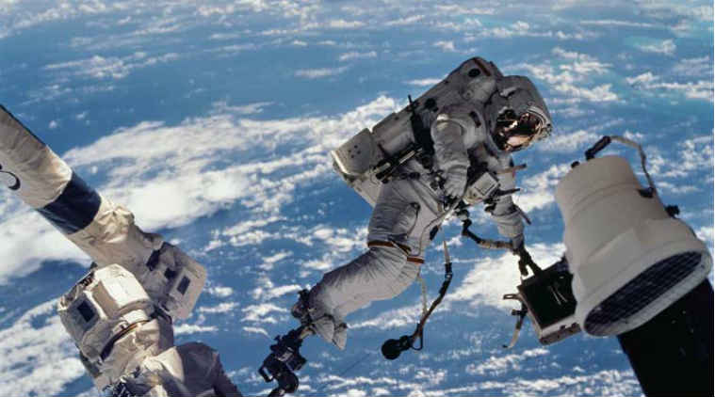
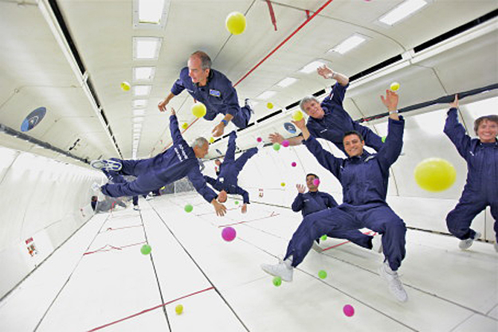
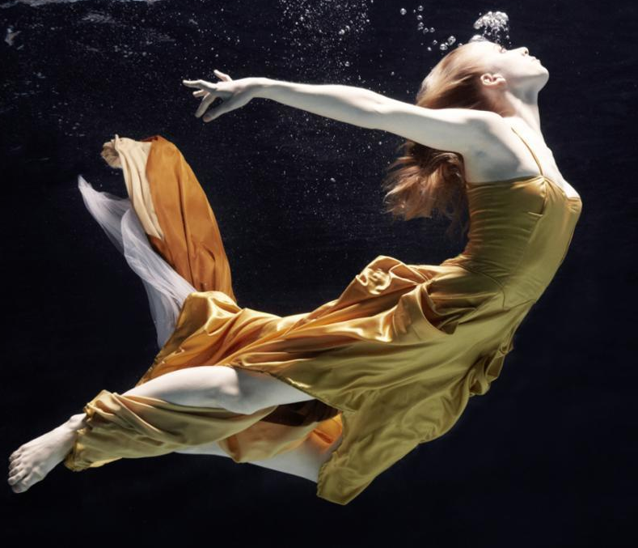
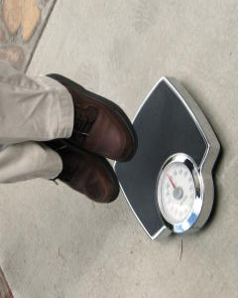
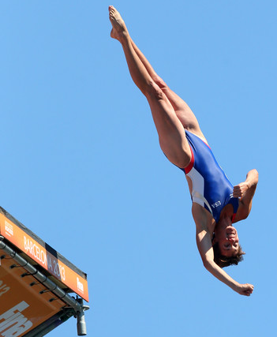
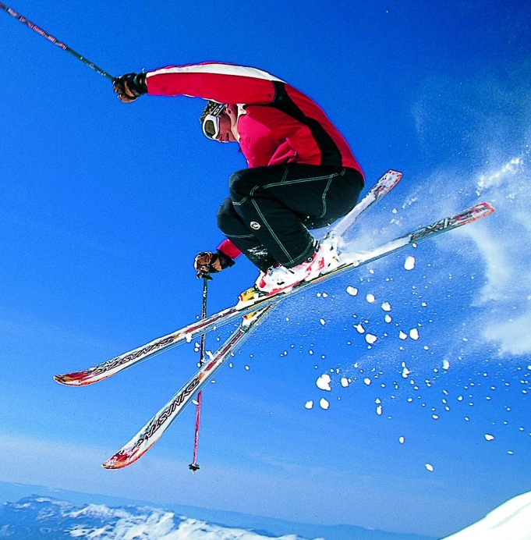

Slide 38

Person standing on scales
Person and scales in free-fall
Y
X
700 N
0 N
weight:
scale reading
F_{N} = 700 N
weight:
scale reading
F_{N} = 0 N

Slide 39
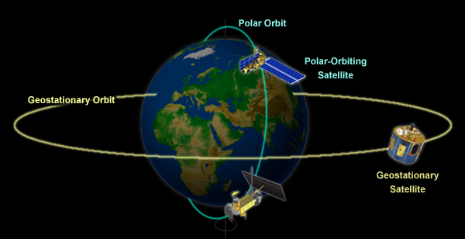
polar orbit
polar orbiting
satellite
geostationary
orbit
geosynchronous
satellite

Slide 40
Moon
satellite
Earth
Kepler’s 3rd Law

Slide 41
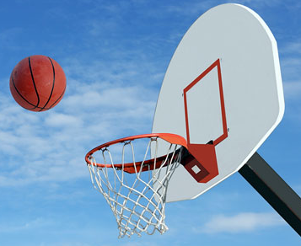

Slide 42
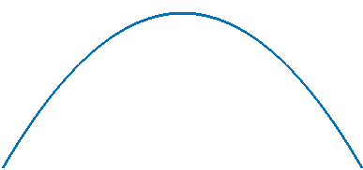
Y
X
trajectory of ball
maximum
height
range
Event #1
Launch of ball
Event #2
Ball at max height
Event #3
Ball hits ground

Slide 43
enter simulation time
enter initial velocity v_{oy}
enter initial position R₀
v_{oy}
t = 16
start
t = 0
R₀

Slide 44
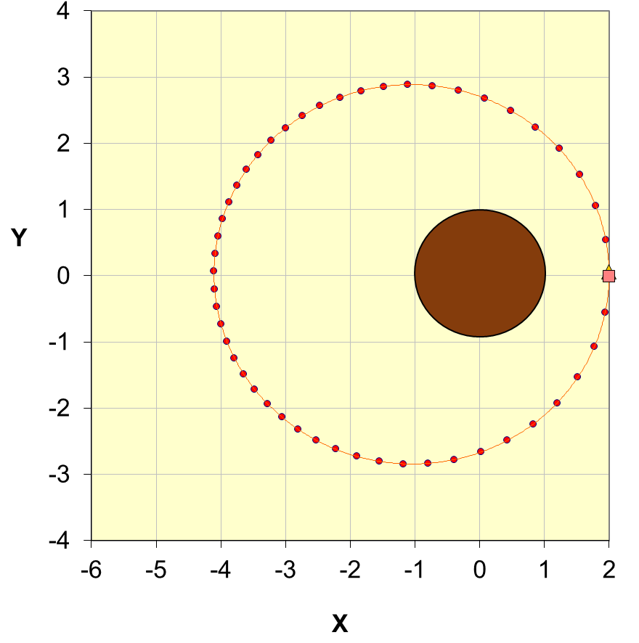
3.4+2.8 = 6.2
3.4
2.8
2.3
3.8
3.8+2.3 = 6.1

Slide 45
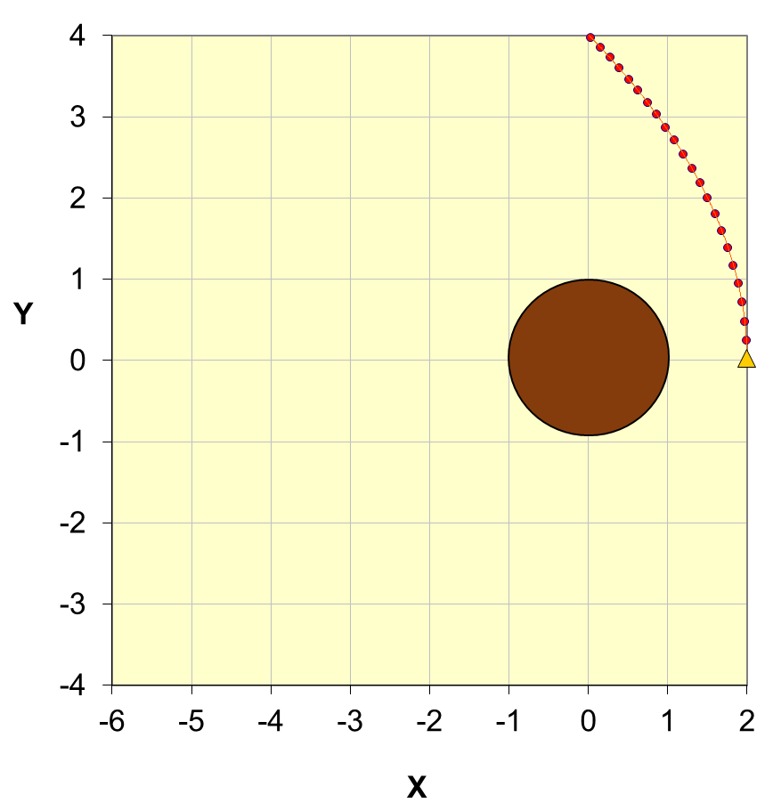
motion with a constant velocity along a straight line

Slide 46
orbital velocity (tangential) velocity
velocity component perpendicular to radius vector
angle between velocity and radius vectors
arc length
r
dA = area swept out in time dt
angle swept out in time dt
Provided dt is small, the area of the sector swept out can be approximated by the area of a triangle
(1/2 base x height)
r

