Slide 1
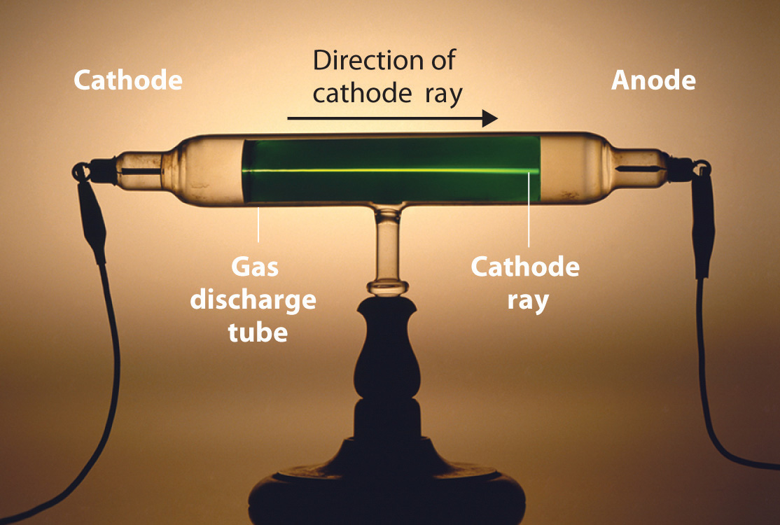

Slide 2
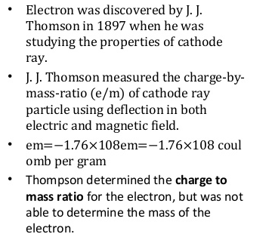
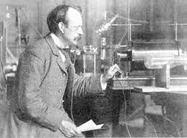

Slide 3


cathode (-)
anode (+)
positive beam of particles
emerging from hole in cathode

Slide 4
incident alpha particles
scattered alpha particles
electron
positive charge

Slide 5
alpha particle source
movable zinc sulfide detector
lead screen with hole
thin metal foil

Slide 6
e
incident alpha particles
e
e
+
e
e
e
+
e
+
e
e
e
e
+
e
e
e
e
+
e
+
e
e
e
+
e
e
e
e
+
e
e
e
+
e
e
e
e
+
e
e
e
+
e
+
e
e
e
e
+
e
scattered alpha particles
e
e
e
+
e
+
e
e
e
+
e
e
e
e
+
e
e
e
+
e

Slide 7
negative electron attracted towards positive nucleus
electron (-)
+
spiral path of electron towards positive nucleus

Slide 8
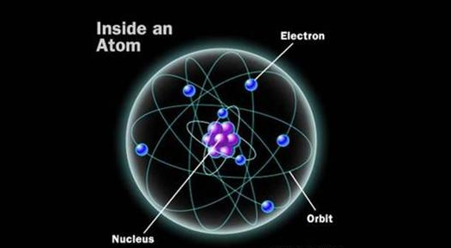
negative electron
electron orbits
positive nucleus

Slide 9
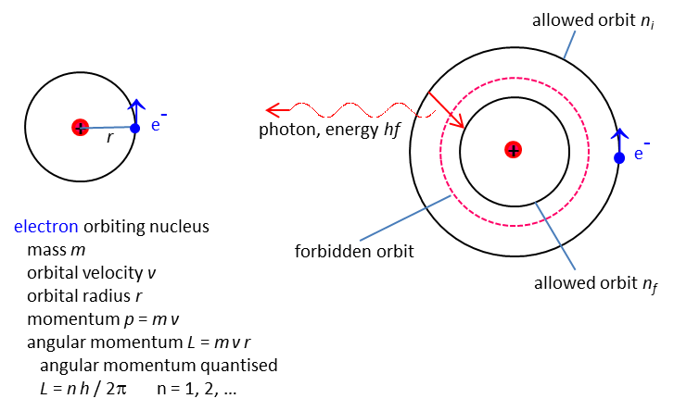

Slide 10
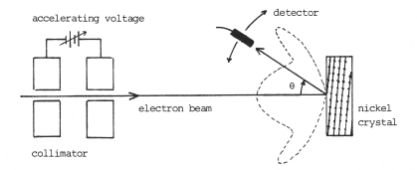
detector
accelerating high voltage
electron beam
collimator
nickel crystal
electrons reflected off parallel planes of Ni atoms

Slide 11
electric field at time t
λ
particle (photon)
wave

Slide 12
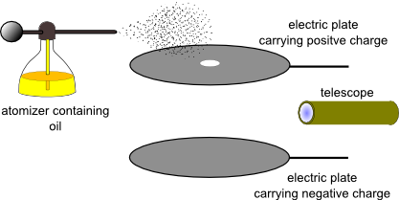

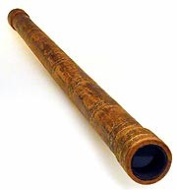
atomiser
some oil-drops acquire a negative charge
+ plate
light
source
d
oil drop
(enlarged view)
viewing
microscope
emf V
- plate

Slide 13
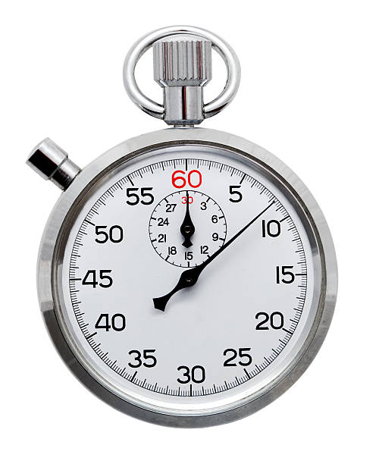
electric field switch on
s
time interval t_{E} for oil drop to rise at constant velocity through displacement s
electric field switch off
s
time interval t_{G} for oil drop to fall at constant velocity through displacement s

Slide 14
charge q
density of air
viscosity of air
density of oil drop
radius of oil drop R
volume of oil drop Vol
mass of oil drop m
Gravitational force
Buoyancy force (weight of air displaced)
Resistive force always in opposition to the motion and is given by Stokes’s Law
Electric force

Slide 15
suspended oil drop

Slide 16
Falling oil drop moving at its terminal velocity

Slide 17
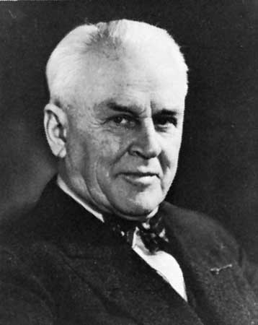
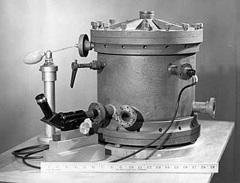

Slide 18
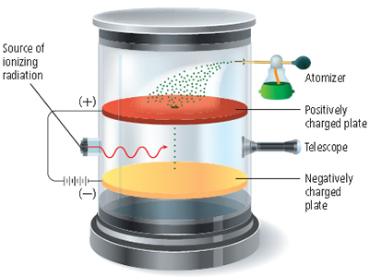
atomiser
ionising
radiation
+ plate
telescope
light source
- plate

Slide 19
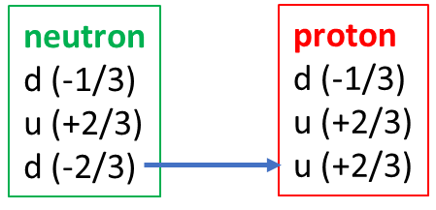
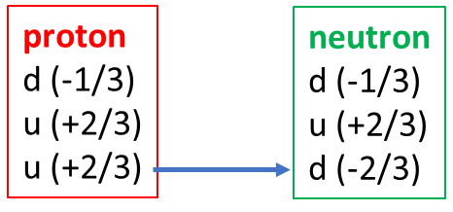
-1
-1

