Slide 1
initial conditions
t₁ = 0 x₁ v₁ = u
final conditions
t₂ = t x₂ v₂ = v
+X
x = 0
origin
always show an arrow
for +X direction
always specify the origin
v < 0 a < 0
v > 0 a < 0
v < 0 a > 0
v > 0 a > 0
+X
x < 0
x > 0
x = 0
origin

Slide 2





Slide 4



Z
$$\hat{k}$$
O(0,0,0)
$$\hat{j}$$
Y
$$\hat{i}$$
X

Slide 5
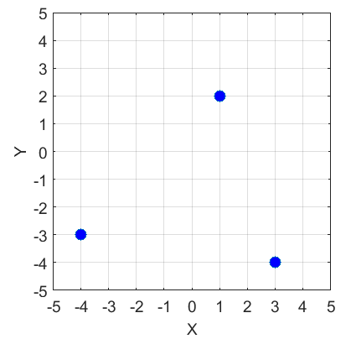






P(1, 2)
$${\vec{s}}_{P}$$
[m]
O
$$θ_{P}$$
$$θ_{Q}$$
$$θ_{R}$$
$${\vec{s}}_{R}$$
R(-4, -3)
$${\vec{s}}_{Q}$$
Q(3, -4)
[m]

Slide 6



P(1, 2)
[m]
O
$${\vec{s}}_{R}$$
$${\vec{s}}_{Q}$$
$${\vec{s}}_{RQ}$$
R(-4, -3)
Q(3, -4)
[m]

Slide 7
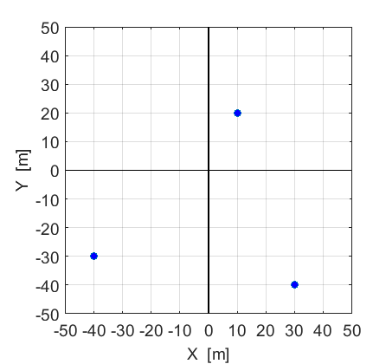



Event 1:
t = 10 s
x = 10 m, y = 20 m
$$\hat{j}$$
O(0,0)
$$\hat{i}$$
Event 3:
t = 200 s
x = -40 m, y = -30 m
Event 2:
t = 100 s
x = 30 m, y = -40 m

Slide 8
O(0,0)
$$\hat{j}$$
$$\hat{i}$$

Slide 9
$$\hat{j}$$
$$\hat{i}$$

Slide 10



P(1, 2)
$${\vec{s}}_{P}$$
[m]
$${\vec{s}}_{PQ}$$
O
R(-4, -3)
$${\vec{s}}_{Q}$$
Q(3, -4)
[m]

Slide 11




Y
$$\vec{s}$$
$$\hat{j}$$
$$θ$$
$$\hat{i}$$
O(0, 0)
X

Slide 13
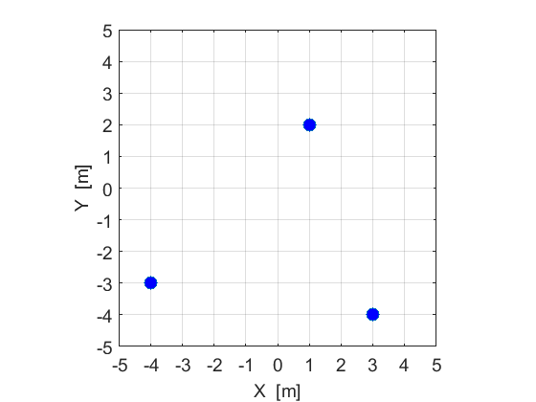





P(1, 2)
$${\vec{s}}_{RP}$$
$${\vec{s}}_{P}$$
$${\vec{s}}_{QP}$$
$${\vec{s}}_{R}$$
$${\vec{s}}_{Q}$$
$${\vec{s}}_{RQ}$$
Q(3, -4)
R(-4, -3)

Slide 14
P(1, 2)
Q(3, -4)
R(-4, -3)

Slide 16

head
tail
$$\vec{v}$$
v
v

Slide 17



$$\vec{B}$$
- $\vec{A}$
$$2\vec{A}$$

Slide 20


$$\hat{n}$$
$$\hat{n}$$

Slide 21

complex situation
Identify the crate as the system
The system is represented as a dot
in a scientific annotated diagram
M

Slide 22







Initial position of crate
final position of crate
Y
$${\vec{F}}_{N}$$
$${\vec{F}}_{N}$$
$${\vec{F}}_{T}$$
$${\vec{F}}_{T}$$
X
$${\vec{F}}_{G}$$
$${\vec{F}}_{G}$$
$$\vec{s}$$
displacement of crate
$${\vec{F}}_{T}$$
$$φ$$

Slide 23







applied force
$$\vec{F}$$
Origin:
pivot point
$$\vec{r}$$
lever arm vector
$$\hat{n}$$
$$\vec{F}$$
$$\vec{r}$$
$$θ$$

Slide 24
$$\hat{j}$$
$$\hat{i}$$

Slide 25
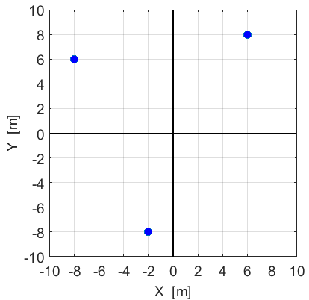

P(6, 8)
Q(-8, 6)
O(0, 0)
$$\hat{j}$$
$$\hat{i}$$
$${\vec{s}}_{R}$$
R(-2, -8)

Slide 26
P(6, 8)
Q(-8, 6)
O(0, 0)
$$\hat{j}$$
$$\hat{i}$$
R(-2, -8)

Slide 27
x
v = 0
v
v < 0
v > 0
t
t
velocity = slope of tangent x/t graph
change in displacement =
area under v/t graph
v
a = 0
a
a < 0
a > 0
t
t
acceleration =
slope of tangent v/t graph
change in velocity =
area under a/t graph

Slide 28
a > 0
a > 0
≡
F₁
m
F₂
m
+
m
g = +9.8 m.s⁻²
r
F_{C}
centripetal acceleration a_{C} directed
towards centre of circle
v
centripetal force F_{C} directed
towards centre of circle
Magnitude of v is constant
Change in direction of v is always directed to centre of circle

Slide 29
+
v > 0
v < 0
m
m
p = m v > 0
p = m v < 0
v₁ = u
force F acts time Δt
v₂ = v
m
m
initial momentum p₁
final momentum p₂

Slide 30
+
v > 0
v < 0
m
m
p = m v > 0
p = m v < 0
v₁ = u
force F acts over displacement Δs
v₂ = v
m
m
initial KE E_{K1}
final KE E_{K2}
work done on object W = F Δs

Slide 31
+Q
V
electric field is uniform between charged plates
d
-
q_{e}
V = 0
electron accelerated
by electric field
-Q

Slide 32
v_{orb2}
r₂
v_{orb1}
r₁
T₂
T₁
M

Slide 33
A
I
ammeter
ε
R
V
voltmeter

Slide 34
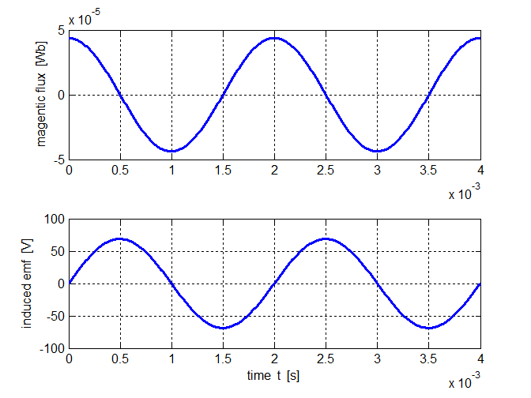
slope = 0
Φ_{Bmax}
T/4
max neg slope
max pos slope

Slide 35
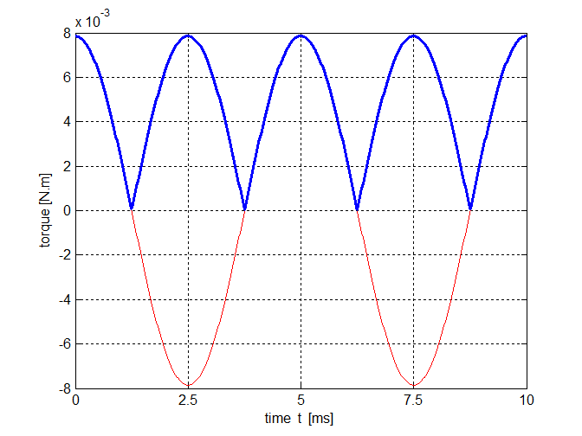
A
A
coil rotates clockwise
current
I (out)
side views of coil
A
B
A
A
A
A
A
A
0º
current
I (in)
θ →
180º
360º
90º
270º
torque always acts to produce a clockwise rotation
T = 5.0 ms

Slide 36
uniform magnetic field B into page
v
negative charge q enters uniform
B-field
F_{B} causes a change in direction, no change in speed since F_{B} acts at right angle to v
r
force F on charge always directed to centre of circle
Circular motion: Magnetic force = Centripetal force

