Slide 1
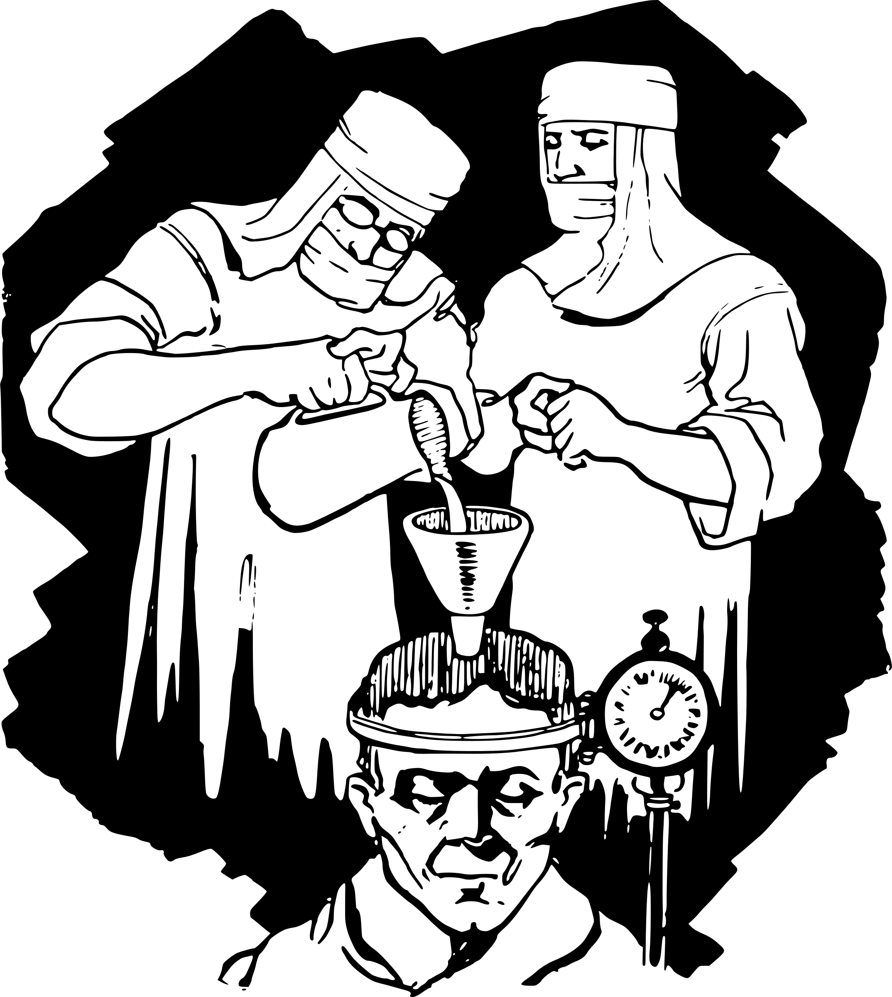


Slide 2


Slide 3
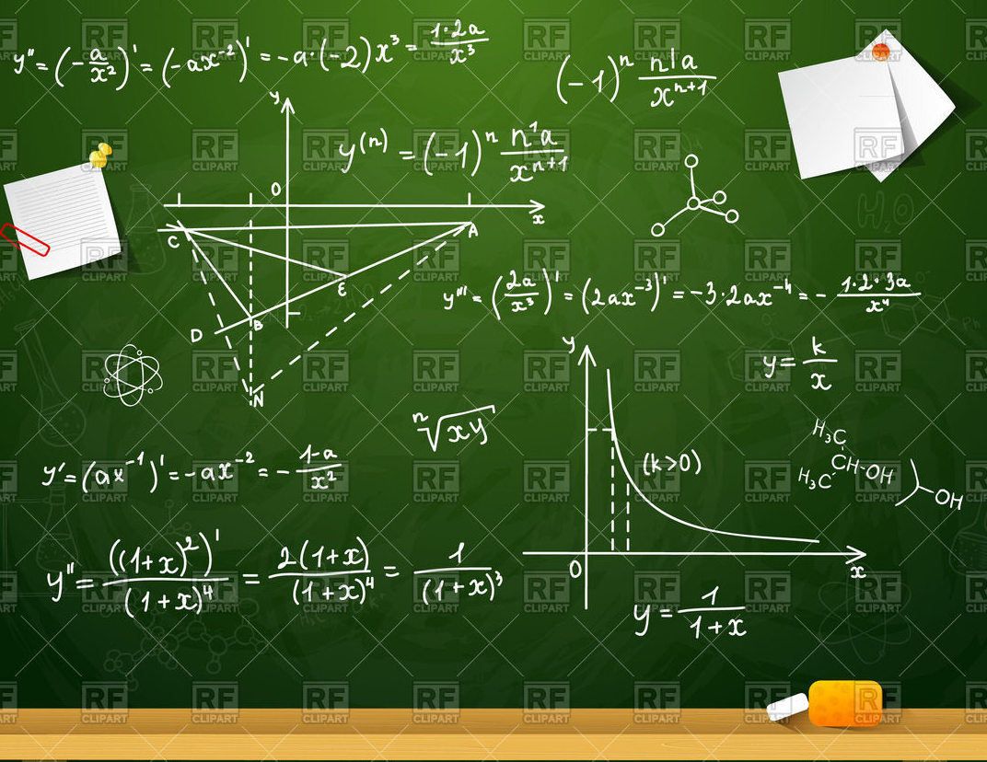

Slide 4

If you put your two fists together, it about the size of your brain

Slide 5
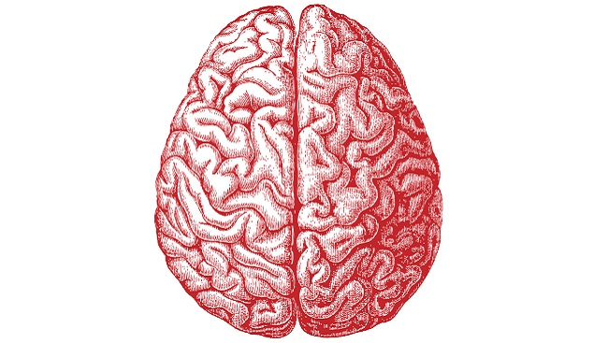
corpus callosum
left side functions
right side functions
* analytic though
* language
* logic
* analysis
* mathematics
* science
* number skills
* reasoning
* sequencing
* writing
* right-had control
* creativity
* imagination
* intuition
* insight
* holistic though
* rhythm
* music
* images
* colour
* daydreaming
* [3D] forms
* left hand control

Slide 6


Big deal !!!
What’s wrong with this linear approach to learning?
Memory Mind Maps
have many advantages

Slide 7





With your MMM you don’t need to waste 90% of your time reading.
MMM
MMM
MMM
Make use of your MMM. You can spend just a few seconds very often in reviewing them.

Slide 8
习近平主持中共中央党外人士座谈会 喜迎十九大
《习近平关于社会主义文化建设论述摘编》出版发行
十八次党代会十八座里程碑 解决了啥难题 砥砺奋进
I have no idea what is written, I hope it is not offensive
Without basic knowledge and memory, the information above in not meaningful.

Slide 9
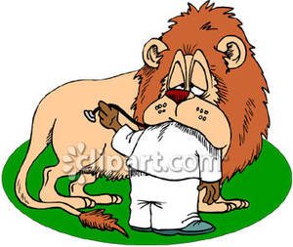
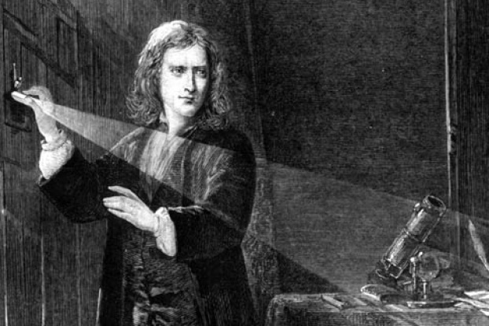
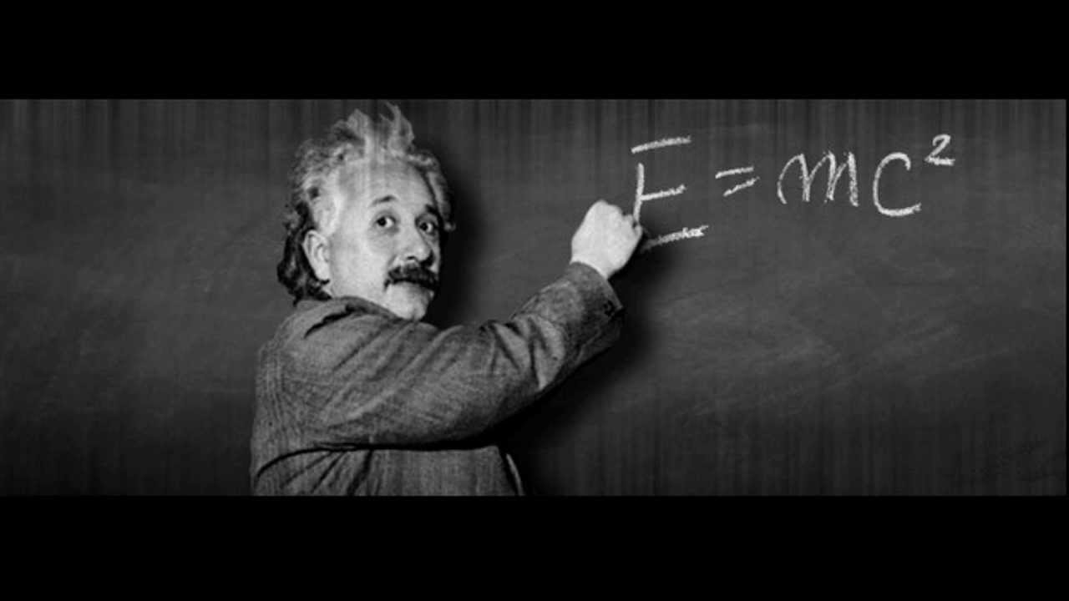
You can easily recall a picture but not the words
Einstein eats Newton’s Laws

Slide 10
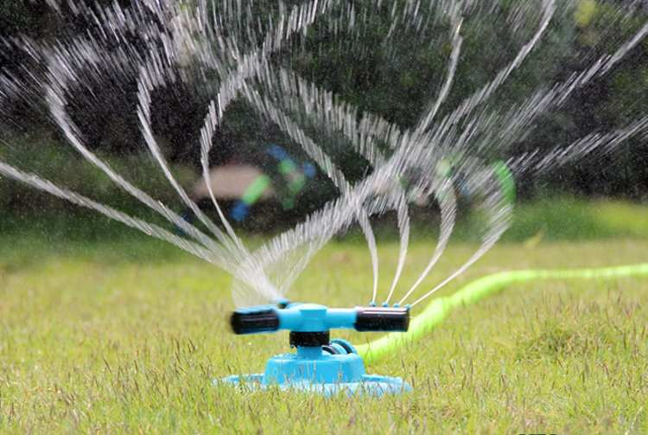



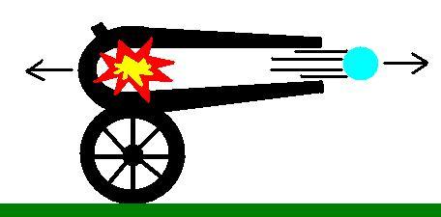
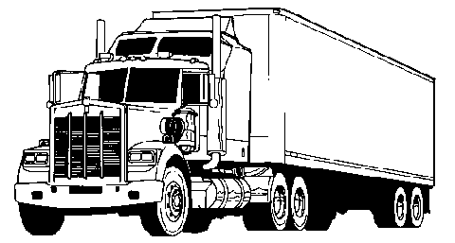




Newton’s 3rd Law
What story does each picture tell ???

Slide 11


How can you associate an electric current with the devil?

Slide 12
name of physical quantity is often not necessary
must include unit
show unknown values ?

Slide 13


known and unknown values clearly presented (symbol value unit)
5 significant figures
4 s.f.
3 s.f.
answers have at most 3 significant figures.
signs are important: need reference frame
Use diagrams to clarify meaning of symbols
Y
$$\hat{j}$$
Origin t = 0, s = 0
$$\hat{i}$$
X
using unit vectors makes physics simpler
use ( ) not x signs – no units with numbers
units always after numbers
scalar quantities
final answer correct number of significant figures

Slide 14

Y
$$\hat{j}$$
$$\hat{i}$$
X
Newton’s Law of
Universal Gravitation
Coulomb’s Law
Masses attract each other
Charges repel each other
Net force is zero
number electrons
removes
Q is negative since electrons removed

Slide 15
1 ms = 1x10⁻³ s 1 μs = 1x10⁻⁶ s 1 ns = 1x10⁻⁹ s
34.5 ms = 34.5x10⁻³ s
543.5 ns = 543.5x10⁻⁹ s
43.5 μs = 43.5x10⁻⁶ s
multiple the number by the conversion factor
NO – don’t move the decimal point about
34.5 ms = 0.0345 m
1 min = 60 s
1h = 60 min = (60) (60) s
1 day = 24 h = (24) (60) (60) s
1 year = 356 days = (365) (24) (60) (60) s
use ( ) not the multiplication sign x

Slide 16
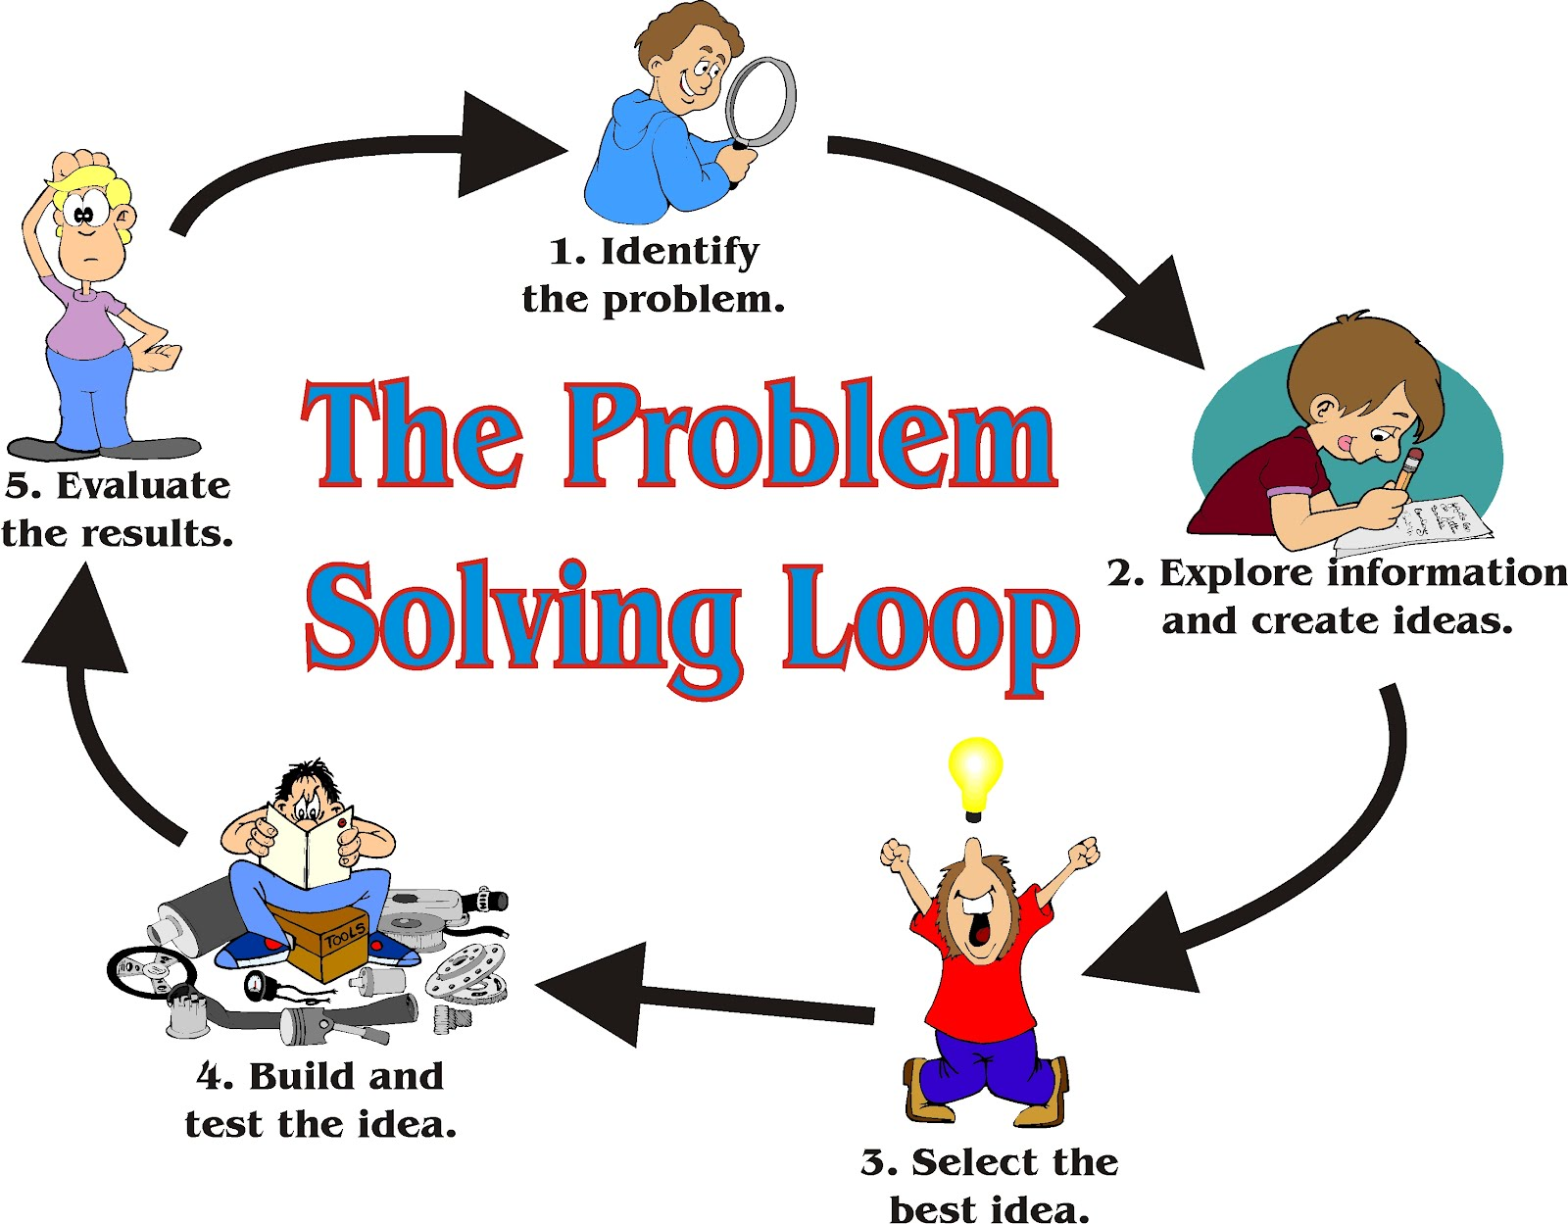
visualise the physical situation
how to approach the problem
evaluate answer
annotated
diagram;
knowns
& unknowns
put it all together
What do I know?
concepts, laws, principles, equations

