Slide 1

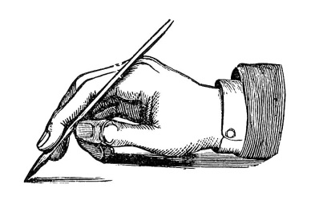


Slide 2

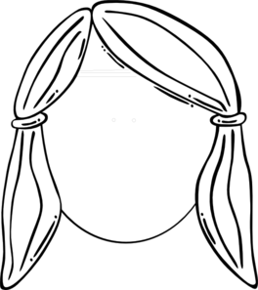
you can process ~5 chunks of information at any one time

Slide 3
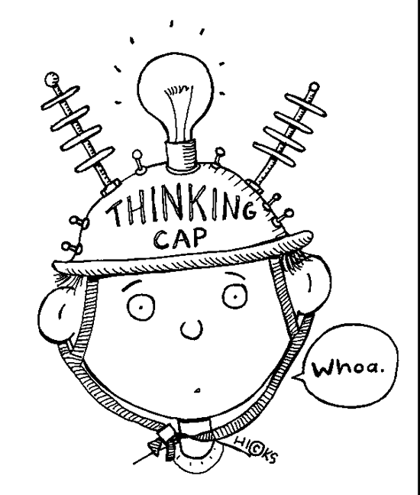

Slide 4
a = - 10 m.s⁻²
m = 5 .0 kg
max height v₁ = 0 m.s⁻¹ s₁ = ? m t₁ = ? s
+
F_{G} = - mg
ground: v₂ = ? m.s⁻¹ s₂ = 0 m t₂ = ? s
u = +20 m.s⁻¹

Slide 5
Ball A
Ball B
+
m_{A}= m_{B} = m
velocities of ball just before impact u_{A} = -u u_{B} = -u
velocities of balls just after impact v_{A} = 0 v_{B} = +u

Slide 6
copper tube
magnet falls slowly
glass tube
magnet falls freely
B_{induced}
right hand screw rule
S
N
S
N
S
N
F_{B}
F_{G} = mg
F_{G} = mg
B_{magnet}
Newton’s 2nd law
induced current
(Farady’s / Lenz’s laws)
a_{glass} > a_{copper}
Induced current produces a magnetic field to oppose the motion of the falling magnet (same magnetic poles repel)

