Slide 1

s
I
II
III
IV
V
(0,0)
t

Slide 2
Question 2
A ball starts from rest and rolls down the ramp.
Select the correct speed v against time t graph:
v
A
v
B
t
t
v
C
v
D
t
t
v
E
t

Slide 3
s
A
s
B
t
t
s
C
s
D
t
t
s
E
t

Slide 5
4
v [m.s⁻¹]
0
8
0
2
4
6
t [s]
-8

Slide 6
20
v [m.s⁻¹]
0
0
t [s]
80

Slide 7


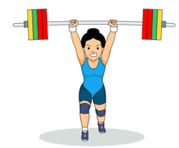

It is not useful just thinking about an equation, you need to write it down
Physics is fun
You need brain training as well as physical training

Slide 8
Correct answer

Slide 9
Correct answer 1: C
+X

Slide 10
Correct answer 2: A
+X

Slide 11
Correct answer 3: E
+X

